Slide 1
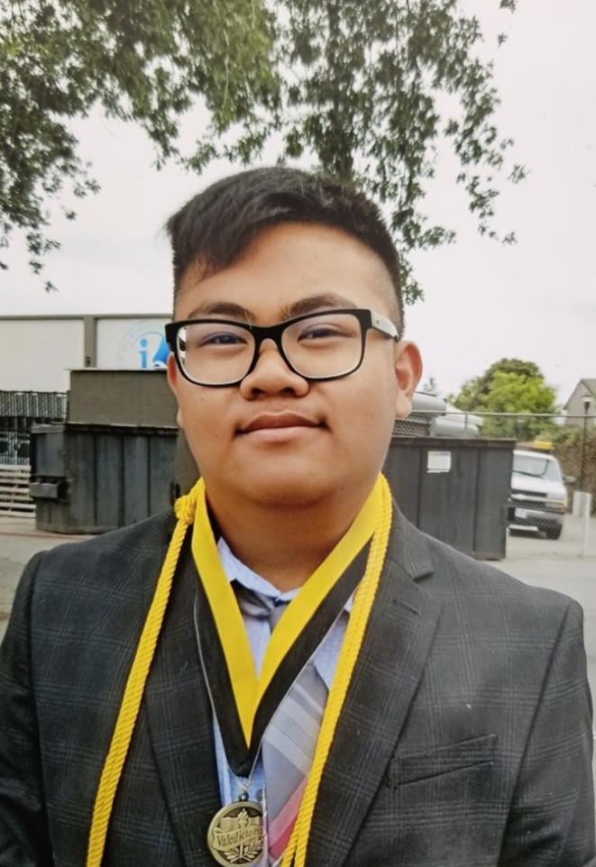
in the loving memory of
Lorenzo Roman Seriosa
Gather Hymn:
Here I Am, Lord
Responsorial Psalm: 23
The Lord is My Shepherd
Prep. of the Gifts Hymn:
Shelter Me O God.
Communion Hymn:
I Am The Bread Of Life.
How Great Throu Art.
Incense:
Song Of Farewell.
Recessional Hymn:
Amazing Grace

Slide 2
1. I, The Lord of sea and sky.
I have heard my people cry.
All who dwell in dark and sin.
My hand will save.
I who made the stars of night. I will make their darkness bright.
Who will bear my light to them? Who shall I send?

Slide 3
Refrain: Here I am Lord. Is it I, Lord? I have heard you calling in the night. I will go, Lord. If you lead me I will hold your people in my heart.

Slide 4
2. I, The Lord of snow and rain.
I have borne my people’s pain. I have wept for love of them.
They turn away. I will break their hearts of stone.
Give them hearts for love alone. I will speak my word to them. Whom shall I send?

Slide 5
Refrain: Here I am Lord. Is it I, Lord? I have heard you calling in the night. I will go, Lord. If you lead me I will hold your people in my heart.

Slide 6
3. I, The Lord of wind and flame,
I will tend the poor and lame.
I will set a feast for them.
My hand will save. Finest bread I will provide.
Till their hearts be satified.
I will give my life to them.
Whom shall I send?

Slide 7
Refrain: Here I am Lord. Is it I, Lord? I have heard you calling in the night. I will go, Lord. If you lead me I will hold your people in my heart.

Slide 8
in the loving memory of
Lorenzo Roman Seriosa
Responsorial Psalm: Psalm 23

Slide 9
Responsorial Psalm: Psalm 23
The Lord is my shepherd, there is nothing I shall want.

Slide 10
in the loving memory of
Jopeph Toàn Kim Phạm
Gospel Acclamation

Slide 11
Alleluia Alleluia Alleluia.
I am the resurrection and the life, says the Lord: whoever believes in me will never die

Slide 12
in the loving memory of
Lorenzo Roman Seriosa
Preparation of The Gift Song:
Shelter Me, O God

Slide 13
Chorus: Shelter me, O God
hide me in the shadow of your wings. You alone are my hope.
1. When my foes surround me, set me high above their reach. Hear me when I call your name.

Slide 14
Chorus: Shelter me, O God
hide me in the shadow of your wings. You alone are my hope.
2. As a mother gathers her young beneath her care, gather me into your arms

Slide 15
Chorus: Shelter me, O God
hide me in the shadow of your wings. You alone are my hope.
3. Though I walk in darkness, through the needle’s eye of death, you will never leave my side.

Slide 16
in the loving memory of
Lorenzo Roman Seriosa
Santos

Slide 17
Holy, Holy, Holy Lord God of hosts.
Heaven and earth are full, are full of your glory. Hosanna, Hosanna! Hosanna in the highest.

Slide 18
Blessed is he who comes, who comes in the name of the Lord.
Hosanna, Hosanna! Hosanna in the highest.

Slide 19
in the loving memory of
Lorenzo Roman Seriosa
Memorial Acclamation

Slide 20
We proclaim your Death, O Lord,
and profess your Resurrection until you come again.

Slide 21
in the loving memory of
Lorenzo Roman Seriosa
Amen

Slide 22
Amen, Amen.
Amen, Amen
Amen, Amen
Amen. Amen.

Slide 23
in the loving memory of
Lorenzo Roman Seriosa

Slide 24
Lamb of God your take away the sins of the world. Have mercy on us. (repeat as needed)
Lamb of God your take away the sins of the world.
grant us peace.

Slide 25
in the loving memory of
Lorenzo Roman Seriosa
Communion respond

Slide 26
Behold the Lamb of God,
behold him who takes away the sins of the world.
Blessed are those called to the supper of the Lamb.
Lord, I am not worthy
that You should enter under my roof, but only say the word and my soul shall be healed.

Slide 27
in the loving memory of
Lorenzo Roman Seriosa
Communion Hymn 1:
I Am the Bread Of Life

Slide 28
1. I am the bread of life.
You who comes to me shall not hunger;
And who believes in Me shall not thirst.
No one can come to Me
Unless the Father beckons.

Slide 29
Refrain:
And I will raise you up.
And I will raise you up.
And I will raise you up on the last day.

Slide 30
2. The bread that I will give
Is My flesh for the life of the world.
And if you eat of this bread.
You shall live for ever,
you shall live for ever

Slide 31
Refrain:
And I will raise you up.
And I will raise you up.
And I will raise you up on the last day.

Slide 32
3. Unless you eat Of the flesh of the Son of Man.
And drink of His blood.
And drink of His blood.
You shall not have life within you.

Slide 33
Refrain:
And I will raise you up.
And I will raise you up.
And I will raise you up on the last day.

Slide 34
4. I am the resurrection
I am the life
He who believes in Me
Even if he die
He shall live for ever

Slide 35
Refrain:
And I will raise you up.
And I will raise you up.
And I will raise you up on the last day.

Slide 36
5. Yes, Lord, we believe
That You are the Christ
The Son of God,
Who has come
Into the world

Slide 37
Refrain:
And I will raise you up.
And I will raise you up.
And I will raise you up on the last day.

Slide 38
in the loving memory of
Lorenzo Roman Seriosa
Communion Hymn 2:
How Great Throu Art

Slide 39
1. Oh Lord my God! when I in awesome wonder Consider all the worlds thy hands have made, I see the stars, I hear the **rolling thunder, Thy power throughout the universe displayed;

Slide 40
REFRAIN: Then sings my soul, my savior God to thee; How great thou art, How great thou art! Then sings my soul, my savior God to thee; How great thou art, how great thou art!

Slide 41
2. When thru the woods and forest glades I wander, And hear the birds sing sweetly in the trees; When I look down from lofty mountain grandeur.
And hear the brook, and feel the gentle breeze;

Slide 42
REFRAIN: Then sings my soul, my savior God to thee; How great thou art, How great thou art! Then sings my soul, my savior God to thee; How great thou art, how great thou art!

Slide 43
3. And when I think that God, his Son not sparing, Sent Him to die, I scarce can take it in, That on the cross, my burden gladly bearing, He bled and died to take away my sin;

Slide 44
REFRAIN: Then sings my soul, my savior God to thee; How great thou art, How great thou art! Then sings my soul, my savior God to thee; How great thou art, how great thou art!

Slide 45
in the loving memory of
Lorenzo Roman Seriosa
Ending Hymn:
Amazing Grace

Slide 46
1. Amazing Grace, how sweet the sound,
That saved a wretch like me. I once was lost but now am found, was blind, but now I see.
in the loving memory of
Jopeph Toàn Kim Phạm

Slide 47
2. T'was Grace that taught my heart to fear. And Grace, my fears relieved. How precious did that Grace appear the hour I first believed.
in the loving memory of
Jopeph Toàn Kim Phạm

Slide 48
3. Through many dangers, toils and snares I have already come; 'Tis Grace that brought me safe thus far and Grace will lead me home.
in the loving memory of
Jopeph Toàn Kim Phạm

Slide 49
4. The Lord has promised good to me. His word my hope secures. He will my shield and portion be, as long as life endures.
in the loving memory of
Jopeph Toàn Kim Phạm

Slide 50
5. When we've been here ten thousand years bright shining as the sun. We've no less days to sing God's praise than when we've first begun.
in the loving memory of
Jopeph Toàn Kim Phạm

Slide 51
in the loving memory of
Lorenzo Roman Seriosa

