Slide 1
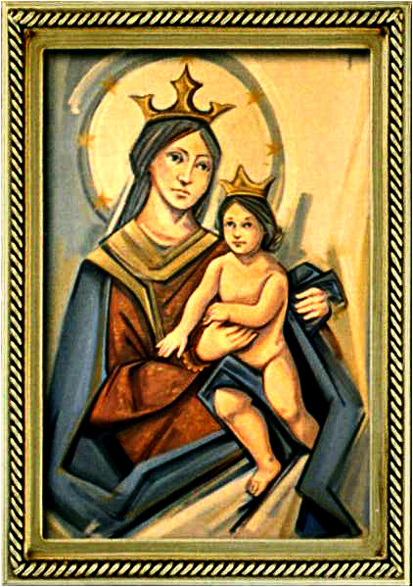
Solemnity of Saints Peter and Paul
Gather Hymn:
All Are Welcome
Responsorial Psalm: 34
The Angel of The Lord
Prep. of the Gifts Hymn:
Ubi Caritas
Communion Hymn:
I Have Loved You
Recessional Hymn:
We Are The Light Of The World

Slide 2
Verse 1: Let us build a house where love can dwell And all can safely live, A place where saints and children tell How hearts learn to forgive.

Slide 3
Verse 2: Built of hopes and dreams and visions,
Rock of faith and vault of grace; Here the love of Christ shall end divisions;

Slide 4
Chorus: All are welcome, all are welcome,
All are welcome in this place.

Slide 5
Verse 3: Let us build a house where prophets speak, And words are strong and true, Where all God's children dare to seek To dream God's reign anew.

Slide 6
Chorus: All are welcome, all are welcome,
All are welcome in this place.

Slide 7
Penitential Act (Confiteor 2011) 1 of 3:

Slide 8
I confess to almighty God and to you, my brothers and sisters, that I have greatly sinned, in my thoughts and in my words,

Slide 9
in what I have done
and in what I have failed to do,
through my fault,
through my fault,
through my most grievious fault;

Slide 10
therefore I ask blessed Mary ever-Virgin, all the Angels and Saints, and you, my brothers and sisters, to pray for me to the Lord our God.

Slide 11
Gloria Hymn

Slide 12
Refrain:
Glory to God, Glory to God. Glory to God in the highest, and on earth, peace on earth, peace to people of good will

Slide 13
1. We praise you, we bless you, we adore you, we glorify you, we give you thanks for your great glory. Lord God, heavenly King, O God, almighty Father.

Slide 14
Refrain:
Glory to God, Glory to God. Glory to God in the highest, and on earth, peace on earth, peace to people of good will

Slide 15
2. Lord Jesus Christ, only Begotten Son, Lord God, Lamb of God, Son of the Father, you take away the sins of the world, have mercy on us. You take way the sins of the world, receive our pray you are seated at the right hand, the right hand of the Father, have mercy on us

Slide 16
Refrain:
Glory to God, Glory to God. Glory to God in the highest, and on earth, peace on earth, peace to people of good will

Slide 17
3. For you alone are the Holy One, you alone are the Lord, you alone are the Most High, Jesus Christ with the Holy Spirit, in the glory of God the Father.

Slide 18
Refrain:
Glory to God, Glory to God. Glory to God in the highest, and on earth, peace on earth, peace to people of good will. Amen Amen.

Slide 19
Responsorial Psalm: 34
Angel of God

Slide 20
Responsorial Psalm: Psalm 34
The angel of the Lord will rescue those who fear him

Slide 21
Gospel Acclamation

Slide 22
Alleluia Alleluia Alleluia.
You are Peter and upon this rock I will build my Church, and the gates of the netherworld shall not prevail against it.

Slide 23
Profession Of Faith
Creed

Slide 24
Nicene Creed p1
I believe in one God, the Father almighty, maker of heaven and earth, of all things visible and invisible.

Slide 25
Nicene Creed p2
I believe in one Lord Jesus Christ, the Only Begotten Son of God, born of the Father before all ages.

Slide 26
Nicene Creed p3
God from God, Light from Light, true God from true God, begotten, not made, consubstantial with the Father; through Him all things were made.

Slide 27
Nicene Creed p4
For us men and for our salvation He came down from heaven, and by the Holy Spirit was incarnate of the Virgin Mary, and became man.

Slide 28
Nicene Creed p5
For our sake He was crucified under Pontius Pilate, He suffered death and was buried, and rose again on the third day in accordance with the Scriptures.

Slide 29
Nicene Creed p6
He ascended into heaven and is seated at the right hand of the Father.

Slide 30
Nicene Creed p7
He will come again in glory to judge the living and the dead and His kingdom will have no end.

Slide 31
Nicene Creed p8
I believe in the Holy Spirit, the Lord, the giver of life, who proceeds from the Father and the Son,

Slide 32
Nicene Creed p9
who with the Father and the Son is adored and glorified, who has spoken through the prophets.

Slide 33
Nicene Creed p10
I believe in one, holy, catholic and apostolic Church. I confess one Baptism for the forgiveness of sins

Slide 34
Nicene Creed p11
and I look forward to the resurrection of the dead and the life of the world to come. Amen.

Slide 35
Preparation of The Gift Song:
Ubi Caritas

Slide 36
Ubi cartias est vera, est vera
Deus ibi est
Deus ibi est
The love of Christ joins us together
Let us rejoice in him
And in our love and care for all Now love God in return

Slide 37
Ubi cartias est vera, est vera
Deus ibi est
Deus ibi est
In true communion let us gather
May all division cease
And in their place be Christ the Lord
Our risen Prince of Peace

Slide 38
Ubi cartias est vera, est vera
Deus ibi est
Deus ibi est
May we who gather at this table
To share the bread of life
Become a sacrament of love
Your healing touch, O' Christ

Slide 39
Ubi cartias est vera, est vera
Deus ibi est
Deus ibi est
For those in need make us your mercy
For those oppressed, your might
Make us your Church a holy sign
Of justice and new life

Slide 40
Ubi cartias est vera, est vera
Deus ibi est
Deus ibi est
May we one day behold your glory
And see you face to face
Rejoicing with the saints of God
To sing eternal praise

Slide 41
Holy Holy

Slide 42
Holy, Holy, Holy Lord God of hosts.
Heaven and earth are full, are full of your glory. Hosanna, Hosanna! Hosanna in the highest.

Slide 43
Blessed is he who comes, who comes in the name of the Lord.
Hosanna, Hosanna! Hosanna in the highest.

Slide 44
Memorial Acclamation

Slide 45
We proclaim your Death, O Lord,
and profess your Resurrection until you come again.

Slide 46
Amen

Slide 47
Amen, Amen.
Amen, Amen
Amen, Amen
Amen. Amen.

Slide 48
Lamb Of God

Slide 49
Lamb of God your take away the sins of the world. Have mercy on us. (repeat as needed)
Lamb of God your take away the sins of the world.
grant us peace.

Slide 50
Communion respond

Slide 51
Behold the Lamb of God,
behold him who takes away the sins of the world.
Blessed are those called to the supper of the Lamb.
Lord, I am not worthy
that You should enter under my roof, but only say the word and my soul shall be healed.

Slide 52
Communion Hymn 1:
I Have Loved You

Slide 53
I have loved you with an everlasting love,
I have called you and you are mine. (2x)

Slide 54
1. Seek the face of the Lord and long for him:
He will bring you his light and his peace.

Slide 55
I have loved you with an everlasting love,
I have called you and you are mine. (2x)

Slide 56
2. Seek the face of the Lord and long for him:
He will bring you his joy and his hope.

Slide 57
I have loved you with an everlasting love,
I have called you and you are mine. (2x)

Slide 58
3. Seek the face of the Lord and long for him:
He will bring you his care and his love.

Slide 59
I have loved you with an everlasting love,
I have called you and you are mine. (2x)

Slide 60
Announcements:

Slide 62
Ending Hymn:
We are the Light of the World

Slide 63
1. Blessed are they who are poor in spirit, Theirs is the kingdom of God. Bless us, O Lord, make us poor in spirit;
** Bless us, O Lord, our God. We are the light of the world, May our light shine before all, that they may see the good we do, and give glory to God

Slide 64
2. Blessed are they who are meek and humble. They will inherit the earth. Bless us, O Lord, make us meek and humble;
** Bless us, O Lord, our God. We are the light of the world, May our light shine before all, that they may see the good we do, and give glory to God

Slide 65
Ending Hymn:
Dear Lady Of Fatima

Slide 66
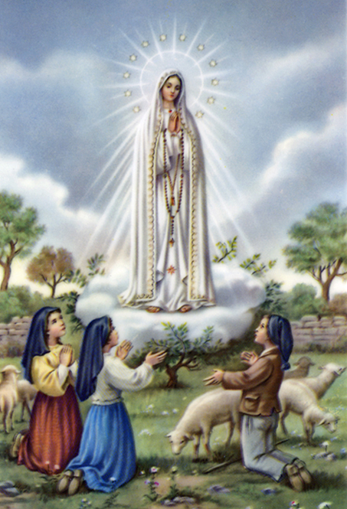
1a. Dear Lady of Fatima we come on bended knee to beg your intercession for peace and unity.

Slide 67
1b. Dear Mary won’t you show us the right and shining way? We pledge our love and offer you a Rosary each day.

Slide 68
2a. You promised at Fatima each time that you appeard to help us. If we pray to youto banish war and fear.

Slide 69
2b. Dear Lady on first Saturday we ask your guidding hand for grace and guidance here on earth and protection for our hand.

Slide 70
Ending Hymn:
On This Day

Slide 71
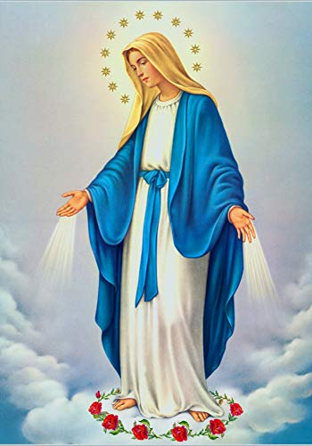
**. On this day, O beautiful Mother, On this day we give thee our love. Near the, Madonna, fondly we hover, Trusting thy gentle care to prove.

Slide 72
1. On this day we ask to share, Dearest Mother, thy sweet care; Aid us ere our feet astray Wanner from thy guiding way.

Slide 73
**. On this day, O beautiful Mother, On this day we give thee our love. Near the, Madonna, fondly we hover, Trusting thy gentle care to prove.

Slide 74
2. Queen of angels, deign to hear. Lisping children's humble prayer; Young hearts gain, O virgin pure, Sweetly to thyself allure.

Slide 75
THANK YOU
CÁM ƠN
MARAMING SALAMAT PO
MUCHAS GRACIAS
  நன்றி (Naṉṟi)

Slide 76
THANK YOU
CÁM ƠN
MARAMING SALAMAT PO
MUCHAS GRACIAS
  நன்றி (Naṉṟi)

