Slide 1
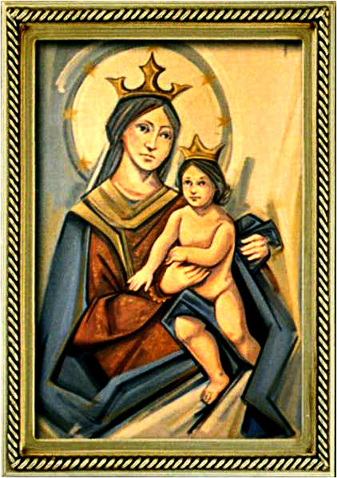
The Solemnity of Our Lord Jesus Christ, King of the Universe
Gather Hymn:
Worthy is the Lamb.
Responsorial Psalm: 122
Let us Go Rejoicing.
Prep. of the Gifts Hymn:
At The Name Of Jesus.
Communion Hymn:
Unless a Grain of Wheat
Recessional Hymn:
To Jesus Christ, Our Sovereign King.

Slide 2
Refrain: Worthy is the Lamb that was slain to receive honor and glory. Worthy are the ones who believe to receive the goodness of God.

Slide 3
1. Worthy are you, O Paschal Lamb. Wisdom and strength belong now to you. You laid down your life and died upon the cross: we’ve become a people of hope.

Slide 4
Refrain: Worthy is the Lamb that was slain to receive honor and glory. Worthy are the ones who believe to receive the goodness of God.

Slide 5
2. Worthy are you, O Bread of Life. Salvation and joy belong now to us. By conquering death and rising to new life, we’ve become a people of praise.

Slide 6
Refrain: Worthy is the Lamb that was slain to receive honor and glory. Worthy are the ones who believe to receive the goodness of God.

Slide 7
3. Worthy are you, O Risen Christ. Wonders and signs, revealing your might. Your power and glory shine upon our lives: we’ve become your light for the world.

Slide 8
Refrain: Worthy is the Lamb that was slain to receive honor and glory. Worthy are the ones who believe to receive the goodness of God.

Slide 9
Penitential Act (Confiteor 2011) 1 of 3:

Slide 10
I confess to almighty God and to you, my brothers and sisters, that I have greatly sinned, in my thoughts and in my words,

Slide 11
in what I have done and in what I have failed to do, through my fault,
through my fault, through my most grievious fault;

Slide 12
therefore I ask blessed Mary ever-Virgin, all the Angels and Saints, and you, my brothers and sisters, to pray for me to the Lord our God.

Slide 13
Gloria Hymn

Slide 14
Refrain:
Glory to God, Glory to God. Glory to God in the highest, and on earth, peace on earth, peace to people of good will

Slide 15
1. We praise you, we bless you, we adore you, we glorify you, we give you thanks for your great glory. Lord God, heavenly King, O God, almighty Father.

Slide 16
Refrain:
Glory to God, Glory to God. Glory to God in the highest, and on earth, peace on earth, peace to people of good will

Slide 17
2. Lord Jesus Christ, only Begotten Son, Lord God, Lamb of God, Son of the Father, you take away the sins of the world, have mercy on us. You take way the sins of the world, receive our pray you are seated at the right hand, the right hand of the Father, have mercy on us

Slide 18
Refrain:
Glory to God, Glory to God. Glory to God in the highest, and on earth, peace on earth, peace to people of good will

Slide 19
3. For you alone are the Holy One, you alone are the Lord, you alone are the Most High, Jesus Christ with the Holy Spirit, in the glory of God the Father.

Slide 20
Refrain:
Glory to God, Glory to God. Glory to God in the highest, and on earth, peace on earth, peace to people of good will. Amen Amen.

Slide 21
Responsorial Psalm: 122 Let us Go Rejoicing

Slide 22
Responsorial Psalm: Psalm 98 Let us go rejoicing to the house of the Lord.

Slide 23
Gospel Acclamation

Slide 24
Alleluia Alleluia Alleluia. Blessed is he who comes in the name of the Lord! Blessed is the kingdom of our father David that is to come!

Slide 25
Profession Of Faith Creed

Slide 26
Nicene Creed p1
I believe in one God, the Father almighty, maker of heaven and earth, of all things visible and invisible.

Slide 27
Nicene Creed p2
I believe in one Lord Jesus Christ, the Only Begotten Son of God, born of the Father before all ages.

Slide 28
Nicene Creed p3
God from God, Light from Light, true God from true God, begotten, not made, consubstantial with the Father; through Him all things were made.

Slide 29
Nicene Creed p4
For us men and for our salvation He came down from heaven, and by the Holy Spirit was incarnate of the Virgin Mary, and became man.

Slide 30
Nicene Creed p5
For our sake He was crucified under Pontius Pilate, He suffered death and was buried, and rose again on the third day in accordance with the Scriptures.

Slide 31
Nicene Creed p6
He ascended into heaven and is seated at the right hand of the Father.

Slide 32
Nicene Creed p7
He will come again in glory to judge the living and the dead and His kingdom will have no end.

Slide 33
Nicene Creed p8
I believe in the Holy Spirit, the Lord, the giver of life, who proceeds from the Father and the Son,

Slide 34
Nicene Creed p9
who with the Father and the Son is adored and glorified, who has spoken through the prophets.

Slide 35
Nicene Creed p10
I believe in one, holy, catholic and apostolic Church. I confess one Baptism for the forgiveness of sins

Slide 36
Nicene Creed p11
and I look forward to the resurrection of the dead and the life of the world to come. Amen.

Slide 37
Preparation of The Gift Song: At The Name Of Jesus

Slide 38
Refrain: At the name of Jesus Every knee shall bow, every tongue confess him King of glory now. Jesus is Lord, King of glory now! now!

Slide 39
1. He emptied himself, as a slave, yet free, came in human likeness for you and for me; in human likeness for you and for me.

Slide 40
Refrain: At the name of Jesus Every knee shall bow, every tongue confess him King of glory now. Jesus is Lord, King of glory now! now!

Slide 41
2. He humbled himself, and obeyed God's will. On a cross he died on Cavary's hill; for you and me he obeyed God's will.

Slide 42
Refrain: At the name of Jesus Every knee shall bow, every tongue confess him King of glory now. Jesus is Lord, King of glory now! now!

Slide 43
3. God exalt ed him, raised him up on high, so above all others his name will not die; that name we hon-or and glorify.

Slide 44
Refrain: At the name of Jesus Every knee shall bow, every tongue confess him King of glory now. Jesus is Lord, King of glory now! now!

Slide 45
4. Christ Jesus will come at the end of time, come with jubilation to call us home. Until that day you and I will proclaim.

Slide 46
Refrain: At the name of Jesus Every knee shall bow, every tongue confess him King of glory now. Jesus is Lord, King of glory now! now!

Slide 47
Holy Holy

Slide 48
Holy, Holy, Holy Lord God of hosts. Heaven and earth are full, are full of your glory. Hosanna, Hosanna! Hosanna in the highest.

Slide 49
Blessed is he who comes, who comes in the name of the Lord. Hosanna, Hosanna! Hosanna in the highest.

Slide 50
Memorial Acclamation

Slide 51
We proclaim your Death, O Lord, and profess your Resurrection until you come again.

Slide 52
Amen

Slide 53
Amen, Amen. Amen, Amen Amen, Amen
Amen. Amen.

Slide 54
Lamb Of God

Slide 55
Lamb of God your take away the sins of the world. Have mercy on us. (repeat as needed)
Lamb of God your take away the sins of the world.
grant us peace.

Slide 56
Communion respond

Slide 57
Behold the Lamb of God,
behold him who takes away the sins of the world.
Blessed are those called to the supper of the Lamb. Lord, I am not worthy
that You should enter under my roof, but only say the word and my soul shall be healed.

Slide 58
Communion Hymn 1: Unless A Grain Of Wheat

Slide 59
Refrain: Unless a grain of wheat shall fall upon the ground and die, it remains but a single grain with no life.
1. If we have died with him, then we shall live with him; If we hold firm, we shall reign with him.

Slide 60
Refrain: Unless a grain of wheat shall fall upon the ground and die, it remains but a single grain with no life.
2. If anyone serves me, then they must follow me; wherever I am, my servant will be.

Slide 61
Refrain: Unless a grain of wheat shall fall upon the ground and die, it remains but a single grain with no life.
3. Make your home in me as I make mine in you; those who remain in me bear much fruit.

Slide 62
Refrain: Unless a grain of wheat shall fall upon the ground and die, it remains but a single grain with no life.
4. If you remain in me and my word lives in you, then you will be my disciples.

Slide 63
Refrain: Unless a grain of wheat shall fall upon the ground and die, it remains but a single grain with no life.
5. Those who love me are loved by my Father; we shall be with them and dwell in them.

Slide 64
Refrain: Unless a grain of wheat shall fall upon the ground and die, it remains but a single grain with no life.
6. Peace I leave with you, my peace I give to you; peace which the world cannot give is my gift.

Slide 65
Communion Hymn 1: I have loved you

Slide 66
I have loved you with an everlasting love, I have called you and you are mine. (2x)

Slide 67
1. Seek the face of the Lord and long for him: He will bring you his light and his peace.

Slide 68
I have loved you with an everlasting love, I have called you and you are mine. (2x)

Slide 69
2. Seek the face of the Lord and long for him: He will bring you his joy and his hope.

Slide 70
I have loved you with an everlasting love, I have called you and you are mine. (2x)

Slide 71
3. Seek the face of the Lord and long for him: He will bring you his care and his love.

Slide 72
I have loved you with an everlasting love, I have called you and you are mine. (2x)

Slide 73
Announcements:

Slide 74
Ending Hymn: On this day, O beautiful Mother

Slide 75
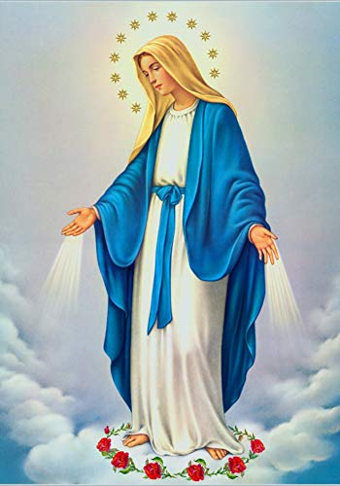
**. On this day, O beautiful Mother, On this day we give thee our love. Near the, Madonna, fondly we hover, Trusting thy gentle care to prove.

Slide 76
1. On this day we ask to share, Dearest Mother, thy sweet care; Aid us ere our feet astray Wanner from thy guiding way.

Slide 77
**. On this day, O beautiful Mother, On this day we give thee our love. Near the, Madonna, fondly we hover, Trusting thy gentle care to prove.

Slide 78
2. Queen of angels, deign to hear. Lisping children's humble prayer; Young hearts gain, O virgin pure, Sweetly to thyself allure.

Slide 79
**. On this day, O beautiful Mother, On this day we give thee our love. Near the, Madonna, fondly we hover, Trusting thy gentle care to prove.

Slide 80
Ending Hymn: Lady Of Fatima

Slide 81
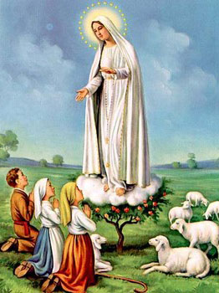
1. Dear Lady of Fatima we come on bended knee To beg your intercession for peace and unity. Dear Mary won't you show us the right and shining way? We pledge our love and offer you a Rosary each day.

Slide 82
2. You promised at Fatima Each time that you appeared To help us If we pray to you to banish war and fear. Dear Lady on first days we ask your guiding hand for grace and guidance here on earth protection for our land.

Slide 83
Ending Hymn: On This Day

Slide 84
**. On this day, O beautiful Mother, On this day we give thee our love. Near the, Madonna, fondly we hover, Trusting thy gentle care to prove.

Slide 85
1. On this day we ask to share, Dearest Mother, thy sweet care; Aid us ere our feet astray Wanner from thy guiding way.

Slide 86
**. On this day, O beautiful Mother, On this day we give thee our love. Near the, Madonna, fondly we hover, Trusting thy gentle care to prove.

Slide 87
2. Queen of angels, deign to hear. Lisping children's humble prayer; Young hearts gain, O virgin pure, Sweetly to thyself allure.

Slide 88
Ending Hymn: To Jesus Christ, Our King.

Slide 89
1. To Jesus Christ, our Sov’reign King, who is the world’s salvation, All praise and homage do we bring and thanks and adoration.
** Christ Jesus, victor! Christ Jesus, ruler! Christ Jesus, Lord and redeemer!

Slide 90
2. Thy reign extend, O King benign, to every land and nation; For in thy kingdom, Lord divine, Alone we find salvation.
** Christ Jesus, victor! Christ Jesus, ruler! Christ Jesus, Lord and redeemer!

Slide 91
THANK YOU
CÁM ƠN
MARAMING SALAMAT PO
MUCHAS GRACIAS
நன்றி (Naṉṟi)

Slide 92
THANK YOU
CÁM ƠN
MARAMING SALAMAT PO
MUCHAS GRACIAS
நன்றி (Naṉṟi)

