Slide 1
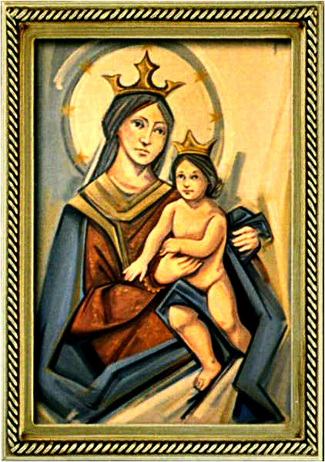
Ordinary Time 17 Year C
Gather Hymn:
Sing to the Mountain
Responsorial Psalm: 138
One The Day I Call
Prep. of the Gifts Hymn:
O How Blessed
Communion Hymn:
God’s Holy Gifts
Recessional Hymn:
O Bless The Lord

Slide 2
Sing to the mountains, sing to the sea. Raise your voices, lift your hearts. This is the day the Lord has made. Let all the earth rejoice.

Slide 3
1. I will give thanks to you, my Lord. You have answered my plea. You have saved my soul from death. You are my strength and song.

Slide 4
Sing to the mountains, sing to the sea. Raise your voices, lift your hearts. This is the day the Lord has made. Let all the earth rejoice.

Slide 5
2. Holy, holy, holy Lord. Heaven and earth are full of your glory.

Slide 6
Sing to the mountains, sing to the sea. Raise your voices, lift your hearts. This is the day the Lord has made. Let all the earth rejoice.

Slide 7
3. This is the day that the Lord has made. let us be glad and rejoice. He has turned all death to life. Sing of the glory of God.

Slide 8
Sing to the mountains, sing to the sea. Raise your voices, lift your hearts. This is the day the Lord has made. Let all the earth rejoice.

Slide 9
Penitential Act (Confiteor 2011) 1 of 3:

Slide 10
I confess to almighty God and to you, my brothers and sisters, that I have greatly sinned, in my thoughts and in my words,

Slide 11
in what I have done and in what I have failed to do, through my fault,
through my fault, through my most grievious fault;

Slide 12
therefore I ask blessed Mary ever-Virgin, all the Angels and Saints, and you, my brothers and sisters, to pray for me to the Lord our God.

Slide 13
Gloria Hymn

Slide 14
Refrain:
Glory to God, Glory to God. Glory to God in the highest, and on earth, peace on earth, peace to people of good will

Slide 15
1. We praise you, we bless you, we adore you, we glorify you, we give you thanks for your great glory. Lord God, heavenly King, O God, almighty Father.

Slide 16
Refrain:
Glory to God, Glory to God. Glory to God in the highest, and on earth, peace on earth, peace to people of good will

Slide 17
2. Lord Jesus Christ, only Begotten Son, Lord God, Lamb of God, Son of the Father, you take away the sins of the world, have mercy on us. You take way the sins of the world, receive our pray you are seated at the right hand, the right hand of the Father, have mercy on us

Slide 18
Refrain:
Glory to God, Glory to God. Glory to God in the highest, and on earth, peace on earth, peace to people of good will

Slide 19
3. For you alone are the Holy One, you alone are the Lord, you alone are the Most High, Jesus Christ with the Holy Spirit, in the glory of God the Father.

Slide 20
Refrain:
Glory to God, Glory to God. Glory to God in the highest, and on earth, peace on earth, peace to people of good will. Amen Amen.

Slide 21
Responsorial Psalm: 138 The Day I Called

Slide 22
Responsorial Psalm: Psalm 138 Lord, on the day I called for help, you answered me, you answered me.

Slide 23
Gospel Acclamation

Slide 24
Alleluia Alleluia Alleluia. You have received a Spirit of adoption, through which we cry, Abba, Father.

Slide 25
Profession Of Faith Creed

Slide 26
Nicene Creed p1
I believe in one God, the Father almighty, maker of heaven and earth, of all things visible and invisible.

Slide 27
Nicene Creed p2
I believe in one Lord Jesus Christ, the Only Begotten Son of God, born of the Father before all ages.

Slide 28
Nicene Creed p3
God from God, Light from Light, true God from true God, begotten, not made, consubstantial with the Father; through Him all things were made.

Slide 29
Nicene Creed p4
For us men and for our salvation He came down from heaven, and by the Holy Spirit was incarnate of the Virgin Mary, and became man.

Slide 30
Nicene Creed p5
For our sake He was crucified under Pontius Pilate, He suffered death and was buried, and rose again on the third day in accordance with the Scriptures.

Slide 31
Nicene Creed p6
He ascended into heaven and is seated at the right hand of the Father.

Slide 32
Nicene Creed p7
He will come again in glory to judge the living and the dead and His kingdom will have no end.

Slide 33
Nicene Creed p8
I believe in the Holy Spirit, the Lord, the giver of life, who proceeds from the Father and the Son,

Slide 34
Nicene Creed p9
who with the Father and the Son is adored and glorified, who has spoken through the prophets.

Slide 35
Nicene Creed p10
I believe in one, holy, catholic and apostolic Church. I confess one Baptism for the forgiveness of sins

Slide 36
Nicene Creed p11
and I look forward to the resurrection of the dead and the life of the world to come. Amen.

Slide 37
Preparation of The Gift Song: O How Blessed

Slide 38
1. O how blessed are the poor in spirit the kingdom of God is theirs. O how blessed those who well in sorrow, they surely will be consoled.

Slide 39
Refrain: Rejoice and be glad, beloved of the Lord, the kingdom of heaven is your. The first shall be last, the last shall be first, for such is the wisdom of God.

Slide 40
2. O how blessed are the meek and lowly, for they shall possess the earth. O how blessed those who thirst for justice, they surely will have their fill.

Slide 41
Refrain: Rejoice and be glad, beloved of the Lord, the kingdom of heaven is your. The first shall be last, the last shall be first, for such is the wisdom of God.

Slide 42
3. O how blessed are the pure of heart for they shall behold God's face. O how blessed those who mend the mercy, forgiveness is their reward.

Slide 43
Refrain: Rejoice and be glad, beloved of the Lord, the kingdom of heaven is your. The first shall be last, the last shall be first, for such is the wisdom of God.

Slide 44
4. O how blessed those who fight of peace, the children of God are they. O how blessed those despised and hated, who bear it because of me.

Slide 45
Refrain: Rejoice and be glad, beloved of the Lord, the kingdom of heaven is your. The first shall be last, the last shall be first, for such is the wisdom of God.

Slide 46
Holy Holy

Slide 47
Holy, Holy, Holy Lord God of hosts. Heaven and earth are full, are full of your glory. Hosanna, Hosanna! Hosanna in the highest.

Slide 48
Blessed is he who comes, who comes in the name of the Lord. Hosanna, Hosanna! Hosanna in the highest.

Slide 49
Memorial Acclamation

Slide 50
We proclaim your Death, O Lord, and profess your Resurrection until you come again.

Slide 51
Amen

Slide 52
Amen, Amen. Amen, Amen Amen, Amen
Amen. Amen.

Slide 53
Lamb Of God

Slide 54
Lamb of God your take away the sins of the world. Have mercy on us. (repeat as needed)
Lamb of God your take away the sins of the world.
grant us peace.

Slide 55
Communion respond

Slide 56
Behold the Lamb of God,
behold him who takes away the sins of the world.
Blessed are those called to the supper of the Lamb. Lord, I am not worthy
that You should enter under my roof, but only say the word and my soul shall be healed.

Slide 57
Communion Hymn 1: God Holy Gifts

Slide 58
Refrain: God's holy gifts for God's holy people; come now to share the banquet of Christ. Feed on his love with faith and thanksgiving. Know in your heart that he died for you.

Slide 59
1. May the Body of Christ be food for our souls and bring us to everlasting life.

Slide 60
Refrain: God's holy gifts for God's holy people; come now to share the banquet of Christ. Feed on his love with faith and thanksgiving. Know in your heart that he died for you.

Slide 61
2. May the Blood of the Lord protect us from harm and Mark us as God's beloved ones.

Slide 62
Refrain: God's holy gifts for God's holy people; come now to share the banquet of Christ. Feed on his love with faith and thanksgiving. Know in your heart that he died for you.

Slide 63
3. As the grain of this bread was gathered as one, may we who believe be bound by love.

Slide 64
Refrain: God's holy gifts for God's holy people; come now to share the banquet of Christ. Feed on his love with faith and thanksgiving. Know in your heart that he died for you.

Slide 65
4. As the cup that we share is emptied for all, may we offer up our lives in love.

Slide 66
Refrain: God's holy gifts for God's holy people; come now to share the banquet of Christ. Feed on his love with faith and thanksgiving. Know in your heart that he died for you.

Slide 67
5. When we eat of this bread and drink of this cup, we hold in our memory Christ the Lord.

Slide 68
Refrain: God's holy gifts for God's holy people; come now to share the banquet of Christ. Feed on his love with faith and thanksgiving. Know in your heart that he died for you.

Slide 69
Announcements:

Slide 71
Ending Hymn: O Blessed The Lord

Slide 72
Refrain. O Bless the Lord, the God of our salvation, Rock of strength and a refuge sure. O bless the Lord, the God of every nation over all the earth!

Slide 73
1. O bless the Lord, highest heavens above! Bless the Lord! Glorify his name! Sun in the day, moon and start in the night, worship and praise!

Slide 74
Refrain. O Bless the Lord, the God of our salvation, Rock of strength and a refuge sure. O bless the Lord, the God of every nation over all the earth!

Slide 75
2. Let all the earth sing with joy to the Lord, all the seas, creatures of the deep! Mountains and hills, birds an beasts in the fields, worship and praise!

Slide 76
Refrain. O Bless the Lord, the God of our salvation, Rock of strength and a refuge sure. O bless the Lord, the God of every nation over all the earth!

Slide 77
Ending Hymn: Lady Of Fatima

Slide 78
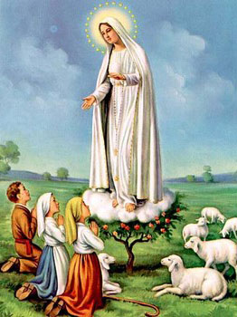
1. Dear Lady of Fatima we come on bended knee To beg your intercession for peace and unity. Dear Mary won't you show us the right and shining way? We pledge our love and offer you a Rosary each day.

Slide 79
2. You promised at Fatima Each time that you appeared To help us If we pray to you to banish war and fear. Dear Lady on first days we ask your guiding hand for grace and guidance here on earth protection for our land.

Slide 80
Ending Hymn: On This Day

Slide 81
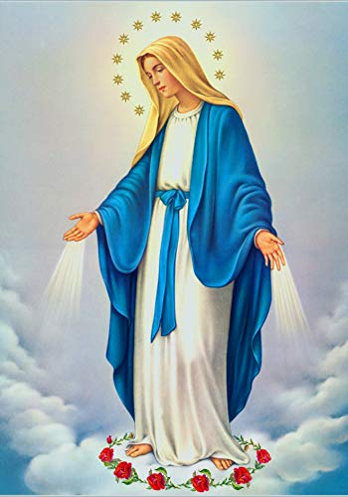
**. On this day, O beautiful Mother, On this day we give thee our love. Near the, Madonna, fondly we hover, Trusting thy gentle care to prove.

Slide 82
1. On this day we ask to share, Dearest Mother, thy sweet care; Aid us ere our feet astray Wanner from thy guiding way.

Slide 83
**. On this day, O beautiful Mother, On this day we give thee our love. Near the, Madonna, fondly we hover, Trusting thy gentle care to prove.

Slide 84
2. Queen of angels, deign to hear. Lisping children's humble prayer; Young hearts gain, O virgin pure, Sweetly to thyself allure.

Slide 85
THANK YOU
CÁM ƠN
MARAMING SALAMAT PO
MUCHAS GRACIAS
நன்றி (Naṉṟi)

Slide 86
THANK YOU
CÁM ƠN
MARAMING SALAMAT PO
MUCHAS GRACIAS
நன்றி (Naṉṟi)

