Slide 1
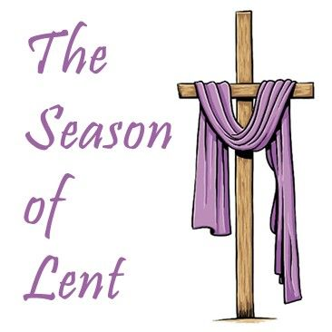
Second Sunday of Lent
Gather Song:
Our God Is Here
Responsorial Psalm 33:
Lord, Let Your Mercy
Prep. of the Gifts:
Greate in Me
Communion Song :
Transfigure Us, O Lord
During the Lenten season, please be silent and wait for the presider to exit before we leave. Thank You

Slide 2
1. Here in this time, here in this place, Here we are standing face to face. Here in our hearts, here in our lives, Our God is here.
Here for the broken, here for the strong, Here in this temple we belong. Here in our hearts, here in our lives, Our God is here

Slide 3
"Holy! Holy! Holy are you!"
We cry: "Holy! Holy! Holy and true!"
Amen, we do believe our God is here.
Our God is here.

Slide 4
2. Here in the Word, God is revealed, Here where the wounded can be healed.
Here in our hearts, here in our lives, Our God is here.
Here we become what we receive, Here in this Eucharistic feast. We are his body, living as one; Our God is here.

Slide 5
"Holy! Holy! Holy are you!"
We cry: "Holy! Holy! Holy and true!"
Amen, we do believe our God is here.
Our God is here.

Slide 6
Responsorial Psalm: Psalm 33
Psalm 33 Lord Let Your Mercy

Slide 7
Responsorial Psalm 33:
Lord, let your mercy be on us as we place our trust in you.

Slide 8
Gospel Acclamation

Slide 9
Refrain: Praise to you, Lord Jesus Christ, Word from the heart of God
If today you hear God’s voice, do not close the doors of your hearts to the word of life and truth.

Slide 10
Profession Of Faith
Creed

Slide 11
Nicene Creed p1
I believe in one God, the Father almighty, maker of heaven and earth, of all things visible and invisible.

Slide 12
Nicene Creed p2
I believe in one Lord Jesus Christ, the Only Begotten Son of God, born of the Father before all ages.

Slide 13
Nicene Creed p3
God from God, Light from Light, true God from true God, begotten, not made, consubstantial with the Father; through Him all things were made.

Slide 14
Nicene Creed p4
For us men and for our salvation He came down from heaven, and by the Holy Spirit was incarnate of the Virgin Mary, and became man.

Slide 15
Nicene Creed p5
For our sake He was crucified under Pontius Pilate, He suffered death and was buried, and rose again on the third day in accordance with the Scriptures.

Slide 16
Nicene Creed p6
He ascended into heaven and is seated at the right hand of the Father.

Slide 17
Nicene Creed p7
He will come again in glory to judge the living and the dead and His kingdom will have no end.

Slide 18
Nicene Creed p8
I believe in the Holy Spirit, the Lord, the giver of life, who proceeds from the Father and the Son,

Slide 19
Nicene Creed p9
who with the Father and the Son is adored and glorified, who has spoken through the prophets.

Slide 20
Nicene Creed p10
I believe in one, holy, catholic and apostolic Church. I confess one Baptism for the forgiveness of sins

Slide 21
Nicene Creed p11
and I look forward to the resurrection of the dead and the life of the world to come. Amen.

Slide 22
Preparation of The Gift Song:
Create in Me Psalm 51

Slide 23
Refrain: Create in me a clean heart
Create in me a clean heart.
1. Have mercy on me God,
In your compassion.
Remove my sin.
Wash me from my guilt.

Slide 24
Refrain: Create in me a clean heart
Create in me a clean heart.
2. O purify my heart
And teach me wisdom;
Then I shall be cleaner than a snow

Slide 25
Refrain: Create in me a clean heart
Create in me a clean heart.
3. O give me back the joy
Of your salvation;
A willing spirit sustain in me.

Slide 26
Holy Holy

Slide 27
Holy, Holy, Holy Lord God of hosts.
Heaven and earth are full, are full of your glory. Hosanna, Hosanna! Hosanna in the highest.

Slide 28
Blessed is he who comes, who comes in the name of the Lord.
Hosanna, Hosanna! Hosanna in the highest.

Slide 29
Memorial Acclamation

Slide 30
We proclaim your Death, O Lord,
and profess your Resurrection until you come again.

Slide 31
Amen

Slide 32
Amen, Amen.
Amen, Amen
Amen, Amen
Amen. Amen.

Slide 33
Lamb Of God

Slide 34
Lamb of God you take away the sins of the world. Have mercy on us. (repeat as needed)
Lamb of God you take away the sins of the world.
grant us peace.

Slide 35
Communion respond

Slide 36
Behold the Lamb of God,
behold him who takes away the sins of the world.
Blessed are those called to the supper of the Lamb.
Lord, I am not worthy
that You should enter under my roof, but only say the word and my soul shall be healed.

Slide 37
Communion:
Transfigure Us, O Lord

Slide 38
refrain:
Transfigure us, O Lord, transfigure us, O Lord. Break the chains that bind us; speak your healing word, and where you lead we’ll follow. Trfigure us, O Lord

Slide 39
1. Down from heights of glory into the depths below, the love of God selfemptied, the love of God to show. You light the path before us, the way that we must go.

Slide 40
refrain:
Transfigure us, O Lord, transfigure us, O Lord. Break the chains that bind us; speak your healing word, and where you lead we’ll follow. Trfigure us, O Lord

Slide 41
2. Light for those in darkness, the hungry have their fill, glad tidings for the humble, the healing of all ills; in these we glimpse your glory, God’s promises fulfilled.

Slide 42
refrain:
Transfigure us, O Lord, transfigure us, O Lord. Break the chains that bind us; speak your healing word, and where you lead we’ll follow. Trfigure us, O Lord

Slide 43
3. Pardon for the sinner, a shepherd for the sheep, a drink of living water for all who thirst and seek, and feasting at your table, the lowly and the least.

Slide 44
refrain:
Transfigure us, O Lord, transfigure us, O Lord. Break the chains that bind us; speak your healing word, and where you lead we’ll follow. Trfigure us, O Lord

Slide 45
4. To the holy city, Jerusalem, you go; your face set toward the ending, the cross to be your throne. Shall we journey with you and share your paschal road?

Slide 46
refrain:
Transfigure us, O Lord, transfigure us, O Lord. Break the chains that bind us; speak your healing word, and where you lead we’ll follow. Trfigure us, O Lord

Slide 47
Sending Hymn
During the Lenten season, please be silent and wait for the presider to exit before we leave in silent.
Thank You

Slide 48
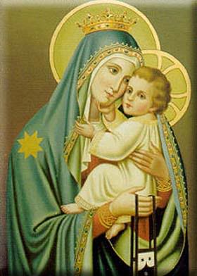
THANK YOU
CÁM ƠN
MARAMING SALAMAT PO
MUCHAS GRACIAS

