Slide 1
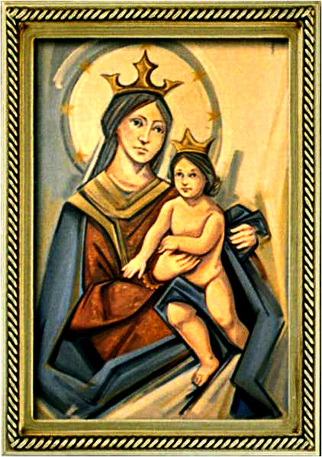
Ordinary Time 21 Year C
Gather Hymn:
God Of Mercy
Responsorial Psalm: 117
Go Out To the World
Prep. of the Gifts Hymn:
Shelter Me O God
Communion Hymn:
Bread of The World
Recessional Hymn:
Going Peace and Serve The Lord

Slide 2
refrain: God of mercy holy mystery ever faithful one, you have pitched your tent among us, reconciling love heart and mind of Christ, live within our lives.

Slide 3
1. You have called us each by name in your great compassion encompassing our failings with mercy. God of mercy lead us.

Slide 4
refrain: God of mercy holy mystery ever faithful one, you have pitched your tent among us, reconciling love heart and mind of Christ, live within our lives.

Slide 5
2. Slow to anger, rich in love, you bestow forgiveness. May we, in turn, forgive those who harm us. God of mercy lead us.

Slide 6
Penitential Act (Confiteor 2011) 1 of 3:

Slide 7
I confess to almighty God and to you, my brothers and sisters, that I have greatly sinned, in my thoughts and in my words,

Slide 8
in what I have done
and in what I have failed to do,
through my fault,
through my fault,
through my most grievious fault;

Slide 9
therefore I ask blessed Mary ever-Virgin, all the Angels and Saints, and you, my brothers and sisters, to pray for me to the Lord our God.

Slide 10
Gloria Hymn

Slide 11
Refrain:
Glory to God, Glory to God. Glory to God in the highest, and on earth, peace on earth, peace to people of good will

Slide 12
1. We praise you, we bless you, we adore you, we glorify you, we give you thanks for your great glory. Lord God, heavenly King, O God, almighty Father.

Slide 13
Refrain:
Glory to God, Glory to God. Glory to God in the highest, and on earth, peace on earth, peace to people of good will

Slide 14
2. Lord Jesus Christ, only Begotten Son, Lord God, Lamb of God, Son of the Father, you take away the sins of the world, have mercy on us. You take way the sins of the world, receive our pray you are seated at the right hand, the right hand of the Father, have mercy on us

Slide 15
Refrain:
Glory to God, Glory to God. Glory to God in the highest, and on earth, peace on earth, peace to people of good will

Slide 16
3. For you alone are the Holy One, you alone are the Lord, you alone are the Most High, Jesus Christ with the Holy Spirit, in the glory of God the Father.

Slide 17
Refrain:
Glory to God, Glory to God. Glory to God in the highest, and on earth, peace on earth, peace to people of good will. Amen Amen.

Slide 18
Responsorial Psalm: 117
Go Out To All The World

Slide 19
Responsorial Psalm: Psalm 117
Go out to all the world and tell the good news.

Slide 20
Gospel Acclamation

Slide 21
Alleluia Alleluia Alleluia.
I am the way, the truth and the life, says the Lord; no one comes to the Father, except through me.

Slide 22
Profession Of Faith
Creed

Slide 23
Nicene Creed p1
I believe in one God, the Father almighty, maker of heaven and earth, of all things visible and invisible.

Slide 24
Nicene Creed p2
I believe in one Lord Jesus Christ, the Only Begotten Son of God, born of the Father before all ages.

Slide 25
Nicene Creed p3
God from God, Light from Light, true God from true God, begotten, not made, consubstantial with the Father; through Him all things were made.

Slide 26
Nicene Creed p4
For us men and for our salvation He came down from heaven, and by the Holy Spirit was incarnate of the Virgin Mary, and became man.

Slide 27
Nicene Creed p5
For our sake He was crucified under Pontius Pilate, He suffered death and was buried, and rose again on the third day in accordance with the Scriptures.

Slide 28
Nicene Creed p6
He ascended into heaven and is seated at the right hand of the Father.

Slide 29
Nicene Creed p7
He will come again in glory to judge the living and the dead and His kingdom will have no end.

Slide 30
Nicene Creed p8
I believe in the Holy Spirit, the Lord, the giver of life, who proceeds from the Father and the Son,

Slide 31
Nicene Creed p9
who with the Father and the Son is adored and glorified, who has spoken through the prophets.

Slide 32
Nicene Creed p10
I believe in one, holy, catholic and apostolic Church. I confess one Baptism for the forgiveness of sins

Slide 33
Nicene Creed p11
and I look forward to the resurrection of the dead and the life of the world to come. Amen.

Slide 34
Preparation of The Gift Song:
Shelter Me, O God

Slide 35
Chorus: Shelter me, O God
hide me in the shadow of your wings. You alone are my hope.
1. When my foes surround me, set me high above their reach. Hear me when I call your name.

Slide 36
Chorus: Shelter me, O God
hide me in the shadow of your wings. You alone are my hope.
2. As a mother gathers her young beneath her care, gather me into your arms

Slide 37
Chorus: Shelter me, O God
hide me in the shadow of your wings. You alone are my hope.
3. Though I walk in darkness, through the needle’s eye of death, you will never leave my side.

Slide 38
Holy Holy

Slide 39
Holy, Holy, Holy Lord God of hosts.
Heaven and earth are full, are full of your glory. Hosanna, Hosanna! Hosanna in the highest.

Slide 40
Blessed is he who comes, who comes in the name of the Lord.
Hosanna, Hosanna! Hosanna in the highest.

Slide 41
Memorial Acclamation

Slide 42
We proclaim your Death, O Lord,
and profess your Resurrection until you come again.

Slide 43
Amen

Slide 44
Amen, Amen.
Amen, Amen
Amen, Amen
Amen. Amen.

Slide 45
Lamb Of God

Slide 46
Lamb of God your take away the sins of the world. Have mercy on us. (repeat as needed)
Lamb of God your take away the sins of the world.
grant us peace.

Slide 47
Communion respond

Slide 48
Behold the Lamb of God,
behold him who takes away the sins of the world.
Blessed are those called to the supper of the Lamb.
Lord, I am not worthy
that You should enter under my roof, but only say the word and my soul shall be healed.

Slide 49
Communion Hymn 1:
Bread of the World

Slide 50
refrain. Bread for the world
A world of hunger
Wine for all peoples
People who thirst
May we who eat
Be bread for others
May we who drink
Pour out our love

Slide 51
1. Lord Jesus Christ
You are the bread of life
Broken to reach and heal the wounds Of human pain
Where we divide Your people
You are waiting there
On bended knee
To wash our feet with endless care

Slide 52
refrain. Bread for the world
A world of hunger
Wine for all peoples
People who thirst
May we who eat
Be bread for others
May we who drink
Pour out our love

Slide 53
2. Lord Jesus Christ
You are the wine of peace
Poured into hearts once broken
And where dryness sleeps
Where we are tired and weary
You are waiting there
To be the way which beckons us
Beyond despair

Slide 54
refrain. Bread for the world
A world of hunger
Wine for all peoples
People who thirst
May we who eat
Be bread for others
May we who drink
Pour out our love

Slide 55
3. Lord Jesus Christ
You call us to your feast, at which the rich and powerful have become the least. Where we survive on others in our human greed, you walk among us begging for your every need.

Slide 56
Announcements:

Slide 58
Ending Hymn:
Going Peace to love and serve the Lord

Slide 59
1. Go in peace to love and serve the Lord Go in peace be-come the liv-ing Word! Christ on our lips and Christ in our hearts, may we show God's love to the world, to the world, may we show God's love to the world.

Slide 60
2. Be Christ's hands now reaching out to all Be Christ's voice inviting with his call Filled with his joy, empowered with his stregnth may we spread God's grace through the world, through the world, may we spread God's grace trough the world.

Slide 61
Ending Hymn:
Lady Of Fatima

Slide 62
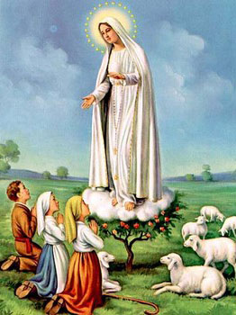
1. Dear Lady of Fatima we come on bended knee To beg your intercession for peace and unity. Dear Mary won't you show us the right and shining way? We pledge our love and offer you a Rosary each day.

Slide 63
2. You promised at Fatima Each time that you appeared To help us If we pray to you to banish war and fear. Dear Lady on first days we ask your guiding hand for grace and guidance here on earth protection for our land.

Slide 64
Ending Hymn:
On This Day

Slide 65
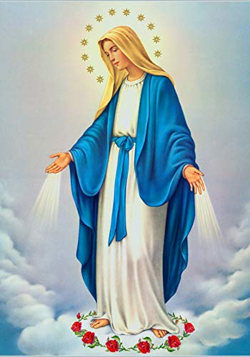
**. On this day, O beautiful Mother, On this day we give thee our love. Near the, Madonna, fondly we hover, Trusting thy gentle care to prove.

Slide 66
1. On this day we ask to share, Dearest Mother, thy sweet care; Aid us ere our feet astray Wanner from thy guiding way.

Slide 67
**. On this day, O beautiful Mother, On this day we give thee our love. Near the, Madonna, fondly we hover, Trusting thy gentle care to prove.

Slide 68
2. Queen of angels, deign to hear. Lisping children's humble prayer; Young hearts gain, O virgin pure, Sweetly to thyself allure.

Slide 69
THANK YOU
CÁM ƠN
MARAMING SALAMAT PO
MUCHAS GRACIAS
  நன்றி (Naṉṟi)

Slide 70
THANK YOU
CÁM ƠN
MARAMING SALAMAT PO
MUCHAS GRACIAS
  நன்றி (Naṉṟi)

