Slide 1
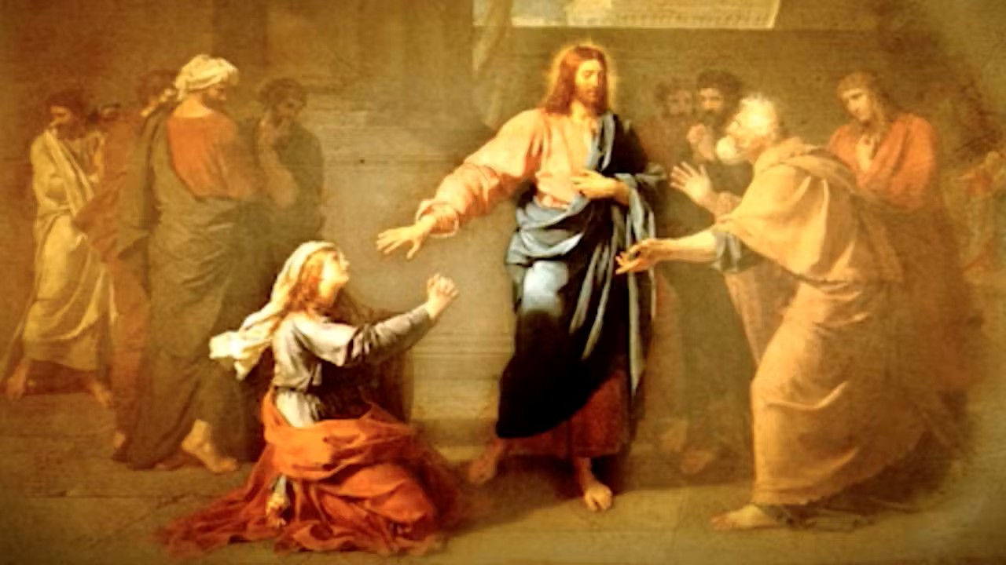
Welcome to Our Lady of Refuge Catholic Church
Sunday Ordinary Time 20th Year A
Gather Song:
Praise, My Soul, The King Of Heaven
Responsorial Psalm 67:
O God Let All the Nation
Prep. of the Gifts:
Prayer of St Francis
Communion Song :
God’s Holy Gift
Recessional:
Hail Holy Queen

Slide 2
1. Praise, my soul, the King of heaven;
to his feet your tribute bring.
Ransomed, healed, restored, forgiven,
evermore his praises sing.
Alleluia, alleluia!
Praise the everlasting King!

Slide 3
2. Praise him for his grace and favor
to his people in distress.
Praise him, still the same as ever,
slow to chide, and swift to bless.
Alleluia, alleluia!
Glorious in his faithfulness!

Slide 4
3. Father like he tends and spares us;
well our feeble frame he knows.
In his hand he gently bears us,
rescues us from all our foes.
Alleluia, alleluia!
Widely yet his mercy flows!

Slide 5
Penitential Act

Slide 6
I confess to almighty God and to you, my brothers and sisters, that I have greatly sinned, in my thoughts and in my words,

Slide 7
in what I have done
and in what I have failed to do,
through my fault,
through my fault,
through my most grievious fault;

Slide 8
therefore I ask blessed Mary ever-Virgin, all the Angels and Saints, and you, my brothers and sisters, to pray for me to the Lord our God.

Slide 9
Gloria Prayer

Slide 10
Refrain:
Glory to God, Glory to God. Glory to God in the highest, and on earth, peace on earth, peace to people of good will

Slide 11
1. We praise you, we bless you, we adore you, we glorify you, we give you thanks for your great glory. Lord God, heavenly King, O God, almighty Father.

Slide 12
2. Lord Jesus Christ, only Begotten Son, Lord God, Lamb of God, Son of the Father, you take away the sins of the world, have mercy on us. You take way the sins of the world, receive our pray you are seated at the right hand, the right hand of the Father, have mercy on us

Slide 13
3. For you alone are the Holy One, you alone are the Lord, you alone are the Most High, Jesus Christ with the Holy Spirit, in the glory of God the Father.

Slide 14
Refrain:
Glory to God, Glory to God. Glory to God in the highest, and on earth, peace on earth, peace to people of good will. Amen Amen.

Slide 15
Psalm 67 O God, Let All the Nations Praise You!

Slide 16
Responsorial Psalm 67:
O God, Let All the Nations Praise You! Let all the nations pray you

Slide 17
Gospel Acclamation

Slide 18
Refrain: Alleluia!
Jesus proclaimed the Gospel of the kingdom and cured every
disease among the people

Slide 19
Profession of Faith

Slide 20
Nicene Creed p1
I believe in one God, the Father almighty, maker of heaven and earth, of all things visible and invisible.

Slide 21
Nicene Creed p2
I believe in one Lord Jesus Christ, the Only Begotten Son of God, born of the Father before all ages.

Slide 22
Nicene Creed p3
God from God, Light from Light, true God from true God, begotten, not made, consubstantial with the Father; through Him all things were made.

Slide 23
Nicene Creed p4
For us men and for our salvation He came down from heaven, and by the Holy Spirit was incarnate of the Virgin Mary, and became man.

Slide 24
Nicene Creed p5
For our sake He was crucified under Pontius Pilate, He suffered death and was buried, and rose again on the third day in accordance with the Scriptures.

Slide 25
Nicene Creed p6
He ascended into heaven and is seated at the right hand of the Father.

Slide 26
Nicene Creed p7
He will come again in glory to judge the living and the dead and His kingdom will have no end.

Slide 27
Nicene Creed p8
I believe in the Holy Spirit, the Lord, the giver of life, who proceeds from the Father and the Son,

Slide 28
Nicene Creed p9
who with the Father and the Son is adored and glorified, who has spoken through the prophets.

Slide 29
Nicene Creed p10
I believe in one, holy, catholic and apostolic Church. I confess one Baptism for the forgiveness of sins

Slide 30
Nicene Creed p11
and I look forward to the resurrection of the dead and the life of the world to come. Amen.

Slide 31
Preparation of The Gift Song
Prayer of St Francis

Slide 32
1. Make me a channel of your peace. Where there is hatred, let me bring your love. Where there is injury, your pardon, Lord, And where there's doubt, true faith in you.

Slide 33
2. Make me a channel of your peace. Where there's despair in life, let me bring hope. Where there is darkness only light, And where there's sadness ever joy.

Slide 34
Refrain:
Oh Master, grant that I may never seek So much to be consoled as to console. To be understood as to understand, To be loved as to love with all my soul.

Slide 35
3. Make me a channel of your peace. It is in pardoning that we are pardoned; In giving of ourselves that we receive, And in dying that we're born to eternal life.

Slide 36
Refrain:
Oh Master, grant that I may never seek So much to be consoled as to console. To be understood as to understand, To be loved as to love with all my soul.

Slide 37
Holy Holy Holy

Slide 38
Holy, Holy, Holy Lord God of hosts.
Heaven and earth are full, are full of your glory. Hosanna, Hosanna! Hosanna in the highest.

Slide 39
Blessed is he who comes, who comes in the name of the Lord.
Hosanna, Hosanna! Hosanna in the highest.

Slide 40
Memorial acclamation

Slide 41
We proclaim your Death, O Lord,
and profess your Resurrection until you come again.

Slide 42
Amen

Slide 43
Amen Amen Mamen

Slide 44
Lamb of God

Slide 45
Lamb of God you take away the sins of the world. Have mercy on us. (repeat as needed)
Lamb of God you take away the sins of the world.
grant us peace.

Slide 46
Communion Respond

Slide 47
Behold the Lamb of God,
behold him who takes away the sins of the world.
Blessed are those called to the supper of the Lamb.
Lord, I am not worthy
that You should enter under my roof, but only say the word and my soul shall be healed.

Slide 48
Communion Hymn
God’s Holy Gift

Slide 49
Refrain: God's holy gifts for God's holy people; come now to share the banquet of Christ. Feed on his love with faith and thanksgiving. Know in your heart that he died for you.

Slide 50
1. May the Body of Christ be food for our souls and bring us to everlasting life.

Slide 51
Refrain: God's holy gifts for God's holy people; come now to share the banquet of Christ. Feed on his love with faith and thanksgiving. Know in your heart that he died for you.

Slide 52
2. May the Blood of the Lord protect us from harm and Mark us as God's beloved ones.

Slide 53
Refrain: God's holy gifts for God's holy people; come now to share the banquet of Christ. Feed on his love with faith and thanksgiving. Know in your heart that he died for you.

Slide 54
3. As the grain of this bread was gathered as one, may we who believe be bound by love.

Slide 55
Refrain: God's holy gifts for God's holy people; come now to share the banquet of Christ. Feed on his love with faith and thanksgiving. Know in your heart that he died for you.

Slide 56
4. As the cup that we share is emptied for all, may we offer up our lives in love.

Slide 57
Refrain: God's holy gifts for God's holy people; come now to share the banquet of Christ. Feed on his love with faith and thanksgiving. Know in your heart that he died for you.

Slide 58
5. When we eat of this bread and drink of this cup, we hold in our memory Christ the Lord.

Slide 59
Refrain: God's holy gifts for God's holy people; come now to share the banquet of Christ. Feed on his love with faith and thanksgiving. Know in your heart that he died for you.

Slide 60
Communion Hymn 2
Ave Maria, Gratia Plena

Slide 61
Ave Maria, gratia plena,
Dominus tecum, benedicta tu in mulieribus, et benedictus fructus ventris tui, Iesus.
Sancta Maria, Mater Dei, ora pro nobis peccatoribus, nunc et in hora mortis nostrae.
Amen.

Slide 62
Sending Hymn
Hail Holy Queen

Slide 63
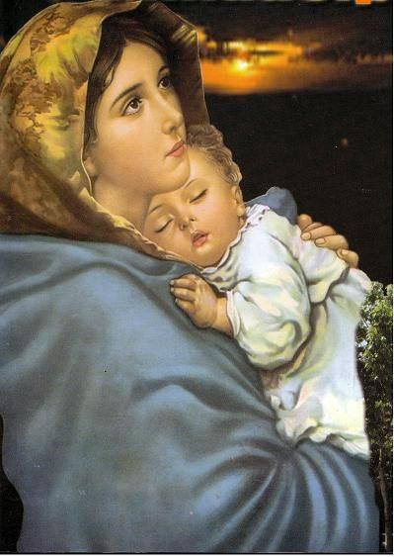
1. Hail Holy Queen enthron'd above, O Maria!
Hail Mother of Mercy and of love.

Slide 64
O Maria! Triumph, all ye Cherubim; Sing with us ye Seraphim!
Heav'n and earth resound the Hymn:
Salve Salve Salve Regina.

Slide 65
2. Our life our sweetness here below O Maria.
Our hope in sorrow and in woe.

Slide 66
O Maria! Triumph, all ye Cherubim; Sing with us ye Seraphim!
Heav'n and earth resound the Hymn:
Salve Salve Salve Regina.

Slide 67
3. And when our life breath leaves us, O Maria!
Show us thy Son, Christ Jesus.

Slide 68
O Maria! Triumph, all ye Cherubim; Sing with us ye Seraphim!
Heav'n and earth resound the Hymn:
Salve Salve Salve Regina.

Slide 69
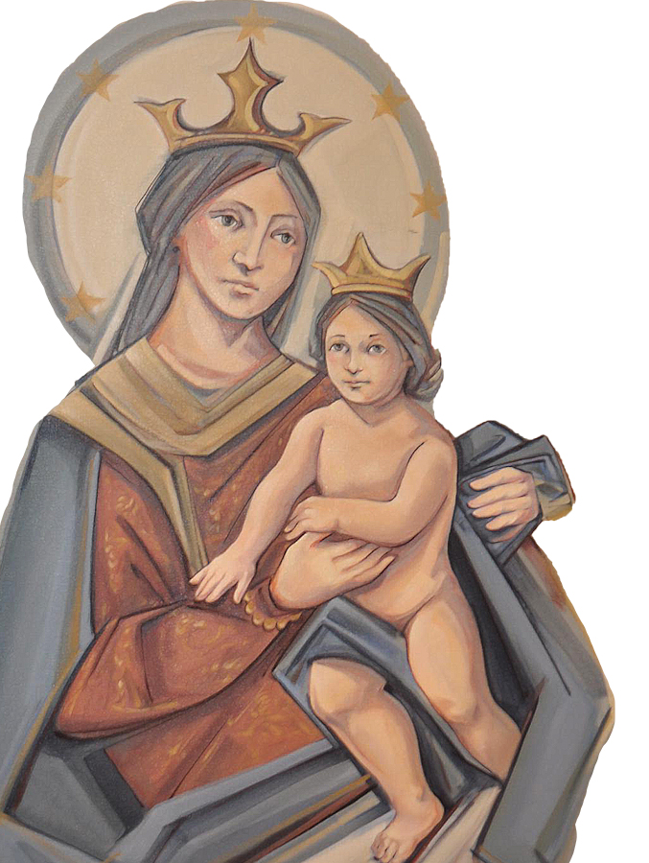
THANK YOU
CÁM ƠN
MARAMING SALAMAT PO
MUCHAS GRACIAS
நன்றி (Nanri)

