Slide 1
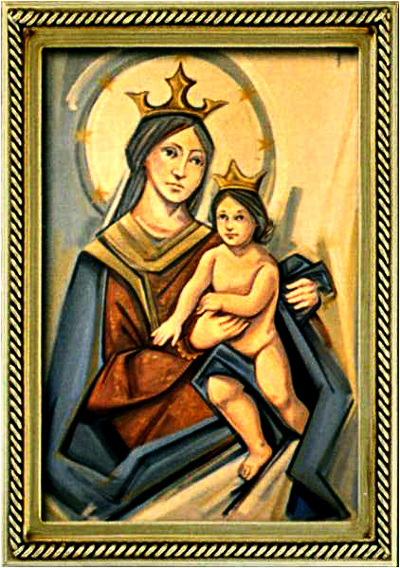
Solemnity of the Ascension of the Lord
Gather Hymn:
Hail The Day That Sees Him Rise
Sprinkling Rite Hymn:
Water Of Life
Responsorial Psalm: 47
God Mounts His Throne To Shouts of Joy
Prep. of the Gifts Hymn:
One Sacrifice Of Christ
Communion Hymn:
Worthy Is The Lamb
Recessional Hymn:
Tell The Good News

Slide 2
1. Hail the day that sees him rise, Alleluia! To his throne beyond the skies. Alleluia! Christ, the Lamb for sinners given, Alleluia! enters now the highest heaven. Alleluia!

Slide 3
2. There for him high triumph waits; Alleluia! lift your heads, eternal gates. Alleluia! He has conquered death and sin; Alleluia! Take the King of glory in. Alleluia!

Slide 4
3. Highest heaven its Lord receives; Alleluia! Yet he loves the earth he leaves. Alleluia! Though returning to his throne, Alleluia! Still he calls us all his own. Alleluia!

Slide 5
4. See! He lifts his hands above. Alleluia!
See! He shows the wounds of love. Alleluia!
Hark! His gracious lips bestow. Alleluia!
Blessings on his church below. Alleluia

Slide 6
Penitential Act (Confiteor 2011) 1 of 3:

Slide 7
I confess to almighty God and to you, my brothers and sisters, that I have greatly sinned, in my thoughts and in my words,

Slide 8
in what I have done and in what I have failed to do, through my fault,
through my fault, through my most grievious fault;

Slide 9
therefore I ask blessed Mary ever-Virgin, all the Angels and Saints, and you, my brothers and sisters, to pray for me to the Lord our God.

Slide 10
Water of Life

Slide 11
Water of life, holy reminder; touching, renewing the body of Christ. Water of life, holy reminder; touching, renewing the body of life.

Slide 12
4. All generations, com forth and receive the blessing of this holy water; making us one with the God who forgives, the one who is faithful and just.

Slide 13
Water of life, holy reminder; touching, renewing the body of Christ. Water of life, holy reminder; touching, renewing the body of life.

Slide 14
5. Bringing new hope to the children of God, regardless of color or story; Cleansing our spirits with kindness and truth, and keeping the promise a live

Slide 15
Water of life, holy reminder; touching, renewing the body of Christ. Water of life, holy reminder; touching, renewing the body of life.

Slide 16
5. Deep as the heavens and wide as the sea, your mercy and love have no ending. Guiding our steps in the journey of faith, you show us the way to your king dom.

Slide 17
Gloria Hymn

Slide 18
Refrain:
Glory to God, Glory to God. Glory to God in the highest, and on earth, peace on earth, peace to people of good will

Slide 19
1. We praise you, we bless you, we adore you, we glorify you, we give you thanks for your great glory. Lord God, heavenly King, O God, almighty Father.

Slide 20
Refrain:
Glory to God, Glory to God. Glory to God in the highest, and on earth, peace on earth, peace to people of good will

Slide 21
2. Lord Jesus Christ, only Begotten Son, Lord God, Lamb of God, Son of the Father, you take away the sins of the world, have mercy on us. You take way the sins of the world, receive our pray you are seated at the right hand, the right hand of the Father, have mercy on us

Slide 22
Refrain:
Glory to God, Glory to God. Glory to God in the highest, and on earth, peace on earth, peace to people of good will

Slide 23
3. For you alone are the Holy One, you alone are the Lord, you alone are the Most High, Jesus Christ with the Holy Spirit, in the glory of God the Father.

Slide 24
Refrain:
Glory to God, Glory to God. Glory to God in the highest, and on earth, peace on earth, peace to people of good will. Amen Amen.

Slide 25
Responsorial Psalm: Psalm 47 God Mounts His Throne To Shouts of Joy

Slide 26
Responsorial Psalm: Psalm 47 God mounts his throne to shouts of joy: a blare of trumpets for the Lord

Slide 27
Gospel Acclamation

Slide 28
Alleluia Alleluia Alleluia. Go and teach all nations, says the Lord; I am with you always, until the end of the world.

Slide 29
Profession Of Faith Creed

Slide 30
Nicene Creed p1
I believe in one God, the Father almighty, maker of heaven and earth, of all things visible and invisible.

Slide 31
Nicene Creed p2
I believe in one Lord Jesus Christ, the Only Begotten Son of God, born of the Father before all ages.

Slide 32
Nicene Creed p3
God from God, Light from Light, true God from true God, begotten, not made, consubstantial with the Father; through Him all things were made.

Slide 33
Nicene Creed p4
For us men and for our salvation He came down from heaven, and by the Holy Spirit was incarnate of the Virgin Mary, and became man.

Slide 34
Nicene Creed p5
For our sake He was crucified under Pontius Pilate, He suffered death and was buried, and rose again on the third day in accordance with the Scriptures.

Slide 35
Nicene Creed p6
He ascended into heaven and is seated at the right hand of the Father.

Slide 36
Nicene Creed p7
He will come again in glory to judge the living and the dead and His kingdom will have no end.

Slide 37
Nicene Creed p8
I believe in the Holy Spirit, the Lord, the giver of life, who proceeds from the Father and the Son,

Slide 38
Nicene Creed p9
who with the Father and the Son is adored and glorified, who has spoken through the prophets.

Slide 39
Nicene Creed p10
I believe in one, holy, catholic and apostolic Church. I confess one Baptism for the forgiveness of sins

Slide 40
Nicene Creed p11
and I look forward to the resurrection of the dead and the life of the world to come. Amen.

Slide 41
Gift One Sacrifice of Christ

Slide 42
1a. One sacrifice of Christ, one throne above the heavens. Christ has risen as he said, and will come to wake the dead. Christ will return to set us free.

Slide 43
1b. One sacrifice of love, one message for the nations: Jesus suffered, died and rose, and ascended to the throne. Christ will return to save the world.

Slide 44
2a. One gaze we lift above, where Love was drawn to heaven. We stand watchful through the night for our King to come in light, heirs to the glory of the Lamb.

Slide 45
2b. One mighty Word of truth: Christ did arise in triumph. Now he sits upon the throne; God’s right hand is he alone. Christ reigns in splendor over all.

Slide 46
3a. One banquet richly set for all God’s holy people. We will dine in joy and peace, and our song will never cease, praising the Lamb upon the throne.

Slide 47
3b. One shout of joy we raise, one voice in exaltation. For in glory Christ has gone, and in hope we now are drawn to one sacrifice of Christ, one sacrifice of Christ.

Slide 48
Holy Holy

Slide 49
Holy, Holy, Holy Lord God of hosts. Heaven and earth are full, are full of your glory. Hosanna, Hosanna! Hosanna in the highest.

Slide 50
Blessed is he who comes, who comes in the name of the Lord. Hosanna, Hosanna! Hosanna in the highest.

Slide 51
Memorial Acclamation

Slide 52
We proclaim your Death, O Lord, and profess your Resurrection until you come again.

Slide 53
Amen

Slide 54
Amen, Amen. Amen, Amen Amen, Amen
Amen. Amen.

Slide 55
Lamb Of God

Slide 56
Lamb of God your take away the sins of the world. Have mercy on us. (repeat as needed)
Lamb of God your take away the sins of the world.
grant us peace.

Slide 57
Communion respond

Slide 58
Behold the Lamb of God,
behold him who takes away the sins of the world.
Blessed are those called to the supper of the Lamb. Lord, I am not worthy
that You should enter under my roof, but only say the word and my soul shall be healed.

Slide 59
Communion Hymn 1: Worthy is The Lamb

Slide 60
Refrain: Worthy is the Lamb that was slain to receive honor and glory. Worthy are the ones who believe to receive the goodness of God.

Slide 61
1. Worthy are you, O Paschal Lamb. Wisdom and strength belong now to you. You laid down your life and died upon the cross: we’ve become a people of hope.

Slide 62
Refrain: Worthy is the Lamb that was slain to receive honor and glory. Worthy are the ones who believe to receive the goodness of God.

Slide 63
2. Worthy are you, O Bread of Life. Salvation and joy belong now to us. By conquering death and rising to new life, we’ve become a people of praise.

Slide 64
Refrain: Worthy is the Lamb that was slain to receive honor and glory. Worthy are the ones who believe to receive the goodness of God.

Slide 65
3. Worthy are you, O Risen Christ. Wonders and signs, revealing your might. Your power and glory shine upon our lives: we’ve become your light for the world.

Slide 66
Refrain: Worthy is the Lamb that was slain to receive honor and glory. Worthy are the ones who believe to receive the goodness of God.

Slide 67
Announcements:

Slide 68
1. Today’s second collection is for Catholic Communications Campaign. Half of your donation will stay in our diocese to support local communications efforts. The other half will support national projects in the United States and around the world. Thank you.

Slide 69
2. We are happy to report on the sixteenth week of ADA 2025 campaign results with 12 families pledging a total amount of $2,185 dollars, for a total pledged amount of $148,965 dollars. Given this result we are $64,563 dollars above the diocesan’s goal of $84,402 dollars,

Slide 70
so thanks to all of you who already made your pledge. We still want to encourage 100% participation from all families attending Masses here, because all new pledges received from now on will be reimbursed to our parish. Thank you all for your support.

Slide 71
3. 3. Last week, our Sunday collections for the parish totaled $9,409 dollars. The parish week-to-week financial report is available on the parish webpage and the weekly bulletin.

Slide 72
Ending Hymn: Tell The Good News

Slide 73
1. Tell the good news to all the earth: Jesus reveals our human worth. Let every heart to joy give birth!
Alleluia Alleluia alleluia!

Slide 74
2. Filled with the Spirit Jesus came Healing the sick, the blind and lame. Let every creature praise his name!
Alleluia Alleluia alleluia!

Slide 75
3. Filled with the Spirit forth we go; Jesus' own word, the seed we sow. Let every land the gospel know!
Alleluia Alleluia alleluia!

Slide 76
Ending Hymn: Dear Lady Of Fatima

Slide 77
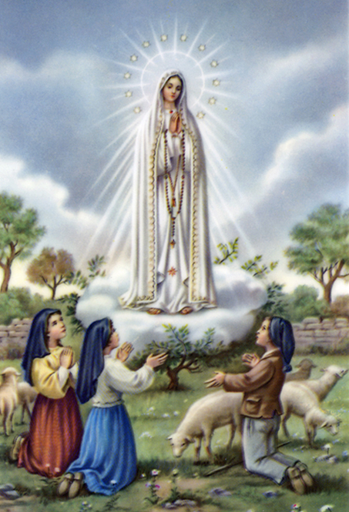
1a. Dear Lady of Fatima we come on bended knee to beg your intercession for peace and unity.

Slide 78
1b. Dear Mary won’t you show us the right and shining way? We pledge our love and offer you a Rosary each day.

Slide 79
2a. You promised at Fatima each time that you appeard to help us. If we pray to youto banish war and fear.

Slide 80
2b. Dear Lady on first Saturday we ask your guidding hand for grace and guidance here on earth and protection for our hand.

Slide 81
Ending Hymn: On This Day

Slide 82
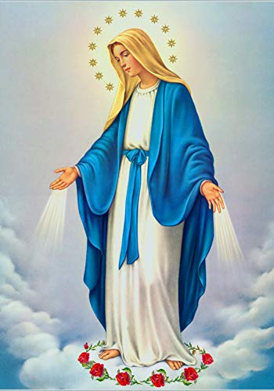
**. On this day, O beautiful Mother, On this day we give thee our love. Near the, Madonna, fondly we hover, Trusting thy gentle care to prove.

Slide 83
1. On this day we ask to share, Dearest Mother, thy sweet care; Aid us ere our feet astray Wanner from thy guiding way.

Slide 84
**. On this day, O beautiful Mother, On this day we give thee our love. Near the, Madonna, fondly we hover, Trusting thy gentle care to prove.

Slide 85
2. Queen of angels, deign to hear. Lisping children's humble prayer; Young hearts gain, O virgin pure, Sweetly to thyself allure.

Slide 86
THANK YOU
CÁM ƠN
MARAMING SALAMAT PO
MUCHAS GRACIAS
நன்றி (Naṉṟi)

Slide 87
THANK YOU
CÁM ƠN
MARAMING SALAMAT PO
MUCHAS GRACIAS
நன்றி (Naṉṟi)

