Slide 1
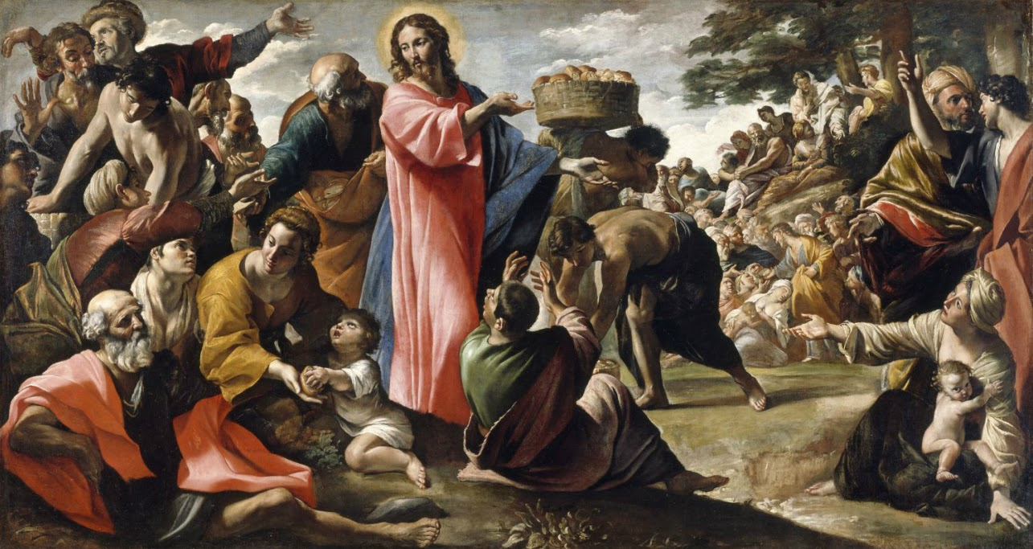
Welcome to Our Lady of Refuge Catholic Church
Sunday Ordinary Time 18th Year A
Gather Song:
I Hear The Voice of Jesus
Responsorial Psalm 145:
The Hand Of The Lord
Prep. of the Gifts:
Come to the River
Communion Song :
Bread of the World
Recessional:
I am The Bread of Life

Slide 2
1a. I heard the voice of Jesus say, “Come unto me and rest;
lay down, O weary one, lay down Thy head upon my breast.”

Slide 3
1b. I came to Jesus as I was,
so weary, worn, and sad;
I found him in a resting place,
and he has made me glad.

Slide 4
2a. I heard the voice of Jesus say, “Behold, I freely give
the living water, thirsty one,
stoop down and drink and live.”

Slide 5
2b. I came to Jesus, and I drank of that life-giving stream;
my thirst was quenched, my soul revived, and now I live in him.

Slide 6
3a. I heard the voice of Jesus say, “I am this dark world’s light; look unto me; Thy morn shall rise,

Slide 7
3b. and all your day be bright.”
I looked to Jesus, and I found
in him my star, my sun;
and in that light of life I’ll walk
till traveling days are done.

Slide 8
Penitential Act

Slide 9
I confess to almighty God and to you, my brothers and sisters, that I have greatly sinned, in my thoughts and in my words,

Slide 10
in what I have done
and in what I have failed to do,
through my fault,
through my fault,
through my most grievious fault;

Slide 11
therefore I ask blessed Mary ever-Virgin, all the Angels and Saints, and you, my brothers and sisters, to pray for me to the Lord our God.

Slide 12
Gloria Prayer

Slide 13
Refrain:
Glory to God, Glory to God. Glory to God in the highest, and on earth, peace on earth, peace to people of good will

Slide 14
1. We praise you, we bless you, we adore you, we glorify you, we give you thanks for your great glory. Lord God, heavenly King, O God, almighty Father.

Slide 15
2. Lord Jesus Christ, only Begotten Son, Lord God, Lamb of God, Son of the Father, you take away the sins of the world, have mercy on us. You take way the sins of the world, receive our pray you are seated at the right hand, the right hand of the Father, have mercy on us

Slide 16
3. For you alone are the Holy One, you alone are the Lord, you alone are the Most High, Jesus Christ with the Holy Spirit, in the glory of God the Father.

Slide 17
Refrain:
Glory to God, Glory to God. Glory to God in the highest, and on earth, peace on earth, peace to people of good will. Amen Amen.
Gloria Prayer
Gloria Prayer

Slide 18
Responsorial Psalm 145
The Hand of The Lord

Slide 19
Responsorial Psalm 145:
The hand of the Lord feeds us he answers all our needs, he answers all our needs

Slide 20
Gospel Acclamation

Slide 21
Refrain: Alleluia!
One does not live on bread alone,
but on every word that comes forth from the mouth of God.

Slide 22
Profession Of Faith
Creed

Slide 23
Nicene Creed p1
I believe in one God, the Father almighty, maker of heaven and earth, of all things visible and invisible.

Slide 24
Nicene Creed p2
I believe in one Lord Jesus Christ, the Only Begotten Son of God, born of the Father before all ages.

Slide 25
Nicene Creed p3
God from God, Light from Light, true God from true God, begotten, not made, consubstantial with the Father; through Him all things were made.

Slide 26
Nicene Creed p4
For us men and for our salvation He came down from heaven, and by the Holy Spirit was incarnate of the Virgin Mary, and became man.

Slide 27
Nicene Creed p5
For our sake He was crucified under Pontius Pilate, He suffered death and was buried, and rose again on the third day in accordance with the Scriptures.

Slide 28
Nicene Creed p6
He ascended into heaven and is seated at the right hand of the Father.

Slide 29
Nicene Creed p7
He will come again in glory to judge the living and the dead and His kingdom will have no end.

Slide 30
Nicene Creed p8
I believe in the Holy Spirit, the Lord, the giver of life, who proceeds from the Father and the Son,

Slide 31
Nicene Creed p9
who with the Father and the Son is adored and glorified, who has spoken through the prophets.

Slide 32
Nicene Creed p10
I believe in one, holy, catholic and apostolic Church. I confess one Baptism for the forgiveness of sins

Slide 33
Nicene Creed p11
and I look forward to the resurrection of the dead and the life of the world to come. Amen.

Slide 34
Preparation of The Gift Song
Come to The River

Slide 35
Refrain. Come, o come, come to the river flowing from the body of Christ. We’ll go down, deep in the water, but in the Lord we shall arise.
1. Washed in waters of rebirth, we have put on Christ Jesus.

Slide 36
Refrain. Come, o come, come to the river flowing from the body of Christ. We’ll go down, deep in the water, but in the Lord we shall arise.
2. Priestly people are we, sealed and send by the Spirit.

Slide 37
Refrain. Come, o come, come to the river flowing from the body of Christ. We’ll go down, deep in the water, but in the Lord we shall arise.
3. Blest are those who thirst for the reign of God’s justice.

Slide 38
Refrain. Come, o come, come to the river flowing from the body of Christ. We’ll go down, deep in the water, but in the Lord we shall arise.
4. Let us walk in the light of God’s holy promise,

Slide 39
Refrain. Come, o come, come to the river flowing from the body of Christ. We’ll go down, deep in the water, but in the Lord we shall arise.
5. Those who sow in tears reap the harvest rejoicing.

Slide 40
Holy Holy Holy

Slide 41
Holy, Holy, Holy Lord God of hosts.
Heaven and earth are full, are full of your glory. Hosanna, Hosanna! Hosanna in the highest.

Slide 42
Blessed is he who comes, who comes in the name of the Lord.
Hosanna, Hosanna! Hosanna in the highest.

Slide 43
Memorial Acclamation

Slide 44
We proclaim your Death, O Lord,
and profess your Resurrection until you come again.

Slide 45
Amen

Slide 46
Amen Amen Amen

Slide 47
Lamb of God

Slide 48
Lamb of God you take away the sins of the world. Have mercy on us. (repeat as needed)
Lamb of God you take away the sins of the world.
grant us peace.

Slide 49
Communion Respond

Slide 50
Behold the Lamb of God,
behold him who takes away the sins of the world.
Blessed are those called to the supper of the Lamb.
Lord, I am not worthy
that You should enter under my roof, but only say the word and my soul shall be healed.

Slide 51
Communion Hymn
Bread For The World

Slide 52
refrain. Bread for the world
A world of hunger
Wine for all peoples
People who thirst
May we who eat
Be bread for others
May we who drink
Pour out our love

Slide 53
1. Lord Jesus Christ
You are the bread of life
Broken to reach and heal the wounds
Of human pain
Where we divide Your people
You are waiting there
On bended knee
To wash our feet with endless care

Slide 54
refrain. Bread for the world
A world of hunger
Wine for all peoples
People who thirst
May we who eat
Be bread for others
May we who drink
Pour out our love

Slide 55
2. Lord Jesus Christ
You are the wine of peace
Poured into hearts once broken
And where dryness sleeps
Where we are tired and weary
You are waiting there
To be the way which beckons us
Beyond despair

Slide 56
refrain. Bread for the world
A world of hunger
Wine for all peoples
People who thirst
May we who eat
Be bread for others
May we who drink
Pour out our love

Slide 57
3. Lord Jesus Christ
You call us to your feast, at which the rich and powerful have become the least. Where we survive on others in our human greed, you walk among us begging for your every need.

Slide 58
Communion Hymn 2
Ave Maria, Gratia Plena

Slide 59
Ave Maria, gratia plena,
Dominus tecum, benedicta tu in mulieribus, et benedictus fructus ventris tui, Iesus.
Sancta Maria, Mater Dei, ora pro nobis peccatoribus, nunc et in hora mortis nostrae.
Amen.

Slide 60
Sending Hymn
I am The Bread of Life

Slide 61
1. I am the bread of life.
You who comes to me shall not hunger;
And who believes in Me shall not thirst.
No one can come to Me
Unless the Father beckons.

Slide 62
Refrain:
And I will raise you up.
And I will raise you up.
And I will raise you up on the last day.

Slide 63
2. The bread that I will give
Is My flesh for the life of the world.
And if you eat of this bread.
You shall live for ever,
you shall live for ever

Slide 64
Refrain:
And I will raise you up.
And I will raise you up.
And I will raise you up on the last day.

Slide 65
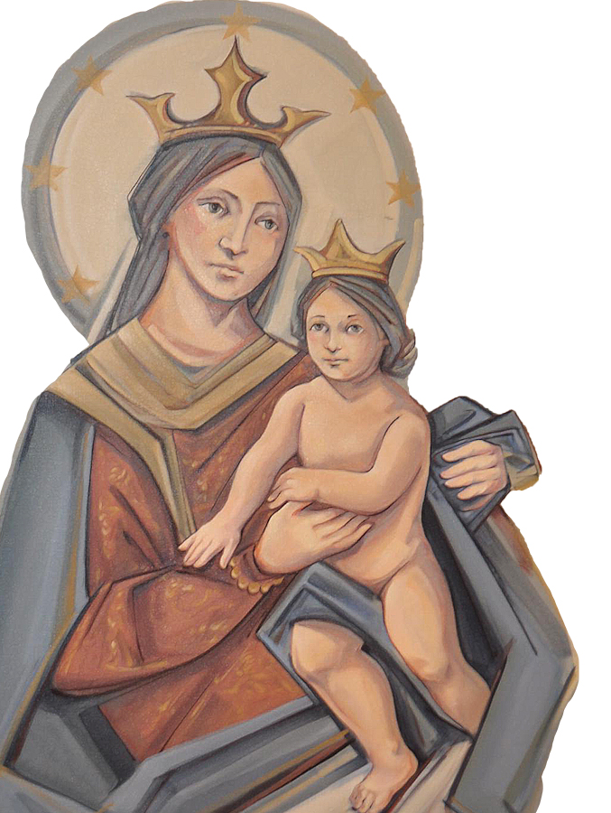
THANK YOU
CÁM ƠN
MARAMING SALAMAT PO
MUCHAS GRACIAS
நன்றி (Nanri)

