Slide 1
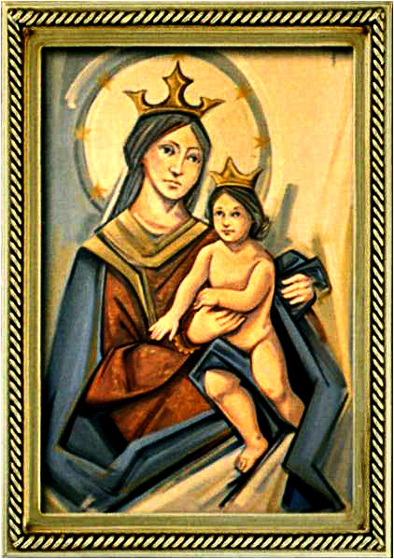
Ordinary Time 30 Year C
Gather Hymn:
Amazing Grace
Responsorial Psalm: 34
The Lord Hears The Cry
Prep. of the Gifts Hymn:
I Love The Lord
Communion Hymn:
There is a longing
Recessional Hymn:
On This Day

Slide 2
1. Amazing Grace, how sweet the sound, That saved a wretch like me. I once was lost but now am found, was blind, but now I see.

Slide 3
2. T'was Grace that taught my heart to fear. And Grace, my fears relieved. How precious did that Grace appear the hour I first believed.

Slide 4
3. Through many dangers, toils and snares I have already come; 'Tis Grace that brought me safe thus far and Grace will lead me home.

Slide 5
4. The Lord has promised good to me. His word my hope secures. He will my shield and portion be, as long as life endures.

Slide 6
5. When we've been here ten thousand years bright shining as the sun. We've no less days to sing God's praise than when we've first begun.

Slide 7
Penitential Act (Confiteor 2011) 1 of 3:

Slide 8
I confess to almighty God and to you, my brothers and sisters, that I have greatly sinned, in my thoughts and in my words,

Slide 9
in what I have done and in what I have failed to do, through my fault,
through my fault, through my most grievious fault;

Slide 10
therefore I ask blessed Mary ever-Virgin, all the Angels and Saints, and you, my brothers and sisters, to pray for me to the Lord our God.

Slide 11
Gloria Hymn

Slide 12
Refrain:
Glory to God, Glory to God. Glory to God in the highest, and on earth, peace on earth, peace to people of good will

Slide 13
1. We praise you, we bless you, we adore you, we glorify you, we give you thanks for your great glory. Lord God, heavenly King, O God, almighty Father.

Slide 14
Refrain:
Glory to God, Glory to God. Glory to God in the highest, and on earth, peace on earth, peace to people of good will

Slide 15
2. Lord Jesus Christ, only Begotten Son, Lord God, Lamb of God, Son of the Father, you take away the sins of the world, have mercy on us. You take way the sins of the world, receive our pray you are seated at the right hand, the right hand of the Father, have mercy on us

Slide 16
Refrain:
Glory to God, Glory to God. Glory to God in the highest, and on earth, peace on earth, peace to people of good will

Slide 17
3. For you alone are the Holy One, you alone are the Lord, you alone are the Most High, Jesus Christ with the Holy Spirit, in the glory of God the Father.

Slide 18
Refrain:
Glory to God, Glory to God. Glory to God in the highest, and on earth, peace on earth, peace to people of good will. Amen Amen.

Slide 19
Responsorial Psalm: 34 The Lord Hears The Cry of The Poor

Slide 20
Responsorial Psalm: Psalm 121 The Lord hears the cry of the poor. Blessed be the Lord.

Slide 21
Gospel Acclamation

Slide 22
Alleluia Alleluia Alleluia. God was reconciling the world to himself in Christ, and entrusting to us the message of salvation.

Slide 23
Profession Of Faith Creed

Slide 24
Nicene Creed p1
I believe in one God, the Father almighty, maker of heaven and earth, of all things visible and invisible.

Slide 25
Nicene Creed p2
I believe in one Lord Jesus Christ, the Only Begotten Son of God, born of the Father before all ages.

Slide 26
Nicene Creed p3
God from God, Light from Light, true God from true God, begotten, not made, consubstantial with the Father; through Him all things were made.

Slide 27
Nicene Creed p4
For us men and for our salvation He came down from heaven, and by the Holy Spirit was incarnate of the Virgin Mary, and became man.

Slide 28
Nicene Creed p5
For our sake He was crucified under Pontius Pilate, He suffered death and was buried, and rose again on the third day in accordance with the Scriptures.

Slide 29
Nicene Creed p6
He ascended into heaven and is seated at the right hand of the Father.

Slide 30
Nicene Creed p7
He will come again in glory to judge the living and the dead and His kingdom will have no end.

Slide 31
Nicene Creed p8
I believe in the Holy Spirit, the Lord, the giver of life, who proceeds from the Father and the Son,

Slide 32
Nicene Creed p9
who with the Father and the Son is adored and glorified, who has spoken through the prophets.

Slide 33
Nicene Creed p10
I believe in one, holy, catholic and apostolic Church. I confess one Baptism for the forgiveness of sins

Slide 34
Nicene Creed p11
and I look forward to the resurrection of the dead and the life of the world to come. Amen.

Slide 35
Preparation of The Gift Song: I Love The Lord

Slide 36
1- I love the Lord who has heard my cry.
I love the Lord, standing at my side I love the Lord, always close to me. I love the Lord, love the Lord who saves and sets me free.

Slide 37
2- I seek the Lord through each night and day. I seek the Lord as I walk my I seek the Lord when the light seems gone. I seek the Lord, seek the Lord who calls me to go on.

Slide 38
3- I need the Lord more than I can tell. I need the Lord this I know so well! I need the Lord, how I need the Lord! I need the Lord, need the Lord with love on me out pound.

Slide 39
4- I praise the Lord sing-ing clear and strong. I praise the Lord, focus of my song. I praise the Lord, strengthening my voice. I praise the Lord, praise the Lord and rap-t'rous-ly rejoice

Slide 40
Holy Holy

Slide 41
Holy, Holy, Holy Lord God of hosts. Heaven and earth are full, are full of your glory. Hosanna, Hosanna! Hosanna in the highest.

Slide 42
Blessed is he who comes, who comes in the name of the Lord. Hosanna, Hosanna! Hosanna in the highest.

Slide 43
Memorial Acclamation

Slide 44
We proclaim your Death, O Lord, and profess your Resurrection until you come again.

Slide 45
Amen

Slide 46
Amen, Amen. Amen, Amen Amen, Amen
Amen. Amen.

Slide 47
Lamb Of God

Slide 48
Lamb of God your take away the sins of the world. Have mercy on us. (repeat as needed)
Lamb of God your take away the sins of the world.
grant us peace.

Slide 49
Communion respond

Slide 50
Behold the Lamb of God,
behold him who takes away the sins of the world.
Blessed are those called to the supper of the Lamb. Lord, I am not worthy
that You should enter under my roof, but only say the word and my soul shall be healed.

Slide 51
Communion Hymn 1: There is a Longing

Slide 52
Refrain: There is a longing in our hearts, o Lord. For you to reveal yourself to us. There is a longing in our hearts for love we only find in you, our God.
1. For Justice, for freedom. mercy; hear our prayer. In sorrow, in grief: Be near, hear our prayer, O God.

Slide 53
Refrain: There is a longing in our hearts, o Lord. For you to reveal yourself to us. There is a longing in our hearts for love we only find in you, our God.
2. For wisdom, For courage, for comfort: Hear our prayer. In weakness, in fear: be near, hear our prayer, O God.

Slide 54
Refrain: There is a longing in our hearts, o Lord. For you to reveal yourself to us. There is a longing in our hearts for love we only find in you, our God.
3. For Healing, for wholeness, For new life: Hear our prayer. In sickness, in death: Be near, hear our prayer, O God.

Slide 55
Refrain: There is a longing in our hearts, o Lord. For you to reveal yourself to us. There is a longing in our hearts for love we only find in you, our God.
4. Lord save us, take pity, light our darkness. We call you, we wait: Be near, hear our prayer, o God.

Slide 56
Communion Hymn 1: I have loved you

Slide 57
I have loved you with an everlasting love, I have called you and you are mine. (2x)

Slide 58
1. Seek the face of the Lord and long for him: He will bring you his light and his peace.

Slide 59
I have loved you with an everlasting love, I have called you and you are mine. (2x)

Slide 60
2. Seek the face of the Lord and long for him: He will bring you his joy and his hope.

Slide 61
I have loved you with an everlasting love, I have called you and you are mine. (2x)

Slide 62
3. Seek the face of the Lord and long for him: He will bring you his care and his love.

Slide 63
I have loved you with an everlasting love, I have called you and you are mine. (2x)

Slide 64
Announcements:

Slide 66
Ending Hymn: On this day, O beautiful Mother

Slide 67
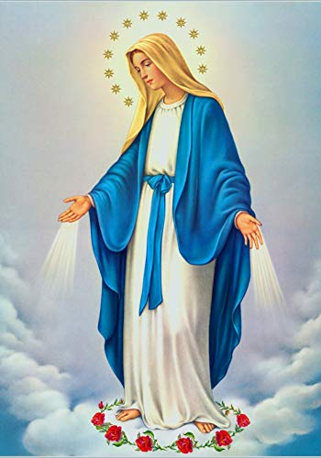
**. On this day, O beautiful Mother, On this day we give thee our love. Near the, Madonna, fondly we hover, Trusting thy gentle care to prove.

Slide 68
1. On this day we ask to share, Dearest Mother, thy sweet care; Aid us ere our feet astray Wanner from thy guiding way.

Slide 69
**. On this day, O beautiful Mother, On this day we give thee our love. Near the, Madonna, fondly we hover, Trusting thy gentle care to prove.

Slide 70
2. Queen of angels, deign to hear. Lisping children's humble prayer; Young hearts gain, O virgin pure, Sweetly to thyself allure.

Slide 71
**. On this day, O beautiful Mother, On this day we give thee our love. Near the, Madonna, fondly we hover, Trusting thy gentle care to prove.

Slide 72
Ending Hymn: Lady Of Fatima

Slide 73
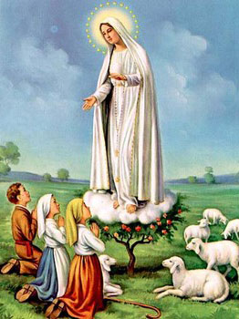
1. Dear Lady of Fatima we come on bended knee To beg your intercession for peace and unity. Dear Mary won't you show us the right and shining way? We pledge our love and offer you a Rosary each day.

Slide 74
2. You promised at Fatima Each time that you appeared To help us If we pray to you to banish war and fear. Dear Lady on first days we ask your guiding hand for grace and guidance here on earth protection for our land.

Slide 75
Ending Hymn: On This Day

Slide 76
**. On this day, O beautiful Mother, On this day we give thee our love. Near the, Madonna, fondly we hover, Trusting thy gentle care to prove.

Slide 77
1. On this day we ask to share, Dearest Mother, thy sweet care; Aid us ere our feet astray Wanner from thy guiding way.

Slide 78
**. On this day, O beautiful Mother, On this day we give thee our love. Near the, Madonna, fondly we hover, Trusting thy gentle care to prove.

Slide 79
2. Queen of angels, deign to hear. Lisping children's humble prayer; Young hearts gain, O virgin pure, Sweetly to thyself allure.

Slide 80
THANK YOU
CÁM ƠN
MARAMING SALAMAT PO
MUCHAS GRACIAS
நன்றி (Naṉṟi)

Slide 81
THANK YOU
CÁM ƠN
MARAMING SALAMAT PO
MUCHAS GRACIAS
நன்றி (Naṉṟi)

