Slide 1
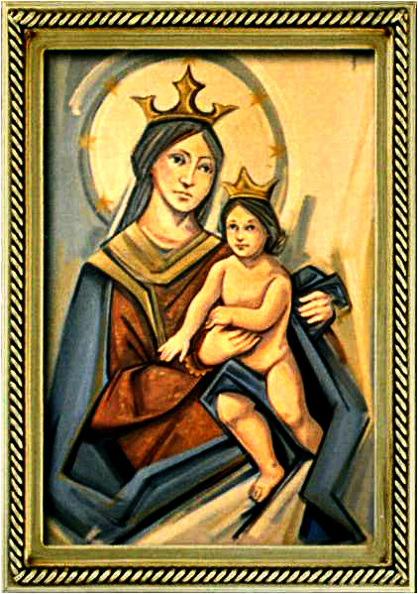
Ordinary Time 14 Year C
Gather Hymn:
Come, Follow Me
Responsorial Psalm: 66
Psalm 66 Let All The Earth
Prep. of the Gifts Hymn:
We Walk by Faith
Communion Hymn:
Here, I am Lord
Recessional Hymn:
America The Beautiful

Slide 2
Refrain Come, follow me and live; do not be afraid. Believe and trust in me; your faith will give you strength. Leave all your fears behind you; let your heart be free for I will be your guide. Oh, come and follow me.

Slide 3
1. Come, follow in these foot steps; I’ll lead you gently home. No shelter, food nor money, will you need up-on this road.

Slide 4
Refrain Come, follow me and live; do not be afraid. Believe and trust in me; your faith will give you strength. Leave all your fears behind you; let your heart be free for I will be your guide. Oh, come and follow me.

Slide 5
2. Come, walk across the water: place all your faith in me. Cast all your doubs behind you to the wind and raging sea.

Slide 6
Refrain Come, follow me and live; do not be afraid. Believe and trust in me; your faith will give you strength. Leave all your fears behind you; let your heart be free for I will be your guide. Oh, come and follow me.

Slide 7
3. If you remain within me, my words remain in you. Whatever you may ask of me, that is what I will do.

Slide 8
Penitential Act (Confiteor 2011) 1 of 3:

Slide 9
I confess to almighty God and to you, my brothers and sisters, that I have greatly sinned, in my thoughts and in my words,

Slide 10
in what I have done and in what I have failed to do, through my fault,
through my fault, through my most grievious fault;

Slide 11
therefore I ask blessed Mary ever-Virgin, all the Angels and Saints, and you, my brothers and sisters, to pray for me to the Lord our God.

Slide 12
Gloria Hymn

Slide 13
Refrain:
Glory to God, Glory to God. Glory to God in the highest, and on earth, peace on earth, peace to people of good will

Slide 14
1. We praise you, we bless you, we adore you, we glorify you, we give you thanks for your great glory. Lord God, heavenly King, O God, almighty Father.

Slide 15
Refrain:
Glory to God, Glory to God. Glory to God in the highest, and on earth, peace on earth, peace to people of good will

Slide 16
2. Lord Jesus Christ, only Begotten Son, Lord God, Lamb of God, Son of the Father, you take away the sins of the world, have mercy on us. You take way the sins of the world, receive our pray you are seated at the right hand, the right hand of the Father, have mercy on us

Slide 17
Refrain:
Glory to God, Glory to God. Glory to God in the highest, and on earth, peace on earth, peace to people of good will

Slide 18
3. For you alone are the Holy One, you alone are the Lord, you alone are the Most High, Jesus Christ with the Holy Spirit, in the glory of God the Father.

Slide 19
Refrain:
Glory to God, Glory to God. Glory to God in the highest, and on earth, peace on earth, peace to people of good will. Amen Amen.

Slide 20
Responsorial Psalm: 66 Let all the Earth Cry out.

Slide 21
Responsorial Psalm: Psalm 66 Let all the earth cry out to God with joy, with joy.

Slide 22
Gospel Acclamation

Slide 23
Alleluia Alleluia Alleluia. Let the peace of Christ control your hearts; let the word of Christ dwell in you richly.

Slide 24
Profession Of Faith Creed

Slide 25
Nicene Creed p1
I believe in one God, the Father almighty, maker of heaven and earth, of all things visible and invisible.

Slide 26
Nicene Creed p2
I believe in one Lord Jesus Christ, the Only Begotten Son of God, born of the Father before all ages.

Slide 27
Nicene Creed p3
God from God, Light from Light, true God from true God, begotten, not made, consubstantial with the Father; through Him all things were made.

Slide 28
Nicene Creed p4
For us men and for our salvation He came down from heaven, and by the Holy Spirit was incarnate of the Virgin Mary, and became man.

Slide 29
Nicene Creed p5
For our sake He was crucified under Pontius Pilate, He suffered death and was buried, and rose again on the third day in accordance with the Scriptures.

Slide 30
Nicene Creed p6
He ascended into heaven and is seated at the right hand of the Father.

Slide 31
Nicene Creed p7
He will come again in glory to judge the living and the dead and His kingdom will have no end.

Slide 32
Nicene Creed p8
I believe in the Holy Spirit, the Lord, the giver of life, who proceeds from the Father and the Son,

Slide 33
Nicene Creed p9
who with the Father and the Son is adored and glorified, who has spoken through the prophets.

Slide 34
Nicene Creed p10
I believe in one, holy, catholic and apostolic Church. I confess one Baptism for the forgiveness of sins

Slide 35
Nicene Creed p11
and I look forward to the resurrection of the dead and the life of the world to come. Amen.

Slide 36
Preparation of The Gift Song: We Walk by Faith

Slide 37
1. We walk by faith and not by sight: No gracious words we hear, Of Him who as none ever spoke.
Yet we believe Him near

Slide 38
2. We may not touch His hands and side Or follow where He trod Yet in His promise we rejoice And cry "My Lord and God"

Slide 39
3. Help then, oh Lord, our unbelief And our faith abound To call on you when you are near And seek where you are found

Slide 40
4. That when our life of faith is done In realms of clearer light We may behold you as you are In full and endless sight

Slide 41
Holy Holy

Slide 42
Holy, Holy, Holy Lord God of hosts. Heaven and earth are full, are full of your glory. Hosanna, Hosanna! Hosanna in the highest.

Slide 43
Blessed is he who comes, who comes in the name of the Lord. Hosanna, Hosanna! Hosanna in the highest.

Slide 44
Memorial Acclamation

Slide 45
We proclaim your Death, O Lord, and profess your Resurrection until you come again.

Slide 46
Amen

Slide 47
Amen, Amen. Amen, Amen Amen, Amen
Amen. Amen.

Slide 48
Lamb Of God

Slide 49
Lamb of God your take away the sins of the world. Have mercy on us. (repeat as needed)
Lamb of God your take away the sins of the world.
grant us peace.

Slide 50
Communion respond

Slide 51
Behold the Lamb of God,
behold him who takes away the sins of the world.
Blessed are those called to the supper of the Lamb. Lord, I am not worthy
that You should enter under my roof, but only say the word and my soul shall be healed.

Slide 52
Communion Hymn 1: Here I am Lord

Slide 53
1. I, The Lord of sea and sky. I have heard my people cry. All who dwell in dark and sin. My hand will save. I who made the stars of night. I will make their darkness bright. Who will bear my light to them? Who shall I send?

Slide 54
Refrain: Here I am Lord. Is it I, Lord? I have heard you calling in the night. I will go, Lord. If you lead me I will hold your people in my heart.

Slide 55
2. I, The Lord of snow and rain. I have borne my people’s pain. I have wept for love of them. They turn away. I will break their hearts of stone. Give them hearts for love alone. I will speak my word to them. Whom shall I send?

Slide 56
Refrain: Here I am Lord. Is it I, Lord? I have heard you calling in the night. I will go, Lord. If you lead me I will hold your people in my heart.

Slide 57
3. I, The Lord of wind and flame, I will tend the poor and lame. I will set a feast for them. My hand will save. Finest bread I will provide. Till their hearts be satified. I will give my life to them. Whom shall I send?

Slide 58
Refrain: Here I am Lord. Is it I, Lord? I have heard you calling in the night. I will go, Lord. If you lead me I will hold your people in my heart.

Slide 59
Announcements:

Slide 61
Ending Hymn: America The Beautiful

Slide 62
1. O beautiful for spacious skies, For amber waves of grain. For purple mountain majesties Above the fruited plain! America! America! God shed his grace on thee. And crown thy good with
brotherhood. From sea to shining sea!

Slide 63
2. O beautiful for pilgrim feet, Whose stern impassioned stress A thoroughfare of freedom beat Across the wilderness! America! America! God mend thine every flaw, Confirm thy soul in self-control, Thy liberty in law!

Slide 64
Ending Hymn: On This Day

Slide 65
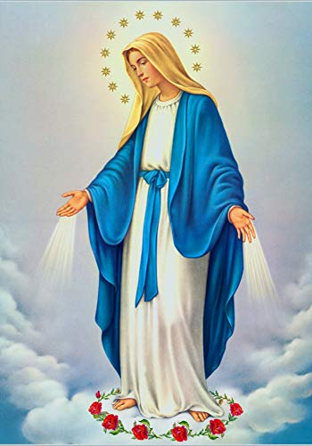
**. On this day, O beautiful Mother, On this day we give thee our love. Near the, Madonna, fondly we hover, Trusting thy gentle care to prove.

Slide 66
1. On this day we ask to share, Dearest Mother, thy sweet care; Aid us ere our feet astray Wanner from thy guiding way.

Slide 67
**. On this day, O beautiful Mother, On this day we give thee our love. Near the, Madonna, fondly we hover, Trusting thy gentle care to prove.

Slide 68
2. Queen of angels, deign to hear. Lisping children's humble prayer; Young hearts gain, O virgin pure, Sweetly to thyself allure.

Slide 69
THANK YOU
CÁM ƠN
MARAMING SALAMAT PO
MUCHAS GRACIAS
நன்றி (Naṉṟi)

Slide 70
THANK YOU
CÁM ƠN
MARAMING SALAMAT PO
MUCHAS GRACIAS
நன்றி (Naṉṟi)

