Slide 1
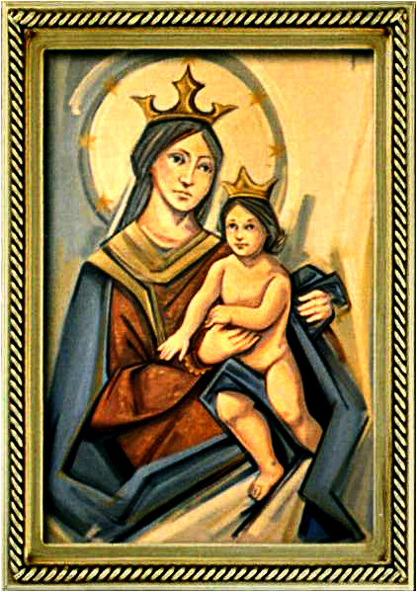
The Solemnity of the Most Holy Trinity
Gather Hymn:
I Sing The Mighty Power Of God
Responsorial Psalm: 8
O Lord, Our God , How Wonderful
Prep. of the Gifts Hymn:
All My Days
Communion Hymn:
How Great Thou Art
Recessional Hymn:
Go Peace to Love and Serve The Lord

Slide 2
1. I sing the mighty pow’r of God That made the mountains rise, That spread the flowing seas abroad, and build the lofty skies. I sing the wisdom that ordained The sun to rule the day; The moon shines full at his command, and all the start obey.

Slide 3
2. I sing the goodness of the Lord that filled the earth with food; He formed the creatures with his word, and then pronounced them good. Lord how thy wonders are displayed where ever I turn my eye; if I survey the ground I tread, or gaze upon the sky!

Slide 4
3. there’s not a plant or flow’r below but makes thy glories known; And clouds arise, and tempests blow by order from thy throne; While all that borrows life from thee Is ever in thy care, and every where that I can be, thou, God, are present there.

Slide 5
Penitential Act (Confiteor 2011) 1 of 3:

Slide 6
I confess to almighty God and to you, my brothers and sisters, that I have greatly sinned, in my thoughts and in my words,

Slide 7
in what I have done
and in what I have failed to do,
through my fault,
through my fault,
through my most grievious fault;

Slide 8
therefore I ask blessed Mary ever-Virgin, all the Angels and Saints, and you, my brothers and sisters, to pray for me to the Lord our God.

Slide 9
Gloria Hymn

Slide 10
Refrain:
Glory to God, Glory to God. Glory to God in the highest, and on earth, peace on earth, peace to people of good will

Slide 11
1. We praise you, we bless you, we adore you, we glorify you, we give you thanks for your great glory. Lord God, heavenly King, O God, almighty Father.

Slide 12
Refrain:
Glory to God, Glory to God. Glory to God in the highest, and on earth, peace on earth, peace to people of good will

Slide 13
2. Lord Jesus Christ, only Begotten Son, Lord God, Lamb of God, Son of the Father, you take away the sins of the world, have mercy on us. You take way the sins of the world, receive our pray you are seated at the right hand, the right hand of the Father, have mercy on us

Slide 14
Refrain:
Glory to God, Glory to God. Glory to God in the highest, and on earth, peace on earth, peace to people of good will

Slide 15
3. For you alone are the Holy One, you alone are the Lord, you alone are the Most High, Jesus Christ with the Holy Spirit, in the glory of God the Father.

Slide 16
Refrain:
Glory to God, Glory to God. Glory to God in the highest, and on earth, peace on earth, peace to people of good will. Amen Amen.

Slide 17
Responsorial Psalm: Psalm 8
O Lord, Our God, How Wonderful

Slide 18
Responsorial Psalm: Psalm 08
O Lord, our God, how wonderful your name, how wonderful your name in all the earth.

Slide 19
Gospel Acclamation

Slide 20
Alleluia Alleluia Alleluia.
Glory to the Father, the Son, and the Holy Spirit; to God who is, who was and who is to come.

Slide 21
Profession Of Faith
Creed

Slide 22
Nicene Creed p1
I believe in one God, the Father almighty, maker of heaven and earth, of all things visible and invisible.

Slide 23
Nicene Creed p2
I believe in one Lord Jesus Christ, the Only Begotten Son of God, born of the Father before all ages.

Slide 24
Nicene Creed p3
God from God, Light from Light, true God from true God, begotten, not made, consubstantial with the Father; through Him all things were made.

Slide 25
Nicene Creed p4
For us men and for our salvation He came down from heaven, and by the Holy Spirit was incarnate of the Virgin Mary, and became man.

Slide 26
Nicene Creed p5
For our sake He was crucified under Pontius Pilate, He suffered death and was buried, and rose again on the third day in accordance with the Scriptures.

Slide 27
Nicene Creed p6
He ascended into heaven and is seated at the right hand of the Father.

Slide 28
Nicene Creed p7
He will come again in glory to judge the living and the dead and His kingdom will have no end.

Slide 29
Nicene Creed p8
I believe in the Holy Spirit, the Lord, the giver of life, who proceeds from the Father and the Son,

Slide 30
Nicene Creed p9
who with the Father and the Son is adored and glorified, who has spoken through the prophets.

Slide 31
Nicene Creed p10
I believe in one, holy, catholic and apostolic Church. I confess one Baptism for the forgiveness of sins

Slide 32
Nicene Creed p11
and I look forward to the resurrection of the dead and the life of the world to come. Amen.

Slide 33
Preparation of The Gift Song:
All My Days

Slide 34
[Chorus]
Till the end of my day oh Lord I will bless your name
Sing your praise, give You thanks
All my days

Slide 35
[Verse 1]
You have made me little less than a god And have lavished my heart with your love
With dignity and honor you've clothed me Given me rule over all

Slide 36
[Chorus]
Till the end of my day oh Lord
I will bless your name
Sing your praise, give You thanks
All my days

Slide 37
[Verse 2]
You have blessed me with good things and plenty
And surrounded my table with friends
Their love and their laughter enrich me;
Together we sing your praise

Slide 38
[Chorus]
Till the end of my day oh Lord
I will bless your name
Sing your praise, give You thanks
All my days

Slide 39
[Verse 3]
Your sun and your moon give me light
And your stars show the way through the night Your rivers and streams have refreshed me I will sing your praise

Slide 40
[Chorus]
Till the end of my day oh Lord
I will bless your name
Sing your praise, give You thanks
All my days

Slide 41
Holy Holy

Slide 42
Holy, Holy, Holy Lord God of hosts.
Heaven and earth are full, are full of your glory. Hosanna, Hosanna! Hosanna in the highest.

Slide 43
Blessed is he who comes, who comes in the name of the Lord.
Hosanna, Hosanna! Hosanna in the highest.

Slide 44
Memorial Acclamation

Slide 45
We proclaim your Death, O Lord,
and profess your Resurrection until you come again.

Slide 46
Amen

Slide 47
Amen, Amen.
Amen, Amen
Amen, Amen
Amen. Amen.

Slide 48
Lamb Of God

Slide 49
Lamb of God your take away the sins of the world. Have mercy on us. (repeat as needed)
Lamb of God your take away the sins of the world.
grant us peace.

Slide 50
Communion respond

Slide 51
Behold the Lamb of God,
behold him who takes away the sins of the world.
Blessed are those called to the supper of the Lamb.
Lord, I am not worthy
that You should enter under my roof, but only say the word and my soul shall be healed.

Slide 52
Communion Hymn 1:
How Great Thou Art

Slide 53
1. Oh Lord my God! when I in awesome wonder Consider all the worlds thy hands have made, I see the stars, I hear the **rolling thunder, Thy power throughout the universe displayed;

Slide 54
REFRAIN: Then sings my soul, my savior God to thee; How great thou art, How great thou art! Then sings my soul, my savior God to thee; How great thou art, how great thou art!

Slide 55
2. When thru the woods and forest glades I wander, And hear the birds sing sweetly in the trees; When I look down from lofty mountain grandeur.
And hear the brook, and feel the gentle breeze;

Slide 56
REFRAIN: Then sings my soul, my savior God to thee; How great thou art, How great thou art! Then sings my soul, my savior God to thee; How great thou art, how great thou art!

Slide 57
3. And when I think that God, his Son not sparing, Sent Him to die, I scarce can take it in, That on the cross, my burden gladly bearing, He bled and died to take away my sin;

Slide 58
REFRAIN: Then sings my soul, my savior God to thee; How great thou art, How great thou art! Then sings my soul, my savior God to thee; How great thou art, how great thou art!

Slide 59
4. When Christ shall come With shout of acclamation and take me home, what joy shall fill my heart!
Then I shall bow in humble adoration,
And there proclaim, my God how great thou art!

Slide 60
Announcements:

Slide 61
1. Today’s second collection is to commemorate Father’s Day. We want to congratulate every father who is present here and to wish them a joyful day accompanied by your beloved ones. God bless you all.

Slide 62
2. We are happy to report on the eighteenth week of ADA 2025 campaign results with 5 families pledging a total amount of $1,250 dollars, for a total pledged amount of $152,325 dollars. Given this result we are $67,923 dollars above the diocesan’s goal of $84,402 dollars,

Slide 63
so thanks to all of you who already made your pledge. We still want to encourage 100% participation from all families attending Masses here, because all new pledges received from now on will be reimbursed to our parish. Thank you all for your support.

Slide 64
3.
3. On Sunday July 20th, 2025 a vocations soccer game will be held at the Archbishop Mitty High School Soccer Field from 4:30pm to 8pm. Admission is $10 dollars per ticket, also you can participate in a raffle by buying tickets at $10 dollars each.

Slide 65
All funds collected will be used to support seminarians and their formation program. Tickets on sale st the parish office during its working hours.

Slide 66
4. We will have an All-Night Eucharistic Adoration on the occasion of the Feast of the Most Holy Body and Blood of Christ better known as Corpus Christi. All parishioners of Our Lady of Refuge Parish are warmly invited to participate. Please review the adoration schedule in the parish bulletin to invite the members of your ministry or association to attend.

Slide 67
5. Last week, our Sunday collections for the parish totaled $14,518 dollars, which includes $5,428 dollars of the second collection for the building fund. The parish week-to-week financial report is available on the parish webpage and the weekly bulletin.

Slide 68
6. Please mention the issue with the paschal candle.

Slide 69
Ending Hymn:
Go Peace to Love and Serve the Lord

Slide 70
1. Go in peace to love and serve the Lord Go in peace be-come the liv-ing Word! Christ on our lips and Christ in our hearts, may we show God's love to the world, to the world, may we show God's love to the world.

Slide 71
2. Be Christ's hands now reaching out to all Be Christ's voice inviting with his call Filled with his joy, empowered with his stregnth may we spread God's grace through the world, through the world, may we spread God's grace trough the world.

Slide 72
Ending Hymn:
Dear Lady Of Fatima

Slide 73
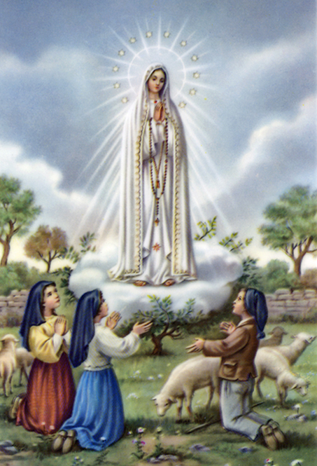
1a. Dear Lady of Fatima we come on bended knee to beg your intercession for peace and unity.

Slide 74
1b. Dear Mary won’t you show us the right and shining way? We pledge our love and offer you a Rosary each day.

Slide 75
2a. You promised at Fatima each time that you appeard to help us. If we pray to youto banish war and fear.

Slide 76
2b. Dear Lady on first Saturday we ask your guidding hand for grace and guidance here on earth and protection for our hand.

Slide 77
Ending Hymn:
On This Day

Slide 78
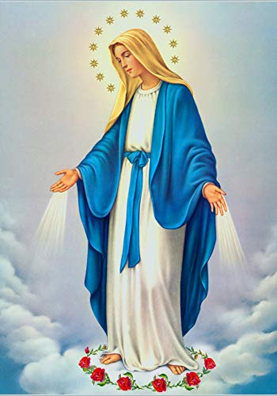
**. On this day, O beautiful Mother, On this day we give thee our love. Near the, Madonna, fondly we hover, Trusting thy gentle care to prove.

Slide 79
1. On this day we ask to share, Dearest Mother, thy sweet care; Aid us ere our feet astray Wanner from thy guiding way.

Slide 80
**. On this day, O beautiful Mother, On this day we give thee our love. Near the, Madonna, fondly we hover, Trusting thy gentle care to prove.

Slide 81
2. Queen of angels, deign to hear. Lisping children's humble prayer; Young hearts gain, O virgin pure, Sweetly to thyself allure.

Slide 82
THANK YOU
CÁM ƠN
MARAMING SALAMAT PO
MUCHAS GRACIAS
  நன்றி (Naṉṟi)

Slide 83
THANK YOU
CÁM ƠN
MARAMING SALAMAT PO
MUCHAS GRACIAS
  நன்றி (Naṉṟi)

