Slide 1
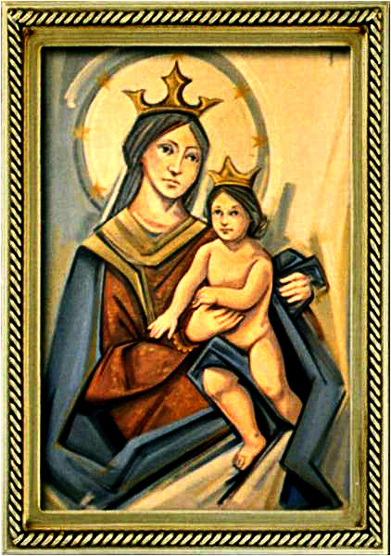
The Solemnity of the Most Holy Body and Blood of Christ
Gather Hymn:
I Am The Bread of Life
Responsorial Psalm: 110
You Are a priest for ever.
Prep. of the Gifts Hymn:
Our Blessing Cup
Communion Hymn:
Gift of finest Wheat
Recessional Hymn:
Sing to the Mountain.

Slide 2
1. I am the bread of life.
You who comes to me shall not hunger;
And who believes in Me shall not thirst.
No one can come to Me
Unless the Father beckons.

Slide 3
Refrain:
And I will raise you up.
And I will raise you up.
And I will raise you up on the last day.

Slide 4
2. The bread that I will give
Is My flesh for the life of the world.
And if you eat of this bread.
You shall live for ever,
you shall live for ever

Slide 5
Refrain:
And I will raise you up.
And I will raise you up.
And I will raise you up on the last day.

Slide 6
3. Unless you eat Of the flesh of the Son of Man.
And drink of His blood.
And drink of His blood.
You shall not have life within you.

Slide 7
Refrain:
And I will raise you up.
And I will raise you up.
And I will raise you up on the last day.

Slide 8
4. I am the resurrection
I am the life
He who believes in Me
Even if he die
He shall live for ever

Slide 9
Refrain:
And I will raise you up.
And I will raise you up.
And I will raise you up on the last day.

Slide 10
5. Yes, Lord, we believe
That You are the Christ
The Son of God,
Who has come
Into the world

Slide 11
Refrain:
And I will raise you up.
And I will raise you up.
And I will raise you up on the last day.

Slide 12
Penitential Act (Confiteor 2011) 1 of 3:

Slide 13
I confess to almighty God and to you, my brothers and sisters, that I have greatly sinned, in my thoughts and in my words,

Slide 14
in what I have done
and in what I have failed to do,
through my fault,
through my fault,
through my most grievious fault;

Slide 15
therefore I ask blessed Mary ever-Virgin, all the Angels and Saints, and you, my brothers and sisters, to pray for me to the Lord our God.

Slide 16
Gloria Hymn

Slide 17
Refrain:
Glory to God, Glory to God. Glory to God in the highest, and on earth, peace on earth, peace to people of good will

Slide 18
1. We praise you, we bless you, we adore you, we glorify you, we give you thanks for your great glory. Lord God, heavenly King, O God, almighty Father.

Slide 19
Refrain:
Glory to God, Glory to God. Glory to God in the highest, and on earth, peace on earth, peace to people of good will

Slide 20
2. Lord Jesus Christ, only Begotten Son, Lord God, Lamb of God, Son of the Father, you take away the sins of the world, have mercy on us. You take way the sins of the world, receive our pray you are seated at the right hand, the right hand of the Father, have mercy on us

Slide 21
Refrain:
Glory to God, Glory to God. Glory to God in the highest, and on earth, peace on earth, peace to people of good will

Slide 22
3. For you alone are the Holy One, you alone are the Lord, you alone are the Most High, Jesus Christ with the Holy Spirit, in the glory of God the Father.

Slide 23
Refrain:
Glory to God, Glory to God. Glory to God in the highest, and on earth, peace on earth, peace to people of good will. Amen Amen.

Slide 24
Responsorial Psalm: Psalm 110
You are a Priest forever

Slide 25
Responsorial Psalm: Psalm 47
You are a priest for ever, in the line of Melchizedck (0x2)

Slide 26
Gospel Acclamation

Slide 27
Alleluia Alleluia Alleluia.
Go and teach all nations, says the Lord;
I am with you always, until the end of the world.

Slide 28
Profession Of Faith
Creed

Slide 29
Nicene Creed p1
I believe in one God, the Father almighty, maker of heaven and earth, of all things visible and invisible.

Slide 30
Nicene Creed p2
I believe in one Lord Jesus Christ, the Only Begotten Son of God, born of the Father before all ages.

Slide 31
Nicene Creed p3
God from God, Light from Light, true God from true God, begotten, not made, consubstantial with the Father; through Him all things were made.

Slide 32
Nicene Creed p4
For us men and for our salvation He came down from heaven, and by the Holy Spirit was incarnate of the Virgin Mary, and became man.

Slide 33
Nicene Creed p5
For our sake He was crucified under Pontius Pilate, He suffered death and was buried, and rose again on the third day in accordance with the Scriptures.

Slide 34
Nicene Creed p6
He ascended into heaven and is seated at the right hand of the Father.

Slide 35
Nicene Creed p7
He will come again in glory to judge the living and the dead and His kingdom will have no end.

Slide 36
Nicene Creed p8
I believe in the Holy Spirit, the Lord, the giver of life, who proceeds from the Father and the Son,

Slide 37
Nicene Creed p9
who with the Father and the Son is adored and glorified, who has spoken through the prophets.

Slide 38
Nicene Creed p10
I believe in one, holy, catholic and apostolic Church. I confess one Baptism for the forgiveness of sins

Slide 39
Nicene Creed p11
and I look forward to the resurrection of the dead and the life of the world to come. Amen.

Slide 40
Preparation of The Gift Song:
Our Blessing Cup

Slide 41
Refrain: Our blessing cup is a communion with the blood of Christ; And the bread we break, it is a sharing in the body of the Lord.
1. How can we make a return for all the goodness God has shown?
We will take the cup of life and call upon God’s name.

Slide 42
Refrain: Our blessing cup is a communion with the blood of Christ; And the bread we break, it is a sharing in the body of the Lord.
2. Precious indeed in your sight the life and death of those you love.We are your servants, for you have set us free.

Slide 43
Refrain: Our blessing cup is a communion with the blood of Christ; And the bread we break, it is a sharing in the body of the Lord.
3. Gracious and merciful God, we give you thanks and bless your name: With all your people, praise and glory to your name.

Slide 44
Refrain: Our blessing cup is a communion with the blood of Christ; And the bread we break, it is a sharing in the body of the Lord.
4. For you have heard my voice, for you have heard my pleading.
Though death surrounded me, you heard and answered me.

Slide 45
Holy Holy

Slide 46
Holy, Holy, Holy Lord God of hosts.
Heaven and earth are full, are full of your glory. Hosanna, Hosanna! Hosanna in the highest.

Slide 47
Blessed is he who comes, who comes in the name of the Lord.
Hosanna, Hosanna! Hosanna in the highest.

Slide 48
Memorial Acclamation

Slide 49
We proclaim your Death, O Lord,
and profess your Resurrection until you come again.

Slide 50
Amen

Slide 51
Amen, Amen.
Amen, Amen
Amen, Amen
Amen. Amen.

Slide 52
Lamb Of God

Slide 53
Lamb of God your take away the sins of the world. Have mercy on us. (repeat as needed)
Lamb of God your take away the sins of the world.
grant us peace.

Slide 54
Communion respond

Slide 55
Behold the Lamb of God,
behold him who takes away the sins of the world.
Blessed are those called to the supper of the Lamb.
Lord, I am not worthy
that You should enter under my roof, but only say the word and my soul shall be healed.

Slide 56
Communion Hymn 1:
Gift Of Finest Wheat

Slide 57
Refrain: You satisfy the hungry heart, with gift of finest wheat, come give to us o saving Lord, the bread of life to eat.
1. As when the shepherd calls his sheep, they know and heed his voice; so when You call Your family Lord, we follow and rejoice.

Slide 58
Refrain: You satisfy the hungry heart, with gift of finest wheat, come give to us o saving Lord, the bread of life to eat.
2. With joyful lips we sing to You, our praise and gratitude. That You should count us worthy Lord, to share this heavenly food.

Slide 59
Refrain: You satisfy the hungry heart, with gift of finest wheat, come give to us o saving Lord, the bread of life to eat.
3. Is not the cup we bless and share The blood of Christ outpoured? Do not one cup, one loaf, declare our oneness in the Lord?

Slide 60
Refrain: You satisfy the hungry heart, with gift of finest wheat, come give to us o saving Lord, the bread of life to eat.
4. The mystery of Your presence Lord, no mortal tongue can tell; whom all the world cannot contain comes in our hearts to dwell.

Slide 61
Refrain: You satisfy the hungry heart, with gift of finest wheat, come give to us o saving Lord, the bread of life to eat.
5. You give yourself to us o Lord, then selfless let us be,
to serve each other in Your name in truth and charity.

Slide 62
Announcements:

Slide 63
1. On Sunday July 20th, 2025 a vocations soccer game will be held at the Archbishop Mitty High School Soccer Field from 4:30pm to 8pm.

Slide 64
Admission is $10 dollars per ticket, also you can participate in a raffle by buying tickets at $10 dollars each. All funds collected will be used to support seminarians and their formation program. Tickets on sale st the parish office during its working hours.

Slide 65
2. Now that religious education classes are over, our parish hall is available for rent during the summer months for private events. We offer a special rate for registered parishioners. Please call or stop by the parish office for more details.

Slide 66
3.
3. Last week, our Sunday collections for the parish totaled $11,927 dollars. The parish week-to-week financial report is available on the parish webpage and the weekly bulletin.

Slide 67
Ending Hymn:
Sing To the Mountain

Slide 68
Sing to the mountains, sing to the sea.
Raise your voices, lift your hearts.
This is the day the Lord has made.
Let all the earth rejoice.

Slide 69
1. I will give thanks to you, my Lord.
You have answered my plea.
You have saved my soul from death.
You are my strength and song.

Slide 70
Sing to the mountains, sing to the sea.
Raise your voices, lift your hearts.
This is the day the Lord has made.
Let all the earth rejoice.

Slide 71
2. Holy, holy, holy Lord.
Heaven and earth are full of your glory.

Slide 72
Sing to the mountains, sing to the sea.
Raise your voices, lift your hearts.
This is the day the Lord has made.
Let all the earth rejoice.

Slide 73
Ending Hymn:
Dear Lady Of Fatima

Slide 74
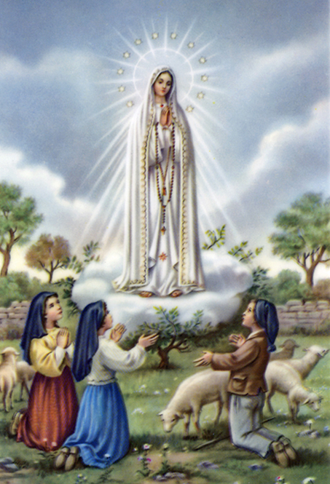
1a. Dear Lady of Fatima we come on bended knee to beg your intercession for peace and unity.

Slide 75
1b. Dear Mary won’t you show us the right and shining way? We pledge our love and offer you a Rosary each day.

Slide 76
2a. You promised at Fatima each time that you appeard to help us. If we pray to youto banish war and fear.

Slide 77
2b. Dear Lady on first Saturday we ask your guidding hand for grace and guidance here on earth and protection for our hand.

Slide 78
Ending Hymn:
On This Day

Slide 79
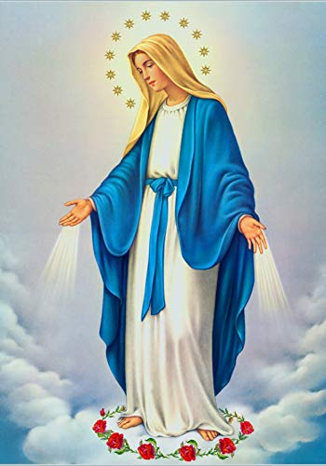
**. On this day, O beautiful Mother, On this day we give thee our love. Near the, Madonna, fondly we hover, Trusting thy gentle care to prove.

Slide 80
1. On this day we ask to share, Dearest Mother, thy sweet care; Aid us ere our feet astray Wanner from thy guiding way.

Slide 81
**. On this day, O beautiful Mother, On this day we give thee our love. Near the, Madonna, fondly we hover, Trusting thy gentle care to prove.

Slide 82
2. Queen of angels, deign to hear. Lisping children's humble prayer; Young hearts gain, O virgin pure, Sweetly to thyself allure.

Slide 83
THANK YOU
CÁM ƠN
MARAMING SALAMAT PO
MUCHAS GRACIAS
  நன்றி (Naṉṟi)

Slide 84
THANK YOU
CÁM ƠN
MARAMING SALAMAT PO
MUCHAS GRACIAS
  நன்றி (Naṉṟi)

