Slide 1
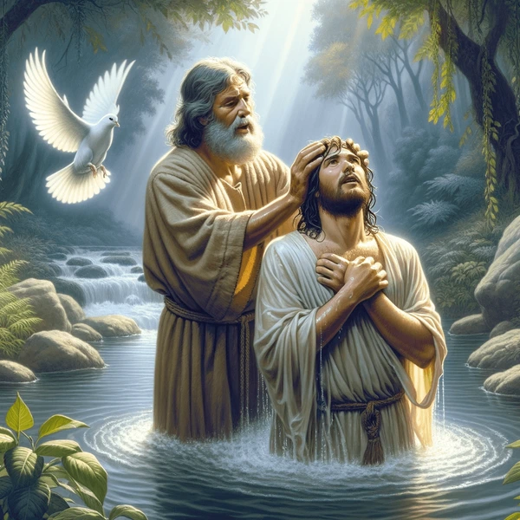
The Baptism of the Lord
Gather Song:
When Jesus Comes to Baptized
Responsorial Psalm 29:
The Lord will Bless
Prep. of the Gifts:
One Lord
Communion Song :
Behold the Body of Christ
Recessional:
The Spirit Sends Us Forth

Slide 2
1. When Jesus comes to be baptized, He leaves the hidden years behind, The years of safety and the peace To bear the sins of humankind.

Slide 3
2. The Spirit of the Lord comes down, Anoints the Christ to suffering, To preach the word, to free the bound, And to the mourner, comfort bring.

Slide 4
3. He will not quench the dying flame, And what is bruised he will not break, But heal the wound in justtice dealt, And out of death his triumph make.

Slide 5
4. O Spirit help us be like Christ: To live in love charity, To walk in truth and justice now, And grow in Christian dignity.

Slide 6
5) We praise you, God, source of all life, We praise ou, Christ, 0e-ter-nal Word, we praise you, Spir-it, gra-cious gift: your tri-une pres-ence fills our world.

Slide 7
Penitential Act (Confiteor 2011) 1 of 3:

Slide 8
I confess to almighty God and to you, my brothers and sisters, that I have greatly sinned, in my thoughts and in my words,

Slide 9
in what I have done
and in what I have failed to do,
through my fault,
through my fault,
through my most grievious fault;

Slide 10
therefore I ask blessed Mary ever-Virgin, all the Angels and Saints, and you, my brothers and sisters, to pray for me to the Lord our God.

Slide 11
Gloria

Slide 12
Refrain:
Glory to God, Glory to God. Glory to God in the highest, and on earth, peace on earth, peace to people of good will

Slide 13
1. We praise you, we bless you, we adore you, we glorify you, we give you thanks for your great glory. Lord God, heavenly King, O God, almighty Father.

Slide 14
2. Lord Jesus Christ, only Begotten Son, Lord God, Lamb of God, Son of the Father, you take away the sins of the world, have mercy on us. You take way the sins of the world, receive our pray you are seated at the right hand, the right hand of the Father, have mercy on us

Slide 15
3. For you alone are the Holy One, you alone are the Lord, you alone are the Most High, Jesus Christ with the Holy Spirit, in the glory of God the Father.

Slide 16
Refrain:
Glory to God, Glory to God. Glory to God in the highest, and on earth, peace on earth, peace to people of good will. Amen Amen.

Slide 17
Responsorial Psalm: Psalm 29
The Lord Will bless his people

Slide 18
Refrain:
The Lord will bless his people with peace, his people with peace

Slide 19
Gospel Acclamation

Slide 20
Refrain: Alleluia!
The heavens were opened and the voice of the Father thundered:
This is my beloved Son, listen to him.

Slide 21
Profession Of Faith
Creed

Slide 22
Nicene Creed p1
I believe in one God, the Father almighty, maker of heaven and earth, of all things visible and invisible.

Slide 23
Nicene Creed p2
I believe in one Lord Jesus Christ, the Only Begotten Son of God, born of the Father before all ages.

Slide 24
Nicene Creed p3
God from God, Light from Light, true God from true God, begotten, not made, consubstantial with the Father; through Him all things were made.

Slide 25
Nicene Creed p4
For us men and for our salvation He came down from heaven, and by the Holy Spirit was incarnate of the Virgin Mary, and became man.

Slide 26
Nicene Creed p5
For our sake He was crucified under Pontius Pilate, He suffered death and was buried, and rose again on the third day in accordance with the Scriptures.

Slide 27
Nicene Creed p6
He ascended into heaven and is seated at the right hand of the Father.

Slide 28
Nicene Creed p7
He will come again in glory to judge the living and the dead and His kingdom will have no end.

Slide 29
Nicene Creed p8
I believe in the Holy Spirit, the Lord, the giver of life, who proceeds from the Father and the Son,

Slide 30
Nicene Creed p9
who with the Father and the Son is adored and glorified, who has spoken through the prophets.

Slide 31
Nicene Creed p10
I believe in one, holy, catholic and apostolic Church. I confess one Baptism for the forgiveness of sins

Slide 32
Nicene Creed p11
and I look forward to the resurrection of the dead and the life of the world to come. Amen.

Slide 33
Preparation of The Gift Song:
God of Mercy

Slide 34
refrain: God of mercy holy mystery ever faithful one, you have pitched your tent among us, reconciling love heart and mind of Christ, live within our lives.

Slide 35
1. You have called us each by name in your great compassion encompassing our failings with mercy. God of mercy lead us.

Slide 36
refrain: God of mercy holy mystery ever faithful one, you have pitched your tent among us, reconciling love heart and mind of Christ, live within our lives.

Slide 37
2. Slow to anger, rich in love, you bestow forgiveness. May we, in turn, forgive those who harm us. God of mercy lead us.

Slide 38
refrain: God of mercy holy mystery ever faithful one, you have pitched your tent among us, reconciling love heart and mind of Christ, live within our lives.

Slide 39
3. In our midst as one who pain, wounded down divisions, to all in need you send us as neighbor. God of mercy lead us.

Slide 40
refrain: God of mercy holy mystery ever faithful one, you have pitched your tent among us, reconciling love heart and mind of Christ, live within our lives.

Slide 41
4. Reaching out to those in pain, wounded and abandoned, may we create safe havens for healing. God of mercy lead us.

Slide 42
refrain: God of mercy holy mystery ever faithful one, you have pitched your tent among us, reconciling love heart and mind of Christ, live within our lives.

Slide 43
5. In the word of truth you speak, word of hope and chalenge , you summon us to speak for the voiceless. God of mercy lead us.

Slide 44
refrain: God of mercy holy mystery ever faithful one, you have pitched your tent among us, reconciling love heart and mind of Christ, live within our lives.

Slide 45
6. In this Bread we break and share in this Cup of blessing, you summon us to work for true justice. God of mercy lead us.

Slide 46
refrain: God of mercy holy mystery ever faithful one, you have pitched your tent among us, reconciling love heart and mind of Christ, live within our lives.

Slide 47
Holy Holy

Slide 48
Holy, Holy, Holy Lord God of hosts.
Heaven and earth are full, are full of your glory. Hosanna, Hosanna! Hosanna in the highest.

Slide 49
Blessed is he who comes, who comes in the name of the Lord.
Hosanna, Hosanna! Hosanna in the highest.

Slide 50
Memorial Acclamation

Slide 51
We proclaim your Death, O Lord,
and profess your Resurrection until you come again.

Slide 52
Amen

Slide 53
Amen, Amen.
Amen, Amen
Amen, Amen
Amen. Amen.

Slide 54
Lamb Of God

Slide 55
Lamb of God you take away the sins of the world. Have mercy on us. (repeat as needed)
Lamb of God you take away the sins of the world.
grant us peace.

Slide 56
Communion respond

Slide 57
Behold the Lamb of God,
behold him who takes away the sins of the world.
Blessed are those called to the supper of the Lamb.
Lord, I am not worthy
that You should enter under my roof, but only say the word and my soul shall be healed.

Slide 58
Communion Hymn
Spirit and Grace

Slide 59
1. Spirit and grace, here in this meal; you are the wind that breathes through the field Gather the wheat and form us in Christ. Come, be our source and breath of life

Slide 60
Refrain: In the bread, blessed, broken and shared. Christ is our life, whose presence we bear Come, O spirit, make your grace revealed. in this holy meal.

Slide 61
2. Spirit and grace, here in this meal; you are the life: that flows through the wine. Gather this drink and form us in Christ. Come, be our source and blood of life.

Slide 62
Refrain: In the bread, blessed, broken and shared. Christ is our life, whose presence we bear Come, O spirit, make your grace revealed. in this holy meal.

Slide 63
3. Spirit and grace, here in this place; you are the light that shines in this space. Gather your people and form us in Christ. Come, be the heartbeat of our lives.

Slide 64
Refrain: In the bread, blessed, broken and shared. Christ is our life, whose presence we bear Come, O spirit, make your grace revealed. in this holy meal.

Slide 65
Sending Hymn
Song of Thankfulness and Praisse

Slide 66
1: Songs of thankfulness and praise Jesus, Lord, to thee we raise, Manifested by the star. To the sages from afar; Branch of roy al David's stem In thy birth al Bethlehem; Praises be to thee addressed, God in flesh made manifest.

Slide 67
2: Manifest at Jordan's stream, Prophet, Priest, and King supreme; And at Cana, wedding guest, In thy Godhead manifest; Mani fest in power divine, Changing water into wine; Praises be to the addressed, God in flesh

Slide 68
THANK YOU
CÁM ƠN
MARAMING SALAMAT PO
MUCHAS GRACIAS
நன்றி (Nanri)

