Slide 1
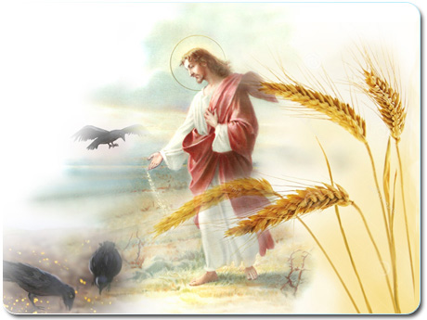
Welcome to Our Lady of Refuge Catholic Church
Sunday Ordinary Time 15th Year A
Gather Song:
They’ll Know We Are Christians
Responsorial Psalm 65:
The Seed That Falls
Prep. of the Gifts:
Your Words Are Spirit and Life
Communion Song :
Gift Of Finest Wheat
Ave Maria
Recessional:
Dear Lady Of Fatima

Slide 2
1. Christians, Let Us Love One Another,
As We Share The True Living Bread.
Jesus Is Our God And Our Brother;
With His Flesh And Blood We Are Fed.
Everyone Who Loves Is Born Of God,
Jesus Is Our Life, God Is Love.

Slide 3
2. We Who Break This Bread Are One Body,
We Who Share This Cup Are All One,
Children Of Our Father In eaven,
We Are Heirs With God’s Only Son.
Everyone Who Loves Is Born Of God,
Jesus Is Our Life, God Is Love.

Slide 4
3. We Who Eat And Drink At This Table,
Die And Rise Again With Our Lord,
Drawing From Our Rock Living Water,
Given To All Who Thirst For Accord.
Everyone Who Loves Is Born Of God,
Jesus Is Our Life, God Is Love.

Slide 5
4. On The Path Of Life We May Falter,
Earthly Food Alone Leaves Us Weak;
Always You Invite From The Altar,
Hungry Souls Their Food Here Must Seek.
Everyone Who Loves Is Born Of God,
Jesus Is Our Life, God Is Love.

Slide 6
5. Wheat and grape in-ear-nate a must'ry: Jesus is the true living bread. Let us eat with hoy and thanks giving. Trusting in the word he has said.
Everyone Who Loves Is Born Of God,
Jesus Is Our Life, God Is Love.

Slide 7
6. Jesus is the vine, we the branches; We are grains of wheat, Christ the bread. Those who eat this bread live forever, One with Christ, our Lord and our Head.
Everyone Who Loves Is Born Of God,
Jesus Is Our Life, God Is Love.

Slide 8
Penitential Act

Slide 9
I confess to almighty God and to you, my brothers and sisters, that I have greatly sinned, in my thoughts and in my words,

Slide 10
in what I have done
and in what I have failed to do,
through my fault,
through my fault,
through my most grievious fault;

Slide 11
therefore I ask blessed Mary ever-Virgin, all the Angels and Saints, and you, my brothers and sisters, to pray for me to the Lord our God.

Slide 12
Gloria Prayer

Slide 13
Refrain:
Glory to God, Glory to God. Glory to God in the highest, and on earth, peace on earth, peace to people of good will

Slide 14
1. We praise you, we bless you, we adore you, we glorify you, we give you thanks for your great glory. Lord God, heavenly King, O God, almighty Father.

Slide 15
2. Lord Jesus Christ, only Begotten Son, Lord God, Lamb of God, Son of the Father, you take away the sins of the world, have mercy on us. You take way the sins of the world, receive our pray you are seated at the right hand, the right hand of the Father, have mercy on us

Slide 16
3. For you alone are the Holy One, you alone are the Lord, you alone are the Most High, Jesus Christ with the Holy Spirit, in the glory of God the Father.

Slide 17
Refrain:
Glory to God, Glory to God. Glory to God in the highest, and on earth, peace on earth, peace to people of good will. Amen Amen.

Slide 18
Gloria Prayer

Slide 19
Responsorial Psalm 65
The seed that fall

Slide 20
Responsorial Psalm 65:
The seed that falls on good ground will yield a fruitful harvest.

Slide 21
Gospel Acclamation

Slide 22
Refrain: Alleluia!
The seed is the word of God, Christ is the sower.
All who come to him will have life forever.

Slide 23
Profession Of Faith
Creed

Slide 24
Nicene Creed p1
I believe in one God, the Father almighty, maker of heaven and earth, of all things visible and invisible.

Slide 25
Nicene Creed p2
I believe in one Lord Jesus Christ, the Only Begotten Son of God, born of the Father before all ages.

Slide 26
Nicene Creed p3
God from God, Light from Light, true God from true God, begotten, not made, consubstantial with the Father; through Him all things were made.

Slide 27
Nicene Creed p4
For us men and for our salvation He came down from heaven, and by the Holy Spirit was incarnate of the Virgin Mary, and became man.

Slide 28
Nicene Creed p5
For our sake He was crucified under Pontius Pilate, He suffered death and was buried, and rose again on the third day in accordance with the Scriptures.

Slide 29
Nicene Creed p6
He ascended into heaven and is seated at the right hand of the Father.

Slide 30
Nicene Creed p7
He will come again in glory to judge the living and the dead and His kingdom will have no end.

Slide 31
Nicene Creed p8
I believe in the Holy Spirit, the Lord, the giver of life, who proceeds from the Father and the Son,

Slide 32
Nicene Creed p9
who with the Father and the Son is adored and glorified, who has spoken through the prophets.

Slide 33
Nicene Creed p10
I believe in one, holy, catholic and apostolic Church. I confess one Baptism for the forgiveness of sins

Slide 34
Nicene Creed p11
and I look forward to the resurrection of the dead and the life of the world to come. Amen.

Slide 35
Preparation of The Gift Song
Your Words are Spirit and Life

Slide 36
Refrain: Your words are spirit and life, O Lord: richer than gold, stronger than death. Your words are spirit and life, O Lord; life everlasting.

Slide 37
1. God's law is perfect, refreshing the soul, reviving the weary spirit. God's rule can be trusted: bringing us wisdom, bringing God's wisdom to birth.

Slide 38
Refrain: Your words are spirit and life, O Lord: richer than gold, stronger than death. Your words are spirit and life, O Lord; life everlasting.

Slide 39
2. God's precepts keep us; their purpose is right. They gladden the hearts of people. God's command is so clear it brings us new vision; bringing God's light to our eyes.

Slide 40
Refrain: Your words are spirit and life, O Lord: richer than gold, stronger than death. Your words are spirit and life, O Lord; life everlasting.

Slide 41
3. Living by God's truth is holy and sure; God's presence is everlasting. God's truth is eternal, bringing us justice; bringing God's justice to earth.

Slide 42
Refrain: Your words are spirit and life, O Lord: richer than gold, stronger than death. Your words are spirit and life, O Lord; life everlasting.

Slide 43
4. God's word is precious, desired more than gold; worth more than we dare
imagine and, sweeter than honey, this word will feed us, bringing fulfillment and joy.

Slide 44
Refrain: Your words are spirit and life, O Lord: richer than gold, stronger than death. Your words are spirit and life, O Lord; life everlasting.

Slide 45
Holy Holy Holy

Slide 46
Holy, Holy, Holy Lord God of hosts.
Heaven and earth are full, are full of your glory. Hosanna, Hosanna! Hosanna in the highest.

Slide 47
Blessed is he who comes, who comes in the name of the Lord.
Hosanna, Hosanna! Hosanna in the highest.

Slide 48
Memorial Acclamation

Slide 49
We proclaim your Death, O Lord,
and profess your Resurrection until you come again.

Slide 50
Amen

Slide 51
Amen Amen Amen

Slide 52
Lamb Of God

Slide 53
Lamb of God you take away the sins of the world. Have mercy on us. (repeat as needed)
Lamb of God you take away the sins of the world.
grant us peace.

Slide 54
Communion Respond

Slide 55
Behold the Lamb of God,
behold him who takes away the sins of the world.
Blessed are those called to the supper of the Lamb.
Lord, I am not worthy
that You should enter under my roof, but only say the word and my soul shall be healed.

Slide 56
Communion Hymn

Slide 57
Refrain: You satisfy the hungry heart, with gift of finest wheat, come give to us o saving Lord, the bread of life to eat.
1. As when the shepherd calls his sheep, they know and heed his voice; so when You call Your family Lord, we follow and rejoice.

Slide 58
Refrain: You satisfy the hungry heart, with gift of finest wheat, come give to us o saving Lord, the bread of life to eat.
2. With joyful lips we sing to You, our praise and gratitude. That You should count us worthy Lord, to share this heavenly food.

Slide 59
Refrain: You satisfy the hungry heart, with gift of finest wheat, come give to us o saving Lord, the bread of life to eat.
3. Is not the cup we bless and share The blood of Christ outpoured? Do not one cup, one loaf, declare our oneness in the Lord?

Slide 60
Refrain: You satisfy the hungry heart, with gift of finest wheat, come give to us o saving Lord, the bread of life to eat.
4. The mystery of Your presence Lord, no mortal tongue can tell; whom all the world cannot contain comes in our hearts to dwell.

Slide 61
Refrain: You satisfy the hungry heart, with gift of finest wheat, come give to us o saving Lord, the bread of life to eat.
5. You give yourself to us o Lord, then selfless let us be,
to serve each other in Your name in truth and charity.

Slide 62
Ave Maria

Slide 63
Ave Maria, gratia plena,
Dominus tecum, benedicta tu in mulieribus, et benedictus fructus ventris tui, Iesus.
Sancta Maria, Mater Dei, ora pro nobis peccatoribus, nunc et in hora mortis nostrae.
Amen.

Slide 64
Dear Lady of Famtima

Slide 65
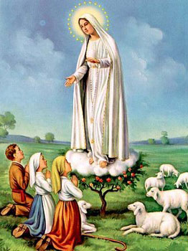
1. Dear Lady of Fatima we come on bended knee To beg your intercession for peace and unity. Dear Mary won't you show us the right and shining way? We pledge our love and offer you a Rosary each day.

Slide 66
2. You promised at Fatima Each time that you appeared To help us If we pray to you to banish war and fear. Dear Lady on first days we ask your guiding hand for grace and guidance here on earth protection for our land.

Slide 67
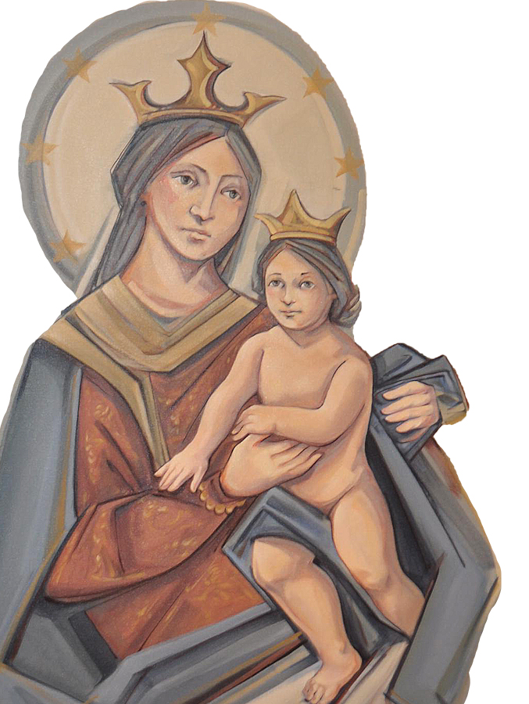
THANK YOU
CÁM ƠN
MARAMING SALAMAT PO
MUCHAS GRACIAS
நன்றி (Nanri)

