Slide 1
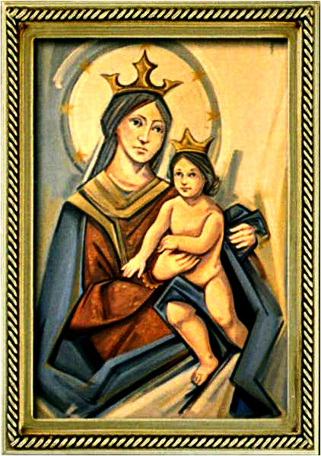
Ordinary Time 26 Year C
Gather Hymn:
God Have Chosen Me
Responsorial Psalm: 146
Praise The Lord My Soul
Prep. of the Gifts Hymn:
The Summon
Communion Hymn:
Bread of the World
Recessional Hymn:
For You Are My God

Slide 2
Verse 1: God has chosen me, God has chosen me to bring good news to the poor. God has chosen me, God has chosen me to bring new sight to those searching for light: God has chosen me, chosen me.

Slide 3
Refrain: And to tell the world that God's kingdom is near to remove oppression and break down fear, yes, God's time is near God's time is near Gods time is near

Slide 4
Verse 2: God has chosen me, God has chosen me to set alight a new fire. God has chosen me, God has chosen me to bring to birth a new kingdom on earth: God has chosen me, chosen me.

Slide 5
Refrain: And to tell the world that God's kingdom is near to remove oppression and break down fear, yes, God's time is near God's time is near Gods time is near

Slide 6
Penitential Act (Confiteor 2011) 1 of 3:

Slide 7
I confess to almighty God and to you, my brothers and sisters, that I have greatly sinned, in my thoughts and in my words,

Slide 8
in what I have done and in what I have failed to do, through my fault,
through my fault, through my most grievious fault;

Slide 9
therefore I ask blessed Mary ever-Virgin, all the Angels and Saints, and you, my brothers and sisters, to pray for me to the Lord our God.

Slide 10
Gloria Hymn

Slide 11
Refrain:
Glory to God, Glory to God. Glory to God in the highest, and on earth, peace on earth, peace to people of good will

Slide 12
1. We praise you, we bless you, we adore you, we glorify you, we give you thanks for your great glory. Lord God, heavenly King, O God, almighty Father.

Slide 13
Refrain:
Glory to God, Glory to God. Glory to God in the highest, and on earth, peace on earth, peace to people of good will

Slide 14
2. Lord Jesus Christ, only Begotten Son, Lord God, Lamb of God, Son of the Father, you take away the sins of the world, have mercy on us. You take way the sins of the world, receive our pray you are seated at the right hand, the right hand of the Father, have mercy on us

Slide 15
Refrain:
Glory to God, Glory to God. Glory to God in the highest, and on earth, peace on earth, peace to people of good will

Slide 16
3. For you alone are the Holy One, you alone are the Lord, you alone are the Most High, Jesus Christ with the Holy Spirit, in the glory of God the Father.

Slide 17
Refrain:
Glory to God, Glory to God. Glory to God in the highest, and on earth, peace on earth, peace to people of good will. Amen Amen.

Slide 18
Responsorial Psalm: 90 In Every Age

Slide 19
Responsorial Psalm: Psalm 90 In every age, O Lord, you have been our refuge

Slide 20
Gospel Acclamation

Slide 21
Alleluia Alleluia Alleluia. Let your face shine upon your servant; and teach me your laws.

Slide 22
Profession Of Faith Creed

Slide 23
Nicene Creed p1
I believe in one God, the Father almighty, maker of heaven and earth, of all things visible and invisible.

Slide 24
Nicene Creed p2
I believe in one Lord Jesus Christ, the Only Begotten Son of God, born of the Father before all ages.

Slide 25
Nicene Creed p3
God from God, Light from Light, true God from true God, begotten, not made, consubstantial with the Father; through Him all things were made.

Slide 26
Nicene Creed p4
For us men and for our salvation He came down from heaven, and by the Holy Spirit was incarnate of the Virgin Mary, and became man.

Slide 27
Nicene Creed p5
For our sake He was crucified under Pontius Pilate, He suffered death and was buried, and rose again on the third day in accordance with the Scriptures.

Slide 28
Nicene Creed p6
He ascended into heaven and is seated at the right hand of the Father.

Slide 29
Nicene Creed p7
He will come again in glory to judge the living and the dead and His kingdom will have no end.

Slide 30
Nicene Creed p8
I believe in the Holy Spirit, the Lord, the giver of life, who proceeds from the Father and the Son,

Slide 31
Nicene Creed p9
who with the Father and the Son is adored and glorified, who has spoken through the prophets.

Slide 32
Nicene Creed p10
I believe in one, holy, catholic and apostolic Church. I confess one Baptism for the forgiveness of sins

Slide 33
Nicene Creed p11
and I look forward to the resurrection of the dead and the life of the world to come. Amen.

Slide 34
Preparation of The Gift Song: I Love The Lord

Slide 35
1- I love the Lord who has heard my cry.
I love the Lord, standing at my side I love the Lord, always close to me. I love the Lord, love the Lord who saves and sets me free.

Slide 36
2- I seek the Lord through each night and day. I seek the Lord as I walk my I I seek the Lord when the light seems gone. I seek the Lord, seek the Lord who calls me to go on.

Slide 37
3- I need the Lord more than I can tell. I need the Lord this I know so well! I need the Lord, how I need the Lord! I need the Lord, need the Lord with love on me out pound.

Slide 38
4- I praise the Lord sing-ing clear and strong. I praise the Lord, fo-cus of my song. I praise the Lord, strength-en-ing my voice. I praise the Lord, praise the Lord and rap-t'rous-ly re-joice

Slide 39
Holy Holy

Slide 40
Holy, Holy, Holy Lord God of hosts. Heaven and earth are full, are full of your glory. Hosanna, Hosanna! Hosanna in the highest.

Slide 41
Blessed is he who comes, who comes in the name of the Lord. Hosanna, Hosanna! Hosanna in the highest.

Slide 42
Memorial Acclamation

Slide 43
We proclaim your Death, O Lord, and profess your Resurrection until you come again.

Slide 44
Amen

Slide 45
Amen, Amen. Amen, Amen Amen, Amen
Amen. Amen.

Slide 46
Lamb Of God

Slide 47
Lamb of God your take away the sins of the world. Have mercy on us. (repeat as needed)
Lamb of God your take away the sins of the world.
grant us peace.

Slide 48
Communion respond

Slide 49
Behold the Lamb of God,
behold him who takes away the sins of the world.
Blessed are those called to the supper of the Lamb. Lord, I am not worthy
that You should enter under my roof, but only say the word and my soul shall be healed.

Slide 50
Communion Hymn 1: As The Deer Long

Slide 51
Refrain: As the deer longs for running streams, so I long, so I long so I long for you
1. Athirst my soul for you the God who is my life! When shall I see, when shall I see, see the face of God?

Slide 52
Refrain: As the deer longs for running streams, so I long, so I long so I long for you
2. Echoes meet as deep is calling unto deep, over my head, all you mighty waters, sweeping over me.

Slide 53
Refrain: As the deer longs for running streams, so I long, so I long so I long for you
3. Continually the foe delights in taunting me: "where is God, where is your God" Where, O where are you?

Slide 54
Refrain: As the deer longs for running streams, so I long, so I long so I long for you
4. Defend me, God send forth your light and your truth. They will lead me to your holy mountain, to your dwelling place.

Slide 55
Refrain: As the deer longs for running streams, so I long, so I long so I long for you
5. Then I shall go un-to the altar of my God. Praising you, O my joy and gladness, I shall praise your name.

Slide 56
Communion Hymn 1: I have loved you

Slide 57
I have loved you with an everlasting love, I have called you and you are mine. (2x)

Slide 58
1. Seek the face of the Lord and long for him: He will bring you his light and his peace.

Slide 59
I have loved you with an everlasting love, I have called you and you are mine. (2x)

Slide 60
2. Seek the face of the Lord and long for him: He will bring you his joy and his hope.

Slide 61
I have loved you with an everlasting love, I have called you and you are mine. (2x)

Slide 62
3. Seek the face of the Lord and long for him: He will bring you his care and his love.

Slide 63
I have loved you with an everlasting love, I have called you and you are mine. (2x)

Slide 64
Announcements:

Slide 66
Ending Hymn: Rain Down

Slide 67
Refrain:
Rain down, rain down,
rain down
your love on your people.
Rain down, rain down,
rain down
Your Love, God of life.

Slide 68
1. Faithful and true is the Word
of our God All of God's works are so
worthy of trust God's mercy falls on the just and the right Full of God's love is the earth

Slide 69
Refrain:
Rain down, rain down,
rain down
your love on your people.
Rain down, rain down,
rain down
Your Love, God of life.

Slide 70
Ending Hymn: Lady Of Fatima

Slide 71
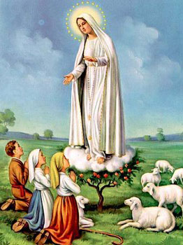
1. Dear Lady of Fatima we come on bended knee To beg your intercession for peace and unity. Dear Mary won't you show us the right and shining way? We pledge our love and offer you a Rosary each day.

Slide 72
2. You promised at Fatima Each time that you appeared To help us If we pray to you to banish war and fear. Dear Lady on first days we ask your guiding hand for grace and guidance here on earth protection for our land.

Slide 73
Ending Hymn: On This Day

Slide 74
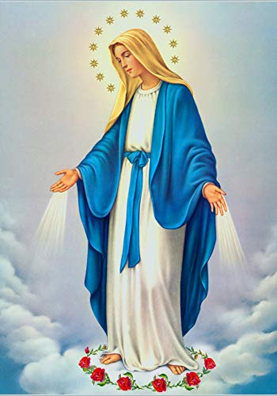
**. On this day, O beautiful Mother, On this day we give thee our love. Near the, Madonna, fondly we hover, Trusting thy gentle care to prove.

Slide 75
1. On this day we ask to share, Dearest Mother, thy sweet care; Aid us ere our feet astray Wanner from thy guiding way.

Slide 76
**. On this day, O beautiful Mother, On this day we give thee our love. Near the, Madonna, fondly we hover, Trusting thy gentle care to prove.

Slide 77
2. Queen of angels, deign to hear. Lisping children's humble prayer; Young hearts gain, O virgin pure, Sweetly to thyself allure.

Slide 78
THANK YOU
CÁM ƠN
MARAMING SALAMAT PO
MUCHAS GRACIAS
நன்றி (Naṉṟi)

Slide 79
THANK YOU
CÁM ƠN
MARAMING SALAMAT PO
MUCHAS GRACIAS
நன்றி (Naṉṟi)

