Slide 1
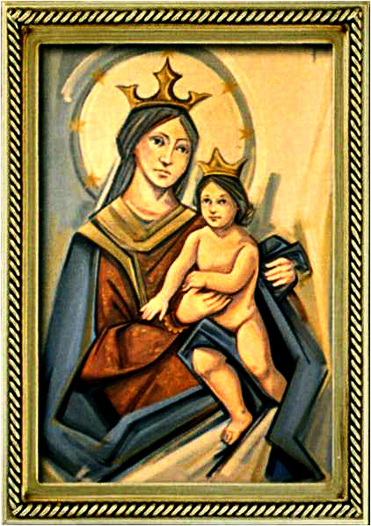
Ordinary Time 15 Year C
Gather Hymn:
The House That Love Is Building
Responsorial Psalm: 69
Turn to the Lord in your need.
Prep. of the Gifts Hymn:
Servant Song
Communion Hymn:
Bread for the World
Recessional Hymn:
Lady of Fatima

Slide 2
1. In the house that Love is building, there is room enough for all. Endless welcome in her rafters, Mercy singing through her walls. Here is refuge for all people
From every tribe and tongue.
In the house that Love is building
There is room for everyone.

Slide 3
2. In the garden Love is tending
There's a great and boundless feast, Where the seeds of hope are planted, And the yield is heaven's peace. As the field becomes a harvest for the many hungry ones,
In the garden Love is tending
There's enough for everyone.

Slide 4
Penitential Act (Confiteor 2011) 1 of 3:

Slide 5
I confess to almighty God and to you, my brothers and sisters, that I have greatly sinned, in my thoughts and in my words,

Slide 6
in what I have done
and in what I have failed to do,
through my fault,
through my fault,
through my most grievious fault;

Slide 7
therefore I ask blessed Mary ever-Virgin, all the Angels and Saints, and you, my brothers and sisters, to pray for me to the Lord our God.

Slide 8
Gloria Hymn

Slide 9
Refrain:
Glory to God, Glory to God. Glory to God in the highest, and on earth, peace on earth, peace to people of good will

Slide 10
1. We praise you, we bless you, we adore you, we glorify you, we give you thanks for your great glory. Lord God, heavenly King, O God, almighty Father.

Slide 11
Refrain:
Glory to God, Glory to God. Glory to God in the highest, and on earth, peace on earth, peace to people of good will

Slide 12
2. Lord Jesus Christ, only Begotten Son, Lord God, Lamb of God, Son of the Father, you take away the sins of the world, have mercy on us. You take way the sins of the world, receive our pray you are seated at the right hand, the right hand of the Father, have mercy on us

Slide 13
Refrain:
Glory to God, Glory to God. Glory to God in the highest, and on earth, peace on earth, peace to people of good will

Slide 14
3. For you alone are the Holy One, you alone are the Lord, you alone are the Most High, Jesus Christ with the Holy Spirit, in the glory of God the Father.

Slide 15
Refrain:
Glory to God, Glory to God. Glory to God in the highest, and on earth, peace on earth, peace to people of good will. Amen Amen.

Slide 16
Responsorial Psalm: 69
Turn to The Lord in your need

Slide 17
Responsorial Psalm: Psalm 69
Turn to the Lord in your need, and you will live. Turn to the Lord in your need, and you will live.

Slide 18
Gospel Acclamation

Slide 19
Alleluia Alleluia Alleluia.
Your words, Lord, are Spirit and life; you have the words of everlasting life.

Slide 20
Profession Of Faith
Creed

Slide 21
Nicene Creed p1
I believe in one God, the Father almighty, maker of heaven and earth, of all things visible and invisible.

Slide 22
Nicene Creed p2
I believe in one Lord Jesus Christ, the Only Begotten Son of God, born of the Father before all ages.

Slide 23
Nicene Creed p3
God from God, Light from Light, true God from true God, begotten, not made, consubstantial with the Father; through Him all things were made.

Slide 24
Nicene Creed p4
For us men and for our salvation He came down from heaven, and by the Holy Spirit was incarnate of the Virgin Mary, and became man.

Slide 25
Nicene Creed p5
For our sake He was crucified under Pontius Pilate, He suffered death and was buried, and rose again on the third day in accordance with the Scriptures.

Slide 26
Nicene Creed p6
He ascended into heaven and is seated at the right hand of the Father.

Slide 27
Nicene Creed p7
He will come again in glory to judge the living and the dead and His kingdom will have no end.

Slide 28
Nicene Creed p8
I believe in the Holy Spirit, the Lord, the giver of life, who proceeds from the Father and the Son,

Slide 29
Nicene Creed p9
who with the Father and the Son is adored and glorified, who has spoken through the prophets.

Slide 30
Nicene Creed p10
I believe in one, holy, catholic and apostolic Church. I confess one Baptism for the forgiveness of sins

Slide 31
Nicene Creed p11
and I look forward to the resurrection of the dead and the life of the world to come. Amen.

Slide 32
Preparation of The Gift Song:
Servant Song

Slide 33
1. What do you want of me, Lord? Where do you want me to serve you? Where can I sing your praises? I am your song.
Refrain: Jesus, Jesus, You are The Lord. Jesus, Jesus, You are the way.

Slide 34
2. I hear you call my name, Lord, And I am moved within me. Your Spirit stirs my deepest self. Sing your songs in me.
Refrain: Jesus, Jesus, You are The Lord. Jesus, Jesus,You are the way.

Slide 35
3. Above, below, and around me, Before, behind, and all through me, Your Spirit burns deep within me. Fire my life with your love.
Refrain: Jesus, Jesus, You are The Lord. Jesus, Jesus, You are the way.

Slide 36
4. You are the light in my darkness. You are my strength when I’m weary. You give me sight when I’m blinded. Come, see for me.
Refrain: Jesus, Jesus, You are The Lord. Jesus, Jesus, You are the way.

Slide 37
5. I am your song and servant, singing your praise like Mary. Surrendered to your Spirit, “Let it be done to me.”
Refrain: Jesus, Jesus, You are The Lord. Jesus, Jesus, You are the way.

Slide 38
Holy Holy

Slide 39
Holy, Holy, Holy Lord God of hosts.
Heaven and earth are full, are full of your glory. Hosanna, Hosanna! Hosanna in the highest.

Slide 40
Blessed is he who comes, who comes in the name of the Lord.
Hosanna, Hosanna! Hosanna in the highest.

Slide 41
Memorial Acclamation

Slide 42
We proclaim your Death, O Lord,
and profess your Resurrection until you come again.

Slide 43
Amen

Slide 44
Amen, Amen.
Amen, Amen
Amen, Amen
Amen. Amen.

Slide 45
Lamb Of God

Slide 46
Lamb of God your take away the sins of the world. Have mercy on us. (repeat as needed)
Lamb of God your take away the sins of the world.
grant us peace.

Slide 47
Communion respond

Slide 48
Behold the Lamb of God,
behold him who takes away the sins of the world.
Blessed are those called to the supper of the Lamb.
Lord, I am not worthy
that You should enter under my roof, but only say the word and my soul shall be healed.

Slide 49
Communion Hymn 1:
Bread For The World

Slide 50
refrain. Bread for the world
A world of hunger
Wine for all peoples
People who thirst
May we who eat
Be bread for others
May we who drink
Pour out our love

Slide 51
1. Lord Jesus Christ
You are the bread of life
Broken to reach and heal the wounds Of human pain
Where we divide Your people
You are waiting there On bended knee To wash our feet with endless care

Slide 52
refrain. Bread for the world
A world of hunger
Wine for all peoples
People who thirst
May we who eat
Be bread for others
May we who drink
Pour out our love

Slide 53
2. Lord Jesus Christ
You are the wine of peace
Poured into hearts once broken
And where dryness sleeps
Where we are tired and weary
You are waiting there
To be the way which beckons us
Beyond despair

Slide 54
refrain. Bread for the world
A world of hunger
Wine for all peoples
People who thirst
May we who eat
Be bread for others
May we who drink
Pour out our love

Slide 55
3. Lord Jesus Christ
You call us to your feast, at which the rich and powerful have become the least. Where we survive on others in our human greed, you walk among us begging for your every need.

Slide 56
Announcements:

Slide 58
Ending Hymn:
Lady Of Fatima

Slide 59
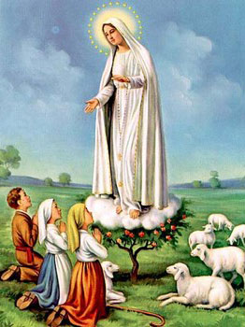
1. Dear Lady of Fatima we come on bended knee To beg your intercession for peace and unity. Dear Mary won't you show us the right and shining way? We pledge our love and offer you a Rosary each day.

Slide 60
2. You promised at Fatima Each time that you appeared To help us If we pray to you to banish war and fear. Dear Lady on first days we ask your guiding hand for grace and guidance here on earth protection for our land.

Slide 61
Ending Hymn:
On This Day

Slide 62
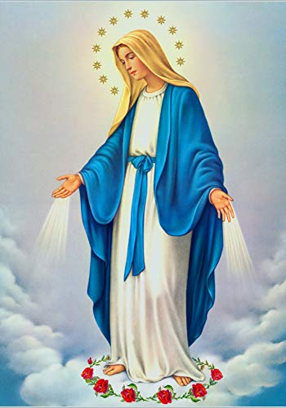
**. On this day, O beautiful Mother, On this day we give thee our love. Near the, Madonna, fondly we hover, Trusting thy gentle care to prove.

Slide 63
1. On this day we ask to share, Dearest Mother, thy sweet care; Aid us ere our feet astray Wanner from thy guiding way.

Slide 64
**. On this day, O beautiful Mother, On this day we give thee our love. Near the, Madonna, fondly we hover, Trusting thy gentle care to prove.

Slide 65
2. Queen of angels, deign to hear. Lisping children's humble prayer; Young hearts gain, O virgin pure, Sweetly to thyself allure.

Slide 66
THANK YOU
CÁM ƠN
MARAMING SALAMAT PO
MUCHAS GRACIAS
  நன்றி (Naṉṟi)

Slide 67
THANK YOU
CÁM ƠN
MARAMING SALAMAT PO
MUCHAS GRACIAS
  நன்றி (Naṉṟi)

