Slide 1
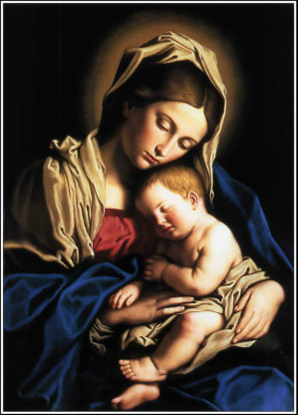
Solemnity of the Blessed Virgin Mary, the Mother of God
Gather Song:
Song Of Mary
Responsorial Psalm 067:
May God Bless Us
Prep. of the Gifts:
Ave Maria (Mary sing the joyful song)
Communion Song :
Silent Night.
Mary, Joseph, Pray For Us
Ave Maria The Prayer
Recessional:
Joy to the World

Slide 2
1. Let us sing the praises of Mary, daughter of David's holy line, she who heard the voice of an angel telling the plan of God's design, how in wisdom's holy sight she would mother heaven's Christ. Blessed be the name of Mary, she who trusted the love of God.

Slide 3
2. Let us sing the praises of Mary, chosen as blessed from the least, she who heard the song of the angels filing the night with heaven's peace. When the promised time had come she gave birth to God's own Son. Blessed be the name of Mary, she who trusted the love of God.

Slide 4
3. Let us sing the praised of Mary, woman of strong and steadfast love. She who raised the Savior of nations held in her arms the Son of God. She who knew the Father's grace taught her Son to know God's face. Blessed be the name of Mary, she who trusted the love of God.

Slide 5
Penitential Act (Confiteor 2011) 1 of 3:

Slide 6
I confess to almighty God and to you, my brothers and sisters, that I have greatly sinned, in my thoughts and in my words,

Slide 7
in what I have done and in what I have failed to do, through my fault,
through my fault, through my most grievious fault;

Slide 8
therefore I ask blessed Mary ever-Virgin, all the Angels and Saints, and you, my brothers and sisters, to pray for me to the Lord our God.

Slide 9
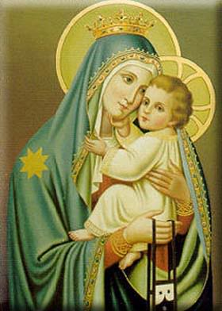
Kyrie

Slide 10
Cantor: Kyrie, Kyrie Eleison.

Slide 11
All: Kyrie, Kyrie Eleison.

Slide 12
Cantor: Christe, Christe, Eleison.

Slide 13
All: Christe, Christe eleison.

Slide 14
Cantor: Kyrie, Kyrie Eleison.

Slide 15
All: Kyrie, Kyrie Eleison.

Slide 16
Christmas Gloria

Slide 17
Refrain. Glo..........ria
In excelsis Deo.
Glo..........ria
In excelsis Deo.

Slide 18
1. We praise you, we bless you, we adore you, we glorify you, we give you thanks for your great glory. Lord God, heavenly King, O God, almighty Father.

Slide 19
2. Lord Jesus Christ, only Begotten Son, Lord God, Lamb of God, Son of the Father, you take away the sins of the world, have mercy on us. You take way the sins of the world, receive our pray you are seated at the right hand, the right hand of the Father, have mercy on us

Slide 20
3. For you alone are the Holy One, you alone are the Lord, you alone are the Most High, Jesus Christ with the Holy Spirit, in the glory of God the Father.

Slide 21
Refrain. Glo..........ria
In excelsis Deo.
Glo..........ria
In excelsis Deo.

Slide 22
Responsorial Psalm: Psalm 67 May God bless us in his mercy

Slide 23
Responsorial Psalm:
May God bless us in his mercy.
May God bless us in his mercy.

Slide 24
Gospel Acclamation

Slide 25
Refrain: Alleluia! In the past God spoke to our ancestors through the prophets; in these last days, he has spoken to us through the Son.

Slide 26
Profession Of Faith Creed

Slide 27
Nicene Creed p1
I believe in one God, the Father almighty, maker of heaven and earth, of all things visible and invisible.

Slide 28
Nicene Creed p2
I believe in one Lord Jesus Christ, the Only Begotten Son of God, born of the Father before all ages.

Slide 29
Nicene Creed p3
God from God, Light from Light, true God from true God, begotten, not made, consubstantial with the Father; through Him all things were made.

Slide 30
Nicene Creed p4
For us men and for our salvation He came down from heaven, and by the Holy Spirit was incarnate of the Virgin Mary, and became man.

Slide 31
Nicene Creed p5
For our sake He was crucified under Pontius Pilate, He suffered death and was buried, and rose again on the third day in accordance with the Scriptures.

Slide 32
Nicene Creed p6
He ascended into heaven and is seated at the right hand of the Father.

Slide 33
Nicene Creed p7
He will come again in glory to judge the living and the dead and His kingdom will have no end.

Slide 34
Nicene Creed p8
I believe in the Holy Spirit, the Lord, the giver of life, who proceeds from the Father and the Son,

Slide 35
Nicene Creed p9
who with the Father and the Son is adored and glorified, who has spoken through the prophets.

Slide 36
Nicene Creed p10
I believe in one, holy, catholic and apostolic Church. I confess one Baptism for the forgiveness of sins

Slide 37
Nicene Creed p11
and I look forward to the resurrection of the dead and the life of the world to come. Amen.

Slide 38
Preparation of The Gift Song: Mary Sing With Joyful Heart

Slide 39
1. Mary, sing with joyful heart: "You Should bear Emmanuel!" Virgin Mother, full of grace, pray for us to God your Son! Ave, ave ave, Maria! Ave, ave, ave, Maria!.

Slide 40
2. "Sing my soul of God's great love! Sing my heart your song of joy! Praise his won-ders, praise his name, praise his gift of God, my Son!" Ave, ave ave, Maria! Ave, ave, ave, Maria!.

Slide 41
3. Angels sing as shepherds watch: "Praise to God, his peace on earth! Christ the Savior, Shepherd King, sleeps in straw in David's town!“ Ave, ave ave, Maria! Ave, ave, ave, Maria!.

Slide 42
3. Angels sing as shepherds watch: "Praise to God, his peace on earth! Christ the Savior, ShepherdKing, sleeps in straw in David's town!“ Ave, ave ave, Maria! Ave, ave, ave, Maria!.

Slide 43
Holy Holy

Slide 44
Holy, Holy, Holy Lord God of hosts. Heaven and earth are full, are full of your glory. Hosanna, Hosanna! Hosanna in the highest.

Slide 45
Blessed is he who comes, who comes in the name of the Lord. Hosanna, Hosanna! Hosanna in the highest.

Slide 46
Memorial Acclamation

Slide 47
*Anunciamos tu muerte, Señor, proclamamos tu resurreción. Ven Señor Jesus, Señor Jesus. (2x)

Slide 48
Amen

Slide 49
Amen, Amen. Amen, Amen

Slide 50
Lamb Of God

Slide 51
Lamb of God you take away the sins of the world. Have mercy on us. (repeat as needed)
Lamb of God you take away the sins of the world.
grant us peace.

Slide 52
Communion respond

Slide 53
Behold the Lamb of God,
behold him who takes away the sins of the world.
Blessed are those called to the supper of the Lamb. Lord, I am not worthy
that You should enter under my roof, but only say the word and my soul shall be healed.

Slide 54
Communion Song : Silent Night – Noche de Paz

Slide 55
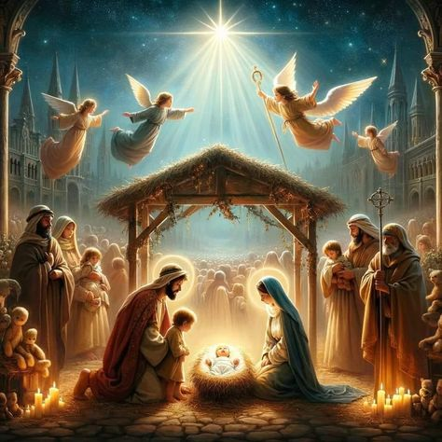
1a: Silent night, holy night, All is calm, All is bright Round yon Virgin Mother and Child.

Slide 56
1b: Holy Infant so tender and mild. Sleep in heavenly peace. Sleep in heavenly peace.

Slide 57
2a: Noche de paz, noche de amor. Todo duerme en derredor. Entre los astros que esparcen su luz,

Slide 58
2b: bella anunciando al niñito Jesús, brilla la estrella de paz, brilla la estrella de paz.

Slide 59
3a: Silent night, holy night, Shepherds quake all the sight: Glories stream from heaven afar,

Slide 60
3b: Heavenly hosts sing alleluia: Christ the Savior is born! Christ the Savior is born!

Slide 61
4a: Noche de paz, Noche de_amor; Mira qué gran resplandor. Luce_en el ros-tro del Nino Jesús

Slide 62
4b: En el pesebre del mundo la luz, brilla la estrella de paz, brilla la estrella de paz.

Slide 63
5a: Silent night, holy night, Son of God love’s pure light Radiant beams from thy holy face,

Slide 64
5b: With the dawn of redeeming grace, Jesus Lord at thy birth, Jesus Lord at they birth.

Slide 65
6a: Noche de paz, Noche de_amor; Al Divino Salvador Que por nosotros na-ció_en un portal.

Slide 66
6b: Himnos cantemos de_amor celestial. ;Gloria por siempre_al Senor! ;Gloria por siempre_al Senor

Slide 67
Communion Song : Mary, Joseph, Pray For Us

Slide 68
1.O holy Mary, maiden mild who bravely knelt before the angel, crafted a home, tended a child, the blessed Jesus, Who faced a life-time set with hardship, yet weathered all with grace and love, O holy Mary, pray for us.

Slide 69
2. O holy Joseph, husband strong, who heard the words of God's own angel, crafted a home, tended a child, the blessed Jesus, You were a shelter from the storms, and weathered all with grace and love, O holy joseph, pray for us.

Slide 70
3. That through our life-times, blessed by God, we'll walk beside our guardian angel, and craft a home, rotted in love, the love of Jesus, Give us the strength and grant us wis-dom to weather all with grace and love, O holy

Slide 71
Communion Song : Ave Maria – Gratia plena

Slide 72
Ave Maria, gratia plena, Dominus tecum, benedicta tu in mulieribus, et benedictus fructus ventris tui, Iesus. Sancta Maria, Mater Dei, ora pro nobis peccatoribus, nunc et in hora mortis nostrae. Amen.

Slide 73
Recessional Hymn: Joy To The World

Slide 74
1. Joy to the world! the Lord is come; Let earth receive her King; Let ev'ry heart prepare him room, And heav'n and nature sing, and heav'n and nature sing, And heav'n, and heav'n and nature sing.

Slide 75
2. Joy to the world! the Savior reigns; Let us our songs employ; While fields and floods, rocks, hills and plains Repeat the sounding joy, repeat the sounding joy, Repeat, repeat the sounding joy.

Slide 76
And the happy New Year
And the happy New Year
And the happy ….. New … Year……

Slide 77
Merry Christmas
&
Happy New Year

