Slide 1
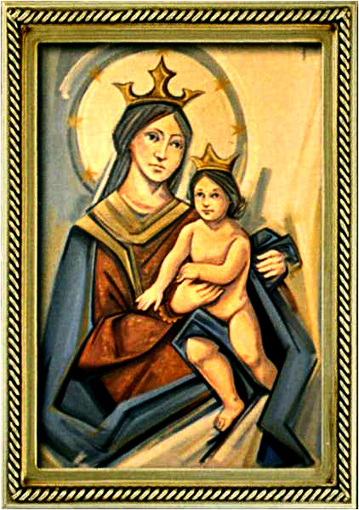
Ordinary Time 28 Year C
Gather Hymn:
Sing A New Song
Responsorial Psalm: 98
The Lord Has Revealed
Prep. of the Gifts Hymn:
Amazing Grace
Communion Hymn:
Gift of Finest Wheat
Recessional Hymn:
Blest Be The Lord

Slide 2
Sing a new song unto the Lord;
let your song be sung from mountains high. Sing a new song unto the Lord, singing alleluia
1. O Lord people dance for joy.
O come before the Lord, and play for him on glad tambourines, and let your trumpet sound.

Slide 3
Sing a new song unto the Lord;
let your song be sung from mountains high. Sing a new song unto the Lord, singing alleluia.
2. Rise, O children, from your sleep; your Savior now has come.
He has turned your sorrow o joy
and filled your soul with song.

Slide 4
Sing a new song unto the Lord;
let your song be sung from mountains high. Sing a new song unto the Lord, singing alleluia.
3. Glad my soul for I have seen
the glory of the Lord. The trumpet sounds; the dead shall be raised.
I know my Savior lives.

Slide 5
Penitential Act (Confiteor 2011) 1 of 3:

Slide 6
I confess to almighty God and to you, my brothers and sisters, that I have greatly sinned, in my thoughts and in my words,

Slide 7
in what I have done
and in what I have failed to do,
through my fault,
through my fault,
through my most grievious fault;

Slide 8
therefore I ask blessed Mary ever-Virgin, all the Angels and Saints, and you, my brothers and sisters, to pray for me to the Lord our God.

Slide 9
Gloria Hymn

Slide 10
Refrain:
Glory to God, Glory to God. Glory to God in the highest, and on earth, peace on earth, peace to people of good will

Slide 11
1. We praise you, we bless you, we adore you, we glorify you, we give you thanks for your great glory. Lord God, heavenly King, O God, almighty Father.

Slide 12
Refrain:
Glory to God, Glory to God. Glory to God in the highest, and on earth, peace on earth, peace to people of good will

Slide 13
2. Lord Jesus Christ, only Begotten Son, Lord God, Lamb of God, Son of the Father, you take away the sins of the world, have mercy on us. You take way the sins of the world, receive our pray you are seated at the right hand, the right hand of the Father, have mercy on us

Slide 14
Refrain:
Glory to God, Glory to God. Glory to God in the highest, and on earth, peace on earth, peace to people of good will

Slide 15
3. For you alone are the Holy One, you alone are the Lord, you alone are the Most High, Jesus Christ with the Holy Spirit, in the glory of God the Father.

Slide 16
Refrain:
Glory to God, Glory to God. Glory to God in the highest, and on earth, peace on earth, peace to people of good will. Amen Amen.

Slide 17
Responsorial Psalm: 98
The Lord Has Revealed to the Nations

Slide 18
Responsorial Psalm: Psalm 98
The Lord has revealed to the nations, revealed his saving power.

Slide 19
Gospel Acclamation

Slide 20
Alleluia Alleluia Alleluia.
In all circumstances, give thanks, for this is the will of God for you in Christ Jesus.

Slide 21
Profession Of Faith
Creed

Slide 22
Nicene Creed p1
I believe in one God, the Father almighty, maker of heaven and earth, of all things visible and invisible.

Slide 23
Nicene Creed p2
I believe in one Lord Jesus Christ, the Only Begotten Son of God, born of the Father before all ages.

Slide 24
Nicene Creed p3
God from God, Light from Light, true God from true God, begotten, not made, consubstantial with the Father; through Him all things were made.

Slide 25
Nicene Creed p4
For us men and for our salvation He came down from heaven, and by the Holy Spirit was incarnate of the Virgin Mary, and became man.

Slide 26
Nicene Creed p5
For our sake He was crucified under Pontius Pilate, He suffered death and was buried, and rose again on the third day in accordance with the Scriptures.

Slide 27
Nicene Creed p6
He ascended into heaven and is seated at the right hand of the Father.

Slide 28
Nicene Creed p7
He will come again in glory to judge the living and the dead and His kingdom will have no end.

Slide 29
Nicene Creed p8
I believe in the Holy Spirit, the Lord, the giver of life, who proceeds from the Father and the Son,

Slide 30
Nicene Creed p9
who with the Father and the Son is adored and glorified, who has spoken through the prophets.

Slide 31
Nicene Creed p10
I believe in one, holy, catholic and apostolic Church. I confess one Baptism for the forgiveness of sins

Slide 32
Nicene Creed p11
and I look forward to the resurrection of the dead and the life of the world to come. Amen.

Slide 33
Preparation of The Gift Song:
Amazing Grace

Slide 34
1. Amazing Grace, how sweet the sound,
That saved a wretch like me. I once was lost but now am found, was blind, but now I see.

Slide 35
2. T'was Grace that taught my heart to fear. And Grace, my fears relieved. How precious did that Grace appear the hour I first believed.

Slide 36
3. Through many dangers, toils and snares I have already come; 'Tis Grace that brought me safe thus far and Grace will lead me home.

Slide 37
4. The Lord has promised good to me. His word my hope secures. He will my shield and portion be, as long as life endures.

Slide 38
5. When we've been here ten thousand years bright shining as the sun. We've no less days to sing God's praise than when we've first begun.

Slide 39
Holy Holy

Slide 40
Holy, Holy, Holy Lord God of hosts.
Heaven and earth are full, are full of your glory. Hosanna, Hosanna! Hosanna in the highest.

Slide 41
Blessed is he who comes, who comes in the name of the Lord.
Hosanna, Hosanna! Hosanna in the highest.

Slide 42
Memorial Acclamation

Slide 43
We proclaim your Death, O Lord,
and profess your Resurrection until you come again.

Slide 44
Amen

Slide 45
Amen, Amen.
Amen, Amen
Amen, Amen
Amen. Amen.

Slide 46
Lamb Of God

Slide 47
Lamb of God your take away the sins of the world. Have mercy on us. (repeat as needed)
Lamb of God your take away the sins of the world.
grant us peace.

Slide 48
Communion respond

Slide 49
Behold the Lamb of God,
behold him who takes away the sins of the world.
Blessed are those called to the supper of the Lamb.
Lord, I am not worthy
that You should enter under my roof, but only say the word and my soul shall be healed.

Slide 50
Communion Hymn 1:
Gift of Finest Wheat

Slide 51
Refrain: You satisfy the hungry heart, with gift of finest wheat, come give to us o saving Lord, the bread of life to eat.
1. As when the shepherd calls his sheep, they know and heed his voice; so when You call Your family Lord, we follow and rejoice.

Slide 52
Refrain: You satisfy the hungry heart, with gift of finest wheat, come give to us o saving Lord, the bread of life to eat.
2. With joyful lips we sing to You, our praise and gratitude. That You should count us worthy Lord, to share this heavenly food.

Slide 53
Refrain: You satisfy the hungry heart, with gift of finest wheat, come give to us o saving Lord, the bread of life to eat.
3. Is not the cup we bless and share The blood of Christ outpoured? Do not one cup, one loaf, declare our oneness in the Lord?

Slide 54
Refrain: You satisfy the hungry heart, with gift of finest wheat, come give to us o saving Lord, the bread of life to eat.
4. The mystery of Your presence Lord, no mortal tongue can tell; whom all the world cannot contain comes in our hearts to dwell.

Slide 55
Refrain: You satisfy the hungry heart, with gift of finest wheat, come give to us o saving Lord, the bread of life to eat.
5. You give yourself to us o Lord, then selfless let us be,
to serve each other in Your name in truth and charity.

Slide 56
Communion Hymn 1:
I have loved you

Slide 57
I have loved you with an everlasting love,
I have called you and you are mine. (2x)

Slide 58
1. Seek the face of the Lord and long for him:
He will bring you his light and his peace.

Slide 59
I have loved you with an everlasting love,
I have called you and you are mine. (2x)

Slide 60
2. Seek the face of the Lord and long for him:
He will bring you his joy and his hope.

Slide 61
I have loved you with an everlasting love,
I have called you and you are mine. (2x)

Slide 62
3. Seek the face of the Lord and long for him:
He will bring you his care and his love.

Slide 63
I have loved you with an everlasting love,
I have called you and you are mine. (2x)

Slide 64
Announcements:

Slide 66
Ending Hymn:
Blest Be The Lord

Slide 67
Refrain:
Blest Be The Lord, Blest Be The Lord, The God of mercy, the God who saves.
I shall not fear the dark of night, nor the arrow that files by day.
1. He will release me from the nets of all my foes. He will protect me from their wicked hands. Beneath the shadow of his wings I will rejoice to find a dwelling place secure.

Slide 68
Ending Hymn:
Lady Of Fatima

Slide 69
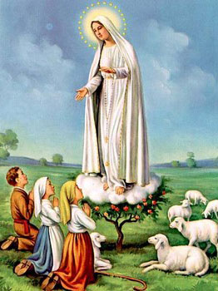
1. Dear Lady of Fatima we come on bended knee To beg your intercession for peace and unity. Dear Mary won't you show us the right and shining way? We pledge our love and offer you a Rosary each day.

Slide 70
2. You promised at Fatima Each time that you appeared To help us If we pray to you to banish war and fear. Dear Lady on first days we ask your guiding hand for grace and guidance here on earth protection for our land.

Slide 71
Ending Hymn:
On This Day

Slide 72
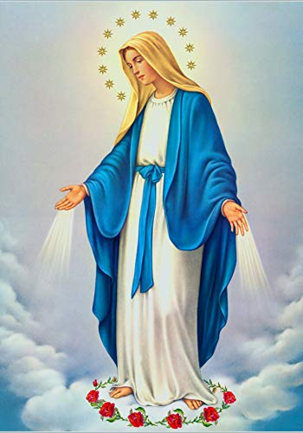
**. On this day, O beautiful Mother, On this day we give thee our love. Near the, Madonna, fondly we hover, Trusting thy gentle care to prove.

Slide 73
1. On this day we ask to share, Dearest Mother, thy sweet care; Aid us ere our feet astray Wanner from thy guiding way.

Slide 74
**. On this day, O beautiful Mother, On this day we give thee our love. Near the, Madonna, fondly we hover, Trusting thy gentle care to prove.

Slide 75
2. Queen of angels, deign to hear. Lisping children's humble prayer; Young hearts gain, O virgin pure, Sweetly to thyself allure.

Slide 76
THANK YOU
CÁM ƠN
MARAMING SALAMAT PO
MUCHAS GRACIAS
  நன்றி (Naṉṟi)

Slide 77
THANK YOU
CÁM ƠN
MARAMING SALAMAT PO
MUCHAS GRACIAS
  நன்றி (Naṉṟi)

