Slide 1
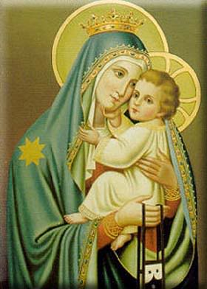
The Baptism of the Lord
Gather Song:
When Jesus Comes to baptized
Responsorial Psalm 104:
O Bless The Lord, My Soul!
Prep. of the Gifts:
God Of Mercy
Communion Song :
I Have Loved You
Recessional:
The Spirit Sends Us Forth

Slide 2
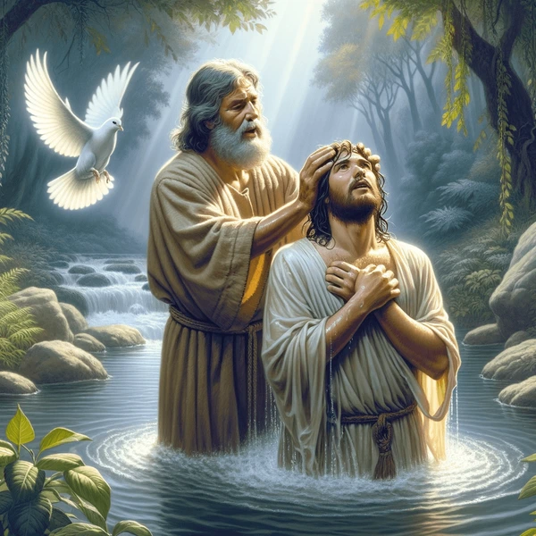
1. When Jesus comes to be baptized, He leaves the hidden years behind, The years of safety and the peace To bear the sins of humankind.

Slide 3
2. The Spirit of the Lord comes down, Anoints the Christ to suffering, To preach the word, to free the bound, And to the mourner, comfort bring.

Slide 4
3. He will not quench the dying flame, And what is bruised he will not break, But heal the wound in justtice dealt, And out of death his triumph make.

Slide 5
4. O Spirit help us be like Christ: To live in love charity, To walk in truth and justice now, And grow in Christian dignity.

Slide 6
5) We praise you, God, source of all life, We praise ou, Christ, 0e-ter-nal Word, we praise you, Spir-it, gra-cious gift: your tri-une pres-ence fills our world.

Slide 7
Penitential Act (Confiteor 2011) 1 of 3:

Slide 8
I confess to almighty God and to you, my brothers and sisters, that I have greatly sinned, in my thoughts and in my words,

Slide 9
in what I have done and in what I have failed to do, through my fault,
through my fault, through my most grievious fault;

Slide 10
therefore I ask blessed Mary ever-Virgin, all the Angels and Saints, and you, my brothers and sisters, to pray for me to the Lord our God.

Slide 11
Kyrie

Slide 12
Cantor: Kyrie, Kyrie Eleison.

Slide 13
All: Kyrie, Kyrie Eleison.

Slide 14
Cantor: Christe, Christe, Eleison.

Slide 15
All: Christe, Christe eleison.

Slide 16
Cantor: Kyrie, Kyrie Eleison.

Slide 17
All: Kyrie, Kyrie Eleison.

Slide 18
Gloria

Slide 19
Refrain:
Glory to God, Glory to God. Glory to God in the highest, and on earth, peace on earth, peace to people of good will

Slide 20
1. We praise you, we bless you, we adore you, we glorify you, we give you thanks for your great glory. Lord God, heavenly King, O God, almighty Father.

Slide 21
Refrain:
Glory to God, Glory to God. Glory to God in the highest, and on earth, peace on earth, peace to people of good will

Slide 22
2. Lord Jesus Christ, only Begotten Son, Lord God, Lamb of God, Son of the Father, you take away the sins of the world, have mercy on us. You take way the sins of the world, receive our pray you are seated at the right hand, the right hand of the Father, have mercy on us

Slide 23
Refrain:
Glory to God, Glory to God. Glory to God in the highest, and on earth, peace on earth, peace to people of good will

Slide 24
3. For you alone are the Holy One, you alone are the Lord, you alone are the Most High, Jesus Christ with the Holy Spirit, in the glory of God the Father.

Slide 25
Refrain:
Glory to God, Glory to God. Glory to God in the highest, and on earth, peace on earth, peace to people of good will. Amen Amen.

Slide 26
Responsorial Psalm: Psalm 98 All The end of The earth. Page 5

Slide 27
Refrain:
All The Ebds if tge earth have seen the power of God.(2x)

Slide 28
Responsorial Psalm: Psalm 104 O Blessed The Lord, My Soul!

Slide 29
Refrain:
O bless the Lord, my soul! (x2)

Slide 30
Gospel Acclamation

Slide 31
Refrain: Alleluia!

Slide 32
Profession Of Faith Creed

Slide 33
Nicene Creed p1
I believe in one God, the Father almighty, maker of heaven and earth, of all things visible and invisible.

Slide 34
Nicene Creed p2
I believe in one Lord Jesus Christ, the Only Begotten Son of God, born of the Father before all ages.

Slide 35
Nicene Creed p3
God from God, Light from Light, true God from true God, begotten, not made, consubstantial with the Father; through Him all things were made.

Slide 36
Nicene Creed p4
For us men and for our salvation He came down from heaven, and by the Holy Spirit was incarnate of the Virgin Mary, and became man.

Slide 37
Nicene Creed p5
For our sake He was crucified under Pontius Pilate, He suffered death and was buried, and rose again on the third day in accordance with the Scriptures.

Slide 38
Nicene Creed p6
He ascended into heaven and is seated at the right hand of the Father.

Slide 39
Nicene Creed p7
He will come again in glory to judge the living and the dead and His kingdom will have no end.

Slide 40
Nicene Creed p8
I believe in the Holy Spirit, the Lord, the giver of life, who proceeds from the Father and the Son,

Slide 41
Nicene Creed p9
who with the Father and the Son is adored and glorified, who has spoken through the prophets.

Slide 42
Nicene Creed p10
I believe in one, holy, catholic and apostolic Church. I confess one Baptism for the forgiveness of sins

Slide 43
Nicene Creed p11
and I look forward to the resurrection of the dead and the life of the world to come. Amen.

Slide 44
Preparation of The Gift Song: God of Mercy

Slide 45
refrain: God of mercy holy mystery ever faithful one, you have pitched your tent among us, reconciling love heart and mind of Christ, live within our lives.

Slide 46
1. You have called us each by name in your great compassion encompassing our failings with mercy. God of mercy lead us.

Slide 47
refrain: God of mercy holy mystery ever faithful one, you have pitched your tent among us, reconciling love heart and mind of Christ, live within our lives.

Slide 48
2. Slow to anger, rich in love, you bestow forgiveness. May we, in turn, forgive those who harm us. God of mercy lead us.

Slide 49
refrain: God of mercy holy mystery ever faithful one, you have pitched your tent among us, reconciling love heart and mind of Christ, live within our lives.

Slide 50
3. In our midst as one who pain, wounded down divisions, to all in need you send us as neighbor. God of mercy lead us.

Slide 51
refrain: God of mercy holy mystery ever faithful one, you have pitched your tent among us, reconciling love heart and mind of Christ, live within our lives.

Slide 52
4. Reaching out to those in pain, wounded and abandoned, may we create safe havens for healing. God of mercy lead us.

Slide 53
refrain: God of mercy holy mystery ever faithful one, you have pitched your tent among us, reconciling love heart and mind of Christ, live within our lives.

Slide 54
5. In the word of truth you speak, word of hope and chalenge , you summon us to speak for the voiceless. God of mercy lead us.

Slide 55
refrain: God of mercy holy mystery ever faithful one, you have pitched your tent among us, reconciling love heart and mind of Christ, live within our lives.

Slide 56
6. In this Bread we break and share in this Cup of blessing, you summon us to work for true justice. God of mercy lead us.

Slide 57
refrain: God of mercy holy mystery ever faithful one, you have pitched your tent among us, reconciling love heart and mind of Christ, live within our lives.

Slide 58
Holy Holy

Slide 59
Holy, Holy, Holy Lord God of hosts. Heaven and earth are full, are full of your glory. Hosanna, Hosanna! Hosanna in the highest.

Slide 60
Blessed is he who comes, who comes in the name of the Lord. Hosanna, Hosanna! Hosanna in the highest.

Slide 61
Memorial Acclamation

Slide 62
We proclaim your Death, O Lord, and profess your Resurrection until you come again.

Slide 63
Amen

Slide 64
Amen, Amen. Amen, Amen Amen, Amen
Amen. Amen.

Slide 65
Lamb Of God

Slide 66
Lamb of God you take away the sins of the world. Have mercy on us. (repeat as needed)
Lamb of God you take away the sins of the world.
grant us peace.

Slide 67
Communion respond

Slide 68
Behold the Lamb of God,
behold him who takes away the sins of the world.
Blessed are those called to the supper of the Lamb. Lord, I am not worthy
that You should enter under my roof, but only say the word and my soul shall be healed.

Slide 69
Preparation of The Gift Song: I Have Loved You

Slide 70
I have loved you with an everlasting love, I have called you and you are mine. (2x)

Slide 71
1. Seek the face of the Lord and long for him: He will bring you his light and his peace.

Slide 72
I have loved you with an everlasting love, I have called you and you are mine. (2x)

Slide 73
2. Seek the face of the Lord and long for him: He will bring you his joy and his hope.

Slide 74
I have loved you with an everlasting love, I have called you and you are mine. (2x)

Slide 75
3. Seek the face of the Lord and long for him: He will bring you his care and his love.

Slide 76
I have loved you with an everlasting love, I have called you and you are mine. (2x)

Slide 77
Communion Song 2: Silent Night Page 12

Slide 78
Sending Hymn The Spirit Sends Us Forth

Slide 79
1. The Spirit sends us forth to serve; We go in Jesus' name To bring glad tidings to the poor, God's favour to proclaim.
2. We go to comfort those who mourn And set the burdened free; Where hope is dim, to share a dream And help the blind to see.

Slide 80
3. We go the be the hands of Christ, To scatter joy like seed And, all our days to cherish life, To do the loving deed.
4. Then let us go to serve in peace, The gospel to proclaim. God's Spirit has empowered us; We go in Jesus' name.

Slide 81
THANK YOU
CÁM ƠN
MARAMING SALAMAT PO
MUCHAS GRACIAS
AND
Merry Christmas

