Slide 1
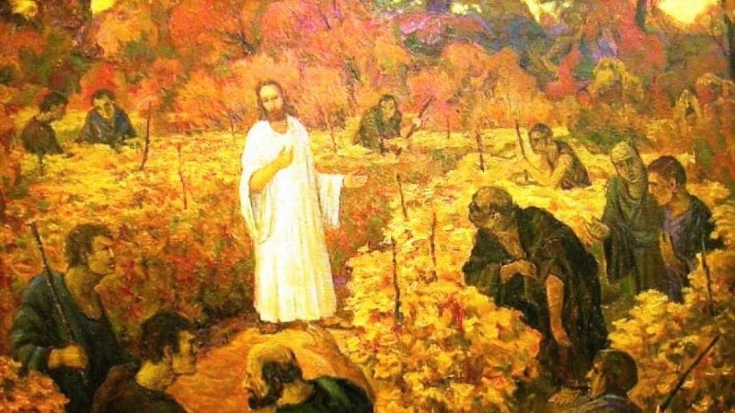
Welcome to Our Lady of Refuge Catholic Church
Sunday Ordinary Time 27 th Year A
Gather Song:
Lift up Your Heart
Responsorial Psalm 80
The Vinyard of the Lord.
Prep. of the Gifts:
Lord, make us your servants of your peace
Communion Song :
The Grace of God /
I Have Loved You
Ave Maria
Recessional:
On This Day

Slide 2
Refrain: Lift up your hearts to the Lord, praise God's gracious mercy! Sing out your joy to the Lord, whose love is enduring.

Slide 3
1. Shout with joy to the Lord, all the earth!
Praise the name above all names! Say to God, "How wondrous your works,
how glorious your name!"

Slide 4
Refrain: Lift up your hearts to the Lord, praise God's gracious mercy! Sing out your joy to the Lord, whose love is enduring.

Slide 5
2. Let the earth worship, singing your praise.
Praise the glory of your name!
Come and see the deeds of the Lord,
bless God's holy name!

Slide 6
Refrain: Lift up your hearts to the Lord, praise God's gracious mercy! Sing out your joy to the Lord, whose love is enduring.

Slide 7
3. God's right hand made a path through the night,
split the waters of the sea.
All creation, lift up your voice:
Our God set us free.

Slide 8
Refrain: Lift up your hearts to the Lord, praise God's gracious mercy! Sing out your joy to the Lord, whose love is enduring.

Slide 9
Penitential Act

Slide 10
I confess to almighty God and to you, my brothers and sisters, that I have greatly sinned, in my thoughts and in my words,

Slide 11
in what I have done
and in what I have failed to do,
through my fault,
through my fault,
through my most grievious fault;

Slide 12
therefore I ask blessed Mary ever-Virgin, all the Angels and Saints, and you, my brothers and sisters, to pray for me to the Lord our God.

Slide 13
Gloria Prayer

Slide 14
Refrain:
Glory to God, Glory to God. Glory to God in the highest, and on earth, peace on earth, peace to people of good will

Slide 15
1. We praise you, we bless you, we adore you, we glorify you, we give you thanks for your great glory. Lord God, heavenly King, O God, almighty Father.

Slide 16
2. Lord Jesus Christ, only Begotten Son, Lord God, Lamb of God, Son of the Father, you take away the sins of the world, have mercy on us. You take way the sins of the world, receive our pray you are seated at the right hand, the right hand of the Father, have mercy on us

Slide 17
3. For you alone are the Holy One, you alone are the Lord, you alone are the Most High, Jesus Christ with the Holy Spirit, in the glory of God the Father.

Slide 18
Refrain:
Glory to God, Glory to God. Glory to God in the highest, and on earth, peace on earth, peace to people of good will. Amen Amen.
Gloria Prayer

Slide 19
Psalm 80
The vineyard of the Lord

Slide 20
Responsorial Psalm 80:
The vineyard of the Lord is the house of Israel.

Slide 21
Gospel Acclamation

Slide 22
Refrain: Alleluia!
I have chosen you from the world, says the Lord,
to go and bear fruit that will remain.

Slide 23
Profession of Faith

Slide 24
Nicene Creed p1
I believe in one God, the Father almighty, maker of heaven and earth, of all things visible and invisible.

Slide 25
Nicene Creed p2
I believe in one Lord Jesus Christ, the Only Begotten Son of God, born of the Father before all ages.

Slide 26
Nicene Creed p3
God from God, Light from Light, true God from true God, begotten, not made, consubstantial with the Father; through Him all things were made.

Slide 27
Nicene Creed p4
For us men and for our salvation He came down from heaven, and by the Holy Spirit was incarnate of the Virgin Mary, and became man.

Slide 28
Nicene Creed p5
For our sake He was crucified under Pontius Pilate, He suffered death and was buried, and rose again on the third day in accordance with the Scriptures.

Slide 29
Nicene Creed p6
He ascended into heaven and is seated at the right hand of the Father.

Slide 30
Nicene Creed p7
He will come again in glory to judge the living and the dead and His kingdom will have no end.

Slide 31
Nicene Creed p8
I believe in the Holy Spirit, the Lord, the giver of life, who proceeds from the Father and the Son,

Slide 32
Nicene Creed p9
who with the Father and the Son is adored and glorified, who has spoken through the prophets.

Slide 33
Nicene Creed p10
I believe in one, holy, catholic and apostolic Church. I confess one Baptism for the forgiveness of sins

Slide 34
Nicene Creed p11
and I look forward to the resurrection of the dead and the life of the world to come. Amen.

Slide 35
Preparation of The Gift Song
Lord, Make Us Servants of Your Peace

Slide 36
1. Lord, make us servants of your peace: where there is hate, may we sow love where there is hurt, may we forgive where there is strife, may we make one.

Slide 37
2. Where all is doubt, may we sow faith; where all is gloom may we sow hope. where all is night may we sow light where all is tears, may we sow joy

Slide 38
refrain: Dying we live, and are reborn through death's dark night to endless day: Lord make us servants of your peace to wake at last in heaven's light.

Slide 39
3. Jesus, our Lord, may we not seek to be consoled, but to console, nor look to understanding hearts, but look for hearts to understand

Slide 40
refrain: Dying we live, and are reborn through death's dark night to endless day: Lord make us servants of your peace to wake at last in heaven's light.

Slide 41
4. May we not look for love's return but to seek love unselfishly. for in our giving we receive, and in forgiving are forgiv'n

Slide 42
refrain: Dying we live, and are reborn through death's dark night to endless day: Lord make us servants of your peace to wake at last in heaven's light.

Slide 43
Holy

Slide 44
Holy, Holy, Holy Lord God of hosts.
Heaven and earth are full, are full of your glory. Hosanna, Hosanna! Hosanna in the highest.

Slide 45
Blessed is he who comes, who comes in the name of the Lord.
Hosanna, Hosanna! Hosanna in the highest.

Slide 46
Memorial acclamation

Slide 47
We proclaim your Death, O Lord,
and profess your Resurrection until you come again.
Memorial acclamation

Slide 48
Amen

Slide 49
Amen Amen Amen

Slide 50
Lamb Of God

Slide 51
Lamb of God you take away the sins of the world. Have mercy on us. (repeat as needed)
Lamb of God you take away the sins of the world.
grant us peace.

Slide 52
Communion Respond

Slide 53
Behold the Lamb of God,
behold him who takes away the sins of the world.
Blessed are those called to the supper of the Lamb.
Lord, I am not worthy
that You should enter under my roof, but only say the word and my soul shall be healed.
Communion Respond

Slide 54
Communion Hymn
The Grace of God

Slide 55
Refrain: The grace of God has appeared and is with us. Our blessed hope and our Savior Jesus Christ. who gave himself for us to redeem us, a people for his own.
1. Christ saved us, not by anything we had done, but by his mercy Christ has saved us.

Slide 56
Refrain: The grace of God has appeared and is with us. Our blessed hope and our Savior Jesus Christ. who gave himself for us to redeem us, a people for his own.
2. In faith though living water we are reborn to new life by the Holy Spirit.

Slide 57
Refrain: The grace of God has appeared and is with us. Our blessed hope and our Savior Jesus Christ. who gave himself for us to redeem us, a people for his own.
3. The Holy Spirit given to us by God is poured on us through Christ our Savior

Slide 58
Refrain: The grace of God has appeared and is with us. Our blessed hope and our Savior Jesus Christ. who gave himself for us to redeem us, a people for his own.
4. Through Christ we have been justified by his grace. to live with him in joy forever.

Slide 59
Communion Hymn
I Have Loved You

Slide 60
Refrain: I have loved you with an everlasting love, I have called you and you are mine. I have loved you with an everlasting love, I have called you and you are mine.
1. Seek the face of the Lord and long for him: He will bring you his light and his peace.

Slide 61
Refrain: I have loved you with an everlasting love, I have called you and you are mine. I have loved you with an everlasting love, I have called you and you are mine.
2. Seek the face of the Lord and long for him: He will bring you his joy and his hope.

Slide 62
Refrain: I have loved you with an everlasting love, I have called you and you are mine. I have loved you with an everlasting love, I have called you and you are mine.
3. Seek the face of the Lord and long for him: He will bring you his care and his love.

Slide 63
Communion Hymn
Ave Maria, Gratia Plena

Slide 64
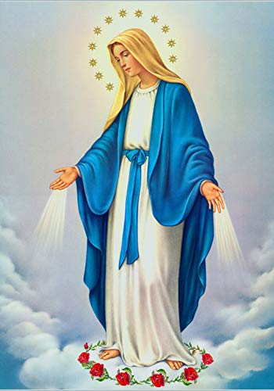
Ave Maria, gratia plena,
Dominus tecum, benedicta tu in mulieribus, et benedictus fructus ventris tui, Jesus.

Slide 65
Sancta Maria, Mater Dei, ora pro nobis peccatoribus, nunc et in hora mortis nostrae.
Amen.

Slide 66
Sending Hymn
On This Day, O Beautiful Mother

Slide 67
**. On this day, O beautiful Mother, On this day we give thee our love. Near the, Madonna, fondly we hover, Trusting thy gentle care to prove.

Slide 68
1. On this day we ask to share, Dearest Mother, thy sweet care; Aid us ere our feet astray Wanner from thy guiding way.

Slide 69
**. On this day, O beautiful Mother, On this day we give thee our love. Near the, Madonna, fondly we hover, Trusting thy gentle care to prove.

Slide 70
2. Queen of angels, deign to hear. Lisping children's humble prayer; Young hearts gain, O virgin pure, Sweetly to thyself allure.

Slide 71
**. On this day, O beautiful Mother, On this day we give thee our love. Near the, Madonna, fondly we hover, Trusting thy gentle care to prove.

Slide 72
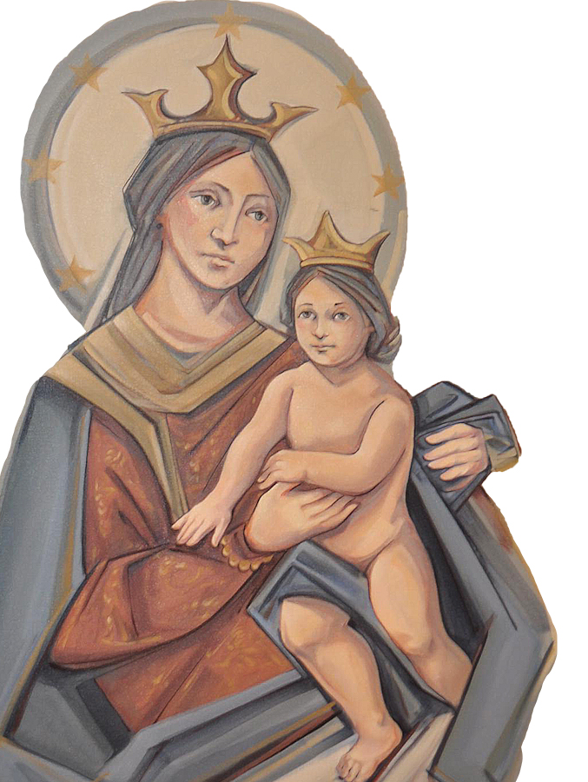
THANK YOU
CÁM ƠN
MARAMING SALAMAT PO
MUCHAS GRACIAS
நன்றி (Nanri)

