Slide 1
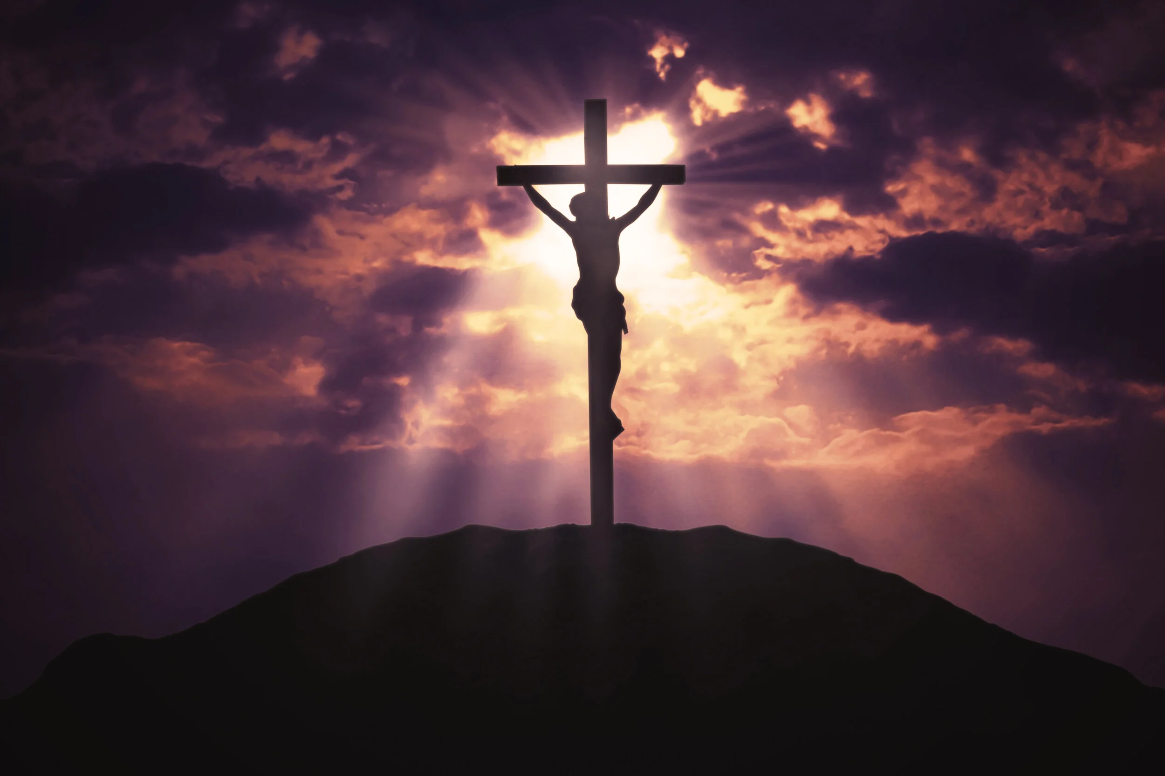
Welcome to Our Lady of Refuge Catholic Church
Sunday Ordinary Time 03 Year A
Gather Song:
Praise To You, O Christ,
Our Savior
Responsorial Psalm 27:
The Lord is My Life
Prep. of the Gifts:
These Alone Are Enough
Communion Song :
I want to walk as a child of the
light
Lord, You Have Come
Recessional:
The Spirit Sends Us Forth

Slide 2
Refrain: Praise to you, O Christ, our Savior, Word of the Father, calling us to life; Son of God who leads us to freedom: glory to you, Lord Jesus Christ!
1. You are the Word who calls us out of darkness; you are the Word who leads us into light; you are the Word who brings us thorough the desert: glory to you, Lord Jesus Christ!

Slide 3
Refrain: Praise to you, O Christ, our Savior, Word of the Father, calling us to life; Son of God who leads us to freedom: glory to you, Lord Jesus Christ!
2. You are the one whom prophets hoped and longed for; you are the one who speaks to us today; you are the one who leads us to our future: glory to you, Lord Jesus Christ!

Slide 4
Refrain: Praise to you, O Christ, our Savior, Word of the Father, calling us to life; Son of God who leads us to freedom: glory to you, Lord Jesus Christ!
3. You are the Word who calls us to be servants; you are the Word whose only law is love; you are the Word - made flesh who lives among us: glory to you, Lord Jesus Christ!

Slide 5
Refrain: Praise to you, O Christ, our Savior, Word of the Father, calling us to life; Son of God who leads us to freedom: glory to you, Lord Jesus Christ!
4. You are the Word who binds us and unites us: you are the Word who calls us to be one; you are the Word who teaches us forgiveness: glory to you, Lord Jesus Christ!

Slide 6
Penitential Act

Slide 7
I confess to almighty God and to you, my brothers and sisters, that I have greatly sinned, in my thoughts and in my words,

Slide 8
in what I have done and in what I have failed to do, through my fault,
through my fault, through my most grievious fault;

Slide 9
therefore I ask blessed Mary ever-Virgin, all the Angels and Saints, and you, my brothers and sisters, to pray for me to the Lord our God.

Slide 10
Gloria Prayer

Slide 11
Refrain:
Glory to God, Glory to God. Glory to God in the highest, and on earth, peace on earth, peace to people of good will

Slide 12
1. We praise you, we bless you, we adore you, we glorify you, we give you thanks for your great glory. Lord God, heavenly King, O God, almighty Father.

Slide 13
2. Lord Jesus Christ, only Begotten Son, Lord God, Lamb of God, Son of the Father, you take away the sins of the world, have mercy on us. You take way the sins of the world, receive our pray you are seated at the right hand, the right hand of the Father, have mercy on us

Slide 14
3. For you alone are the Holy One, you alone are the Lord, you alone are the Most High, Jesus Christ with the Holy Spirit, in the glory of God the Father.

Slide 15
Refrain:
Glory to God, Glory to God. Glory to God in the highest, and on earth, peace on earth, peace to people of good will. Amen Amen.

Slide 16
Responsorial Psalm: Psalm 27 The Lord Is My Light

Slide 17
Refrain:
The Lord is my light, the Lord is my light, the Lord is my light and my salvation

Slide 18
Gospel Acclamation

Slide 19
Refrain: Alleluia!
Jesus proclaimed the Gospel of the kingdom
and cured every disease among the people.

Slide 20
Profession Of Faith Creed

Slide 21
Nicene Creed p1
I believe in one God, the Father almighty, maker of heaven and earth, of all things visible and invisible.

Slide 22
Nicene Creed p2
I believe in one Lord Jesus Christ, the Only Begotten Son of God, born of the Father before all ages.

Slide 23
Nicene Creed p3
God from God, Light from Light, true God from true God, begotten, not made, consubstantial with the Father; through Him all things were made.

Slide 24
Nicene Creed p4
For us men and for our salvation He came down from heaven, and by the Holy Spirit was incarnate of the Virgin Mary, and became man.

Slide 25
Nicene Creed p5
For our sake He was crucified under Pontius Pilate, He suffered death and was buried, and rose again on the third day in accordance with the Scriptures.

Slide 26
Nicene Creed p6
He ascended into heaven and is seated at the right hand of the Father.

Slide 27
Nicene Creed p7
He will come again in glory to judge the living and the dead and His kingdom will have no end.

Slide 28
Nicene Creed p8
I believe in the Holy Spirit, the Lord, the giver of life, who proceeds from the Father and the Son,

Slide 29
Nicene Creed p9
who with the Father and the Son is adored and glorified, who has spoken through the prophets.

Slide 30
Nicene Creed p10
I believe in one, holy, catholic and apostolic Church. I confess one Baptism for the forgiveness of sins

Slide 31
Nicene Creed p11
and I look forward to the resurrection of the dead and the life of the world to come. Amen.

Slide 32
Preparation of The Gift Song: These Alone Are Enough

Slide 33
1. Take my heart, O Lord, take my hopes and dreams. Take my mind with all its plans and schemes. Give me nothing more than your love and grace. These alone, O God, are enough for me.

Slide 34
2. Take my thoughts, Oh Lord, and my memory. Take my tears, my joys, my liberty. Give me nothing more than your love and grace. These alone, O God, are enough for me.

Slide 35
3. I surrender, Lord, all I have and Hold. I return to you your gifts untold. Give me nothing more than your love and grace. These alone, O God, are enough for me.

Slide 36
4. When the darkness falls on my final days, take the very breath that sang your praise. Give me nothing more than your love and grace. These alone, O God, are enough for me.

Slide 37
Holy Holy Holy

Slide 38
Holy, Holy, Holy Lord God of hosts. Heaven and earth are full, are full of your glory. Hosanna, Hosanna! Hosanna in the highest.

Slide 39
Blessed is he who comes, who comes in the name of the Lord. Hosanna, Hosanna! Hosanna in the highest.

Slide 40
Memorial Acclamation

Slide 41
We proclaim your Death, O Lord, and profess your Resurrection until you come again.

Slide 42
Amen

Slide 43
Amen, Amen, Amen.

Slide 44
Lamb Of God

Slide 45
Lamb of God you take away the sins of the world. Have mercy on us. (repeat as needed)
Lamb of God you take away the sins of the world.
grant us peace.

Slide 46
Communion respond

Slide 47
Behold the Lamb of God,
behold him who takes away the sins of the world.
Blessed are those called to the supper of the Lamb. Lord, I am not worthy
that You should enter under my roof, but only say the word and my soul shall be healed.

Slide 48
Communion Hymn 1 I Want to Walk As A Child of the Light

Slide 49
1. I want to walk as a child of the light; I want to fol­low Je­sus. God set the stars to give light to the world; The star of my life is Je­sus.
Refrain: In him there is no dark­ness at all; The night and the day are both alike. The Lamb is the light of the ci­ty of God; Shine in my heart, Lord Je­sus.

Slide 50
2. I want to see the bright­ness of God; I want to look at Je­sus. Clear Sun of right­eous­ness, shine on my path, And show me the way to the Fa­ther.
Refrain: In him there is no dark­ness at all; The night and the day are both alike. The Lamb is the light of the ci­ty of God; Shine in my heart, Lord Je­sus.

Slide 51
3. I’m look­ing for the com­ing of Christ; I want to be with Je­sus. When we have run with pa­tience the race, We shall know the joy of Je­sus.
Refrain: In him there is no dark­ness at all; The night and the day are both alike. The Lamb is the light of the ci­ty of God; Shine in my heart, Lord Je­sus.

Slide 52
Communion Hymn 2 Lord, You Have Come

Slide 53
1. Lord, you have come to the seashore, neither searching for the rich nor the wise, desiring only that I should follow.
* O Lord, with your eyes set upon me, gently smiling, you have spoke my name; all I longed for I have found by the water, at your side, I will seek other shores.

Slide 54
2. Lord, see my goods, my possessions; in my boat you find no power, no wealth. Will you accept, then, my nets and labor?
* O Lord, with your eyes set upon me, gently smiling, you have spoke my name; all I longed for I have found by the water, at your side, I will seek other shores.

Slide 55
3. Lord, take my hands and direct them. Help me spend myself in seeking the lost, returning love for the love you gave me.
* O Lord, with your eyes set upon me, gently smiling, you have spoke my name; all I longed for I have found by the water, at your side, I will seek other shores.

Slide 56
4. Lord, as I drift on the waters, be the resting place of my restless heart, my life’s companion, my friend and refuge.
* O Lord, with your eyes set upon me, gently smiling, you have spoke my name; all I longed for I have found by the water, at your side, I will seek other shores.

Slide 57
Sending Hymn The Spirit Sends Us Forth

Slide 58
1. The Spirit sends us forth to serve; We go in Jesus' name To bring glad tidings to the poor, God's favor to proclaim.
2. We go to comfort those who mourn And set the burdened free; Where hope is dim, to share a dream And help the blind to see.

Slide 59
3. We go the be the hands of Christ, To scatter joy like seed And, all our days to cherish life, To do the loving deed.
4. Then let us go to serve in peace, The gospel to proclaim. God's Spirit has empowered us; We go in Jesus' name.

Slide 60
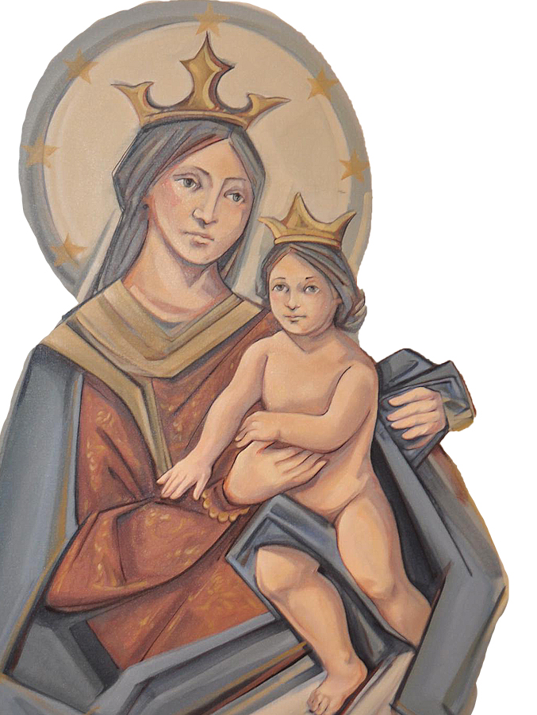
THANK YOU
CÁM ƠN
MARAMING SALAMAT PO
MUCHAS GRACIAS
நன்றி (Nanri)

