Slide 1
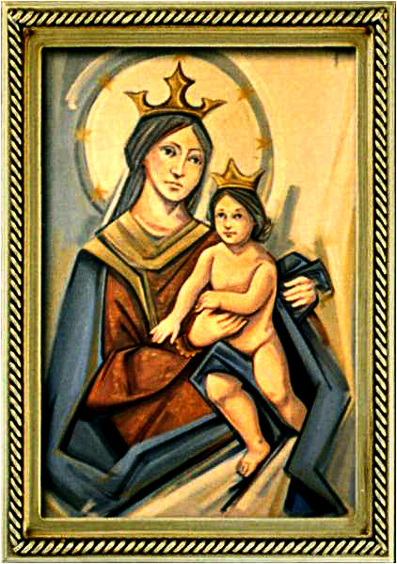
Ordinary Time 19 Year C
Gather Hymn:
Praise, My Soul, The King of Heaven
Responsorial Psalm: 33
Blessed the People The People
Prep. of the Gifts Hymn:
We Walk by Faith
Communion Hymn:
Eat This Bread.
I have loved you.
Recessional Hymn:
There’s Wideness in God’s Mercy

Slide 2
1. Praise, my soul, the King of heaven;
to his feet your tribute bring.
Ransomed, healed, restored, forgiven,
evermore his praises sing.
Alleluia, alleluia!
Praise the everlasting King!

Slide 3
2. Praise him for his grace and favor to his people in distress.
Praise him, still the same as ever,
slow to chide, and swift to bless.
Alleluia, alleluia!
Glorious in his faithfulness!

Slide 4
Penitential Act (Confiteor 2011) 1 of 3:

Slide 5
I confess to almighty God and to you, my brothers and sisters, that I have greatly sinned, in my thoughts and in my words,

Slide 6
in what I have done
and in what I have failed to do,
through my fault,
through my fault,
through my most grievious fault;

Slide 7
therefore I ask blessed Mary ever-Virgin, all the Angels and Saints, and you, my brothers and sisters, to pray for me to the Lord our God.

Slide 8
Gloria Hymn

Slide 9
Refrain:
Glory to God, Glory to God. Glory to God in the highest, and on earth, peace on earth, peace to people of good will

Slide 10
1. We praise you, we bless you, we adore you, we glorify you, we give you thanks for your great glory. Lord God, heavenly King, O God, almighty Father.

Slide 11
Refrain:
Glory to God, Glory to God. Glory to God in the highest, and on earth, peace on earth, peace to people of good will

Slide 12
2. Lord Jesus Christ, only Begotten Son, Lord God, Lamb of God, Son of the Father, you take away the sins of the world, have mercy on us. You take way the sins of the world, receive our pray you are seated at the right hand, the right hand of the Father, have mercy on us

Slide 13
Refrain:
Glory to God, Glory to God. Glory to God in the highest, and on earth, peace on earth, peace to people of good will

Slide 14
3. For you alone are the Holy One, you alone are the Lord, you alone are the Most High, Jesus Christ with the Holy Spirit, in the glory of God the Father.

Slide 15
Refrain:
Glory to God, Glory to God. Glory to God in the highest, and on earth, peace on earth, peace to people of good will. Amen Amen.

Slide 16
Responsorial Psalm: 33
Blessed the people the Lord has chosen

Slide 17
Responsorial Psalm: Psalm 33
Blessed the people the Lord has chosen, to be his own.

Slide 18
Gospel Acclamation

Slide 19
Alleluia Alleluia Alleluia.
Stay awake and be ready!
For you do not know on what day your Lord will come.

Slide 20
Profession Of Faith
Creed

Slide 21
Nicene Creed p1
I believe in one God, the Father almighty, maker of heaven and earth, of all things visible and invisible.

Slide 22
Nicene Creed p2
I believe in one Lord Jesus Christ, the Only Begotten Son of God, born of the Father before all ages.

Slide 23
Nicene Creed p3
God from God, Light from Light, true God from true God, begotten, not made, consubstantial with the Father; through Him all things were made.

Slide 24
Nicene Creed p4
For us men and for our salvation He came down from heaven, and by the Holy Spirit was incarnate of the Virgin Mary, and became man.

Slide 25
Nicene Creed p5
For our sake He was crucified under Pontius Pilate, He suffered death and was buried, and rose again on the third day in accordance with the Scriptures.

Slide 26
Nicene Creed p6
He ascended into heaven and is seated at the right hand of the Father.

Slide 27
Nicene Creed p7
He will come again in glory to judge the living and the dead and His kingdom will have no end.

Slide 28
Nicene Creed p8
I believe in the Holy Spirit, the Lord, the giver of life, who proceeds from the Father and the Son,

Slide 29
Nicene Creed p9
who with the Father and the Son is adored and glorified, who has spoken through the prophets.

Slide 30
Nicene Creed p10
I believe in one, holy, catholic and apostolic Church. I confess one Baptism for the forgiveness of sins

Slide 31
Nicene Creed p11
and I look forward to the resurrection of the dead and the life of the world to come. Amen.

Slide 32
Preparation of The Gift Song:
We Walk by Faith

Slide 33
1. We walk by faith and not by sight: No gracious words we hear, Of Him who as none ever spoke.
Yet we believe Him near

Slide 34
2. We may not touch His hands and side Or follow where He trod Yet in His promise we rejoice And cry "My Lord and God"

Slide 35
3. Help then, oh Lord, our unbelief And our faith abound To call on you when you are near And seek where you are found

Slide 36
4. That when our life of faith is done In realms of clearer light We may behold you as you are In full and endless sight

Slide 37
Holy Holy

Slide 38
Holy, Holy, Holy Lord God of hosts.
Heaven and earth are full, are full of your glory. Hosanna, Hosanna! Hosanna in the highest.

Slide 39
Blessed is he who comes, who comes in the name of the Lord.
Hosanna, Hosanna! Hosanna in the highest.

Slide 40
Memorial Acclamation

Slide 41
We proclaim your Death, O Lord,
and profess your Resurrection until you come again.

Slide 42
Amen

Slide 43
Amen, Amen.
Amen, Amen
Amen, Amen
Amen. Amen.

Slide 44
Lamb Of God

Slide 45
Lamb of God your take away the sins of the world. Have mercy on us. (repeat as needed)
Lamb of God your take away the sins of the world.
grant us peace.

Slide 46
Communion respond

Slide 47
Behold the Lamb of God,
behold him who takes away the sins of the world.
Blessed are those called to the supper of the Lamb.
Lord, I am not worthy
that You should enter under my roof, but only say the word and my soul shall be healed.

Slide 48
Communion Hymn 1:
Eat This Bread

Slide 49
Refrain. Eat this bread drink this cup come to me and never be hungry Eat this bread, drink this cup, trust in me and you will not thirst.
1. I am the bread of life, the true bread sent from the Father.

Slide 50
Refrain. Eat this bread drink this cup come to me and never be hungry Eat this bread, drink this cup, trust in me and you will not thirst.
2. Your Ancestors are manna in the desert but this is the bread come down from heaven.

Slide 51
Refrain. Eat this bread drink this cup come to me and never be hungry Eat this bread, drink this cup, trust in me and you will not thirst.
3. Eat my flesh and drink my blood, and I will raise you up on the last day.

Slide 52
Refrain. Eat this bread drink this cup come to me and never be hungry Eat this bread, drink this cup, trust in me and you will not thirst.
4. Anyone who eats this bread, will live forever.

Slide 53
Refrain. Eat this bread drink this cup come to me and never be hungry Eat this bread, drink this cup, trust in me and you will not thirst.
5. If you believe and eat this bread, you will have eternal life.

Slide 54
Communion Hymn 2:
I have loved you

Slide 55
I have loved you with an everlasting love,
I have called you and you are mine. (2x)
1. Seek the face of the Lord and long for him:
He will bring you his light and his peace.

Slide 56
I have loved you with an everlasting love,
I have called you and you are mine. (2x)
2. Seek the face of the Lord and long for him:
He will bring you his joy and his hope.

Slide 57
I have loved you with an everlasting love,
I have called you and you are mine. (2x)
3. Seek the face of the Lord and long for him:
He will bring you his care and his love.

Slide 58
Announcements:

Slide 59
1. Today’s second collection is for the Pastoral Solidarity Fund for the Church in Africa. Thank you for your generosity and support, your gift is a sign of your solidarity with our brothers and sisters in faith in Africa.

Slide 60
2. We are pleased to announce that the registration period has been extended through August 31, 2025.
Families wishing to enroll their children or youth in the following programs:
• First Communion
• Confirmation (Grades 9-12)
• OCIA for Adults
• OCIC for children (ages 7 and older)

Slide 61
must present the following original documents at the time of registration:
Birth Certificate
Baptismal Certificate
First Communion Certificate (if the sacrament has already been received)

Slide 62
For more information or to register, please contact Arturo Reyes at 408-715-2276.
We thank all families for their commitment to growing in faith and sharing the journey with our parish community.

Slide 63
3. The Assumption of the Blessed Virgin Mary is next Friday August 15th and is a holy day of obligation.
Thursday August 14th –
6:30pm Vigil Mass in English.
Friday August 15th –
8:00 AM Mass in Vietnamese.
9:00 AM Mass in Spanish,
7:00 PM Mass in Spanish.

Slide 64
4. Last week, our Sunday collections for the parish totaled $15,320 dollars, which includes $5,661 dollars of the second collection for the building fund.
The parish week-to-week financial report is available on the parish webpage and the weekly bulletin.

Slide 66
Ending Hymn:
There’s a wideness in God’s Mervy

Slide 67
1. There's a wideness in God's mercy like the wideness of the sea; there's a kindness in his justice, which is more than liberty. There is plentiful redemption. In the blood that has been shed; There is joy for all the members. In the sorrows of the Head.

Slide 68
2 For the love of God is broader.
Than the measures of our mind.
And the heart of the Eternal
is most wonderfully kind.
If our love were but more simple. We should take him at his word, and our lives would be thanksgiving. For the goodness of our Lord.

Slide 69
Ending Hymn:
Lady Of Fatima

Slide 70
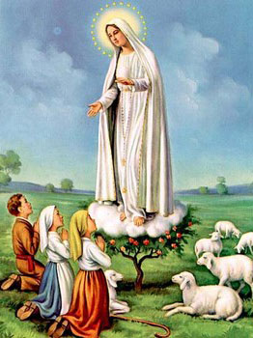
1. Dear Lady of Fatima we come on bended knee To beg your intercession for peace and unity. Dear Mary won't you show us the right and shining way? We pledge our love and offer you a Rosary each day.

Slide 71
2. You promised at Fatima Each time that you appeared To help us If we pray to you to banish war and fear. Dear Lady on first days we ask your guiding hand for grace and guidance here on earth protection for our land.

Slide 72
Ending Hymn:
On This Day

Slide 73
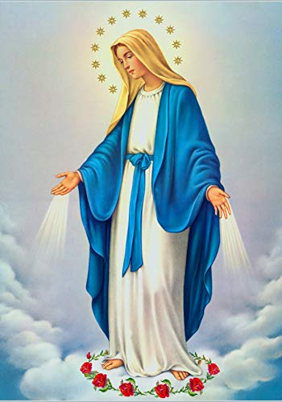
**. On this day, O beautiful Mother, On this day we give thee our love. Near the, Madonna, fondly we hover, Trusting thy gentle care to prove.

Slide 74
1. On this day we ask to share, Dearest Mother, thy sweet care; Aid us ere our feet astray Wanner from thy guiding way.

Slide 75
**. On this day, O beautiful Mother, On this day we give thee our love. Near the, Madonna, fondly we hover, Trusting thy gentle care to prove.

Slide 76
2. Queen of angels, deign to hear. Lisping children's humble prayer; Young hearts gain, O virgin pure, Sweetly to thyself allure.

Slide 77
THANK YOU
CÁM ƠN
MARAMING SALAMAT PO
MUCHAS GRACIAS
  நன்றி (Naṉṟi)

Slide 78
THANK YOU
CÁM ƠN
MARAMING SALAMAT PO
MUCHAS GRACIAS
  நன்றி (Naṉṟi)

