Slide 1
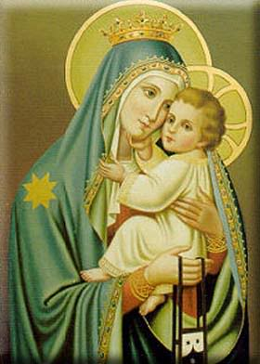
Solemnity of the Blessed Virgin Mary, the Mother of God
Gather Song:
Immaculate Mary
Responsorial Psalm 067:
May God Bless Us
Prep. of the Gifts:
On This Day Beautiful of Mother
Away in the Manger
Communion Song :
Silent Night.
Ave Maria (Mary sing the joyful song)
Recessional:
Joy to the World

Slide 2
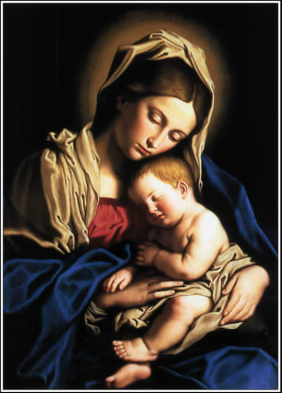
1. Immaculate Marry, your praises we sing. You reign now in heaven with Jesus our King. Refrain: Ave, ave, ave Maria Ave, ave, ave Maria.

Slide 3
2. Del cielo^ha bajado la Madre de Dios. Cantemos el Ave a su concepción. refrain: Ave, ave, ave Maria Ave, ave, ave Maria.

Slide 4
3. In heaven the bless-ed your glory proclaim; On earth we your children in-voke your fair name. refrain: Ave, ave, ave Maria Ave, ave, ave Maria.

Slide 5
4. Virgen sin manchar, oh Madre de amor El ángel te ofrezca mi salutación. refrain: Ave, ave, ave Maria Ave, ave, ave Maria.

Slide 6
5. We pray for our Mother the Church upon earth. And bless, Holy Mary, the land of our birth. refrain: Ave, ave, ave Maria Ave, ave, ave Maria.

Slide 7
Penitential Act (Confiteor 2011) 1 of 3:

Slide 8
I confess to almighty God and to you, my brothers and sisters, that I have greatly sinned, in my thoughts and in my words,

Slide 9
in what I have done and in what I have failed to do, through my fault,
through my fault, through my most grievious fault;

Slide 10
therefore I ask blessed Mary ever-Virgin, all the Angels and Saints, and you, my brothers and sisters, to pray for me to the Lord our God.

Slide 11
Kyrie

Slide 12
Cantor: Kyrie, Kyrie Eleison.

Slide 13
All: Kyrie, Kyrie Eleison.

Slide 14
Cantor: Christe, Christe, Eleison.

Slide 15
All: Christe, Christe eleison.

Slide 16
Cantor: Kyrie, Kyrie Eleison.

Slide 17
All: Kyrie, Kyrie Eleison.

Slide 18
Christmas Gloria Page 3

Slide 19
Refrain. Glo..........ria
In excelsis Deo.
Glo..........ria
In excelsis Deo.

Slide 20
1. We praise you, we bless you, we adore you, we glorify you, we give you thanks for your great glory. Lord God, heavenly King, O God, almighty Father.

Slide 21
Refrain. Glo..........ria
In excelsis Deo.
Glo..........ria
In excelsis Deo.

Slide 22
2. Lord Jesus Christ, only Begotten Son, Lord God, Lamb of God, Son of the Father, you take away the sins of the world, have mercy on us. You take way the sins of the world, receive our pray you are seated at the right hand, the right hand of the Father, have mercy on us

Slide 23
Refrain. Glo..........ria
In excelsis Deo.
Glo..........ria
In excelsis Deo.

Slide 24
3. For you alone are the Holy One, you alone are the Lord, you alone are the Most High, Jesus Christ with the Holy Spirit, in the glory of God the Father.

Slide 25
Refrain. Glo..........ria
In excelsis Deo.
Glo..........ria
In excelsis Deo.

Slide 26
Reading I
Numbers 6:22-27

Slide 27
En aquel tiempo, el Señor habló a Moisés y le dijo: “Di a Aarón y a sus hijos: De esta manera bendecirán a los israelitas:
The LORD said to Moses: “Speak to Aaron and his sons and tell them: This is how you shall bless the Israelites. Say to them:

Slide 28
El Señor te bendiga y te proteja, haga resplandecer su rostro sobre ti y te conceda su favor.
The LORD bless you and keep you! The LORD let his face shine upon you, and be gracious to you!

Slide 29
Que el Señor te mire con benevolencia y te conceda la paz’. Así invocarán mi nombre sobre los israelitas y yo los bendeciré”..
The LORD look upon you kindly and give you peace! So shall they invoke my name upon the Israelites, and I will bless them.”

Slide 30
Responsorial Psalm: Psalm 67 May God bless us in his mercy

Slide 31
Refrain:
May God bless us in his mercy.
May God bless us in his mercy.

Slide 32
Reading 2
Galatians 4:4-7

Slide 33
When the fullness of time had come, God sent his Son, born of a woman, born under the law, to ransom those under the law, so that we might receive adoption as sons.
Hermanos: Al llegar la plenitud de los tiempos, envió Dios a su Hijo, nacido de una mujer, nacido bajo la ley, para rescatar a los que estábamos bajo la ley, a fin de hacernos hijos suyos.

Slide 34
As proof that you are sons, God sent the Spirit of his Son into our hearts, crying out, “Abba, Father!” So you are no longer a slave but a son, and if a son then also an heir, through God.
Puesto que ya son ustedes hijos, Dios envió a sus corazones el Espíritu de su Hijo, que clama “¡Abbá!”, es decir, ¡Padre! Así que ya no eres siervo, sino hijo; y siendo hijo, eres también heredero por voluntad de Dios.

Slide 35
Gospel Acclamation

Slide 36
Refrain: Alleluia!

Slide 37
Gospel
Luke 2:16-21

Slide 38
The shepherds went in haste to Bethlehem and found Mary and Joseph, and the infant lying in the manger. When they saw this, they made known the message that had been told them about this child.
En aquel tiempo, los pastores fueron a toda prisa hacia Belén y encontraron a María, a José y al niño, recostado en el pesebre. Después de verlo, contaron lo que se les había dicho de aquel niño,

Slide 39
All who heard it were amazed by what had been told them by the shepherds. And Mary kept all these things, reflecting on them in her heart. Then the shepherds returned,
María, por su parte, guardaba todas estas cosas y las meditaba en su corazón. Los pastores se volvieron a sus campos, alabando y glorificando a Dios por todo cuanto habían visto y oído, según lo que se les había anunciado.

Slide 40
glorifying and praising God for all they had heard and seen, just as it had been told to them. When eight days were completed for his circumcision, he was named Jesus, the name given him by the angel before he was conceived in the womb.
Cumplidos los ocho días, circuncidaron al niño y le pusieron el nombre de Jesús, aquel mismo que había dicho el ángel, antes de que el niño fuera concebido.

Slide 41
Profession Of Faith Creed

Slide 42
Nicene Creed p1
I believe in one God, the Father almighty, maker of heaven and earth, of all things visible and invisible.

Slide 43
Nicene Creed p2
I believe in one Lord Jesus Christ, the Only Begotten Son of God, born of the Father before all ages.

Slide 44
Nicene Creed p3
God from God, Light from Light, true God from true God, begotten, not made, consubstantial with the Father; through Him all things were made.

Slide 45
Nicene Creed p4
For us men and for our salvation He came down from heaven, and by the Holy Spirit was incarnate of the Virgin Mary, and became man.

Slide 46
Nicene Creed p5
For our sake He was crucified under Pontius Pilate, He suffered death and was buried, and rose again on the third day in accordance with the Scriptures.

Slide 47
Nicene Creed p6
He ascended into heaven and is seated at the right hand of the Father.

Slide 48
Nicene Creed p7
He will come again in glory to judge the living and the dead and His kingdom will have no end.

Slide 49
Nicene Creed p8
I believe in the Holy Spirit, the Lord, the giver of life, who proceeds from the Father and the Son,

Slide 50
Nicene Creed p9
who with the Father and the Son is adored and glorified, who has spoken through the prophets.

Slide 51
Nicene Creed p10
I believe in one, holy, catholic and apostolic Church. I confess one Baptism for the forgiveness of sins

Slide 52
Nicene Creed p11
and I look forward to the resurrection of the dead and the life of the world to come. Amen.

Slide 53
Preparation of The Gift Song: On This Day - Away in the manger

Slide 54
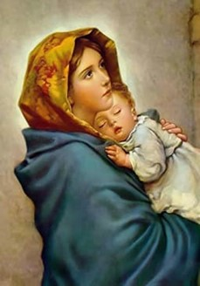
**. On this day, O beautiful Mother, On this day we give thee our love. Near the, Madonna, fondly we hover, Trusting thy gentle care to prove.

Slide 55
1. On this day we ask to share, Dearest Mother, thy sweet care; Aid us ere our feet astray Wanner from thy guiding way.

Slide 56
**. On this day, O beautiful Mother, On this day we give thee our love. Near the, Madonna, fondly we hover, Trusting thy gentle care to prove.

Slide 57
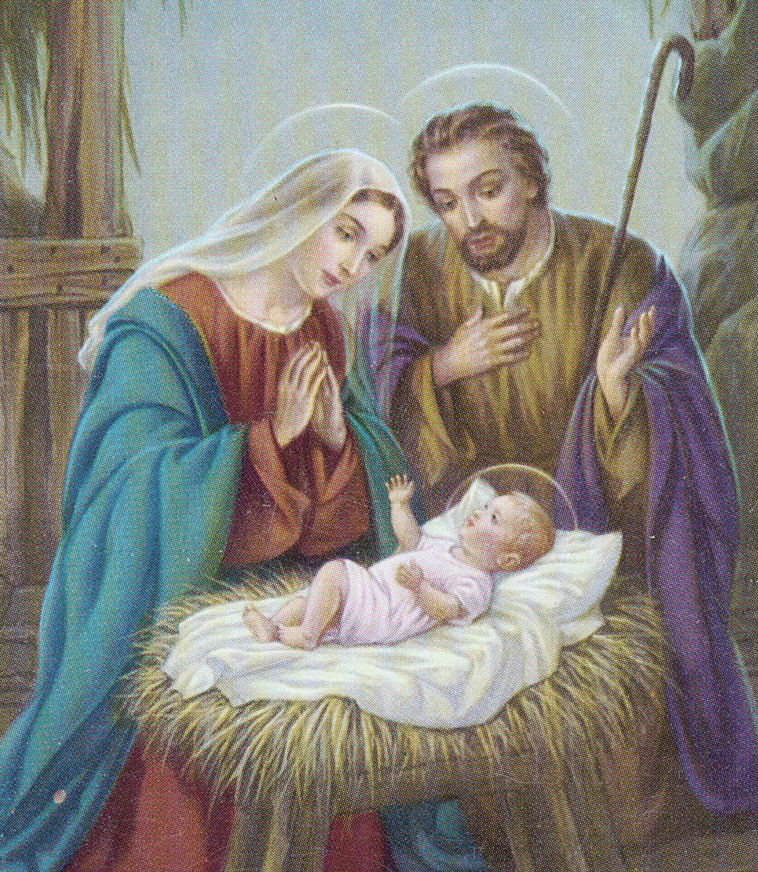
1a. Away in a manger, no crib or a bed, The little Lord Jesus laid down his sweet head.

Slide 58
1b. The stars in the bright sky looked down where he lay, The little Lord Jesus, asleep on the hay.

Slide 59
2a. The cattle are lowing, the baby awakes, But little Lord Jesus, no crying he makes.

Slide 60
2b. I love thee, Lord Jesus! Look down from the sky And stay by my side until morning is nigh.

Slide 61
3a. Be near me, Lord Jesus! I ask thee to stay Close by me forever, and love me, I pray.

Slide 62
3b. Bless all the dear children in thy tender care, And fit us for heaven, to live with thee there.

Slide 63
Holy Holy

Slide 64
Holy, Holy, Holy Lord God of hosts. Heaven and earth are full, are full of your glory. Hosanna, Hosanna! Hosanna in the highest.

Slide 65
Blessed is he who comes, who comes in the name of the Lord. Hosanna, Hosanna! Hosanna in the highest.

Slide 66
Memorial Acclamation

Slide 67
*Anunciamos tu muerte, Señor, proclamamos tu resurreción. Ven Señor Jesus, Señor Jesus. (2x)

Slide 68
Amen

Slide 69
Amen, Amen. Amen, Amen Amen, Amen
Amen. Amen.

Slide 70
Lamb Of God

Slide 71
Lamb of God you take away the sins of the world. Have mercy on us. (repeat as needed)
Lamb of God you take away the sins of the world.
grant us peace.

Slide 72
Cordero de Dios

Slide 73
* Cordero de Dios que quitas el pe cado del mundo, te ple dad de nosotros, ten pel dad de nosotros. * Cordero de Dios que quitas el pe cado del mundo, te ple dad de nosotros, ten pel dad de nosotros.

Slide 74
* Cordero de Dios que quitas el pe cado del mundo, danos la paz, danos la paz, danos, danos, danos la paz, danos, danos, danos la paz.

Slide 75
Communion respond

Slide 76
Behold the Lamb of God,
behold him who takes away the sins of the world.
Blessed are those called to the supper of the Lamb. Lord, I am not worthy
that You should enter under my roof, but only say the word and my soul shall be healed.

Slide 77
Communion Song : Silent Night – Noche de Paz

Slide 78
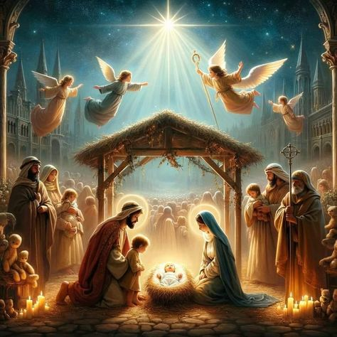
1a: Silent night, holy night, All is calm, All is bright Round yon Virgin Mother and Child.

Slide 79
1b: Holy Infant so tender and mild. Sleep in heavenly peace. Sleep in heavenly peace.

Slide 80
2a: Noche de paz, noche de amor. Todo duerme en derredor. Entre los astros que esparcen su luz,

Slide 81
2b: bella anunciando al niñito Jesús, brilla la estrella de paz, brilla la estrella de paz.

Slide 82
3a: Silent night, holy night, Shepherds quake all the sight: Glories stream from heaven afar,

Slide 83
3b: Heavenly hosts sing alleluia: Christ the Savior is born! Christ the Savior is born!

Slide 84
4a: Noche de paz, Noche de_amor; Mira qué gran resplandor. Luce_en el ros-tro del Nino Jesús

Slide 85
4b: En el pesebre del mundo la luz, brilla la estrella de paz, brilla la estrella de paz.

Slide 86
5a: Silent night, holy night, Son of God love’s pure light Radiant beams from thy holy face,

Slide 87
5b: With the dawn of redeeming grace, Jesus Lord at thy birth, Jesus Lord at they birth.

Slide 88
6a: Noche de paz, Noche de_amor; Al Divino Salvador Que por nosotros na-ció_en un portal.

Slide 89
6b: Himnos cantemos de_amor celestial. ;Gloria por siempre_al Senor! ;Gloria por siempre_al Senor

Slide 90
Communion Song : Angels We Have Heard on High Page 14

Slide 91
1. Angels we have heard on high. Sweetly singing o’er the plains.
And mountains in reply. Echo back their joyous strains.

Slide 92
Refrain: Glo………ria.
In excelsis Deo!
Glo………ria.
In excelsis Deo!

Slide 93
2. Shepherds, why this jubilee? Why your joyous strains prolong? Say what may the tidings be, Which inspire your heav’nly song.

Slide 94
Refrain: Glo………ria.
In excelsis Deo!
Glo………ria.
In excelsis Deo!

Slide 95
3. Come to Bethlehem and see, Him whose birth the angels sing; Come, adore on bended knee, Christ, the Lord, the newborn King.

Slide 96
Refrain: Glo………ria.
In excelsis Deo!
Glo………ria.
In excelsis Deo!

Slide 97
4. See him in a manger laid; Whom the angels praise above; Mary, Joseph, lend your aid, While we raise our hearts in love.

Slide 98
Refrain: Glo………ria.
In excelsis Deo!
Glo………ria.
In excelsis Deo!

Slide 99
Communion Song 2: Silent Night Page 12

Slide 100
1: Silent night, holy night, All is calm, All is bright Round yon Virgin Mother and Child. Holy Infant so tender and mild. Sleep in heavenly peace. Sleep in heavenly peace.

Slide 101
2: Silent night, holy night, Shepherds quake all the sight: Glories stream from heaven afar, Heavenly hosts sing alleluia: Christ the Savior is born! Christ the Savior is born!

Slide 102
3: Silent night, holy night, Son of God love’s pure light Radiant beams from thy holy face, With the dawn of redeeming grace, Jesus Lord at thy birth, Jesus Lord at they birth.

Slide 103
Recessional Hymn: Angels we have heard on high.

Slide 104
1. Angels we have heard on high. Sweetly singing o’er the plains.
And mountains in reply. Echo back their joyous strains.

Slide 105
Refrain: Glo………ria.
In excelsis Deo!
Glo………ria.
In excelsis Deo!

Slide 106
2. Shepherds, why this jubilee? Why your joyous strains prolong? Say what may the tidings be, Which inspire your heav’nly song.

Slide 107
Refrain: Glo………ria.
In excelsis Deo!
Glo………ria.
In excelsis Deo!

Slide 108
3. Come to Bethlehem and see, Him whose birth the angels sing; Come, adore on bended knee, Christ, the Lord, the newborn King.

Slide 109
Refrain: Glo………ria.
In excelsis Deo!
Glo………ria.
In excelsis Deo!

Slide 110
Recessional Hymn: Joy To The World

Slide 111
1. Joy to the world! the Lord is come; Let earth receive her King; Let ev'ry heart prepare him room, And heav'n and nature sing, and heav'n and nature sing, And heav'n, and heav'n and nature sing.

Slide 112
2. Joy to the world! the Savior reigns; Let us our songs employ; While fields and floods, rocks, hills and plains Repeat the sounding joy, repeat the sounding joy, Repeat, repeat the sounding joy.

Slide 113
We wish you a Merry Christmas
We wish you a Merry Christmas
We wish you a Merry Christmas
And the happy new year (x2)
And the happy ….. New … Year……

Slide 114
We wanna wish you a Merry Christmas. We wanna wish you a Merry Christmas We wanna wish you a Merry Christmas From the bottom of my heart.

Slide 115
We wanna wish you a Merry Christmas. We wanna wish you a Merry Christmas We wanna wish you a Merry Christmas From the bottom of my heart.
From my heart / From my heart.

Slide 116
THANK YOU
CÁM ƠN
MARAMING SALAMAT PO
MUCHAS GRACIAS
AND
Merry Christmas

