Slide 1
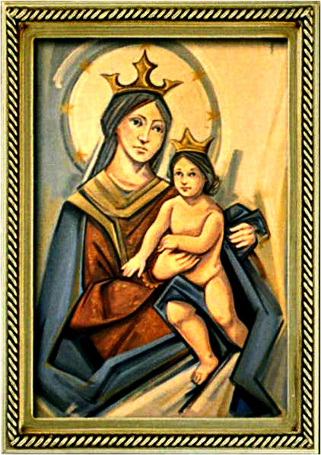
Easter Sunday 6
Gather Hymn:
Come, Christians, Join to Sing
Sprinkling Rite Hymn:
Water Of Life
Responsorial Psalm: 67
O God, Let All the Nations Praise you
Prep. of the Gifts Hymn:
One Sacrufuce Of Christ
Communion Hymn:
Spirit and Grace
Recessional Hymn:
America The Beautif

Slide 2
1 Come, Christians, join to sing Alleluia! Amen!
loud praise to Christ our King; Alleluia! Amen!
let all, with heart and voice, before his throne rejoice; praise is his gracious choice: Alleluia! Amen!

Slide 3
2 Come, lift your hearts on high, Alleluia! Amen!
let praises fill the sky;
Alleluia! Amen!
he is our guide and friend,
to us he'll condescend;
his love shall never end:
Alleluia! Amen!

Slide 4
3 Praise yet our Christ again;
Alleluia! Amen!
life shall not end the strain;
Alleluia! Amen!
on heaven’s blissful shore,
his goodness we’ll adore,
singing forevermore,
"Alleluia! Amen!"

Slide 5
Penitential Act (Confiteor 2011) 1 of 3:

Slide 6
I confess to almighty God and to you, my brothers and sisters, that I have greatly sinned, in my thoughts and in my words,

Slide 7
in what I have done
and in what I have failed to do,
through my fault,
through my fault,
through my most grievious fault;

Slide 8
therefore I ask blessed Mary ever-Virgin, all the Angels and Saints, and you, my brothers and sisters, to pray for me to the Lord our God.

Slide 9
Water of Life

Slide 10
Water of life, holy reminder; touching, renewing the body of Christ. Water of life, holy reminder; touching, renewing the body of life.

Slide 11
4. All generations, com forth and receive the blessing of this holy water; making us one with the God who forgives, the one who is faithful and just.

Slide 12
Water of life, holy reminder; touching, renewing the body of Christ. Water of life, holy reminder; touching, renewing the body of life.

Slide 13
5. Bringing new hope to the children of God, regardless of color or story; Cleansing our spirits with kindness and truth, and keeping the promise a live

Slide 14
Water of life, holy reminder; touching, renewing the body of Christ. Water of life, holy reminder; touching, renewing the body of life.

Slide 15
5. Deep as the heavens and wide as the sea, your mercy and love have no ending. Guiding our steps in the journey of faith, you show us the way to your king dom.

Slide 16
Gloria Hymn

Slide 17
Refrain:
Glory to God, Glory to God. Glory to God in the highest, and on earth, peace on earth, peace to people of good will

Slide 18
1. We praise you, we bless you, we adore you, we glorify you, we give you thanks for your great glory. Lord God, heavenly King, O God, almighty Father.

Slide 19
Refrain:
Glory to God, Glory to God. Glory to God in the highest, and on earth, peace on earth, peace to people of good will

Slide 20
2. Lord Jesus Christ, only Begotten Son, Lord God, Lamb of God, Son of the Father, you take away the sins of the world, have mercy on us. You take way the sins of the world, receive our pray you are seated at the right hand, the right hand of the Father, have mercy on us

Slide 21
Refrain:
Glory to God, Glory to God. Glory to God in the highest, and on earth, peace on earth, peace to people of good will

Slide 22
3. For you alone are the Holy One, you alone are the Lord, you alone are the Most High, Jesus Christ with the Holy Spirit, in the glory of God the Father.

Slide 23
Refrain:
Glory to God, Glory to God. Glory to God in the highest, and on earth, peace on earth, peace to people of good will. Amen Amen.

Slide 24
Responsorial Psalm: Psalm 67
O God, Let All The Nation Praise You

Slide 25
Responsorial Psalm: Psalm 69
O God let all the nations praise you, let all the nations praise you.

Slide 26
Gospel Acclamation

Slide 27
Alleluia Alleluia Alleluia.
Whoever loves me will keep my word, says the Lord, and my Father will love him and we will come to him.

Slide 28
Profession Of Faith
Creed

Slide 29
Nicene Creed p1
I believe in one God, the Father almighty, maker of heaven and earth, of all things visible and invisible.

Slide 30
Nicene Creed p2
I believe in one Lord Jesus Christ, the Only Begotten Son of God, born of the Father before all ages.

Slide 31
Nicene Creed p3
God from God, Light from Light, true God from true God, begotten, not made, consubstantial with the Father; through Him all things were made.

Slide 32
Nicene Creed p4
For us men and for our salvation He came down from heaven, and by the Holy Spirit was incarnate of the Virgin Mary, and became man.

Slide 33
Nicene Creed p5
For our sake He was crucified under Pontius Pilate, He suffered death and was buried, and rose again on the third day in accordance with the Scriptures.

Slide 34
Nicene Creed p6
He ascended into heaven and is seated at the right hand of the Father.

Slide 35
Nicene Creed p7
He will come again in glory to judge the living and the dead and His kingdom will have no end.

Slide 36
Nicene Creed p8
I believe in the Holy Spirit, the Lord, the giver of life, who proceeds from the Father and the Son,

Slide 37
Nicene Creed p9
who with the Father and the Son is adored and glorified, who has spoken through the prophets.

Slide 38
Nicene Creed p10
I believe in one, holy, catholic and apostolic Church. I confess one Baptism for the forgiveness of sins

Slide 39
Nicene Creed p11
and I look forward to the resurrection of the dead and the life of the world to come. Amen.

Slide 40
Gift
One Sacrifice of Christ

Slide 41
1a. One sacrifice of Christ,
one throne above the heavens.
Christ has risen as he said,
and will come to wake the dead. Christ will return to set us free.

Slide 42
1b. One sacrifice of love,
one message for the nations: Jesus suffered, died and rose, and ascended to the throne. Christ will return to save the world.

Slide 43
2a. One gaze we lift above,
where Love was drawn to heaven.
We stand watchful through the night
for our King to come in light,
heirs to the glory of the Lamb.

Slide 44
2b. One mighty Word of truth:
Christ did arise in triumph.
Now he sits upon the throne;
God’s right hand is he alone.
Christ reigns in splendor over all.

Slide 45
3a. One banquet richly set
for all God’s holy people.
We will dine in joy and peace, and our song will never cease, praising the Lamb upon the throne.

Slide 46
3b. One shout of joy we raise, one voice in exaltation. For in glory Christ has gone, and in hope we now are drawn to one sacrifice of Christ, one sacrifice of Christ.

Slide 47
Holy Holy

Slide 48
Holy, Holy, Holy Lord God of hosts.
Heaven and earth are full, are full of your glory. Hosanna, Hosanna! Hosanna in the highest.

Slide 49
Blessed is he who comes, who comes in the name of the Lord.
Hosanna, Hosanna! Hosanna in the highest.

Slide 50
Memorial Acclamation

Slide 51
We proclaim your Death, O Lord,
and profess your Resurrection until you come again.

Slide 52
Amen

Slide 53
Amen, Amen.
Amen, Amen
Amen, Amen
Amen. Amen.

Slide 54
Lamb Of God

Slide 55
Lamb of God your take away the sins of the world. Have mercy on us. (repeat as needed)
Lamb of God your take away the sins of the world.
grant us peace.

Slide 56
Communion respond

Slide 57
Behold the Lamb of God,
behold him who takes away the sins of the world.
Blessed are those called to the supper of the Lamb.
Lord, I am not worthy
that You should enter under my roof, but only say the word and my soul shall be healed.

Slide 58
Communion Hymn 1:
Spirit and Grace

Slide 59
1. Spirit and grace, here in this meal; you are the wind that breathes through the field Gather the wheat and form us in Christ. Come, be our source and breath of life

Slide 60
Refrain: In the bread, blessed, broken and shared. Christ is our life, whose presence we bear Come, O spirit, make your grace revealed. in this holy meal.

Slide 61
2. Spirit and grace, here in this meal; you are the life: that flows through the wine. Gather this drink and form us in Christ. Come, be our source and blood of life.

Slide 62
Refrain: In the bread, blessed, broken and shared. Christ is our life, whose presence we bear Come, O spirit, make your grace revealed. in this holy meal.

Slide 63
3. Spirit and grace, here in this place; you are the light that shines in this space. Gather your people and form us in Christ. Come, be the heartbeat of our lives.

Slide 64
Refrain: In the bread, blessed, broken and shared. Christ is our life, whose presence we bear Come, O spirit, make your grace revealed. in this holy meal.

Slide 65
Announcements:

Slide 66
1. (12 PM Mass ONLY) Today’s second collection is for Catholic Charities. We invite Lucia Carrillo to step forward and use the microphone to talk to you more about the Catholic Charities organization.

Slide 67
2. We are happy to report on the fourteenth week of ADA 2025 campaign results with 5 families pledging a total amount of $1,480 dollars, for a total pledged amount of $146,505 dollars.

Slide 68
Given this result we are $62,103 dollars above the diocesan’s goal of $84,402 dollars, so thanks to all of you who already made your pledge.

Slide 69
We still want to encourage 100% participation from all families attending Masses here, because all new pledges received from now on will be reimbursed to our parish. Thank you all for your support.

Slide 70
3- Last week, our Sunday collections for the parish totaled $11,113 dollars. The parish week-to-week financial report is available on the parish webpage and the weekly bulletin.

Slide 71
Ending Hymn:
America The Beautiful

Slide 72
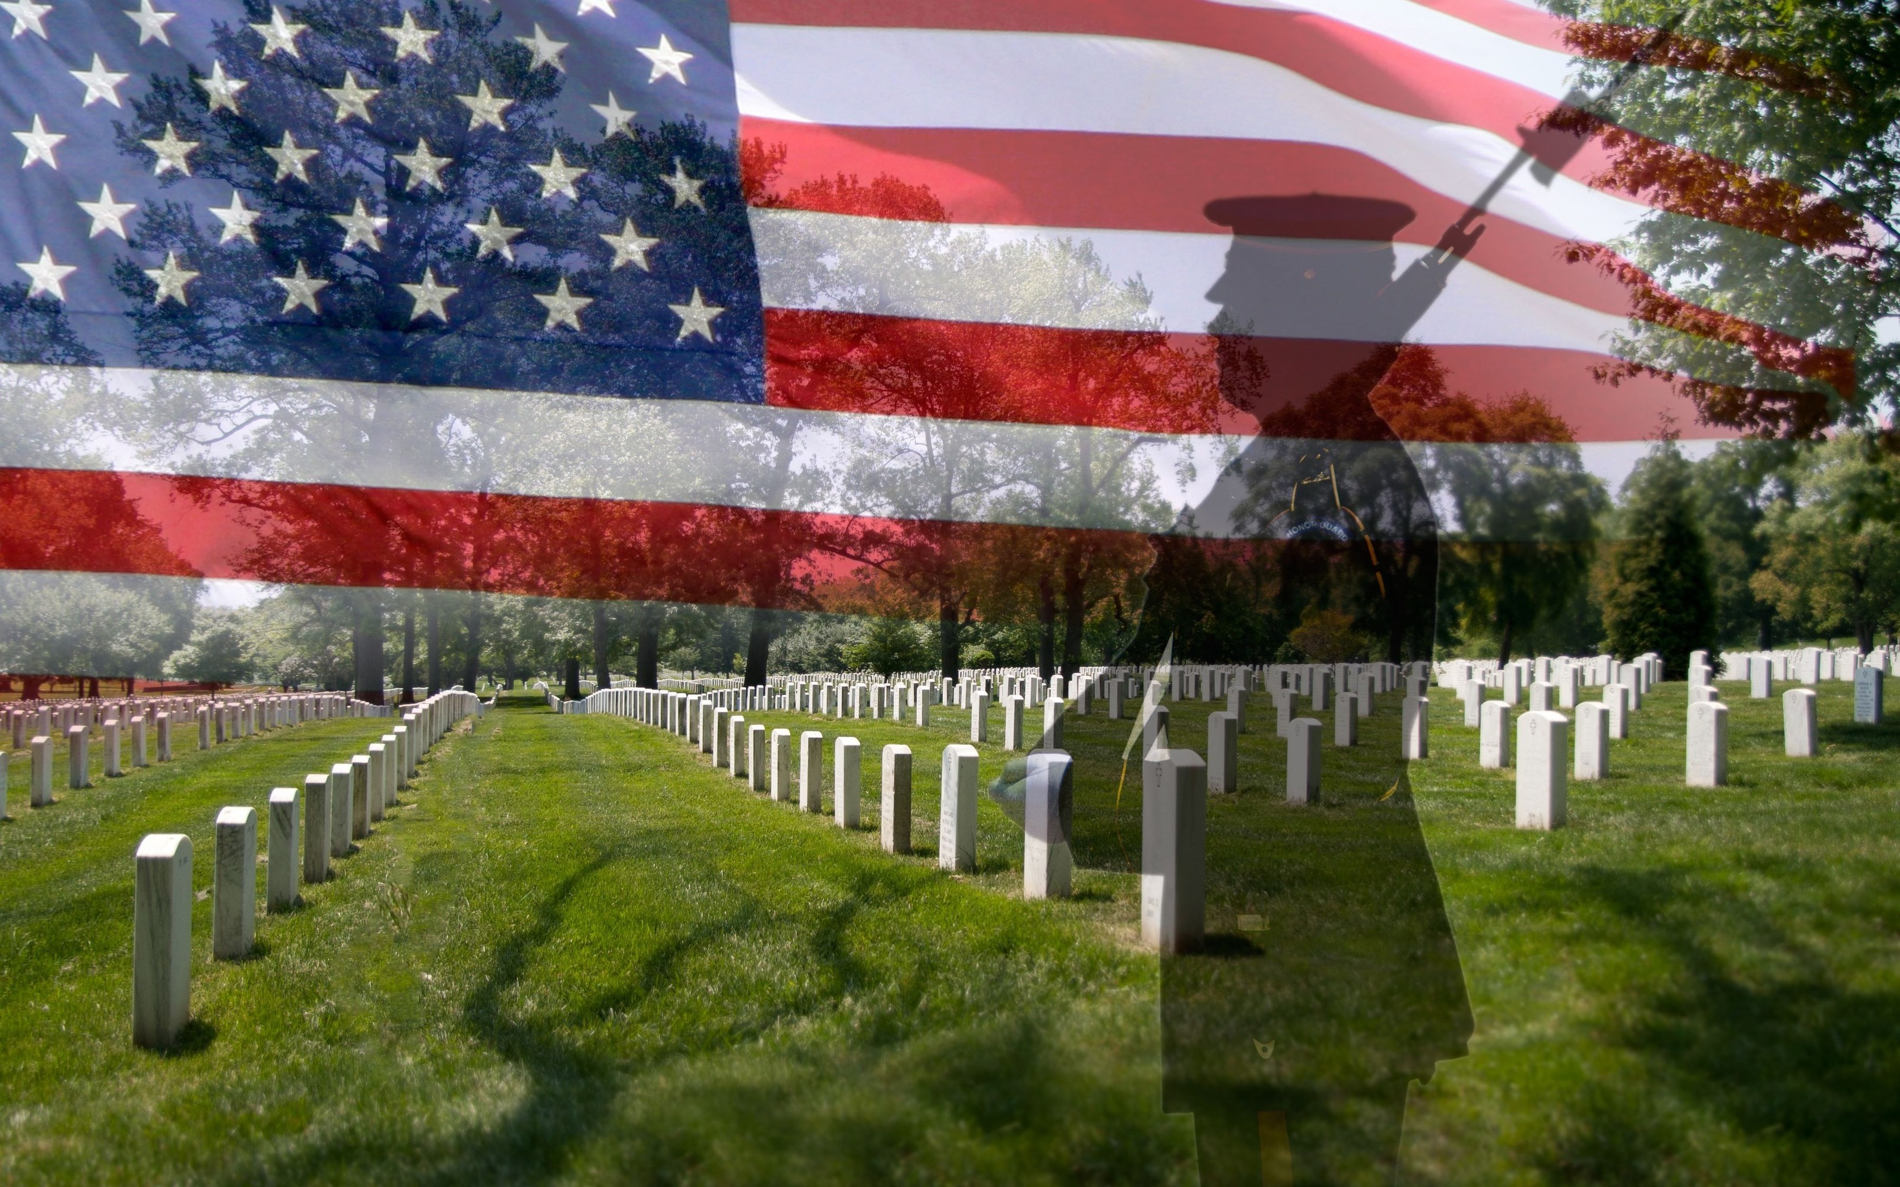
1a. O beautiful for spacious skies, For amber waves of grain. For purple mountain majesties Above the fruited plain!

Slide 73
1b. America! America! God shed his grace on thee. And crown thy good with brotherhood. From sea to shining sea!

Slide 74
2. O beautiful for pilgrim feet, Whose stern impassioned stress A
thoroughfare of freedom beat
Across the wilderness!

Slide 75
2b. America! America!
God mend thine every flaw,
Confirm thy soul in self control,
Thy liberty in law!

Slide 76
3a. O beautiful for heroes proved In liberating strife. Who more than self their country loved And mercy more than life!

Slide 77
3B. America! America! May God thy gold refine
Till all success be nobleness And every gain divine!

Slide 78
Ending Hymn:
Dear Lady Of Fatima

Slide 79
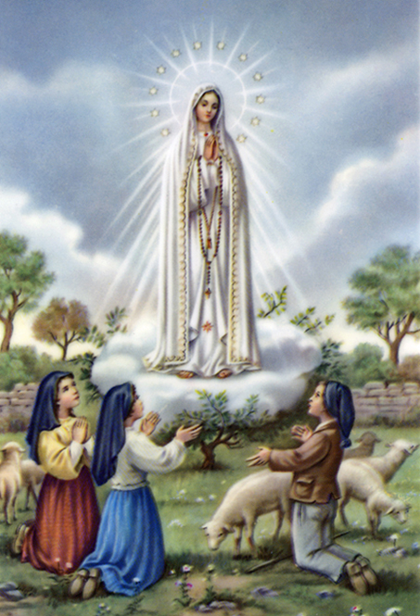
1a. Dear Lady of Fatima we come on bended knee to beg your intercession for peace and unity.

Slide 80
1b. Dear Mary won’t you show us the right and shining way? We pledge our love and offer you a Rosary each day.

Slide 81
2a. You promised at Fatima each time that you appeard to help us. If we pray to youto banish war and fear.

Slide 82
2b. Dear Lady on first Saturday we ask your guidding hand for grace and guidance here on earth and protection for our hand.

Slide 83
Ending Hymn:
On This Day

Slide 84
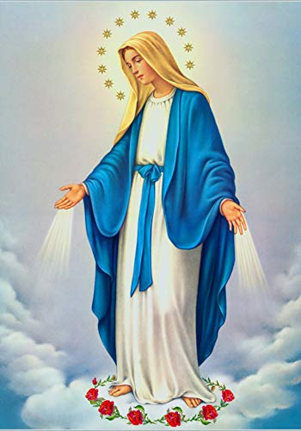
**. On this day, O beautiful Mother, On this day we give thee our love. Near the, Madonna, fondly we hover, Trusting thy gentle care to prove.

Slide 85
1. On this day we ask to share, Dearest Mother, thy sweet care; Aid us ere our feet astray Wanner from thy guiding way.

Slide 86
**. On this day, O beautiful Mother, On this day we give thee our love. Near the, Madonna, fondly we hover, Trusting thy gentle care to prove.

Slide 87
2. Queen of angels, deign to hear. Lisping children's humble prayer; Young hearts gain, O virgin pure, Sweetly to thyself allure.

Slide 88
THANK YOU
CÁM ƠN
MARAMING SALAMAT PO
MUCHAS GRACIAS
  நன்றி (Naṉṟi)

Slide 89
THANK YOU
CÁM ƠN
MARAMING SALAMAT PO
MUCHAS GRACIAS
  நன்றி (Naṉṟi)

