Slide 1
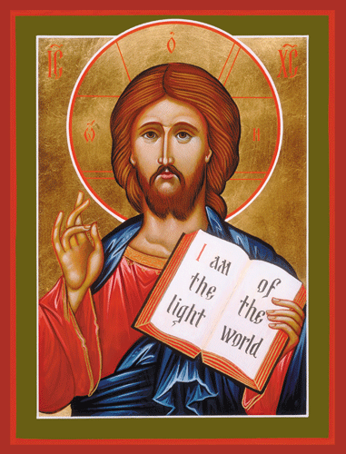
Welcome to Our Lady of Refuge Catholic Church
Sunday Ordinary Time 05 Year A
Gather Song:
Come, Follow Me
Responsorial Psalm 112:
The just man is a light Darkness
Prep. of the Gifts:
God of The Hungry
Communion Song :
Here I Am, Lord.
Recessional:
The Spirit Sends Us Forth

Slide 2
Refrain Come, follow me and live; do not be afraid. Believe and trust in me; your faith will give you strength. Leave all your fears behind you; let your heart be free for I will be your guide. Oh, come and follow me.

Slide 3
1. Come, follow in these foot steps; I’ll lead you gently home. No shelter, food nor money, will you need up-on this road.

Slide 4
Refrain Come, follow me and live; do not be afraid. Believe and trust in me; your faith will give you strength. Leave all your fears behind you; let your heart be free for I will be your guide. Oh, come and follow me.

Slide 5
2. Come, walk across the water: place all your faith in me. Cast all your doubs behind you to the wind and raging sea.

Slide 6
Refrain Come, follow me and live; do not be afraid. Believe and trust in me; your faith will give you strength. Leave all your fears behind you; let your heart be free for I will be your guide. Oh, come and follow me.

Slide 7
3. If you remain within me, my words remain in you. Whatever you may ask of me, that is what I will do.

Slide 8
Penitential Act

Slide 9
I confess to almighty God and to you, my brothers and sisters, that I have greatly sinned, in my thoughts and in my words,

Slide 10
in what I have done and in what I have failed to do, through my fault,
through my fault, through my most grievious fault;

Slide 11
therefore I ask blessed Mary ever-Virgin, all the Angels and Saints, and you, my brothers and sisters, to pray for me to the Lord our God.

Slide 12
Gloria Prayer

Slide 13
Refrain:
Glory to God, Glory to God. Glory to God in the highest, and on earth, peace on earth, peace to people of good will

Slide 14
1. We praise you, we bless you, we adore you, we glorify you, we give you thanks for your great glory. Lord God, heavenly King, O God, almighty Father.

Slide 15
2. Lord Jesus Christ, only Begotten Son, Lord God, Lamb of God, Son of the Father, you take away the sins of the world, have mercy on us. You take way the sins of the world, receive our pray you are seated at the right hand, the right hand of the Father, have mercy on us

Slide 16
3. For you alone are the Holy One, you alone are the Lord, you alone are the Most High, Jesus Christ with the Holy Spirit, in the glory of God the Father.

Slide 17
Refrain:
Glory to God, Glory to God. Glory to God in the highest, and on earth, peace on earth, peace to people of good will. Amen Amen.

Slide 18
Responsorial Psalm: Psalm 112 The Just Man Is a Light Darkness to the Upright

Slide 19
Responsorial Psalm 112:
The just man is a light in darkness to the upright, to the upright.

Slide 20
Gospel Acclamation

Slide 21
Refrain: Alleluia!
I am the light of the world, says the Lord;
Who ever follows me will have the light of life.

Slide 22
Profession Of Faith Creed

Slide 23
Nicene Creed p1
I believe in one God, the Father almighty, maker of heaven and earth, of all things visible and invisible.

Slide 24
Nicene Creed p2
I believe in one Lord Jesus Christ, the Only Begotten Son of God, born of the Father before all ages.

Slide 25
Nicene Creed p3
God from God, Light from Light, true God from true God, begotten, not made, consubstantial with the Father; through Him all things were made.

Slide 26
Nicene Creed p4
For us men and for our salvation He came down from heaven, and by the Holy Spirit was incarnate of the Virgin Mary, and became man.

Slide 27
Nicene Creed p5
For our sake He was crucified under Pontius Pilate, He suffered death and was buried, and rose again on the third day in accordance with the Scriptures.

Slide 28
Nicene Creed p6
He ascended into heaven and is seated at the right hand of the Father.

Slide 29
Nicene Creed p7
He will come again in glory to judge the living and the dead and His kingdom will have no end.

Slide 30
Nicene Creed p8
I believe in the Holy Spirit, the Lord, the giver of life, who proceeds from the Father and the Son,

Slide 31
Nicene Creed p9
who with the Father and the Son is adored and glorified, who has spoken through the prophets.

Slide 32
Nicene Creed p10
I believe in one, holy, catholic and apostolic Church. I confess one Baptism for the forgiveness of sins

Slide 33
Nicene Creed p11
and I look forward to the resurrection of the dead and the life of the world to come. Amen.

Slide 34
Preparation of The Gift Song: God Of The Hungry

Slide 35
1. God of all the hungry millions,
God who suffers with the poor,
still our greed keeps us from sharing
with the hungry at our door.
All who thirst will thirst no longer
when we do as you would do.
May we care for all your people;
Help us know that they are you.

Slide 36
2. God who travels with the stranger, greeted by our apathy, teach us to embrace all people; all can live with dignity. You have bid us clothe the naked, bringing hope in all we do. May we welcome all your people; Help us know that they are you.

Slide 37
3. God who loves the sick, the dying, they are precious in your sight; we will bring them your compassion, fill their living with your light. God who brings the captive freedom, free our hearts to love anew. May we comfort all your people; Help us know that they are you.

Slide 38
Holy Holy Holy

Slide 39
Holy, Holy, Holy Lord God of hosts. Heaven and earth are full, are full of your glory. Hosanna, Hosanna! Hosanna in the highest.

Slide 40
Blessed is he who comes, who comes in the name of the Lord. Hosanna, Hosanna! Hosanna in the highest.

Slide 41
Memorial Acclamation

Slide 42
We proclaim your Death, O Lord, and profess your Resurrection until you come again.

Slide 43
Amen

Slide 44
Amen, Amen, Amen.

Slide 45
Lamb Of God

Slide 46
Lamb of God you take away the sins of the world. Have mercy on us. (repeat as needed)
Lamb of God you take away the sins of the world.
grant us peace.

Slide 47
Communion respond

Slide 48
Behold the Lamb of God,
behold him who takes away the sins of the world.
Blessed are those called to the supper of the Lamb. Lord, I am not worthy
that You should enter under my roof, but only say the word and my soul shall be healed.

Slide 49
Communion Hymn 1 Here I Am, Lord

Slide 50
1. I, The Lord of sea and sky. I have heard my people cry. All who dwell in dark and sin. My hand will save. I who made the stars of night. I will make their darkness bright. Who will bear my light to them? Who shall I send?

Slide 51
Refrain: Here I am Lord. Is it I, Lord? I have heard you calling in the night. I will go, Lord. If you lead me I will hold your people in my heart.

Slide 52
2. I, The Lord of snow and rain. I have borne my people’s pain. I have wept for love of them. They turn away. I will break their hearts of stone. Give them hearts for love alone. I will speak my word to them. Whom shall I send?

Slide 53
Refrain: Here I am Lord. Is it I, Lord? I have heard you calling in the night. I will go, Lord. If you lead me I will hold your people in my heart.

Slide 54
3. I, The Lord of wind and flame, I will tend the poor and lame. I will set a feast for them. My hand will save. Finest bread I will provide. Till their hearts be satified. I will give my life to them. Whom shall I send?

Slide 55
Refrain: Here I am Lord. Is it I, Lord? I have heard you calling in the night. I will go, Lord. If you lead me I will hold your people in my heart.

Slide 56
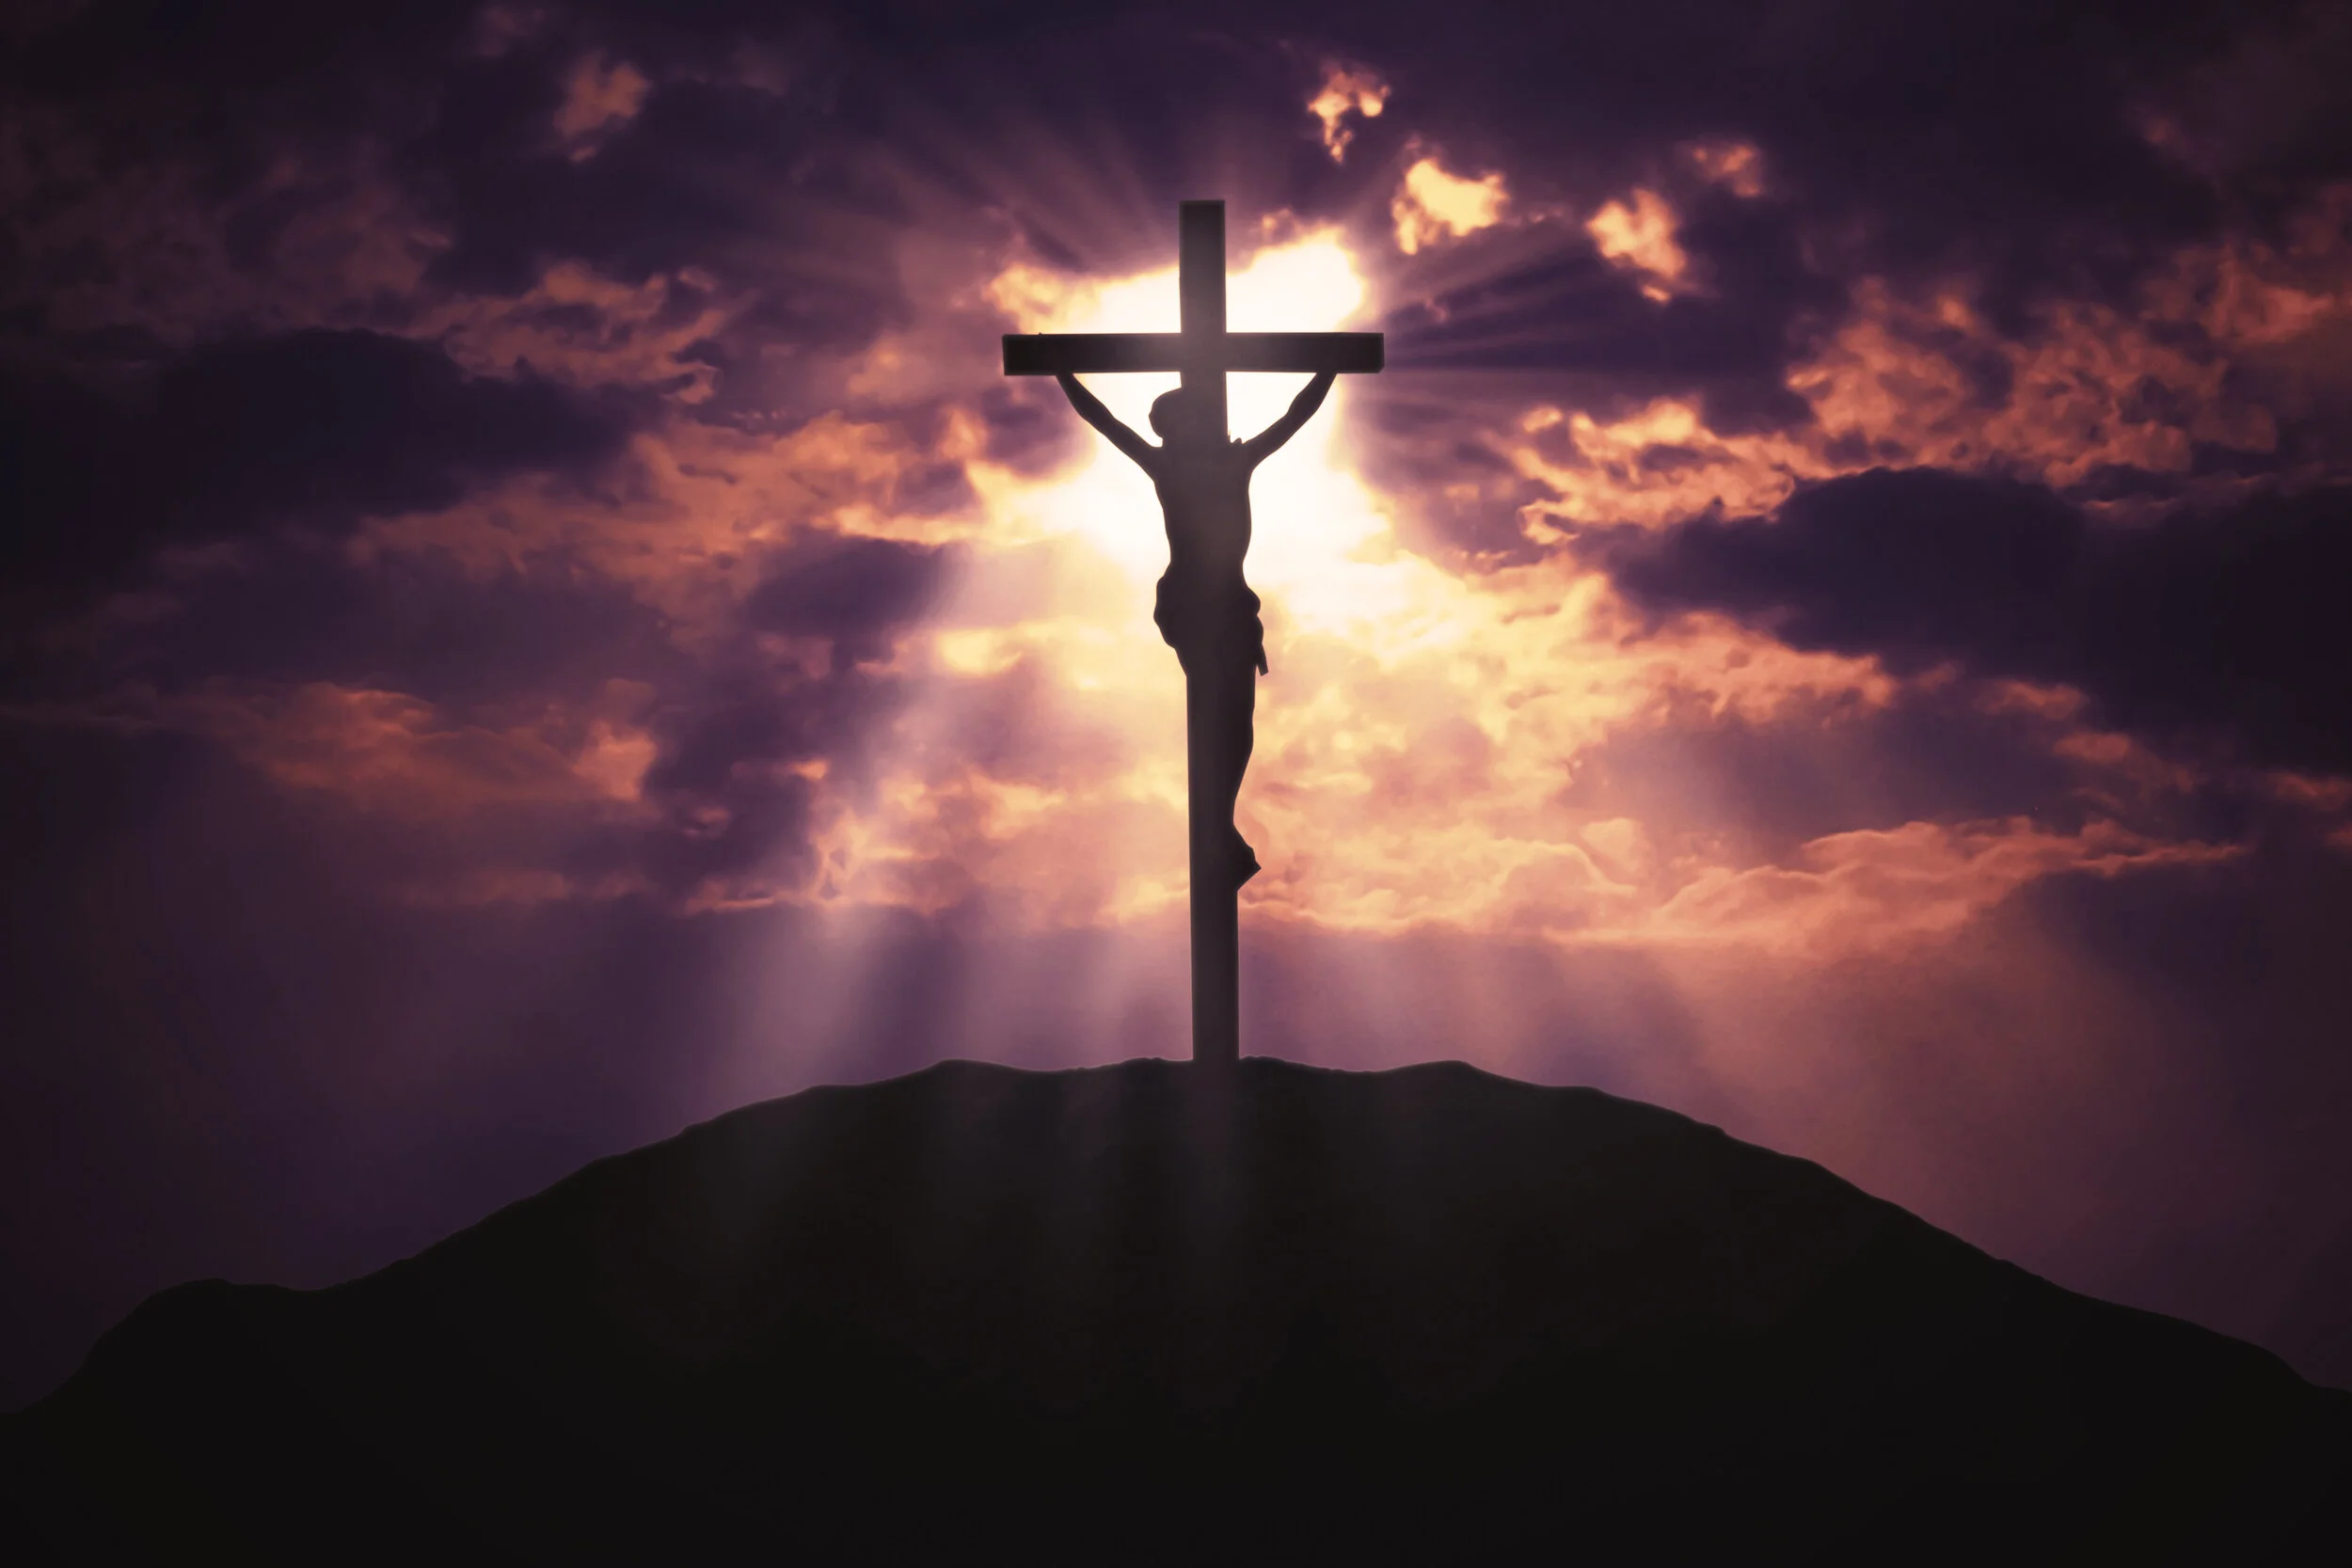
Communion Hymn 2 Lord, You Have Come

Slide 57
1. Lord, you have come to the seashore, neither searching for the rich nor the wise, desiring only that I should follow.
* O Lord, with your eyes set upon me, gently smiling, you have spoke my name; all I longed for I have found by the water, at your side, I will seek other shores.

Slide 58
2. Lord, see my goods, my possessions; in my boat you find no power, no wealth. Will you accept, then, my nets and labor?
* O Lord, with your eyes set upon me, gently smiling, you have spoke my name; all I longed for I have found by the water, at your side, I will seek other shores.

Slide 59
3. Lord, take my hands and direct them. Help me spend myself in seeking the lost, returning love for the love you gave me.
* O Lord, with your eyes set upon me, gently smiling, you have spoke my name; all I longed for I have found by the water, at your side, I will seek other shores.

Slide 60
4. Lord, as I drift on the waters, be the resting place of my restless heart, my life’s companion, my friend and refuge.
* O Lord, with your eyes set upon me, gently smiling, you have spoke my name; all I longed for I have found by the water, at your side, I will seek other shores.

Slide 61
Sending Hymn The Spirit Sends Us Forth

Slide 62
1. The Spirit sends us forth to serve; We go in Jesus' name To bring glad tidings to the poor, God's favour to proclaim.
2. We go to comfort those who mourn And set the burdened free; Where hope is dim, to share a dream And help the blind to see.

Slide 63
3. We go the be the hands of Christ, To scatter joy like seed And, all our days to cherish life, To do the loving deed.
4. Then let us go to serve in peace, The gospel to proclaim. God's Spirit has empowered us; We go in Jesus' name.

Slide 64
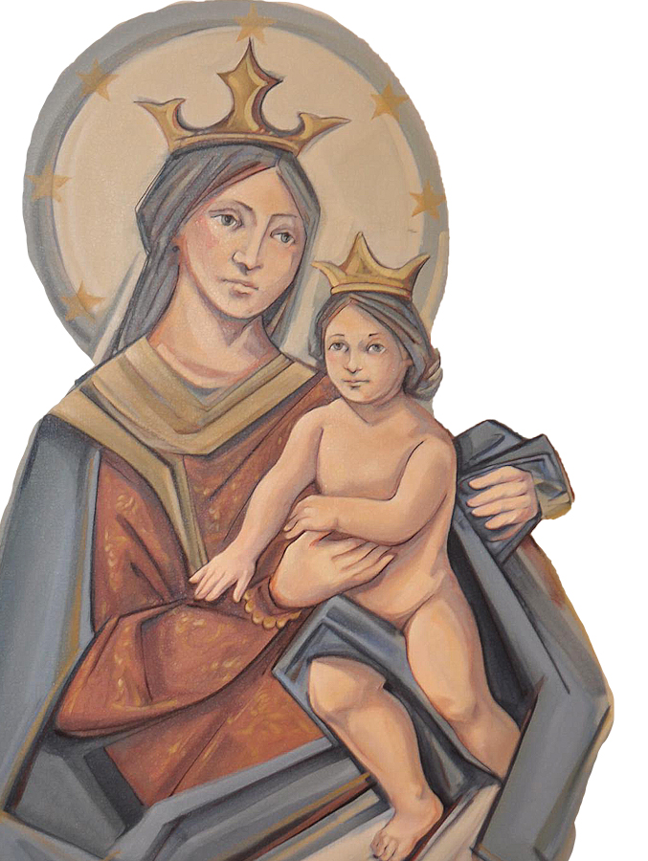
THANK YOU
CÁM ƠN
MARAMING SALAMAT PO
MUCHAS GRACIAS
நன்றி (Nanri)

