Slide 1
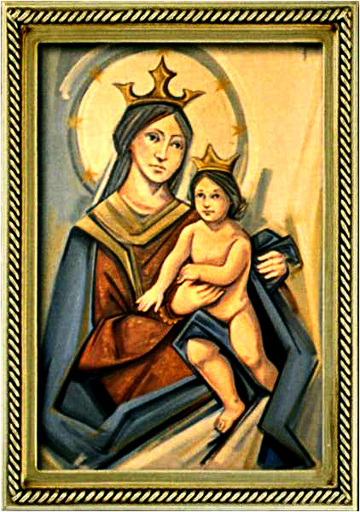
Ordinary Time 23 Year C
Gather Hymn:
Take Up Your Cross
Responsorial Psalm: 90
In Every Age
Prep. of the Gifts Hymn:
I Love The Lord
Communion Hymn:
As The Deer Long
I have loved you
Recessional Hymn:
Rain Down

Slide 2
Refrain Take up your cross, take up your cross, take up your cross and follow me. Take up your cross take up your cross take up your cross and follow me.
1. Whoever wishes to come after me must deny himself; whoever wishes to come after me must take up his cross, and follow me.

Slide 3
Refrain Take up your cross, take up your cross, take up your cross and follow me. Take up your cross take up your cross take up your cross and follow me.
2. Whoever wishes to save his life will lose it. Whoever losses his life for my sake will find it.

Slide 4
Refrain Take up your cross, take up your cross, take up your cross and follow me. Take up your cross take up your cross take up your cross and follow me.
3. Why gain the whole world but lose your soul? Why gain the whole world but love your soul?

Slide 5
Penitential Act (Confiteor 2011) 1 of 3:

Slide 6
I confess to almighty God and to you, my brothers and sisters, that I have greatly sinned, in my thoughts and in my words,

Slide 7
in what I have done and in what I have failed to do, through my fault,
through my fault, through my most grievious fault;

Slide 8
therefore I ask blessed Mary ever-Virgin, all the Angels and Saints, and you, my brothers and sisters, to pray for me to the Lord our God.

Slide 9
Gloria Hymn

Slide 10
Refrain:
Glory to God, Glory to God. Glory to God in the highest, and on earth, peace on earth, peace to people of good will

Slide 11
1. We praise you, we bless you, we adore you, we glorify you, we give you thanks for your great glory. Lord God, heavenly King, O God, almighty Father.

Slide 12
Refrain:
Glory to God, Glory to God. Glory to God in the highest, and on earth, peace on earth, peace to people of good will

Slide 13
2. Lord Jesus Christ, only Begotten Son, Lord God, Lamb of God, Son of the Father, you take away the sins of the world, have mercy on us. You take way the sins of the world, receive our pray you are seated at the right hand, the right hand of the Father, have mercy on us

Slide 14
Refrain:
Glory to God, Glory to God. Glory to God in the highest, and on earth, peace on earth, peace to people of good will

Slide 15
3. For you alone are the Holy One, you alone are the Lord, you alone are the Most High, Jesus Christ with the Holy Spirit, in the glory of God the Father.

Slide 16
Refrain:
Glory to God, Glory to God. Glory to God in the highest, and on earth, peace on earth, peace to people of good will. Amen Amen.

Slide 17
Responsorial Psalm: 90 In Every Age

Slide 18
Responsorial Psalm: Psalm 90 In every age, O Lord, you have been our refuge

Slide 19
Gospel Acclamation

Slide 20
Alleluia Alleluia Alleluia. Let your face shine upon your servant; and teach me your laws.

Slide 21
Profession Of Faith Creed

Slide 22
Nicene Creed p1
I believe in one God, the Father almighty, maker of heaven and earth, of all things visible and invisible.

Slide 23
Nicene Creed p2
I believe in one Lord Jesus Christ, the Only Begotten Son of God, born of the Father before all ages.

Slide 24
Nicene Creed p3
God from God, Light from Light, true God from true God, begotten, not made, consubstantial with the Father; through Him all things were made.

Slide 25
Nicene Creed p4
For us men and for our salvation He came down from heaven, and by the Holy Spirit was incarnate of the Virgin Mary, and became man.

Slide 26
Nicene Creed p5
For our sake He was crucified under Pontius Pilate, He suffered death and was buried, and rose again on the third day in accordance with the Scriptures.

Slide 27
Nicene Creed p6
He ascended into heaven and is seated at the right hand of the Father.

Slide 28
Nicene Creed p7
He will come again in glory to judge the living and the dead and His kingdom will have no end.

Slide 29
Nicene Creed p8
I believe in the Holy Spirit, the Lord, the giver of life, who proceeds from the Father and the Son,

Slide 30
Nicene Creed p9
who with the Father and the Son is adored and glorified, who has spoken through the prophets.

Slide 31
Nicene Creed p10
I believe in one, holy, catholic and apostolic Church. I confess one Baptism for the forgiveness of sins

Slide 32
Nicene Creed p11
and I look forward to the resurrection of the dead and the life of the world to come. Amen.

Slide 33
Preparation of The Gift Song: I Love The Lord

Slide 34
1- I love the Lord who has heard my cry.
I love the Lord, standing at my side I love the Lord, always close to me. I love the Lord, love the Lord who saves and sets me free.

Slide 35
2- I seek the Lord through each night and day. I seek the Lord as I walk my I I seek the Lord when the light seems gone. I seek the Lord, seek the Lord who calls me to go on.

Slide 36
3- I need the Lord more than I can tell. I need the Lord this I know so well! I need the Lord, how I need the Lord! I need the Lord, need the Lord with love on me out pound.

Slide 37
4- I praise the Lord sing-ing clear and strong. I praise the Lord, fo-cus of my song. I praise the Lord, strength-en-ing my voice. I praise the Lord, praise the Lord and rap-t'rous-ly re-joice

Slide 38
Holy Holy

Slide 39
Holy, Holy, Holy Lord God of hosts. Heaven and earth are full, are full of your glory. Hosanna, Hosanna! Hosanna in the highest.

Slide 40
Blessed is he who comes, who comes in the name of the Lord. Hosanna, Hosanna! Hosanna in the highest.

Slide 41
Memorial Acclamation

Slide 42
We proclaim your Death, O Lord, and profess your Resurrection until you come again.

Slide 43
Amen

Slide 44
Amen, Amen. Amen, Amen Amen, Amen
Amen. Amen.

Slide 45
Lamb Of God

Slide 46
Lamb of God your take away the sins of the world. Have mercy on us. (repeat as needed)
Lamb of God your take away the sins of the world.
grant us peace.

Slide 47
Communion respond

Slide 48
Behold the Lamb of God,
behold him who takes away the sins of the world.
Blessed are those called to the supper of the Lamb. Lord, I am not worthy
that You should enter under my roof, but only say the word and my soul shall be healed.

Slide 49
Communion Hymn 1: As The Deer Long

Slide 50
Refrain: As the deer longs for running streams, so I long, so I long so I long for you
1. Athirst my soul for you the God who is my life! When shall I see, when shall I see, see the face of God?

Slide 51
Refrain: As the deer longs for running streams, so I long, so I long so I long for you
2. Echoes meet as deep is calling unto deep, over my head, all you mighty waters, sweeping over me.

Slide 52
Refrain: As the deer longs for running streams, so I long, so I long so I long for you
3. Continually the foe delights in taunting me: "where is God, where is your God" Where, O where are you?

Slide 53
Refrain: As the deer longs for running streams, so I long, so I long so I long for you
4. Defend me, God send forth your light and your truth. They will lead me to your holy mountain, to your dwelling place.

Slide 54
Refrain: As the deer longs for running streams, so I long, so I long so I long for you
5. Then I shall go un-to the altar of my God. Praising you, O my joy and gladness, I shall praise your name.

Slide 55
Communion Hymn 1: I have loved you

Slide 56
I have loved you with an everlasting love, I have called you and you are mine. (2x)

Slide 57
1. Seek the face of the Lord and long for him: He will bring you his light and his peace.

Slide 58
I have loved you with an everlasting love, I have called you and you are mine. (2x)

Slide 59
2. Seek the face of the Lord and long for him: He will bring you his joy and his hope.

Slide 60
I have loved you with an everlasting love, I have called you and you are mine. (2x)

Slide 61
3. Seek the face of the Lord and long for him: He will bring you his care and his love.

Slide 62
I have loved you with an everlasting love, I have called you and you are mine. (2x)

Slide 63
Announcements:

Slide 65
Ending Hymn: Rain Down

Slide 66
Refrain:
Rain down, rain down,
rain down
your love on your people.
Rain down, rain down,
rain down
Your Love, God of life.

Slide 67
1. Faithful and true is the Word
of our God All of God's works are so
worthy of trust God's mercy falls on the just and the right Full of God's love is the earth

Slide 68
Refrain:
Rain down, rain down,
rain down
your love on your people.
Rain down, rain down,
rain down
Your Love, God of life.

Slide 69
Ending Hymn: Lady Of Fatima

Slide 70
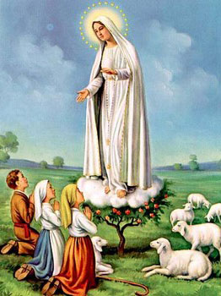
1. Dear Lady of Fatima we come on bended knee To beg your intercession for peace and unity. Dear Mary won't you show us the right and shining way? We pledge our love and offer you a Rosary each day.

Slide 71
2. You promised at Fatima Each time that you appeared To help us If we pray to you to banish war and fear. Dear Lady on first days we ask your guiding hand for grace and guidance here on earth protection for our land.

Slide 72
Ending Hymn: On This Day

Slide 73
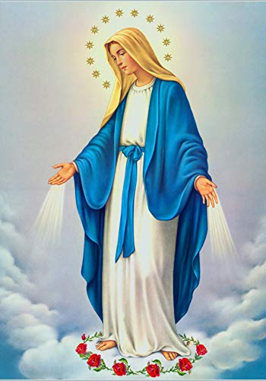
**. On this day, O beautiful Mother, On this day we give thee our love. Near the, Madonna, fondly we hover, Trusting thy gentle care to prove.

Slide 74
1. On this day we ask to share, Dearest Mother, thy sweet care; Aid us ere our feet astray Wanner from thy guiding way.

Slide 75
**. On this day, O beautiful Mother, On this day we give thee our love. Near the, Madonna, fondly we hover, Trusting thy gentle care to prove.

Slide 76
2. Queen of angels, deign to hear. Lisping children's humble prayer; Young hearts gain, O virgin pure, Sweetly to thyself allure.

Slide 77
THANK YOU
CÁM ƠN
MARAMING SALAMAT PO
MUCHAS GRACIAS
நன்றி (Naṉṟi)

Slide 78
THANK YOU
CÁM ƠN
MARAMING SALAMAT PO
MUCHAS GRACIAS
நன்றி (Naṉṟi)

