Slide 1
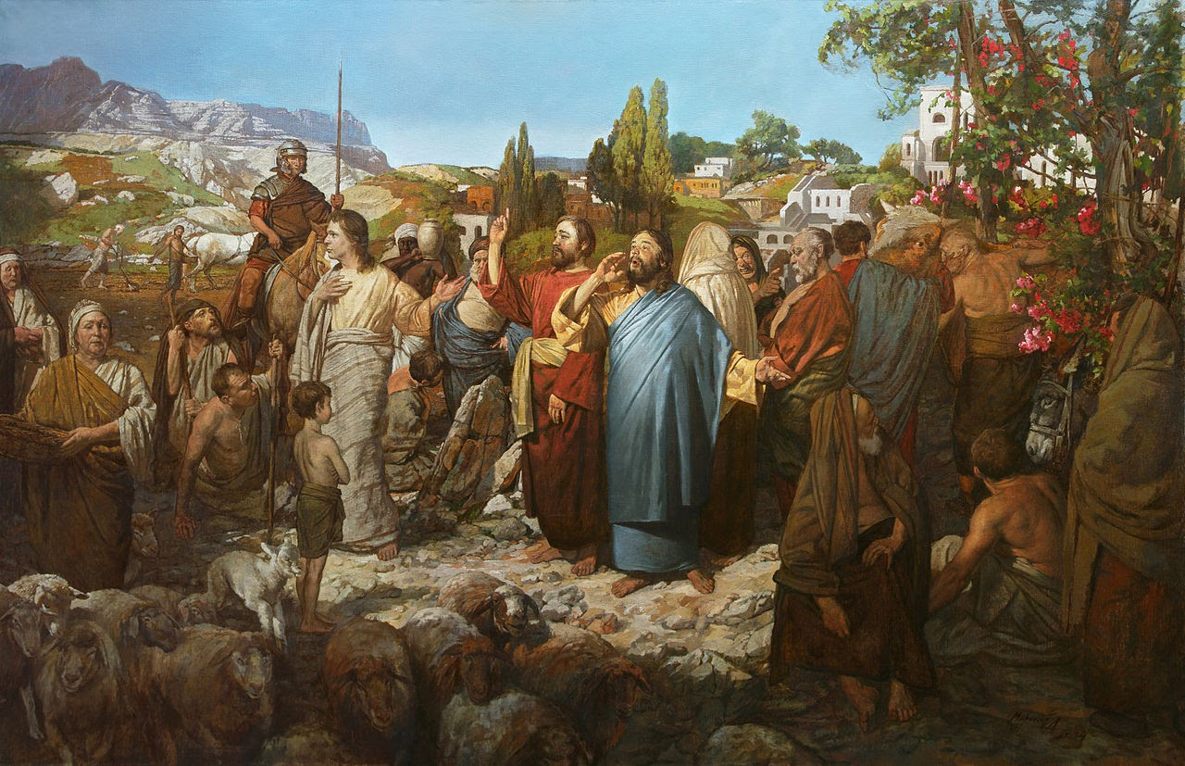
Welcome to Our Lady of Refuge Catholic Church
Sunday Ordinary Time 22 th Year A
Gather Song:
This Day God Gives Me
Responsorial Psalm 63:
My Soul Thirsts
Prep. of the Gifts:
Only This I Want
Communion Song :
Be Not Far From Me
God’s Holy Gifts / Ave Maria
Recessional:
On This Day, O Beautiful Mother

Slide 2
1. This day God gives me Strength of high heaven, Sun and moon shining, Flame in my hearth Flashing of lightning, Wind in its swiftness, Deeps of the ocean, Firmness of earth.

Slide 3
2. This day God sends me Strength as my guardian, Might to uphold me, Wisdom as guide. Your eyes are watchful, your ears are list'ning, Your lips are speaking Friend at my side.

Slide 4
3. God's wa is my ways, God's shield is 'round me, God's host defends me, Saving from ill. Angels of heaven, Drive from me always All that would harm me, Stand by me still.

Slide 5
4. Rising I thank you, Mighty and Strong One, King of creation giver of rest, Firmly confessing Threeness of Persons, Oneness of Godhead Trinity blest.

Slide 6
Penitential Act

Slide 7
I confess to almighty God and to you, my brothers and sisters, that I have greatly sinned, in my thoughts and in my words,

Slide 8
in what I have done
and in what I have failed to do,
through my fault,
through my fault,
through my most grievious fault;

Slide 9
therefore I ask blessed Mary ever-Virgin, all the Angels and Saints, and you, my brothers and sisters, to pray for me to the Lord our God.

Slide 10
Gloria Prayer

Slide 11
Refrain:
Glory to God, Glory to God. Glory to God in the highest, and on earth, peace on earth, peace to people of good will

Slide 12
1. We praise you, we bless you, we adore you, we glorify you, we give you thanks for your great glory. Lord God, heavenly King, O God, almighty Father.

Slide 13
2. Lord Jesus Christ, only Begotten Son, Lord God, Lamb of God, Son of the Father, you take away the sins of the world, have mercy on us. You take way the sins of the world, receive our pray you are seated at the right hand, the right hand of the Father, have mercy on us

Slide 14
3. For you alone are the Holy One, you alone are the Lord, you alone are the Most High, Jesus Christ with the Holy Spirit, in the glory of God the Father.

Slide 15
Refrain:
Glory to God, Glory to God. Glory to God in the highest, and on earth, peace on earth, peace to people of good will. Amen Amen.
Gloria Prayer

Slide 16
Psalm 63
My Soul Thrists

Slide 17
Responsorial Psalm 63:
My soul thirsts for you, Lord. Like the desert thirsts for rain, It is your face I long for; You alone are life to me.

Slide 18
Gospel Acclamation

Slide 19
Refrain: Alleluia!
May the Father of our Lord Jesus Christ enlighten the eyes of our hearts, that we may know what is the hope that belongs to our call.

Slide 20
Profession of Faith

Slide 21
Nicene Creed p1
I believe in one God, the Father almighty, maker of heaven and earth, of all things visible and invisible.

Slide 22
Nicene Creed p2
I believe in one Lord Jesus Christ, the Only Begotten Son of God, born of the Father before all ages.

Slide 23
Nicene Creed p3
God from God, Light from Light, true God from true God, begotten, not made, consubstantial with the Father; through Him all things were made.

Slide 24
Nicene Creed p4
For us men and for our salvation He came down from heaven, and by the Holy Spirit was incarnate of the Virgin Mary, and became man.

Slide 25
Nicene Creed p5
For our sake He was crucified under Pontius Pilate, He suffered death and was buried, and rose again on the third day in accordance with the Scriptures.

Slide 26
Nicene Creed p6
He ascended into heaven and is seated at the right hand of the Father.

Slide 27
Nicene Creed p7
He will come again in glory to judge the living and the dead and His kingdom will have no end.

Slide 28
Nicene Creed p8
I believe in the Holy Spirit, the Lord, the giver of life, who proceeds from the Father and the Son,

Slide 29
Nicene Creed p9
who with the Father and the Son is adored and glorified, who has spoken through the prophets.

Slide 30
Nicene Creed p10
I believe in one, holy, catholic and apostolic Church. I confess one Baptism for the forgiveness of sins

Slide 31
Nicene Creed p11
and I look forward to the resurrection of the dead and the life of the world to come. Amen.

Slide 32
Preparation of The Gift Song
Only This I Want

Slide 33
Refrain: Only This I want, but to know the Lord. And to bear his cross, so to wear the crown he wore.
1. All but this is loss, worthless refuse to me, for to gain the Lord is to gain and I need.

Slide 34
Refrain: Only This I want, but to know the Lord. And to bear his cross, so to wear the crown he wore.
2. I will run the race, I will fight the good fight. So to win the prize of the kingdom o

Slide 35
Refrain: Only This I want, but to know the Lord. And to bear his cross, so to wear the crown he wore.
3. Let your heart be glad, always glad in the Lord, so to shine like starts in the darkness of the nigh.

Slide 36
Holy Holy Holy

Slide 37
Holy, Holy, Holy Lord God of hosts.
Heaven and earth are full, are full of your glory. Hosanna, Hosanna! Hosanna in the highest.

Slide 38
Blessed is he who comes, who comes in the name of the Lord.
Hosanna, Hosanna! Hosanna in the highest.

Slide 39
Memorial acclamation

Slide 40
We proclaim your Death, O Lord,
and profess your Resurrection until you come again.
Memorial acclamation

Slide 41
Amen

Slide 42
Amen Amen Amen

Slide 43
Lamb Of God

Slide 44
Lamb of God you take away the sins of the world. Have mercy on us. (repeat as needed)
Lamb of God you take away the sins of the world.
grant us peace.

Slide 45
Communion Respond

Slide 46
Behold the Lamb of God,
behold him who takes away the sins of the world.
Blessed are those called to the supper of the Lamb.
Lord, I am not worthy
that You should enter under my roof, but only say the word and my soul shall be healed.

Slide 47
Communion Hymn
Be Not Far From Me

Slide 48
1. Be not far from me when trouble is near. Lord, deliver me from my fear Be my sure defense throught storming rage my rock, my deliverer, ever age to age.
** Lord, be not far, Lord, be not far from me Lord, be not far. Lord, be not far from me when trouble is near

Slide 49
2. Through my wandering lonely miles Through the dark of night. All my trials, Be my guiding light my strenght my heart. Aways beside me, Lord never to dpart. ** Lord, be not far, Lord, be not far from me Lord, be not far. Lord, be not far from me when trouble is near

Slide 50
2. All creation, Lord will praise your name May your mighty deeds be proclaimed May the lowly ones their voices raise, and tell of your righteousness through the end of days.
** Lord, be not far, Lord, be not far from me Lord, be not far. Lord, be not far from me when trouble is near

Slide 51
4. Be not far from me when trouble is near. Lord, deliver me from my fear Be my sure defense throught storming rage my rock, my deliverer, ever age to age.
** Lord, be not far, Lord, be not far from me Lord, be not far. Lord, be not far from me when trouble is near

Slide 52
Communion Hymn
God’s Holy Gifts

Slide 53
Refrain: God's holy gifts for God's holy people; come now to share the banquet of Christ. Feed on his love with faith and thanksgiving. Know in your heart that he died for you.

Slide 54
1. May the Body of Christ be food for our souls and bring us to everlasting life.

Slide 55
Refrain: God's holy gifts for God's holy people; come now to share the banquet of Christ. Feed on his love with faith and thanksgiving. Know in your heart that he died for you.

Slide 56
2. May the Blood of the Lord protect us from harm and Mark us as God's beloved ones.

Slide 57
Refrain: God's holy gifts for God's holy people; come now to share the banquet of Christ. Feed on his love with faith and thanksgiving. Know in your heart that he died for you.

Slide 58
3. As the grain of this bread was gathered as one, may we who believe be bound by love.

Slide 59
Refrain: God's holy gifts for God's holy people; come now to share the banquet of Christ. Feed on his love with faith and thanksgiving. Know in your heart that he died for you.

Slide 60
4. As the cup that we share is emptied for all, may we offer up our lives in love.

Slide 61
Refrain: God's holy gifts for God's holy people; come now to share the banquet of Christ. Feed on his love with faith and thanksgiving. Know in your heart that he died for you.

Slide 62
5. When we eat of this bread and drink of this cup, we hold in our memory Christ the Lord.

Slide 63
Refrain: God's holy gifts for God's holy people; come now to share the banquet of Christ. Feed on his love with faith and thanksgiving. Know in your heart that he died for you.

Slide 64
Communion Hymn 2
Ave Maria, Gratia Plena

Slide 65
Ave Maria, gratia plena,
Dominus tecum, benedicta tu in mulieribus, et benedictus fructus ventris tui, Iesus.
Sancta Maria, Mater Dei, ora pro nobis peccatoribus, nunc et in hora mortis nostrae.
Amen.

Slide 66
Sending Hymn
On This Day, O Beautiful Mother

Slide 67
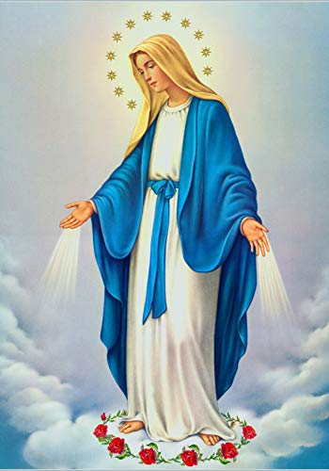
**. On this day, O beautiful Mother, On this day we give thee our love. Near the, Madonna, fondly we hover, Trusting thy gentle care to prove.

Slide 68
1. On this day we ask to share, Dearest Mother, thy sweet care; Aid us ere our feet astray Wanner from thy guiding way.

Slide 69
**. On this day, O beautiful Mother, On this day we give thee our love. Near the, Madonna, fondly we hover, Trusting thy gentle care to prove.

Slide 70
2. Queen of angels, deign to hear. Lisping children's humble prayer; Young hearts gain, O virgin pure, Sweetly to thyself allure.

Slide 71
**. On this day, O beautiful Mother, On this day we give thee our love. Near the, Madonna, fondly we hover, Trusting thy gentle care to prove.

Slide 72
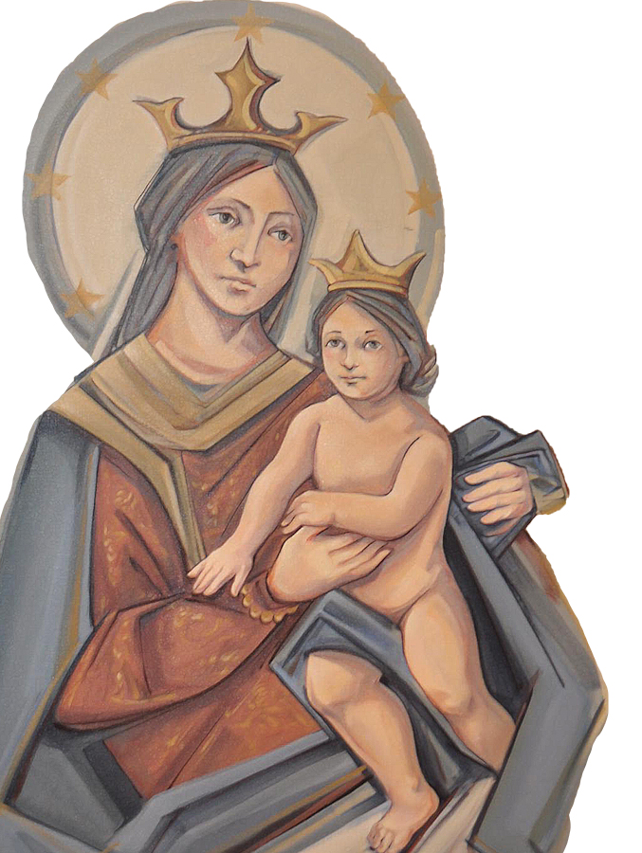
THANK YOU
CÁM ƠN
MARAMING SALAMAT PO
MUCHAS GRACIAS
நன்றி (Nanri)

