Slide 1
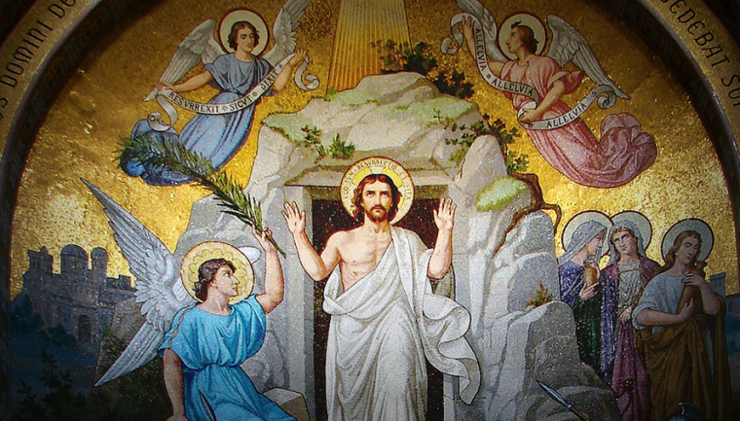
Easter Sunday 1
Gather Hymn:
Alleluia Let The Holy Anthem
Water of Life
Responsorial Psalm:
118 This is The Day.
Easter Sequence:
Alleluia Alleluia
Prep. of the Gifts Hymn:
Worthy is The Lamb
Communion Hymn:
I am the bread of life
Recessional Hymn:
Jesus Christ is Risen Today.

Slide 2
1. Alleluia Alleluia let the holy anthem rise And the choirs of heaven chant it In the temple of the skies Let the mountains skip with gladness And the joyful valleys ringWith Hosannas in the highest To our Saviour and our King

Slide 3
2. Alleluia Alleluia like the sun from out the wave
He has risen up in triumph from
The darkness of the grave
He's the Splendour of the Nations
He's the lamp of endless day
He's the very Lord of Glory
Who is risen up today

Slide 4
Penitential Act (Confiteor 2011)

Slide 5
I confess to almighty God and to you, my brothers and sisters, that I have greatly sinned, in my thoughts and in my words,

Slide 6
in what I have done
and in what I have failed to do,
through my fault,
through my fault,
through my most grievious fault;

Slide 7
therefore I ask blessed Mary ever-Virgin, all the Angels and Saints, and you, my brothers and sisters, to pray for me to the Lord our God.

Slide 8
Water of Life

Slide 9
Water of life, holy reminder; touching, renewing the body of Christ. Water of life, holy reminder; touching, renewing the body of life.

Slide 10
4. All generations, com forth and receive the blessing of this holy water; making us one with the God who forgives, the one who is faithful and just.

Slide 11
Water of life, holy reminder; touching, renewing the body of Christ. Water of life, holy reminder; touching, renewing the body of life.

Slide 12
5. Bringing new hope to the children of God, regardless of color or story; Cleansing our spirits with kindness and truth, and keeping the promise a live

Slide 13
Water of life, holy reminder; touching, renewing the body of Christ. Water of life, holy reminder; touching, renewing the body of life.

Slide 14
5. Deep as the heavens and wide as the sea, your mercy and love have no ending. Guiding our steps in the journey of faith, you show us the way to your king dom.

Slide 15
Gloria Hymn

Slide 16
Refrain:
Glory to God, Glory to God. Glory to God in the highest, and on earth, peace on earth, peace to people of good will

Slide 17
1. We praise you, we bless you, we adore you, we glorify you, we give you thanks for your great glory. Lord God, heavenly King, O God, almighty Father.

Slide 18
Refrain:
Glory to God, Glory to God. Glory to God in the highest, and on earth, peace on earth, peace to people of good will

Slide 19
2. Lord Jesus Christ, only Begotten Son, Lord God, Lamb of God, Son of the Father, you take away the sins of the world, have mercy on us. You take way the sins of the world, receive our pray you are seated at the right hand, the right hand of the Father, have mercy on us

Slide 20
Refrain:
Glory to God, Glory to God. Glory to God in the highest, and on earth, peace on earth, peace to people of good will

Slide 21
3. For you alone are the Holy One, you alone are the Lord, you alone are the Most High, Jesus Christ with the Holy Spirit, in the glory of God the Father.

Slide 22
Refrain:
Glory to God, Glory to God. Glory to God in the highest, and on earth, peace on earth, peace to people of good will. Amen Amen.

Slide 24
Responsorial Psalm: Psalm 118
This is The Day

Slide 25
Responsorial Psalm: Psalm 18
This is the day the Lord has made; Let us rejoice and be glad.

Slide 26
Easter Sequence
Alleluia Alleluia

Slide 27
1. Alleluia Alleluia! Hearts to heaven and voices raise.
Sing to Go a hymn of gladness, Sing to God a hymn of praise.
He who on the cross as Savior. For the world’s salvation bled,
Jesus Christ, the King of Glory, Now is risen from the dead.

Slide 28
2. Now the iron bars are broken, Christ from death to life is born. Glorious life, and life immortal, on this resurrection morn; Christ has triumphed, and we conquer by his mighty enterprise, We with him to the life eternal by his resurrection rise

Slide 29
3. Alleluia! Alleluia! Glory be to God on high. Alleluia to the Savior, who has won the victory; Alleluia to the Spirit, Font of love and sanctity; Alleluia! Alleluia! To the Triune Majesty.

Slide 30
Easter Sequence
Christ is Risen

Slide 31
1a. To The Paschal Victim. Give thankful praise!
Christ ever sinless, his sheep now he saves.
1b. Death and life contended. In dreadful strife:
Death did not hold him, immortal his life.

Slide 32
Refrain.
Alleluia his triumph we sing! Christ is arisen, the Victor, the King!

Slide 33
2a. Mary, speak, confessing what you have seen.
Christ’s tomb lies empty where once he had been;
2b. Angels bright, confirming; Shroud laid aside.
He goes to Galilee, he lives though he died.

Slide 34
Refrain.
Alleluia his triumph we sing! Christ is arisen, the Victor, the King!

Slide 35
3a. Christians, sing his glory with every breath; Sing his kingdom, victorious o’er death!
3b. Jesus, grant us mercy: New life from heaven! Christ ever reigns! Alleluia! Amen!

Slide 36
Refrain.
Alleluia his triumph we sing! Christ is arisen, the Victor, the King!

Slide 37
Easter Sequence
Gospel Acclamation

Slide 38
Alleluia Alleluia Alleluia.
, God spoke to

Slide 39
Profession Of Faith
Creed

Slide 40
Nicene Creed p1
I believe in one God, the Father almighty, maker of heaven and earth, of all things visible and invisible.

Slide 41
Nicene Creed p2
I believe in one Lord Jesus Christ, the Only Begotten Son of God, born of the Father before all ages.

Slide 42
Nicene Creed p3
God from God, Light from Light, true God from true God, begotten, not made, consubstantial with the Father; through Him all things were made.

Slide 43
Nicene Creed p4
For us men and for our salvation He came down from heaven, and by the Holy Spirit was incarnate of the Virgin Mary, and became man.

Slide 44
Nicene Creed p5
For our sake He was crucified under Pontius Pilate, He suffered death and was buried, and rose again on the third day in accordance with the Scriptures.

Slide 45
Nicene Creed p6
He ascended into heaven and is seated at the right hand of the Father.

Slide 46
Nicene Creed p7
He will come again in glory to judge the living and the dead and His kingdom will have no end.

Slide 47
Nicene Creed p8
I believe in the Holy Spirit, the Lord, the giver of life, who proceeds from the Father and the Son,

Slide 48
Nicene Creed p9
who with the Father and the Son is adored and glorified, who has spoken through the prophets.

Slide 49
Nicene Creed p10
I believe in one, holy, catholic and apostolic Church. I confess one Baptism for the forgiveness of sins

Slide 50
Nicene Creed p11
and I look forward to the resurrection of the dead and the life of the world to come. Amen.

Slide 51
Gift
Worthy is The Lamb

Slide 52
Refrain: Worthy is the Lamb that was slain to receive honor and glory. Worthy are the ones who believe to receive the goodness of God.

Slide 53
1. Worthy are you, O Paschal Lamb. Wisdom and strength belong now to you. You laid down your life and died upon the cross: we’ve become a people of hope.

Slide 54
Refrain: Worthy is the Lamb that was slain to receive honor and glory. Worthy are the ones who believe to receive the goodness of God.

Slide 55
2. Worthy are you, O Bread of Life. Salvation and joy belong now to us. By conquering death and rising to new life,
we’ve become a people of praise.

Slide 56
Refrain: Worthy is the Lamb that was slain to receive honor and glory. Worthy are the ones who believe to receive the goodness of God.

Slide 57
3. Worthy are you, O Risen Christ. Wonders and signs, revealing your might. Your power and glory shine upon our lives: we’ve become your light for the world.

Slide 58
Refrain: Worthy is the Lamb that was slain to receive honor and glory. Worthy are the ones who believe to receive the goodness of God.

Slide 59
Holy Holy Holy

Slide 60
Holy, Holy, Holy Lord God of hosts.
Heaven and earth are full, are full of your glory. Hosanna, Hosanna! Hosanna in the highest.

Slide 61
Blessed is he who comes, who comes in the name of the Lord.
Hosanna, Hosanna! Hosanna in the highest.

Slide 62
Memorial Acclamation

Slide 63
We proclaim your Death, O Lord,
and profess your Resurrection until you come again.

Slide 64
Amen

Slide 65
Amen, Amen.
Amen, Amen
Amen, Amen
Amen. Amen.

Slide 66
Lamb Of God

Slide 67
Lamb of God your take away the sins of the world. Have mercy on us. (repeat as needed)
Lamb of God your take away the sins of the world.
grant us peace.

Slide 68
Communion respond

Slide 69
Communion respond

Slide 70
Behold the Lamb of God,
behold him who takes away the sins of the world.
Blessed are those called to the supper of the Lamb.
Lord, I am not worthy
that You should enter under my roof, but only say the word and my soul shall be healed.

Slide 71
Communion Hymn 1:
I Am The Bread Of Life

Slide 72
1. I am the bread of life.
You who comes to me shall not hunger;
And who believes in Me shall not thirst.
No one can come to Me
Unless the Father beckons.

Slide 73
Refrain:
And I will raise you up.
And I will raise you up.
And I will raise you up on the last day.

Slide 74
2. The bread that I will give
Is My flesh for the life of the world.
And if you eat of this bread.
You shall live for ever,
you shall live for ever

Slide 75
Refrain:
And I will raise you up.
And I will raise you up.
And I will raise you up on the last day.

Slide 76
3. Unless you eat Of the flesh of the Son of Man.
And drink of His blood.
And drink of His blood.
You shall not have life within you.

Slide 77
Refrain:
And I will raise you up.
And I will raise you up.
And I will raise you up on the last day.

Slide 78
4. I am the resurrection
I am the life
He who believes in Me
Even if he die
He shall live for ever

Slide 79
Refrain:
And I will raise you up.
And I will raise you up.
And I will raise you up on the last day.

Slide 80
5. Yes, Lord, we believe
That You are the Christ
The Son of God,
Who has come
Into the world

Slide 81
Refrain:
And I will raise you up.
And I will raise you up.
And I will raise you up on the last day.

Slide 82
Ending Hymn:
Jesus Christ Is Risen Today

Slide 83
Jesus Christ is ris'n today
Alleluia!
Our triumphant holy day,
Alleluia!
Who did once upon the cross, Alleluia!
Suffer to redeem out loss. Alleluia!

Slide 84
Hymns of praise then let us sing, Alleluia!
Unto Christ, our heav'nly King, Alleluia!
Who endured the cross and
grave, Alleluia!
Sinners to redeem and save. Alleluia!

Slide 85
But the pains which he
endured. Alleluia!
Our salvation have procured; Alleluia!
Now he reigns above as King, grave, Alleluia!
Where the angels ever sing
Alleluia!

Slide 86
Sing we to our God above.
Al-le-lu-ia!
Praise eternal as his love.
Al-le-lu-ia!
Praise him, all ye heav'nly host. Al-le-lu-ia!
Fa-ther, Son, and Ho-ly Ghost.
Al-le-lu-ia!

Slide 87
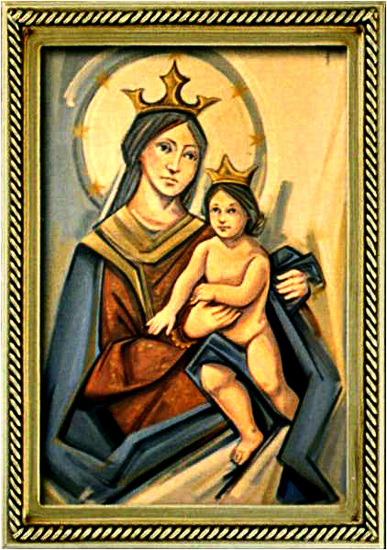
THANK YOU
CÁM ƠN
MARAMING SALAMAT PO
MUCHAS GRACIAS
  நன்றி (Naṉṟi)

