Slide 1
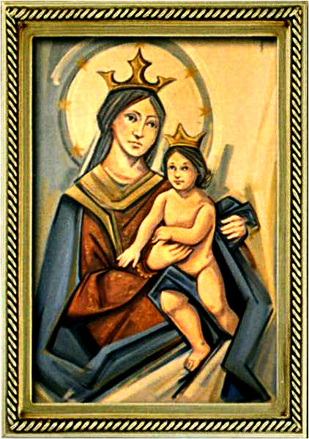
Ordinary Time 29 Year C
Gather Hymn:
Glory and Praise to Oud God
Responsorial Psalm: 121
Our Help is from the Lord.
Prep. of the Gifts Hymn:
Only This I Want
Communion Hymn:
Shelter Me, O God.
Recessional Hymn:
I Sing The Mighty Power Of God.

Slide 2
refrain: Glory and praise to our God, who alone gives light to our days.
Many are the blessings he bears to those who trust in his ways.
1. We, the daughters and sons of him who built the valleys and plains. Praise the wonders our God has done in ev’ry heart that sings.

Slide 3
refrain: Glory and praise to our God, who alone gives light to our days.
Many are the blessings he bears to those who trust in his ways.
2. In his wisdom he strengthens us, like gold that’s tested in fire.
Though the power of sin prevails, our God is there to save.

Slide 4
Penitential Act (Confiteor 2011) 1 of 3:

Slide 5
I confess to almighty God and to you, my brothers and sisters, that I have greatly sinned, in my thoughts and in my words,

Slide 6
in what I have done
and in what I have failed to do,
through my fault,
through my fault,
through my most grievious fault;

Slide 7
therefore I ask blessed Mary ever-Virgin, all the Angels and Saints, and you, my brothers and sisters, to pray for me to the Lord our God.

Slide 8
Gloria Hymn

Slide 9
Refrain:
Glory to God, Glory to God. Glory to God in the highest, and on earth, peace on earth, peace to people of good will

Slide 10
1. We praise you, we bless you, we adore you, we glorify you, we give you thanks for your great glory. Lord God, heavenly King, O God, almighty Father.

Slide 11
Refrain:
Glory to God, Glory to God. Glory to God in the highest, and on earth, peace on earth, peace to people of good will

Slide 12
2. Lord Jesus Christ, only Begotten Son, Lord God, Lamb of God, Son of the Father, you take away the sins of the world, have mercy on us. You take way the sins of the world, receive our pray you are seated at the right hand, the right hand of the Father, have mercy on us

Slide 13
Refrain:
Glory to God, Glory to God. Glory to God in the highest, and on earth, peace on earth, peace to people of good will

Slide 14
3. For you alone are the Holy One, you alone are the Lord, you alone are the Most High, Jesus Christ with the Holy Spirit, in the glory of God the Father.

Slide 15
Refrain:
Glory to God, Glory to God. Glory to God in the highest, and on earth, peace on earth, peace to people of good will. Amen Amen.

Slide 16
Responsorial Psalm: 121
Our Help Is From The Lord

Slide 17
Responsorial Psalm: Psalm 121
Our Help is from the Lord, who made heaven and earth.

Slide 18
Gospel Acclamation

Slide 19
Alleluia Alleluia Alleluia.
The word of God is living and effective, discerning reflections and thoughts of the heart.

Slide 20
Profession Of Faith
Creed

Slide 21
Nicene Creed p1
I believe in one God, the Father almighty, maker of heaven and earth, of all things visible and invisible.

Slide 22
Nicene Creed p2
I believe in one Lord Jesus Christ, the Only Begotten Son of God, born of the Father before all ages.

Slide 23
Nicene Creed p3
God from God, Light from Light, true God from true God, begotten, not made, consubstantial with the Father; through Him all things were made.

Slide 24
Nicene Creed p4
For us men and for our salvation He came down from heaven, and by the Holy Spirit was incarnate of the Virgin Mary, and became man.

Slide 25
Nicene Creed p5
For our sake He was crucified under Pontius Pilate, He suffered death and was buried, and rose again on the third day in accordance with the Scriptures.

Slide 26
Nicene Creed p6
He ascended into heaven and is seated at the right hand of the Father.

Slide 27
Nicene Creed p7
He will come again in glory to judge the living and the dead and His kingdom will have no end.

Slide 28
Nicene Creed p8
I believe in the Holy Spirit, the Lord, the giver of life, who proceeds from the Father and the Son,

Slide 29
Nicene Creed p9
who with the Father and the Son is adored and glorified, who has spoken through the prophets.

Slide 30
Nicene Creed p10
I believe in one, holy, catholic and apostolic Church. I confess one Baptism for the forgiveness of sins

Slide 31
Nicene Creed p11
and I look forward to the resurrection of the dead and the life of the world to come. Amen.

Slide 32
Preparation of The Gift Song:
Only This I Want

Slide 33
Refrain: Only This I want, but to know the Lord. And to bear his cross, so to wear the crown he wore.
1. All but this is loss, worthless refuse to me, for to gain the Lord is to gain and I need.

Slide 34
Refrain: Only This I want, but to know the Lord. And to bear his cross, so to wear the crown he wore.
2. I will run the race, I will fight the good fight. So to win the prize of the kingdom o

Slide 35
Refrain: Only This I want, but to know the Lord. And to bear his cross, so to wear the crown he wore.
3. Let your heart be glad, always glad in the Lord, so to shine like starts in the darkness of the nigh.

Slide 36
Holy Holy

Slide 37
Holy, Holy, Holy Lord God of hosts.
Heaven and earth are full, are full of your glory. Hosanna, Hosanna! Hosanna in the highest.

Slide 38
Blessed is he who comes, who comes in the name of the Lord.
Hosanna, Hosanna! Hosanna in the highest.

Slide 39
Memorial Acclamation

Slide 40
We proclaim your Death, O Lord,
and profess your Resurrection until you come again.

Slide 41
Amen

Slide 42
Amen, Amen.
Amen, Amen
Amen, Amen
Amen. Amen.

Slide 43
Lamb Of God

Slide 44
Lamb of God your take away the sins of the world. Have mercy on us. (repeat as needed)
Lamb of God your take away the sins of the world.
grant us peace.

Slide 45
Communion respond

Slide 46
Behold the Lamb of God,
behold him who takes away the sins of the world.
Blessed are those called to the supper of the Lamb.
Lord, I am not worthy
that You should enter under my roof, but only say the word and my soul shall be healed.

Slide 47
Communion Hymn 1:
Shelter Me, O God

Slide 48
Chorus: Shelter me, O God
hide me in the shadow of your wings. You alone are my hope.
1. When my foes surround me, set me high above their reach. Hear me when I call your name.

Slide 49
Chorus: Shelter me, O God
hide me in the shadow of your wings. You alone are my hope.
2. As a mother gathers her young beneath her care, gather me into your arms

Slide 50
Chorus: Shelter me, O God
hide me in the shadow of your wings. You alone are my hope.
3. Though I walk in darkness, through the needle’s eye of death, you will never leave my side.

Slide 51
Communion Hymn 1:
I have loved you

Slide 52
I have loved you with an everlasting love,
I have called you and you are mine. (2x)

Slide 53
1. Seek the face of the Lord and long for him:
He will bring you his light and his peace.

Slide 54
I have loved you with an everlasting love,
I have called you and you are mine. (2x)

Slide 55
2. Seek the face of the Lord and long for him:
He will bring you his joy and his hope.

Slide 56
I have loved you with an everlasting love,
I have called you and you are mine. (2x)

Slide 57
3. Seek the face of the Lord and long for him:
He will bring you his care and his love.

Slide 58
I have loved you with an everlasting love,
I have called you and you are mine. (2x)

Slide 59
Announcements:

Slide 61
Ending Hymn:
I Sing The Might Power Of God

Slide 62
1. I sing the mighty pow’r of God That made the mountains rise, That spread the flowing seas abroad, and build the lofty skies. I sing the wisdom that ordained The sun to rule the day; The moon shines full at his command, and all the start obey.

Slide 63
2. I sing the goodness of the Lord that filled the earth with food; He formed the creatures with his word, and then pronounced them good. Lord how thy wonders are displayed where ever I turn my eye; if I survey the ground I tread, or gaze upon the sky!

Slide 64
Ending Hymn:
Lady Of Fatima

Slide 65
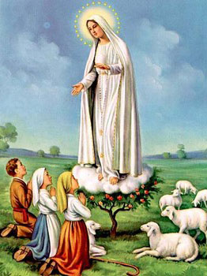
1. Dear Lady of Fatima we come on bended knee To beg your intercession for peace and unity. Dear Mary won't you show us the right and shining way? We pledge our love and offer you a Rosary each day.

Slide 66
2. You promised at Fatima Each time that you appeared To help us If we pray to you to banish war and fear. Dear Lady on first days we ask your guiding hand for grace and guidance here on earth protection for our land.

Slide 67
Ending Hymn:
On This Day

Slide 68
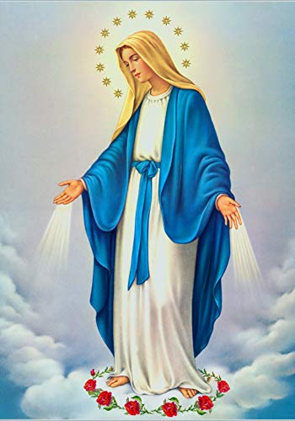
**. On this day, O beautiful Mother, On this day we give thee our love. Near the, Madonna, fondly we hover, Trusting thy gentle care to prove.

Slide 69
1. On this day we ask to share, Dearest Mother, thy sweet care; Aid us ere our feet astray Wanner from thy guiding way.

Slide 70
**. On this day, O beautiful Mother, On this day we give thee our love. Near the, Madonna, fondly we hover, Trusting thy gentle care to prove.

Slide 71
2. Queen of angels, deign to hear. Lisping children's humble prayer; Young hearts gain, O virgin pure, Sweetly to thyself allure.

Slide 72
THANK YOU
CÁM ƠN
MARAMING SALAMAT PO
MUCHAS GRACIAS
  நன்றி (Naṉṟi)

Slide 73
THANK YOU
CÁM ƠN
MARAMING SALAMAT PO
MUCHAS GRACIAS
  நன்றி (Naṉṟi)

