Slide 1
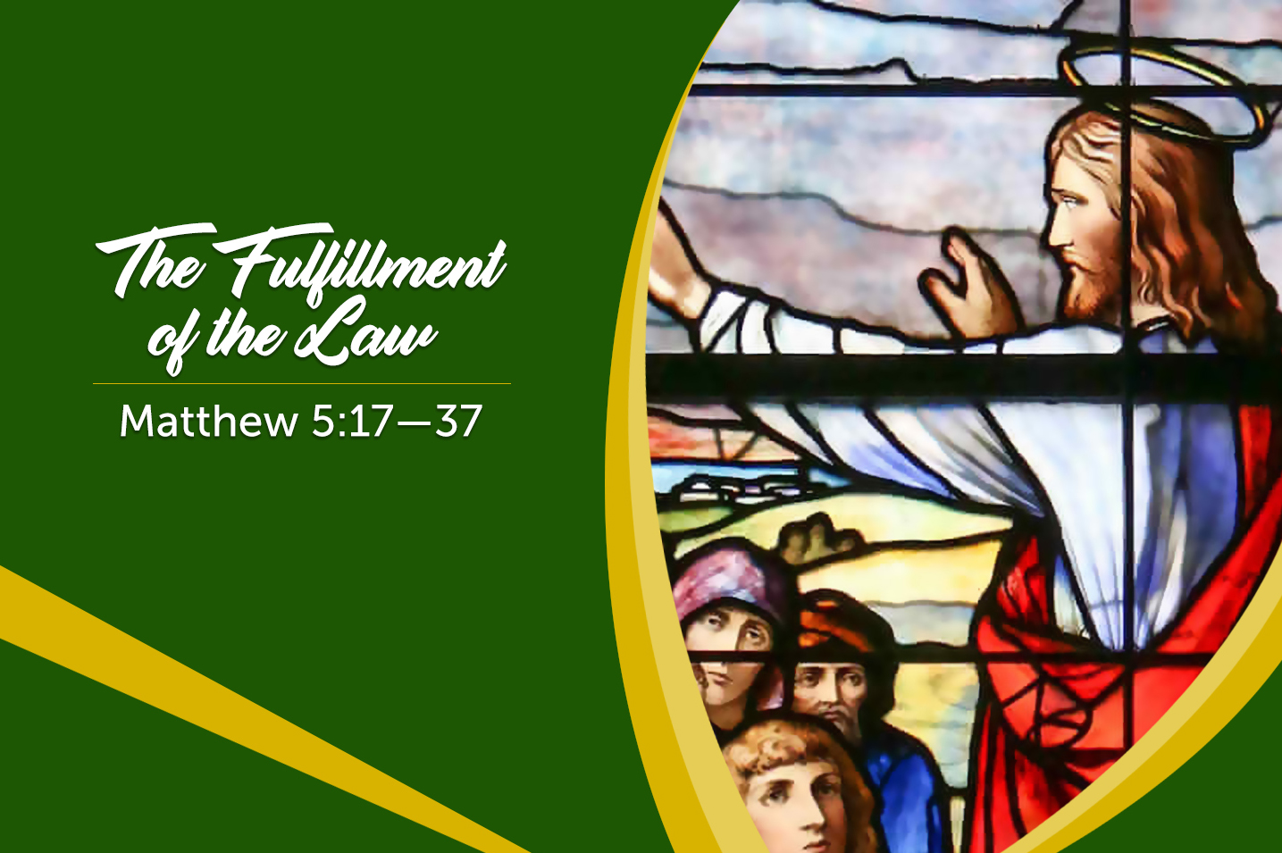
Welcome to Our Lady of Refuge Catholic Church
Sunday Ordinary Time 06 Year A
Gather Song:
Glory And Praise to Our God
Responsorial Psalm 119:
Follow the Law of the Lord
Prep. of the Gifts:
Only In God
Communion Song :
Gift of Finest Wheat
Recessional:
Rain Down

Slide 2
refrain: Glory and praise to our God, who alone gives light to our days. Many are the blessings he bears to those who trust in his ways.
1. We, the daughters and sons of him who built the valleys and plains. Praise the wonders our God has done in ev’ry heart that sings.

Slide 3
refrain: Glory and praise to our God, who alone gives light to our days. Many are the blessings he bears to those who trust in his ways.
2. In his wisdom he strengthens us, like gold that’s tested in fire. Though the power of sin prevails, our God is there to save.

Slide 4
Penitential Act

Slide 5
I confess to almighty God and to you, my brothers and sisters, that I have greatly sinned, in my thoughts and in my words,

Slide 6
in what I have done and in what I have failed to do, through my fault,
through my fault, through my most grievious fault;

Slide 7
therefore I ask blessed Mary ever-Virgin, all the Angels and Saints, and you, my brothers and sisters, to pray for me to the Lord our God.

Slide 8
Gloria Prayer

Slide 9
Refrain:
Glory to God, Glory to God. Glory to God in the highest, and on earth, peace on earth, peace to people of good will

Slide 10
1. We praise you, we bless you, we adore you, we glorify you, we give you thanks for your great glory. Lord God, heavenly King, O God, almighty Father.

Slide 11
2. Lord Jesus Christ, only Begotten Son, Lord God, Lamb of God, Son of the Father, you take away the sins of the world, have mercy on us. You take way the sins of the world, receive our pray you are seated at the right hand, the right hand of the Father, have mercy on us

Slide 12
3. For you alone are the Holy One, you alone are the Lord, you alone are the Most High, Jesus Christ with the Holy Spirit, in the glory of God the Father.

Slide 13
Refrain:
Glory to God, Glory to God. Glory to God in the highest, and on earth, peace on earth, peace to people of good will. Amen Amen.

Slide 14
Responsorial Psalm: Psalm 119 Follow the Law of the Lord

Slide 15
Responsorial Psalm 119:
Blessed are they who follow the law of the Lord!

Slide 16
Gospel Acclamation

Slide 17
Refrain: Alleluia!
Blessed are you, Father, Lord of heaven and earth;
you have revealed to little ones the mysteries of the kingdom.

Slide 18
Profession Of Faith Creed

Slide 19
Nicene Creed p1
I believe in one God, the Father almighty, maker of heaven and earth, of all things visible and invisible.

Slide 20
Nicene Creed p2
I believe in one Lord Jesus Christ, the Only Begotten Son of God, born of the Father before all ages.

Slide 21
Nicene Creed p3
God from God, Light from Light, true God from true God, begotten, not made, consubstantial with the Father; through Him all things were made.

Slide 22
Nicene Creed p4
For us men and for our salvation He came down from heaven, and by the Holy Spirit was incarnate of the Virgin Mary, and became man.

Slide 23
Nicene Creed p5
For our sake He was crucified under Pontius Pilate, He suffered death and was buried, and rose again on the third day in accordance with the Scriptures.

Slide 24
Nicene Creed p6
He ascended into heaven and is seated at the right hand of the Father.

Slide 25
Nicene Creed p7
He will come again in glory to judge the living and the dead and His kingdom will have no end.

Slide 26
Nicene Creed p8
I believe in the Holy Spirit, the Lord, the giver of life, who proceeds from the Father and the Son,

Slide 27
Nicene Creed p9
who with the Father and the Son is adored and glorified, who has spoken through the prophets.

Slide 28
Nicene Creed p10
I believe in one, holy, catholic and apostolic Church. I confess one Baptism for the forgiveness of sins

Slide 29
Nicene Creed p11
and I look forward to the resurrection of the dead and the life of the world to come. Amen.

Slide 30
Preparation of The Gift Song: Only in God

Slide 31
refrain: My stronghold my Savior I shall not be afraid at all My stronghold my Savior I shall not be moved
1. Only in God is my soul at rest In Him comes my salvation He only is my Rock My strength and my salvation

Slide 32
refrain: My stronghold my Savior I shall not be afraid at all My stronghold my Savior I shall not be moved
2. Only in God is found safety When the enemy pursues me Only in God is found glory When I am found meek and found lowly

Slide 33
Holy Holy Holy

Slide 34
Holy, Holy, Holy Lord God of hosts. Heaven and earth are full, are full of your glory. Hosanna, Hosanna! Hosanna in the highest.

Slide 35
Blessed is he who comes, who comes in the name of the Lord. Hosanna, Hosanna! Hosanna in the highest.

Slide 36
Memorial Acclamation

Slide 37
We proclaim your Death, O Lord, and profess your Resurrection until you come again.

Slide 38
Amen

Slide 39
Amen, Amen, Amen.

Slide 40
Lamb Of God

Slide 41
Lamb of God you take away the sins of the world. Have mercy on us. (repeat as needed)
Lamb of God you take away the sins of the world.
grant us peace.

Slide 42
Communion respond

Slide 43
Behold the Lamb of God,
behold him who takes away the sins of the world.
Blessed are those called to the supper of the Lamb. Lord, I am not worthy
that You should enter under my roof, but only say the word and my soul shall be healed.

Slide 44
Communion Hymn 1 Gift Of Finest Wheat

Slide 45
Refrain: You satisfy the hungry heart, with gift of finest wheat, come give to us o saving Lord, the bread of life to eat.
1. As when the shepherd calls his sheep, they know and heed his voice; so when You call Your family Lord, we follow and rejoice.

Slide 46
Refrain: You satisfy the hungry heart, with gift of finest wheat, come give to us o saving Lord, the bread of life to eat.
2. With joyful lips we sing to You, our praise and gratitude. That You should count us worthy Lord, to share this heavenly food.

Slide 47
Refrain: You satisfy the hungry heart, with gift of finest wheat, come give to us o saving Lord, the bread of life to eat.
3. Is not the cup we bless and share The blood of Christ outpoured? Do not one cup, one loaf, declare our oneness in the Lord?

Slide 48
Refrain: You satisfy the hungry heart, with gift of finest wheat, come give to us o saving Lord, the bread of life to eat.
4. The mystery of Your presence Lord, no mortal tongue can tell; whom all the world cannot contain comes in our hearts to dwell.

Slide 49
Refrain: You satisfy the hungry heart, with gift of finest wheat, come give to us o saving Lord, the bread of life to eat.
5. You give yourself to us o Lord, then selfless let us be, to serve each other in Your name in truth and charity.

Slide 50
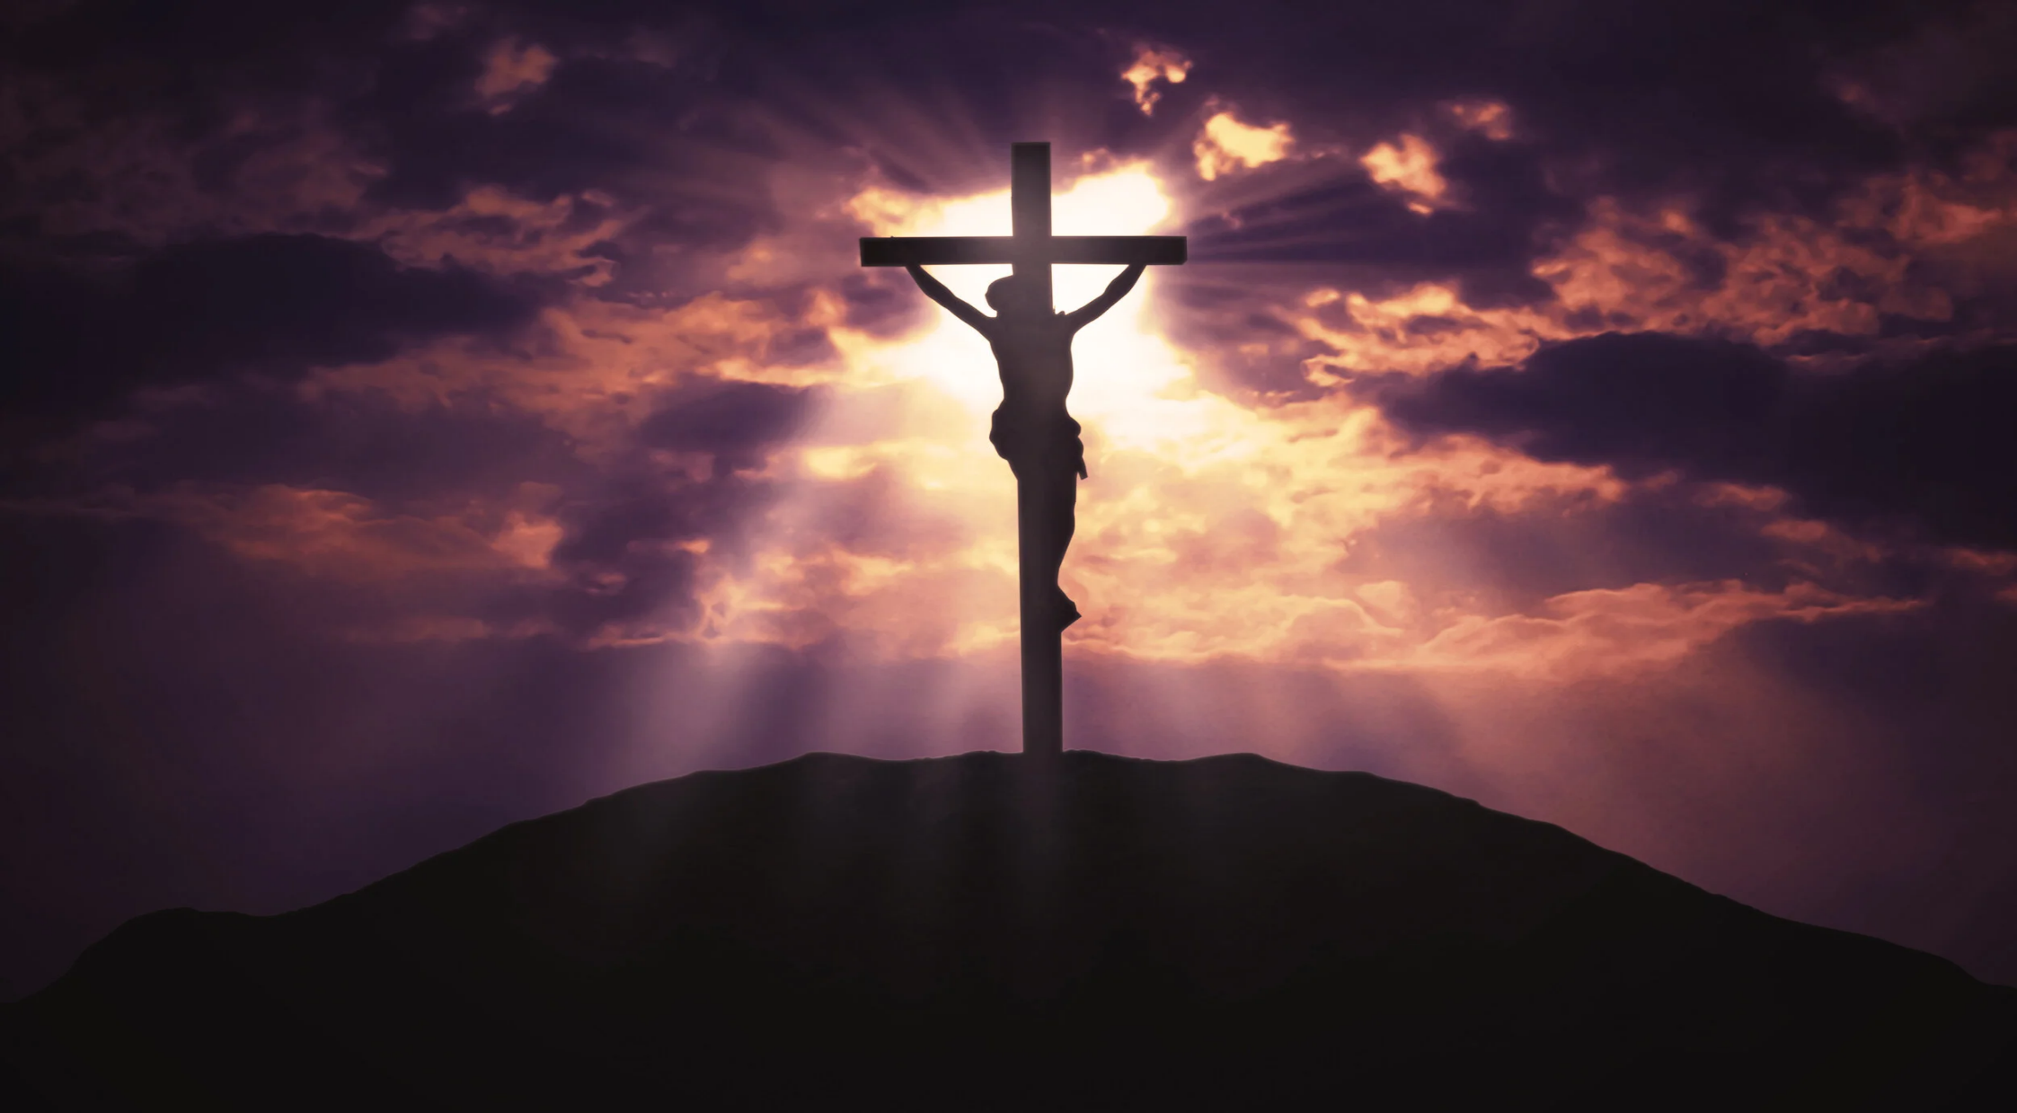
Communion Hymn 2 Lord, You Have Come

Slide 51
1. Lord, you have come to the seashore, neither searching for the rich nor the wise, desiring only that I should follow.
* O Lord, with your eyes set upon me, gently smiling, you have spoke my name; all I longed for I have found by the water, at your side, I will seek other shores.

Slide 52
2. Lord, see my goods, my possessions; in my boat you find no power, no wealth. Will you accept, then, my nets and labor?
* O Lord, with your eyes set upon me, gently smiling, you have spoke my name; all I longed for I have found by the water, at your side, I will seek other shores.

Slide 53
3. Lord, take my hands and direct them. Help me spend myself in seeking the lost, returning love for the love you gave me.
* O Lord, with your eyes set upon me, gently smiling, you have spoke my name; all I longed for I have found by the water, at your side, I will seek other shores.

Slide 54
4. Lord, as I drift on the waters, be the resting place of my restless heart, my life’s companion, my friend and refuge.
* O Lord, with your eyes set upon me, gently smiling, you have spoke my name; all I longed for I have found by the water, at your side, I will seek other shores.

Slide 55
Sending Hymn Rain Down

Slide 56
Refrain:
Rain down, rain down,
rain down
your love on your people.
Rain down, rain down,
rain down
Your Love, God of life.

Slide 57
1. Faithful and true is the Word
of our God All of God's works are so
worthy of trust God's mercy falls on the just and the right Full of God's love is the earth

Slide 58
Refrain:
Rain down, rain down,
rain down
your love on your people.
Rain down, rain down,
rain down
Your Love, God of life.

Slide 59
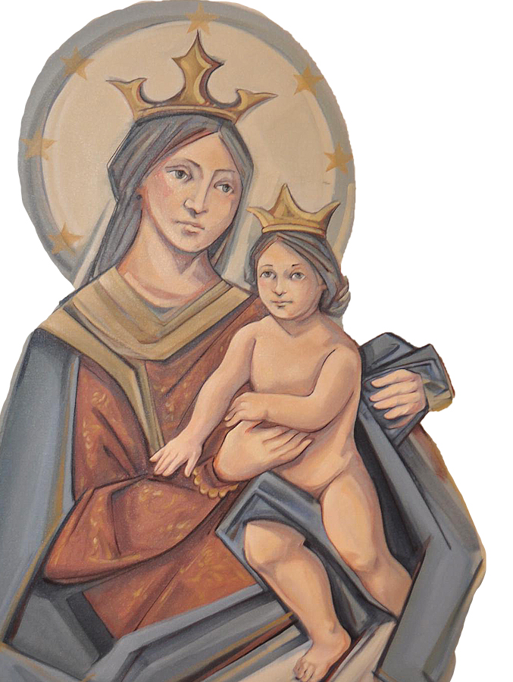
THANK YOU
CÁM ƠN
MARAMING SALAMAT PO
MUCHAS GRACIAS
நன்றி (Nanri)

