Slide 1
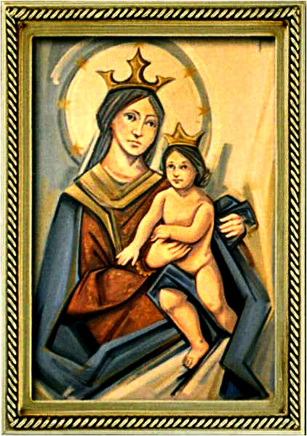
Pentecost Sunday
Gather Hymn:
Come, Holy Ghost
Sprinkling Rite Hymn:
Water Of Life
Responsorial Psalm: 103
Lord, Send out your Spirit
Pentecost Sequence
Come, O Holy Spirit
Prep. of the Gifts Hymn:
Send Out Your Spirit
Communion Hymn:
Spirit and Grace
Recessional Hymn:
Tell The Good News

Slide 2
1a. Come Holy Ghost, Creator blest, And in our hearts take up thy rest; Come with thy grace and heavenly aid.
To fill the hearts which thou hast made; To fill the hearts which thou hast made

Slide 3
2a. O Comforter, to thee we cry, Thou heavenly gift of God most high; Thou font of life and fire of love.
And sweet anointing from above; And sweet anointing from above.

Slide 4
3a. Praise be to thee Father and Son, and Holy Spirit, with them one; And may the Son on us bestow.
The gifts that from the Spirit flow; The gifts that from the Spirit flow.

Slide 5
Penitential Act (Confiteor 2011) 1 of 3:

Slide 6
I confess to almighty God and to you, my brothers and sisters, that I have greatly sinned, in my thoughts and in my words,

Slide 7
in what I have done and in what I have failed to do, through my fault,
through my fault, through my most grievious fault;

Slide 8
therefore I ask blessed Mary ever-Virgin, all the Angels and Saints, and you, my brothers and sisters, to pray for me to the Lord our God.

Slide 9
Water of Life

Slide 10
Water of life, holy reminder; touching, renewing the body of Christ. Water of life, holy reminder; touching, renewing the body of life.

Slide 11
4. All generations, com forth and receive the blessing of this holy water; making us one with the God who forgives, the one who is faithful and just.

Slide 12
Water of life, holy reminder; touching, renewing the body of Christ. Water of life, holy reminder; touching, renewing the body of life.

Slide 13
5. Bringing new hope to the children of God, regardless of color or story; Cleansing our spirits with kindness and truth, and keeping the promise a live

Slide 14
Water of life, holy reminder; touching, renewing the body of Christ. Water of life, holy reminder; touching, renewing the body of life.

Slide 15
5. Deep as the heavens and wide as the sea, your mercy and love have no ending. Guiding our steps in the journey of faith, you show us the way to your king dom.

Slide 16
Gloria Hymn

Slide 17
Refrain:
Glory to God, Glory to God. Glory to God in the highest, and on earth, peace on earth, peace to people of good will

Slide 18
1. We praise you, we bless you, we adore you, we glorify you, we give you thanks for your great glory. Lord God, heavenly King, O God, almighty Father.

Slide 19
Refrain:
Glory to God, Glory to God. Glory to God in the highest, and on earth, peace on earth, peace to people of good will

Slide 20
2. Lord Jesus Christ, only Begotten Son, Lord God, Lamb of God, Son of the Father, you take away the sins of the world, have mercy on us. You take way the sins of the world, receive our pray you are seated at the right hand, the right hand of the Father, have mercy on us

Slide 21
Refrain:
Glory to God, Glory to God. Glory to God in the highest, and on earth, peace on earth, peace to people of good will

Slide 22
3. For you alone are the Holy One, you alone are the Lord, you alone are the Most High, Jesus Christ with the Holy Spirit, in the glory of God the Father.

Slide 23
Refrain:
Glory to God, Glory to God. Glory to God in the highest, and on earth, peace on earth, peace to people of good will. Amen Amen.

Slide 24
Responsorial Psalm: Psalm 47 God Mounts His Throne To Shouts of Joy

Slide 25
Responsorial Psalm: Psalm 47 God mounts his throne to shouts of joy: a blare of trumpets for the Lord

Slide 26
Pentecost Ssquence

Slide 27
1. Come holy spirit , Come ! And from your celestial home. Shed a ray of light divine! Come, Holy Spirit, come! Come, O Father of the poor! Come, O Source of all our store! Come, within our bosoms shine! Come, O Holy Spirit, Come!

Slide 28
2. You, of comforters the best; You, the soul’s most welcome guest; Sweet refreshment here below; Come O Holy Spirit, Come! In our Labor, rest most sweet; Grateful coolness in the heat; Solace in the midst of woe. Come, O holy Spirit, come!

Slide 29
3. O most blessed Light divine, May that Light within us shine, and our inmost being fill. Come, O holy Spirit, come! In your absence, we have naught, Nothing good in deed or thought, Nothing free from taint of ill. Come, O Holy Spirit, come!

Slide 30
Gospel Acclamation

Slide 31
Alleluia Alleluia Alleluia. Go and teach all nations, says the Lord; I am with you always, until the end of the world.

Slide 32
Profession Of Faith Creed

Slide 33
Nicene Creed p1
I believe in one God, the Father almighty, maker of heaven and earth, of all things visible and invisible.

Slide 34
Nicene Creed p2
I believe in one Lord Jesus Christ, the Only Begotten Son of God, born of the Father before all ages.

Slide 35
Nicene Creed p3
God from God, Light from Light, true God from true God, begotten, not made, consubstantial with the Father; through Him all things were made.

Slide 36
Nicene Creed p4
For us men and for our salvation He came down from heaven, and by the Holy Spirit was incarnate of the Virgin Mary, and became man.

Slide 37
Nicene Creed p5
For our sake He was crucified under Pontius Pilate, He suffered death and was buried, and rose again on the third day in accordance with the Scriptures.

Slide 38
Nicene Creed p6
He ascended into heaven and is seated at the right hand of the Father.

Slide 39
Nicene Creed p7
He will come again in glory to judge the living and the dead and His kingdom will have no end.

Slide 40
Nicene Creed p8
I believe in the Holy Spirit, the Lord, the giver of life, who proceeds from the Father and the Son,

Slide 41
Nicene Creed p9
who with the Father and the Son is adored and glorified, who has spoken through the prophets.

Slide 42
Nicene Creed p10
I believe in one, holy, catholic and apostolic Church. I confess one Baptism for the forgiveness of sins

Slide 43
Nicene Creed p11
and I look forward to the resurrection of the dead and the life of the world to come. Amen.

Slide 44
Preparation of The Gift Song: Send out your Spirit

Slide 45
1. How many are your works, O Lord, in wisdom you have made them all, the moon to mark the end of day, the sun to rise and light our way.
Send out your Spirit upon the earth and let your Spirit bring us to birth. Send out your Spirit and make us new till all creation returns to you.

Slide 46
2. Your majesty and glory tell the wonder of the place you dwell. The waters and the winds obey like messengers upon their way.
Send out your Spirit upon the earth and let your Spirit bring us to birth. Send out your Spirit and make us new till all creation returns to you.

Slide 47
3. You set the earth upon its base from age to age in time and space. The universe your care conveys, the planets echo with your praise.
Send out your Spirit upon the earth and let your Spirit bring us to birth. Send out your Spirit and make us new till all creation returns to you.

Slide 48
4. You give the cattle grass to feed, you make the plants to serve our need. We bring forth bread and wine to share. You signs of love are everywhere.
Send out your Spirit upon the earth and let your Spirit bring us to birth. Send out your Spirit and make us new till all creation returns to you.

Slide 49
Holy Holy

Slide 50
Holy, Holy, Holy Lord God of hosts. Heaven and earth are full, are full of your glory. Hosanna, Hosanna! Hosanna in the highest.

Slide 51
Blessed is he who comes, who comes in the name of the Lord. Hosanna, Hosanna! Hosanna in the highest.

Slide 52
Memorial Acclamation

Slide 53
We proclaim your Death, O Lord, and profess your Resurrection until you come again.

Slide 54
Amen

Slide 55
Amen, Amen. Amen, Amen Amen, Amen
Amen. Amen.

Slide 56
Lamb Of God

Slide 57
Lamb of God your take away the sins of the world. Have mercy on us. (repeat as needed)
Lamb of God your take away the sins of the world.
grant us peace.

Slide 58
Communion respond

Slide 59
Behold the Lamb of God,
behold him who takes away the sins of the world.
Blessed are those called to the supper of the Lamb. Lord, I am not worthy
that You should enter under my roof, but only say the word and my soul shall be healed.

Slide 60
Communion Hymn 1: Spirit and Grace

Slide 61
1. Spirit and grace, here in this meal; you are the wind that breathes through the field Gather the wheat and form us in Christ. Come, be our source and breath of life

Slide 62
Refrain: In the bread, blessed, broken and shared. Christ is our life, whose presence we bear Come, O spirit, make your grace revealed. in this holy meal.

Slide 63
2. Spirit and grace, here in this meal; you are the life: that flows through the wine. Gather this drink and form us in Christ. Come, be our source and blood of life.

Slide 64
Refrain: In the bread, blessed, broken and shared. Christ is our life, whose presence we bear Come, O spirit, make your grace revealed. in this holy meal.

Slide 65
3. Spirit and grace, here in this place; you are the light that shines in this space. Gather your people and form us in Christ. Come, be the heartbeat of our lives.

Slide 66
Refrain: In the bread, blessed, broken and shared. Christ is our life, whose presence we bear Come, O spirit, make your grace revealed. in this holy meal.

Slide 67
Announcements:

Slide 68
1. Today’s second collection today is for the Building Fund. This fund helps to maintain, repair, and improve our buildings and facilities. Thank you for your month to month commitment to contribute to this fund.

Slide 69
2. We are happy to report on the seventeenth week of ADA 2025 campaign results with 8 families pledging a total amount of $2,110 dollars, for a total pledged amount of $151,075 dollars.

Slide 70
Given this result we are $66,673 dollars above the diocesan’s goal of $84,402 dollars, so thanks to all of you who already made your pledge.

Slide 71
We still want to encourage 100% participation from all families attending Masses here, because all new pledges received from now on will be reimbursed to our parish. Thank you all for your support.

Slide 72
3. 3. On Sunday July 20th, 2025 a vocations soccer game will be held at the Archbishop Mitty High School Soccer Field from 4:30pm to 8pm. Admission is $10 dollars per ticket, also you can participate in a raffle by buying tickets at $10 dollars each.

Slide 73
All funds collected will be used to support seminarians and their formation program. Tickets on sale st the parish office during its working hours.

Slide 74
3. 4. Last week, our Sunday collections for the parish totaled $11,229 dollars. The parish week-to-week financial report is available on the parish webpage and the weekly bulletin.

Slide 75
Ending Hymn: Tell The Good News

Slide 76
1. Tell the good news to all the earth: Jesus reveals our human worth. Let every heart to joy give birth!
Alleluia Alleluia alleluia!

Slide 77
2. Filled with the Spirit Jesus came Healing the sick, the blind and lame. Let every creature praise his name!
Alleluia Alleluia alleluia!

Slide 78
3. Filled with the Spirit forth we go; Jesus' own word, the seed we sow. Let every land the gospel know!
Alleluia Alleluia alleluia!

Slide 79
Ending Hymn: Dear Lady Of Fatima

Slide 80
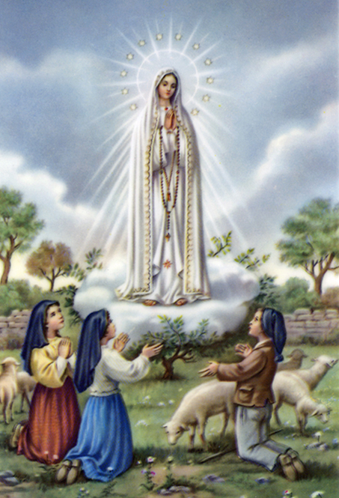
1a. Dear Lady of Fatima we come on bended knee to beg your intercession for peace and unity.

Slide 81
1b. Dear Mary won’t you show us the right and shining way? We pledge our love and offer you a Rosary each day.

Slide 82
2a. You promised at Fatima each time that you appeard to help us. If we pray to youto banish war and fear.

Slide 83
2b. Dear Lady on first Saturday we ask your guidding hand for grace and guidance here on earth and protection for our hand.

Slide 84
Ending Hymn: On This Day

Slide 85
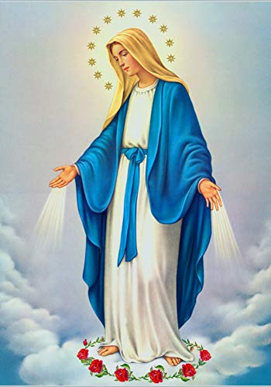
**. On this day, O beautiful Mother, On this day we give thee our love. Near the, Madonna, fondly we hover, Trusting thy gentle care to prove.

Slide 86
1. On this day we ask to share, Dearest Mother, thy sweet care; Aid us ere our feet astray Wanner from thy guiding way.

Slide 87
**. On this day, O beautiful Mother, On this day we give thee our love. Near the, Madonna, fondly we hover, Trusting thy gentle care to prove.

Slide 88
2. Queen of angels, deign to hear. Lisping children's humble prayer; Young hearts gain, O virgin pure, Sweetly to thyself allure.

Slide 89
THANK YOU
CÁM ƠN
MARAMING SALAMAT PO
MUCHAS GRACIAS
நன்றி (Naṉṟi)

Slide 90
THANK YOU
CÁM ƠN
MARAMING SALAMAT PO
MUCHAS GRACIAS
நன்றி (Naṉṟi)

