Slide 1
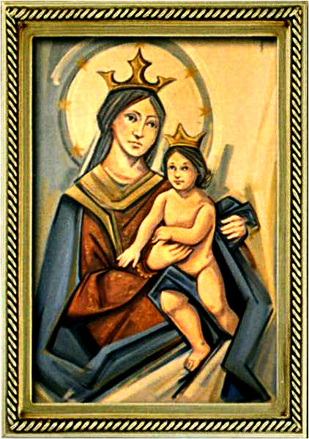
Ordinary Time 18 Year C
Gather Hymn:
Rain Down
Responsorial Psalm: 94
If You Hear His Voice
Prep. of the Gifts Hymn:
Only in God
Communion Hymn:
Behold the Body Of Christ.
Recessional Hymn:
Lead Me Lord

Slide 2
Refrain:
Rain down, rain down,
rain down
your love on your people.
Rain down, rain down,
rain down
Your Love, God of life.

Slide 3
1. Faithful and true is the Word
of our God All of God's works are so
worthy of trust God's mercy falls on the just and the right Full of God's love is the earth

Slide 4
Refrain:
Rain down, rain down,
rain down
your love on your people.
Rain down, rain down,
rain down
Your Love, God of life.

Slide 5
3. God of creation, we long for
Your truth You are the water of
life that we thirst Grant that Your
love and peace touch our hearts
All of our hope lies in You.

Slide 6
Refrain:
Rain down, rain down,
rain down
your love on your people.
Rain down, rain down,
rain down
Your Love, God of life.

Slide 7
Penitential Act (Confiteor 2011) 1 of 3:

Slide 8
I confess to almighty God and to you, my brothers and sisters, that I have greatly sinned, in my thoughts and in my words,

Slide 9
in what I have done
and in what I have failed to do,
through my fault,
through my fault,
through my most grievious fault;

Slide 10
therefore I ask blessed Mary ever-Virgin, all the Angels and Saints, and you, my brothers and sisters, to pray for me to the Lord our God.

Slide 11
Gloria Hymn

Slide 12
Refrain:
Glory to God, Glory to God. Glory to God in the highest, and on earth, peace on earth, peace to people of good will

Slide 13
1. We praise you, we bless you, we adore you, we glorify you, we give you thanks for your great glory. Lord God, heavenly King, O God, almighty Father.

Slide 14
Refrain:
Glory to God, Glory to God. Glory to God in the highest, and on earth, peace on earth, peace to people of good will

Slide 15
2. Lord Jesus Christ, only Begotten Son, Lord God, Lamb of God, Son of the Father, you take away the sins of the world, have mercy on us. You take way the sins of the world, receive our pray you are seated at the right hand, the right hand of the Father, have mercy on us

Slide 16
Refrain:
Glory to God, Glory to God. Glory to God in the highest, and on earth, peace on earth, peace to people of good will

Slide 17
3. For you alone are the Holy One, you alone are the Lord, you alone are the Most High, Jesus Christ with the Holy Spirit, in the glory of God the Father.

Slide 18
Refrain:
Glory to God, Glory to God. Glory to God in the highest, and on earth, peace on earth, peace to people of good will. Amen Amen.

Slide 19
Responsorial Psalm: 95
If Today You Hear His Voice

Slide 20
Responsorial Psalm: Psalm 95 if Today you hear his voice, harden not your hearts, harden not your hearts

Slide 21
Gospel Acclamation

Slide 22
Alleluia Alleluia Alleluia.
Blessed are the poor in spirt, for theirs is the kingdom of heaven.

Slide 23
Profession Of Faith
Creed

Slide 24
Nicene Creed p1
I believe in one God, the Father almighty, maker of heaven and earth, of all things visible and invisible.

Slide 25
Nicene Creed p2
I believe in one Lord Jesus Christ, the Only Begotten Son of God, born of the Father before all ages.

Slide 26
Nicene Creed p3
God from God, Light from Light, true God from true God, begotten, not made, consubstantial with the Father; through Him all things were made.

Slide 27
Nicene Creed p4
For us men and for our salvation He came down from heaven, and by the Holy Spirit was incarnate of the Virgin Mary, and became man.

Slide 28
Nicene Creed p5
For our sake He was crucified under Pontius Pilate, He suffered death and was buried, and rose again on the third day in accordance with the Scriptures.

Slide 29
Nicene Creed p6
He ascended into heaven and is seated at the right hand of the Father.

Slide 30
Nicene Creed p7
He will come again in glory to judge the living and the dead and His kingdom will have no end.

Slide 31
Nicene Creed p8
I believe in the Holy Spirit, the Lord, the giver of life, who proceeds from the Father and the Son,

Slide 32
Nicene Creed p9
who with the Father and the Son is adored and glorified, who has spoken through the prophets.

Slide 33
Nicene Creed p10
I believe in one, holy, catholic and apostolic Church. I confess one Baptism for the forgiveness of sins

Slide 34
Nicene Creed p11
and I look forward to the resurrection of the dead and the life of the world to come. Amen.

Slide 35
Preparation of The Gift Song:
Only in God

Slide 36
refrain: My stronghold my Savior
I shall not be afraid at all
My stronghold my Savior
I shall not be moved
1. Only in God is my soul at rest
In Him comes my salvation
He only is my Rock
My strength and my salvation

Slide 37
refrain: My stronghold my Savior
I shall not be afraid at all
My stronghold my Savior
I shall not be moved
2. Only in God is found safety
When the enemy pursues me
Only in God is found glory
When I am found meek and found lowly

Slide 38
Holy Holy

Slide 39
Holy, Holy, Holy Lord God of hosts.
Heaven and earth are full, are full of your glory. Hosanna, Hosanna! Hosanna in the highest.

Slide 40
Blessed is he who comes, who comes in the name of the Lord.
Hosanna, Hosanna! Hosanna in the highest.

Slide 41
Memorial Acclamation

Slide 42
We proclaim your Death, O Lord,
and profess your Resurrection until you come again.

Slide 43
Amen

Slide 44
Amen, Amen.
Amen, Amen
Amen, Amen
Amen. Amen.

Slide 45
Lamb Of God

Slide 46
Lamb of God your take away the sins of the world. Have mercy on us. (repeat as needed)
Lamb of God your take away the sins of the world.
grant us peace.

Slide 47
Communion respond

Slide 48
Behold the Lamb of God,
behold him who takes away the sins of the world.
Blessed are those called to the supper of the Lamb.
Lord, I am not worthy
that You should enter under my roof, but only say the word and my soul shall be healed.

Slide 49
Communion Hymn 1:
Behold the Body Of Chrsit

Slide 50
1a. In the presence of our God, as we gather here in Christ, feel the Spirit breathe upon us, the breath of life, graced and divine.

Slide 51
1b. We have come to break the bread; we have come to share our lives. Let us bring these fruits to the table. the love of God, yours and mine!

Slide 52
(Refrain) Ang katawan ni Kristo, ang katawan ni Kristo. Behold the body of Christ! Jesus, our Savior and Life! Rejoice, O People of God! We are the Body of Christ!

Slide 53
2a. When we gather in our homes, through our prayers and our meals, we are fed and nourished together, our families, broken and blessed.

Slide 54
2b. In the household of the Lord, Where we come to share the meal, we are fed the words of our savior, one family strengthened and healed.

Slide 55
(Refrain) Ang katawan ni Kristo, ang katawan ni Kristo. Behold the body of Christ! Jesus, our Savior and Life! Rejoice, O People of God! We are the Body of Christ!

Slide 56
(Bridge) Is not the meal that we bless and share a communion in the life of Christ? One bread, one blessing one cup make us one body in our Lord.

Slide 57
3. In the presence of our God, by the justice that is shown, we will build a kingdom together; the love of Christ given to all!

Slide 58
(Refrain) Ang katawan ni Kristo, ang katawan ni Kristo. Behold the body of Christ! Jesus, our Savior and Life! Rejoice, O People of God! We are the Body of Christ!

Slide 59
Announcements:

Slide 60
1. Today’s 2nd collection is for the Building Fund. This fund helps to maintain, repair, and improve our buildings and facilities. Thank you for your month-to-month commitment to contribute to this fund.

Slide 61
2. We are pleased to announce that the registration period has been extended through August 15, 2025.
Families wishing to enroll their children or youth in the following programs:
• First Communion
• Confirmation (Grades 9-12)
• OCIA for Adults
• OCIC for children (ages 7 and older)

Slide 62
must present the following original documents at the time of registration:
Birth Certificate
Baptismal Certificate
First Communion Certificate (if the sacrament has already been received)

Slide 63
For more information or to register, please contact Arturo Reyes at 408-715-2276.
We thank all families for their commitment to growing in faith and sharing the journey with our parish community.

Slide 64
3. Last week, our Sunday collections for the parish totaled $9,203 dollars.
The parish week-to-week financial report is available on the parish webpage and the weekly bulletin.

Slide 66
Ending Hymn:
Lead Me Lord

Slide 67
1. Blessed are the poor in spirit, longing for their Lord. For God’s coming kingdom shall be theirs. Blessed are the sorrowing, for they shall be consoled, and the meek shall come to rule the world.

Slide 68
** Lead me, Lord. Lead me, Lord, By the light of truth to seek and to find the narrow way. Be my way, be my truth; Be my life, my Lord, and lead me, Lord, today.

Slide 69
2. Blessed are the merciful, for mercy shall be theirs, and the pure in heart shall see their God. Blest are they whose hunger only holiness can fill. For I say they shall be satisfied.

Slide 70
** Lead me, Lord. Lead me, Lord, By the light of truth to seek and to find the narrow way. Be my way, be my truth; Be my life, my Lord, and lead me, Lord, today.

Slide 71
Ending Hymn:
Lady Of Fatima

Slide 72
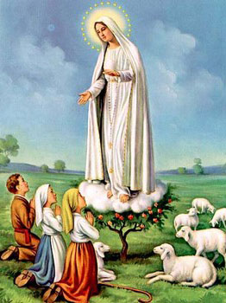
1. Dear Lady of Fatima we come on bended knee To beg your intercession for peace and unity. Dear Mary won't you show us the right and shining way? We pledge our love and offer you a Rosary each day.

Slide 73
2. You promised at Fatima Each time that you appeared To help us If we pray to you to banish war and fear. Dear Lady on first days we ask your guiding hand for grace and guidance here on earth protection for our land.

Slide 74
Ending Hymn:
On This Day

Slide 75
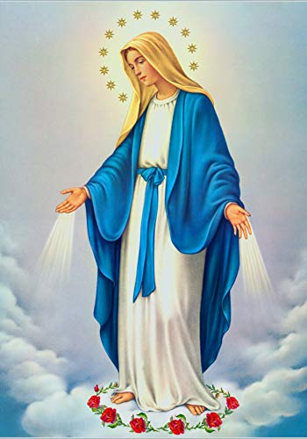
**. On this day, O beautiful Mother, On this day we give thee our love. Near the, Madonna, fondly we hover, Trusting thy gentle care to prove.

Slide 76
1. On this day we ask to share, Dearest Mother, thy sweet care; Aid us ere our feet astray Wanner from thy guiding way.

Slide 77
**. On this day, O beautiful Mother, On this day we give thee our love. Near the, Madonna, fondly we hover, Trusting thy gentle care to prove.

Slide 78
2. Queen of angels, deign to hear. Lisping children's humble prayer; Young hearts gain, O virgin pure, Sweetly to thyself allure.

Slide 79
THANK YOU
CÁM ƠN
MARAMING SALAMAT PO
MUCHAS GRACIAS
  நன்றி (Naṉṟi)

Slide 80
THANK YOU
CÁM ƠN
MARAMING SALAMAT PO
MUCHAS GRACIAS
  நன்றி (Naṉṟi)

