Slide 1
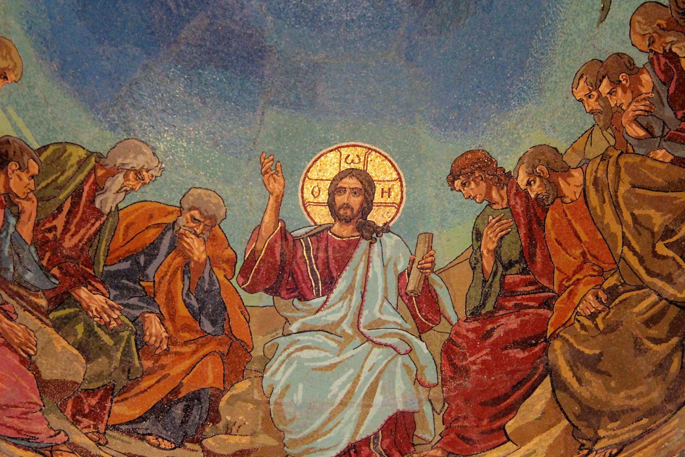
Welcome to Our Lady of Refuge Catholic Church
Sunday Ordinary Time 21th Year A
Gather Song:
God Of Mercy
Responsorial Psalm 138:
Lord Your Love is Eternal
Prep. of the Gifts:
The Summons
Communion Song :
Bread of Life
Recessional:
The Church Of One Foundation

Slide 2
refrain: God of mercy holy mystery ever faithful one, you have pitched your tent among us, reconciling love heart and mind of Christ, live within our lives.

Slide 3
1. You have called us each by name in your great compassion encompassing our failings with mercy. God of mercy lead us.

Slide 4
refrain: God of mercy holy mystery ever faithful one, you have pitched your tent among us, reconciling love heart and mind of Christ, live within our lives.

Slide 5
2. Slow to anger, rich in love, you bestow forgiveness. May we, in turn, forgive those who harm us. God of mercy lead us.

Slide 6
refrain: God of mercy holy mystery ever faithful one, you have pitched your tent among us, reconciling love heart and mind of Christ, live within our lives.

Slide 7
3. In our midst as one who pain, wounded down divisions, to all in need you send us as neighbor. God of mercy lead us.

Slide 8
refrain: God of mercy holy mystery ever faithful one, you have pitched your tent among us, reconciling love heart and mind of Christ, live within our lives.

Slide 9
4. Reaching out to those in pain, wounded and abandoned, may we create safe havens for healing. God of mercy lead us.

Slide 10
refrain: God of mercy holy mystery ever faithful one, you have pitched your tent among us, reconciling love heart and mind of Christ, live within our lives.

Slide 11
5. In the word of truth you speak, word of hope and chalenge , you summon us to speak for the voiceless. God of mercy lead us.

Slide 12
refrain: God of mercy holy mystery ever faithful one, you have pitched your tent among us, reconciling love heart and mind of Christ, live within our lives.

Slide 13
6. In this Bread we break and share in this Cup of blessing, you summon us to work for true justice. God of mercy lead us.

Slide 14
refrain: God of mercy holy mystery ever faithful one, you have pitched your tent among us, reconciling love heart and mind of Christ, live within our lives.

Slide 15
Penitential Act

Slide 16
I confess to almighty God and to you, my brothers and sisters, that I have greatly sinned, in my thoughts and in my words,

Slide 17
in what I have done
and in what I have failed to do,
through my fault,
through my fault,
through my most grievious fault;

Slide 18
therefore I ask blessed Mary ever-Virgin, all the Angels and Saints, and you, my brothers and sisters, to pray for me to the Lord our God.

Slide 19
Gloria Prayer

Slide 20
Refrain:
Glory to God, Glory to God. Glory to God in the highest, and on earth, peace on earth, peace to people of good will

Slide 21
1. We praise you, we bless you, we adore you, we glorify you, we give you thanks for your great glory. Lord God, heavenly King, O God, almighty Father.

Slide 22
2. Lord Jesus Christ, only Begotten Son, Lord God, Lamb of God, Son of the Father, you take away the sins of the world, have mercy on us. You take way the sins of the world, receive our pray you are seated at the right hand, the right hand of the Father, have mercy on us

Slide 23
3. For you alone are the Holy One, you alone are the Lord, you alone are the Most High, Jesus Christ with the Holy Spirit, in the glory of God the Father.

Slide 24
Refrain:
Glory to God, Glory to God. Glory to God in the highest, and on earth, peace on earth, peace to people of good will. Amen Amen.

Slide 25
Psalm 138
Lord, Your Love is Eternal

Slide 26
Responsorial Psalm 138:
Lord, your love is eternal, do not forsake the work of your hands.

Slide 27
Gospel Acclamation

Slide 28
Refrain: Alleluia!
You are Peter and upon this rock I will build my Church and the
gates of the netherworld shall not prevail against it.

Slide 29
Profession of Faith

Slide 30
Nicene Creed p1
I believe in one God, the Father almighty, maker of heaven and earth, of all things visible and invisible.

Slide 31
Nicene Creed p2
I believe in one Lord Jesus Christ, the Only Begotten Son of God, born of the Father before all ages.

Slide 32
Nicene Creed p3
God from God, Light from Light, true God from true God, begotten, not made, consubstantial with the Father; through Him all things were made.

Slide 33
Nicene Creed p4
For us men and for our salvation He came down from heaven, and by the Holy Spirit was incarnate of the Virgin Mary, and became man.

Slide 34
Nicene Creed p5
For our sake He was crucified under Pontius Pilate, He suffered death and was buried, and rose again on the third day in accordance with the Scriptures.

Slide 35
Nicene Creed p6
He ascended into heaven and is seated at the right hand of the Father.

Slide 36
Nicene Creed p7
He will come again in glory to judge the living and the dead and His kingdom will have no end.

Slide 37
Nicene Creed p8
I believe in the Holy Spirit, the Lord, the giver of life, who proceeds from the Father and the Son,

Slide 38
Nicene Creed p9
who with the Father and the Son is adored and glorified, who has spoken through the prophets.

Slide 39
Nicene Creed p10
I believe in one, holy, catholic and apostolic Church. I confess one Baptism for the forgiveness of sins

Slide 40
Nicene Creed p11
and I look forward to the resurrection of the dead and the life of the world to come. Amen.

Slide 41
Preparation of The Gift Song
The Summons

Slide 42
1. Will you come and follow me if I but call your name?
Will you go where you don't know and never be the same?
Will you let my love be shown? Will you let my name be known, will you let my life be grown in you and you in me?

Slide 43
2. Will you leave yourself behind if I but call your name?
Will you care for cruel and kind and never be the same?
Will you risk the hostile stare should your life attract or scare?
Will you let me answer prayer in you and you in me?

Slide 44
3. Will you let the blinded see if I but call your name?
Will you set the prisoners free and never be the same?
Will you kiss the leper clean and do such as this unseen, and admit to what I mean in you and you in me?

Slide 45
4. Will you love the "you" you hide if I but call your name?
Will you quell the fear inside and never be the same?
Will you use the faith you've found to reshape the world around, through my sight and touch and sound in you and you in me?

Slide 46
5. Lord your summons echoes true when you but call my name.
Let me turn and follow you and never be the same.
In Your company I'll go where Your love and foot steps show.
Thus I'll move and live and grow in you and you in me.

Slide 47
Holy Holy Holy

Slide 48
Holy, Holy, Holy Lord God of hosts.
Heaven and earth are full, are full of your glory. Hosanna, Hosanna! Hosanna in the highest.

Slide 49
Blessed is he who comes, who comes in the name of the Lord.
Hosanna, Hosanna! Hosanna in the highest.

Slide 50
Memorial acclamation

Slide 51
We proclaim your Death, O Lord,
and profess your Resurrection until you come again.
Memorial acclamation

Slide 52
Amen

Slide 53
Amen Amen Amen

Slide 54
Lamb Of God

Slide 55
Lamb of God you take away the sins of the world. Have mercy on us. (repeat as needed)
Lamb of God you take away the sins of the world.
grant us peace.

Slide 56
Communion Respond

Slide 57
Behold the Lamb of God,
behold him who takes away the sins of the world.
Blessed are those called to the supper of the Lamb.
Lord, I am not worthy
that You should enter under my roof, but only say the word and my soul shall be healed.

Slide 58
Communion Hymn
Bread of Life

Slide 59
refrain. Bread of life, hope of the world, Jesus Christ our brother: feed us now, give us life, lead us to one another.
1. As we proclaim your death, as we recall your life, We remember your promise. to return again.

Slide 60
refrain. Bread of life, hope of the world, Jesus Christ our brother: feed us now, give us life, lead us to one another.
2. The bread we break and share was scattered once as grain: Just as now it is gathered. make your people one.

Slide 61
refrain. Bread of life, hope of the world, Jesus Christ our brother: feed us now, give us life, lead us to one another.
3. We eat this living bread, we drink this saving cup: sign of hope in our broken world, source of lasting love.

Slide 62
refrain. Bread of life, hope of the world, Jesus Christ our brother: feed us now, give us life, lead us to one another.
4. Hold us in unity, in love for all to see that the world may believe in you God of all who live.

Slide 63
refrain. Bread of life, hope of the world, Jesus Christ our brother: feed us now, give us life, lead us to one another.
5. You are the bread of peace, you are the wine of joy, broken now for your people, poured in endless love.

Slide 64
Communion Hymn 2
Ave Maria, Gratia Plena

Slide 65
Ave Maria, gratia plena,
Dominus tecum, benedicta tu in mulieribus, et benedictus fructus ventris tui, Iesus.
Sancta Maria, Mater Dei, ora pro nobis peccatoribus, nunc et in hora mortis nostrae.
Amen.

Slide 66
Sending Hymn
The Church of One foundation

Slide 67
1. The Church's one foundation Is Jesus Christ her Lord; She is his new creation By water and the word: From heav'n he came and sought her to be his holy bride; with his own blood he bought her, and for her life he died.

Slide 68
2. Elect from every nation Yet one o'er all the earth, Her charter of salvation "One Lord one faith, one birth!" One holy Name she bless-es, partakes one holy food. And to one hope she presses with ev-'ry grace endued.

Slide 69
3. Mid toil and tribulation, And tumult of her war, She waits the consummation of peace forevermore, till with the vision glorious her longing eyes are blest. And the great Church victorious shall be the church at rest.

Slide 70
4. Yet she on earth bath union with God, the Three in One, and with the saints, communion with those sose rest is won. O happy ones and holy! Lord, give us grace that we like them, the meek and lowly on high may dwell with thee.

Slide 71
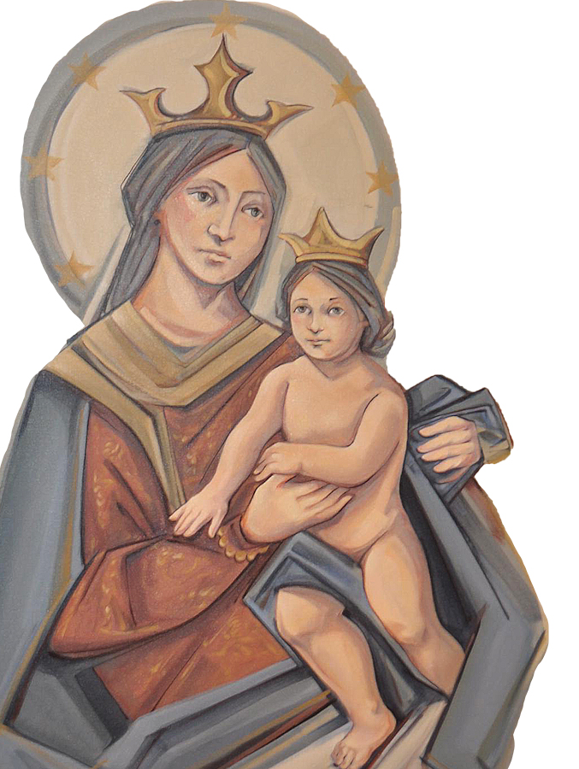
THANK YOU
CÁM ƠN
MARAMING SALAMAT PO
MUCHAS GRACIAS
நன்றி (Nanri)

