Slide 1
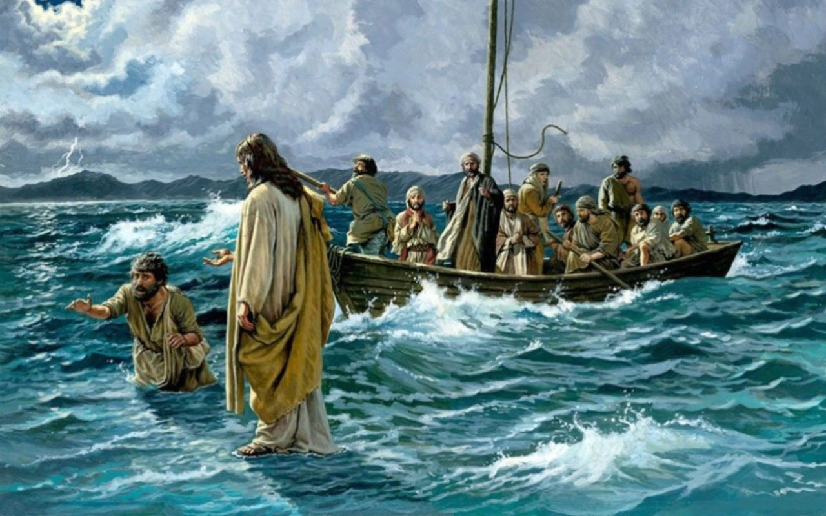
Welcome to Our Lady of Refuge Catholic Church
Sunday Ordinary Time 19th Year A
Gather Song:
I Hear The Voice of Jesus
Responsorial Psalm 85:
Let Us See Your Kindess
Prep. of the Gifts:
Be Still and Know That I Am God.
Communion Song :
Here I Am, Lord
Recessional:
O God, Our Help In Ages Past

Slide 2
1a. I heard the voice of Jesus say, “Come unto me and rest;
lay down, O weary one, lay down Thy head upon my breast.”

Slide 3
1b. I came to Jesus as I was,
so weary, worn, and sad;
I found him in a resting place,
and he has made me glad.

Slide 4
2a. I heard the voice of Jesus say, “Behold, I freely give
the living water, thirsty one,
stoop down and drink and live.”

Slide 5
2b. I came to Jesus, and I drank of that life-giving stream;
my thirst was quenched, my soul revived, and now I live in him.

Slide 6
3a. I heard the voice of Jesus say, “I am this dark world’s light; look unto me; Thy morn shall rise,

Slide 7
3b. and all your day be bright.”
I looked to Jesus, and I found
in him my star, my sun;
and in that light of life I’ll walk
till traveling days are done.

Slide 8
Penitential Act

Slide 9
I confess to almighty God and to you, my brothers and sisters, that I have greatly sinned, in my thoughts and in my words,

Slide 10
in what I have done
and in what I have failed to do,
through my fault,
through my fault,
through my most grievious fault;

Slide 11
therefore I ask blessed Mary ever-Virgin, all the Angels and Saints, and you, my brothers and sisters, to pray for me to the Lord our God.

Slide 12
Gloria Prayer

Slide 13
Refrain:
Glory to God, Glory to God. Glory to God in the highest, and on earth, peace on earth, peace to people of good will

Slide 14
1. We praise you, we bless you, we adore you, we glorify you, we give you thanks for your great glory. Lord God, heavenly King, O God, almighty Father.

Slide 15
2. Lord Jesus Christ, only Begotten Son, Lord God, Lamb of God, Son of the Father, you take away the sins of the world, have mercy on us. You take way the sins of the world, receive our pray you are seated at the right hand, the right hand of the Father, have mercy on us

Slide 16
3. For you alone are the Holy One, you alone are the Lord, you alone are the Most High, Jesus Christ with the Holy Spirit, in the glory of God the Father.

Slide 17
Refrain:
Glory to God, Glory to God. Glory to God in the highest, and on earth, peace on earth, peace to people of good will. Amen Amen.

Slide 18
Responsorial Psalm 85
Let Us See your kindness

Slide 19
Responsorial Psalm 85:
Let us see your kindness, O Lord, grant us your salvation, O God

Slide 20
Gospel Acclamation

Slide 21
Refrain: Alleluia!
I wait for the Lord;
my soul waits for his word.wait for the Lord;
my soul waits for his word.

Slide 22
Profession Of Faith
Creed

Slide 23
Nicene Creed p1
I believe in one God, the Father almighty, maker of heaven and earth, of all things visible and invisible.

Slide 24
Nicene Creed p2
I believe in one Lord Jesus Christ, the Only Begotten Son of God, born of the Father before all ages.

Slide 25
Nicene Creed p3
God from God, Light from Light, true God from true God, begotten, not made, consubstantial with the Father; through Him all things were made.

Slide 26
Nicene Creed p4
For us men and for our salvation He came down from heaven, and by the Holy Spirit was incarnate of the Virgin Mary, and became man.

Slide 27
Nicene Creed p5
For our sake He was crucified under Pontius Pilate, He suffered death and was buried, and rose again on the third day in accordance with the Scriptures.

Slide 28
Nicene Creed p6
He ascended into heaven and is seated at the right hand of the Father.

Slide 29
Nicene Creed p7
He will come again in glory to judge the living and the dead and His kingdom will have no end.

Slide 30
Nicene Creed p8
I believe in the Holy Spirit, the Lord, the giver of life, who proceeds from the Father and the Son,

Slide 31
Nicene Creed p9
who with the Father and the Son is adored and glorified, who has spoken through the prophets.

Slide 32
Nicene Creed p10
I believe in one, holy, catholic and apostolic Church. I confess one Baptism for the forgiveness of sins

Slide 33
Nicene Creed p11
and I look forward to the resurrection of the dead and the life of the world to come. Amen.

Slide 34
Preparation of The Gift Song
Be Still and Know That I Am God

Slide 35
1. Be still and know that I am God.
You are my chosen one, whom my love I give.
My life is yours, in you I live.
Be still, be still and know that I am God.

Slide 36
2. Be still and know that I am God. You are my chosen one, I came to set you free.
Give me your cares and rest in me.
Be still, be still and know that I am God.

Slide 37
3. Be still and know that I am God. You are my chosen one, to whom I show my ways.
My love is with you all your days. Be still, be still and know that I am God

Slide 38
Holy Holy Holy

Slide 39
Holy, Holy, Holy Lord God of hosts.
Heaven and earth are full, are full of your glory. Hosanna, Hosanna! Hosanna in the highest.

Slide 40
Blessed is he who comes, who comes in the name of the Lord.
Hosanna, Hosanna! Hosanna in the highest.

Slide 41
Memorial Acclamation

Slide 42
We proclaim your Death, O Lord,
and profess your Resurrection until you come again.

Slide 43
Amen

Slide 44
Amen Amen Amen

Slide 45
Lamb Of God

Slide 46
Lamb of God you take away the sins of the world. Have mercy on us. (repeat as needed)
Lamb of God you take away the sins of the world.
grant us peace.

Slide 47
Communion Respond

Slide 48
Behold the Lamb of God,
behold him who takes away the sins of the world.
Blessed are those called to the supper of the Lamb.
Lord, I am not worthy
that You should enter under my roof, but only say the word and my soul shall be healed.

Slide 49
Communion Hymn
Here I Am, Lord

Slide 50
1. I, The Lord of sea and sky.
I have heard my people cry.
All who dwell in dark and sin.
My hand will save.
I who made the stars of night. I will make their darkness bright.
Who will bear my light to them? Who shall I send?

Slide 51
Refrain: Here I am Lord. Is it I, Lord? I have heard you calling in the night. I will go, Lord. If you lead me I will hold your people in my heart.

Slide 52
2. I, The Lord of snow and rain.
I have borne my people’s pain. I have wept for love of them.
They turn away. I will break their hearts of stone.
Give them hearts for love alone. I will speak my word to them. Whom shall I send?

Slide 53
Refrain: Here I am Lord. Is it I, Lord? I have heard you calling in the night. I will go, Lord. If you lead me I will hold your people in my heart.

Slide 54
3. I, The Lord of wind and flame,
I will tend the poor and lame.
I will set a feast for them.
My hand will save. Finest bread I will provide.
Till their hearts be satified.
I will give my life to them.
Whom shall I send?

Slide 55
Refrain: Here I am Lord. Is it I, Lord? I have heard you calling in the night. I will go, Lord. If you lead me I will hold your people in my heart.

Slide 56
Communion Hymn 2
Ave Maria, Gratia Plena

Slide 57
Ave Maria, gratia plena,
Dominus tecum, benedicta tu in mulieribus, et benedictus fructus ventris tui, Iesus.
Sancta Maria, Mater Dei, ora pro nobis peccatoribus, nunc et in hora mortis nostrae.
Amen.

Slide 58
Sending Hymn:
O God, Our help in ages past

Slide 59
1. Before the hills in order stood, Or earth received her frame. From everlasting thou art God, to enless years the same.

Slide 60
2. O God, our Help in ages past, Our hope for years to come. Our shelter from the stormy blast. and our eternal Home.

Slide 61
3. A thousand ages in thy sight Are like an evening gone; Short as the watch that ends the night before the rising sun.

Slide 62
4. Time like an everyrolling stream. Soon bears us all away; We fly forgotten, as a dream dies at the op'ning day.

Slide 63
5. O God our help in ages past, our hope for years to come. Be thou our Guard while life shall last, and our eternal home.

Slide 64
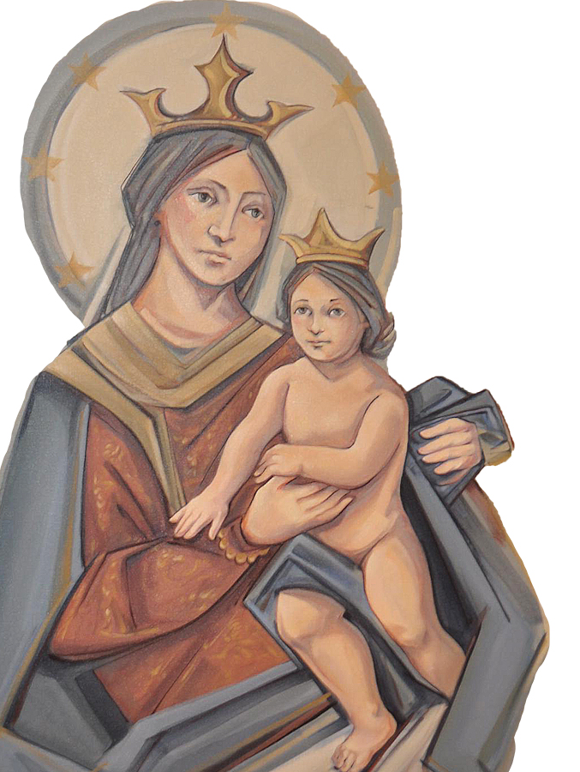
THANK YOU
CÁM ƠN
MARAMING SALAMAT PO
MUCHAS GRACIAS
நன்றி (Nanri)

