Slide 1
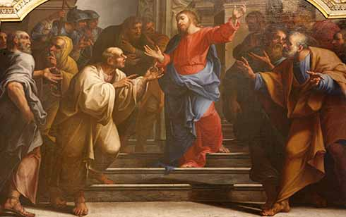
Welcome to Our Lady of Refuge Catholic Church
Sunday Ordinary Time 29 th Year A
Gather Song:
Lord of All Hopefulness
Responsorial Psalm 96
Give the Lord Glogy and Honor.
Prep. of the Gifts:
There is a Longing.
Communion Song :
God’s Holy Gifts
Ave Maria
Recessional:
Song Of Mary

Slide 2
1. Lord of all hopefulness, Lord of all joy, Whose trust, ever childlike no cares ca destroy, Be there at our waking, and give us, we pray Your bliss in our hearts Lord at the break of the day

Slide 3
2. Lord of all eagerness, Lord of all faith, whose strong hands were skilled at the plane and the lathe, Be there at our labors, and give us we pray Your strength in our hearts, Lord at the noon of the day.

Slide 4
3. Lord of all kindliness, Lord of all grace, Your hands swift to welcome, your arms to embrace, Be there at our homing, and give us we pray, Your love in our hearts, Lord at the eve of the day.

Slide 5
4. Lord of all gentleness, Lord of alll calm, Whose voice is contentment, whose presence is balm, Be there at our sleeping, and give us we pray, Your peace in our hearts, Lord at the end of the day.

Slide 6
Penitential Act

Slide 7
I confess to almighty God and to you, my brothers and sisters, that I have greatly sinned, in my thoughts and in my words,

Slide 8
in what I have done
and in what I have failed to do,
through my fault,
through my fault,
through my most grievious fault;

Slide 9
therefore I ask blessed Mary ever-Virgin, all the Angels and Saints, and you, my brothers and sisters, to pray for me to the Lord our God.

Slide 10
Gloria Prayer

Slide 11
Refrain:
Glory to God, Glory to God. Glory to God in the highest, and on earth, peace on earth, peace to people of good will

Slide 12
1. We praise you, we bless you, we adore you, we glorify you, we give you thanks for your great glory. Lord God, heavenly King, O God, almighty Father.

Slide 13
2. Lord Jesus Christ, only Begotten Son, Lord God, Lamb of God, Son of the Father, you take away the sins of the world, have mercy on us. You take way the sins of the world, receive our pray you are seated at the right hand, the right hand of the Father, have mercy on us

Slide 14
3. For you alone are the Holy One, you alone are the Lord, you alone are the Most High, Jesus Christ with the Holy Spirit, in the glory of God the Father.

Slide 15
Refrain:
Glory to God, Glory to God. Glory to God in the highest, and on earth, peace on earth, peace to people of good will. Amen Amen.
Gloria Prayer

Slide 16
Psalm 96:
Give the Lord Glory and Honor

Slide 17
Responsorial Psalm 96:
Give the Lord glory, glory and honor. Give the Lord glory and honor.

Slide 18
Gospel Acclamation
Gospel Acclamation

Slide 19
Refrain: Alleluia!
Shine like lights in the world
as you hold on to the word of life.

Slide 20
Gospel Acclamation
Profession of Faith

Slide 21
Nicene Creed p1
I believe in one God, the Father almighty, maker of heaven and earth, of all things visible and invisible.

Slide 22
Nicene Creed p2
I believe in one Lord Jesus Christ, the Only Begotten Son of God, born of the Father before all ages.

Slide 23
Nicene Creed p3
God from God, Light from Light, true God from true God, begotten, not made, consubstantial with the Father; through Him all things were made.

Slide 24
Nicene Creed p4
For us men and for our salvation He came down from heaven, and by the Holy Spirit was incarnate of the Virgin Mary, and became man.

Slide 25
Nicene Creed p5
For our sake He was crucified under Pontius Pilate, He suffered death and was buried, and rose again on the third day in accordance with the Scriptures.

Slide 26
Nicene Creed p6
He ascended into heaven and is seated at the right hand of the Father.

Slide 27
Nicene Creed p7
He will come again in glory to judge the living and the dead and His kingdom will have no end.

Slide 28
Nicene Creed p8
I believe in the Holy Spirit, the Lord, the giver of life, who proceeds from the Father and the Son,

Slide 29
Nicene Creed p9
who with the Father and the Son is adored and glorified, who has spoken through the prophets.

Slide 30
Nicene Creed p10
I believe in one, holy, catholic and apostolic Church. I confess one Baptism for the forgiveness of sins

Slide 31
Nicene Creed p11
and I look forward to the resurrection of the dead and the life of the world to come. Amen.

Slide 32
Gospel Acclamation
Preparation of The Gift Song
There is A Longing

Slide 33
Refrain: There is a longing in our hearts, o Lord. For you to reveal yourself to us. There is a longing in our hearts for love we only find in you, our God.
1. For Justice, for freedom. mercy; hear our prayer. In sorrow, in grief: Be near, hear our prayer, O God.

Slide 34
Refrain: There is a longing in our hearts, o Lord. For you to reveal yourself to us. There is a longing in our hearts for love we only find in you, our God.
2. For wisdom, For courage, for comfort: Hear our prayer. In weakness, in fear: be near, hear our prayer, O God.

Slide 35
Refrain: There is a longing in our hearts, o Lord. For you to reveal yourself to us. There is a longing in our hearts for love we only find in you, our God.
3. For Healing, for wholeness, For new life: Hear our prayer. In sickness, in death: Be near, hear our prayer, O God.

Slide 36
Refrain: There is a longing in our hearts, o Lord. For you to reveal yourself to us. There is a longing in our hearts for love we only find in you, our God.
4. Lord save us, take pity, light our darkness. We call you, we wait: Be near, hear our prayer, o God.

Slide 37
Gospel Acclamation
Holy Holy Holy

Slide 38
Holy, Holy, Holy Lord God of hosts.
Heaven and earth are full, are full of your glory. Hosanna, Hosanna! Hosanna in the highest.

Slide 39
Blessed is he who comes, who comes in the name of the Lord.
Hosanna, Hosanna! Hosanna in the highest.

Slide 40
Gospel Acclamation
Memorial acclamation

Slide 41
We proclaim your Death, O Lord,
and profess your Resurrection until you come again.
Memorial acclamation

Slide 42
Gospel Acclamation
Amen

Slide 43
Amen Amen Amen

Slide 44
Gospel Acclamation
Lamb of God

Slide 45
Lamb of God you take away the sins of the world. Have mercy on us. (repeat as needed)
Lamb of God you take away the sins of the world.
grant us peace.

Slide 46
Gospel Acclamation
Communion Respond

Slide 47
Behold the Lamb of God,
behold him who takes away the sins of the world.
Blessed are those called to the supper of the Lamb.
Lord, I am not worthy
that You should enter under my roof, but only say the word and my soul shall be healed.
Communion Respond

Slide 48
Gospel Acclamation
Communion Hymn
God’s Holy Gifts

Slide 49
Refrain: God's holy gifts for God's holy people; come now to share the banquet of Christ. Feed on his love with faith and thanksgiving. Know in your heart that he died for you.

Slide 50
1. May the Body of Christ be food for our souls and bring us to everlasting life.

Slide 51
Refrain: God's holy gifts for God's holy people; come now to share the banquet of Christ. Feed on his love with faith and thanksgiving. Know in your heart that he died for you.

Slide 52
2. May the Blood of the Lord protect us from harm and Mark us as God's beloved ones.

Slide 53
Refrain: God's holy gifts for God's holy people; come now to share the banquet of Christ. Feed on his love with faith and thanksgiving. Know in your heart that he died for you.

Slide 54
3. As the grain of this bread was gathered as one, may we who believe be bound by love.

Slide 55
Refrain: God's holy gifts for God's holy people; come now to share the banquet of Christ. Feed on his love with faith and thanksgiving. Know in your heart that he died for you.

Slide 56
4. As the cup that we share is emptied for all, may we offer up our lives in love.

Slide 57
Refrain: God's holy gifts for God's holy people; come now to share the banquet of Christ. Feed on his love with faith and thanksgiving. Know in your heart that he died for you.

Slide 58
5. When we eat of this bread and drink of this cup, we hold in our memory Christ the Lord.

Slide 59
Refrain: God's holy gifts for God's holy people; come now to share the banquet of Christ. Feed on his love with faith and thanksgiving. Know in your heart that he died for you.

Slide 60
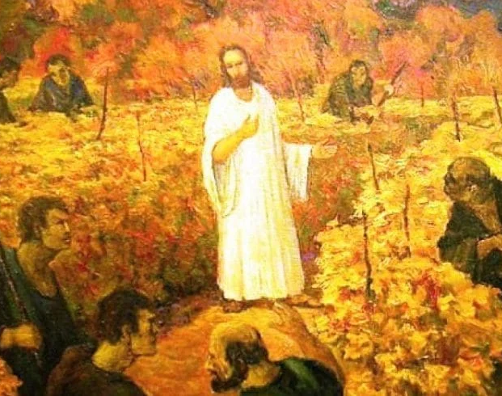
Communion Hymn
I Have Loved You

Slide 61
Refrain: I have loved you with an everlasting love, I have called you and you are mine. I have loved you with an everlasting love, I have called you and you are mine.
1. Seek the face of the Lord and long for him: He will bring you his light and his peace.

Slide 62
Refrain: I have loved you with an everlasting love, I have called you and you are mine. I have loved you with an everlasting love, I have called you and you are mine.
2. Seek the face of the Lord and long for him: He will bring you his joy and his hope.

Slide 63
Refrain: I have loved you with an everlasting love, I have called you and you are mine. I have loved you with an everlasting love, I have called you and you are mine.
3. Seek the face of the Lord and long for him: He will bring you his care and his love.

Slide 64
Gospel Acclamation
Hail Mary

Slide 65
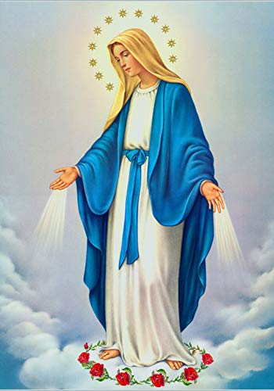
Ave Maria, gratia plena,
Dominus tecum, benedicta tu in mulieribus, et benedictus fructus ventris tui, Jesus.

Slide 66
Sancta Maria, Mater Dei, ora pro nobis peccatoribus, nunc et in hora mortis nostrae.
Amen.

Slide 67
Gospel Acclamation
Sending Hymn
song Of Mary

Slide 68
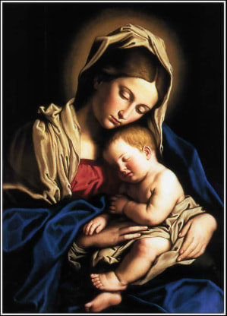
1. Let us sing the praises of Mary, daughter of David's holy line, she who heard the voice of an angel telling the plan of God's design, how in wisdom's holy sight she would mother heaven's Christ. Blessed be the name of Mary, she who trusted the love of God.

Slide 69
2. Let us sing the praises of Mary, chosen as blessed from the least, she who heard the song of the angels filing the night with heaven's peace. When the promised time had come she gave birth to God's own Son. Blessed be the name of Mary, she who trusted the love of God.

Slide 70
3. Let us sing the praised of Mary, woman of strong and steadfast love. She who raised the Savior of nations held in her arms the Son of God. She who knew the Father's grace taught her Son to know God's face. Blessed be the name of Mary, she who trusted the love of God.

Slide 71
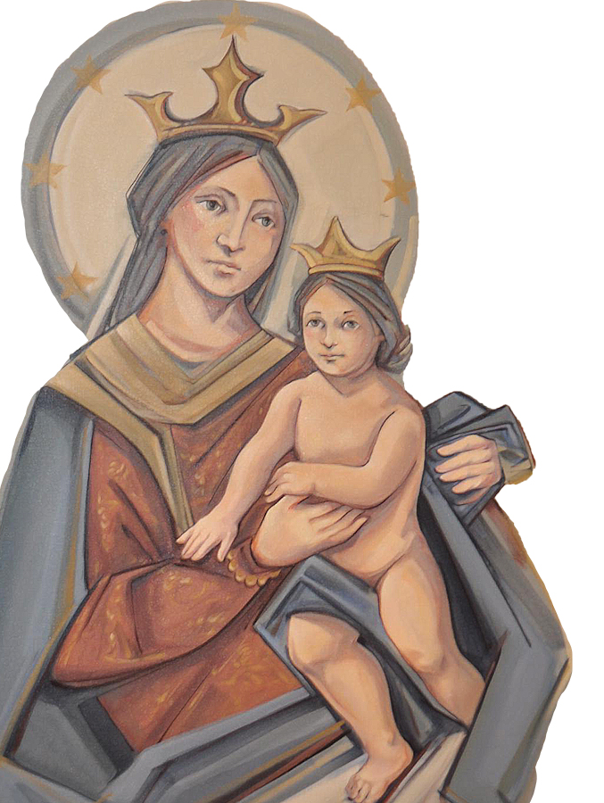
THANK YOU
CÁM ƠN
MARAMING SALAMAT PO
MUCHAS GRACIAS
நன்றி (Nanri)

