Slide 1
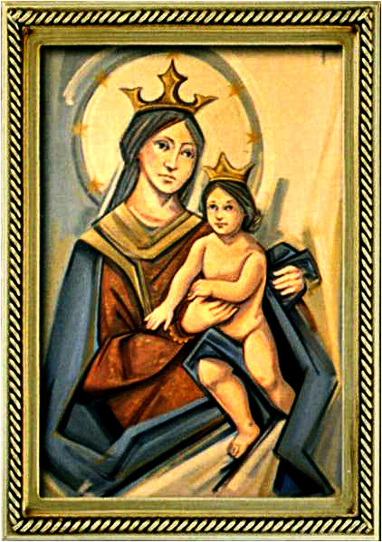
Ordinary Time 22 Year C
Gather Hymn:
Table of Plenty
Responsorial Psalm: 68
Go Out To the World
Prep. of the Gifts Hymn:
Only This I want
Communion Hymn:
Ang Katwan Ni Kristo
Recessional Hymn:
Come and follow Me

Slide 2
Refrain: Come to the feast of heaven and earth! Come to the table of plenty! God will provide for all that we need, here at the table of plenty. 1. O come and sit at my table where saints and sinners are friends. I wait to welcome the lost and lonely to share the cup of my love.

Slide 3
Refrain: Come to the feast of heaven and earth! Come to the table of plenty! God will provide for all that we need, here at the table of plenty.
2. O come and eat without money; come to drink without price. My feast of gladness will feed your spirit with faith and fullness of life.

Slide 4
Penitential Act (Confiteor 2011) 1 of 3:

Slide 5
I confess to almighty God and to you, my brothers and sisters, that I have greatly sinned, in my thoughts and in my words,

Slide 6
in what I have done and in what I have failed to do, through my fault,
through my fault, through my most grievious fault;

Slide 7
therefore I ask blessed Mary ever-Virgin, all the Angels and Saints, and you, my brothers and sisters, to pray for me to the Lord our God.

Slide 8
Gloria Hymn

Slide 9
Refrain:
Glory to God, Glory to God. Glory to God in the highest, and on earth, peace on earth, peace to people of good will

Slide 10
1. We praise you, we bless you, we adore you, we glorify you, we give you thanks for your great glory. Lord God, heavenly King, O God, almighty Father.

Slide 11
Refrain:
Glory to God, Glory to God. Glory to God in the highest, and on earth, peace on earth, peace to people of good will

Slide 12
2. Lord Jesus Christ, only Begotten Son, Lord God, Lamb of God, Son of the Father, you take away the sins of the world, have mercy on us. You take way the sins of the world, receive our pray you are seated at the right hand, the right hand of the Father, have mercy on us

Slide 13
Refrain:
Glory to God, Glory to God. Glory to God in the highest, and on earth, peace on earth, peace to people of good will

Slide 14
3. For you alone are the Holy One, you alone are the Lord, you alone are the Most High, Jesus Christ with the Holy Spirit, in the glory of God the Father.

Slide 15
Refrain:
Glory to God, Glory to God. Glory to God in the highest, and on earth, peace on earth, peace to people of good will. Amen Amen.

Slide 16
Responsorial Psalm: 68 God, in your goodness, you have made a home for the poor

Slide 17
Responsorial Psalm: Psalm 68 God, in your goodness, you have made a home for the poor

Slide 18
Gospel Acclamation

Slide 19
Alleluia Alleluia Alleluia. Take my yoke upon you, says the Lord, and learn from me, for I am meek and humble of heart.

Slide 20
Profession Of Faith Creed

Slide 21
Nicene Creed p1
I believe in one God, the Father almighty, maker of heaven and earth, of all things visible and invisible.

Slide 22
Nicene Creed p2
I believe in one Lord Jesus Christ, the Only Begotten Son of God, born of the Father before all ages.

Slide 23
Nicene Creed p3
God from God, Light from Light, true God from true God, begotten, not made, consubstantial with the Father; through Him all things were made.

Slide 24
Nicene Creed p4
For us men and for our salvation He came down from heaven, and by the Holy Spirit was incarnate of the Virgin Mary, and became man.

Slide 25
Nicene Creed p5
For our sake He was crucified under Pontius Pilate, He suffered death and was buried, and rose again on the third day in accordance with the Scriptures.

Slide 26
Nicene Creed p6
He ascended into heaven and is seated at the right hand of the Father.

Slide 27
Nicene Creed p7
He will come again in glory to judge the living and the dead and His kingdom will have no end.

Slide 28
Nicene Creed p8
I believe in the Holy Spirit, the Lord, the giver of life, who proceeds from the Father and the Son,

Slide 29
Nicene Creed p9
who with the Father and the Son is adored and glorified, who has spoken through the prophets.

Slide 30
Nicene Creed p10
I believe in one, holy, catholic and apostolic Church. I confess one Baptism for the forgiveness of sins

Slide 31
Nicene Creed p11
and I look forward to the resurrection of the dead and the life of the world to come. Amen.

Slide 32
Preparation of The Gift Song: Only This I want

Slide 33
Refrain: Only This I want, but to know the Lord. And to bear his cross, so to wear the crown he wore.
1. All but this is loss, worthless refuse to me, for to gain the Lord is to gain and I need.

Slide 34
Refrain: Only This I want, but to know the Lord. And to bear his cross, so to wear the crown he wore.
2. I will run the race, I will fight the good fight. so to win the prize of the kingdom o

Slide 35
Refrain: Only This I want, but to know the Lord. And to bear his cross, so to wear the crown he wore.
3. Let your heart be glad, always glad in the Lord, so to shine like starts in the darkness of the nigh.

Slide 36
Holy Holy

Slide 37
Holy, Holy, Holy Lord God of hosts. Heaven and earth are full, are full of your glory. Hosanna, Hosanna! Hosanna in the highest.

Slide 38
Blessed is he who comes, who comes in the name of the Lord. Hosanna, Hosanna! Hosanna in the highest.

Slide 39
Memorial Acclamation

Slide 40
We proclaim your Death, O Lord, and profess your Resurrection until you come again.

Slide 41
Amen

Slide 42
Amen, Amen. Amen, Amen Amen, Amen
Amen. Amen.

Slide 43
Lamb Of God

Slide 44
Lamb of God your take away the sins of the world. Have mercy on us. (repeat as needed)
Lamb of God your take away the sins of the world.
grant us peace.

Slide 45
Communion respond

Slide 46
Behold the Lamb of God,
behold him who takes away the sins of the world.
Blessed are those called to the supper of the Lamb. Lord, I am not worthy
that You should enter under my roof, but only say the word and my soul shall be healed.

Slide 47
Communion Hymn 1: Behold the Body of Christ

Slide 48
1a. In the presence of our God, as we gather here in Christ, feel the Spirit breathe upon us, the breath of life, graced and divine.

Slide 49
1b. We have come to break the bread; we have come to share our lives. Let us bring these fruits to the table. the love of God, yours and mine!

Slide 50
(Refrain) Ang katawan ni Kristo, ang katawan ni Kristo. Behold the body of Christ! Jesus, our Savior and Life! Rejoice, O People of God! We are the Body of Christ!

Slide 51
2a. When we gather in our homes, through our prayers and our meals, we are fed and nourished together, our families, broken and blessed.

Slide 52
2b. In the household of the Lord, Where we come to share the meal, we are fed the words of our savior, one family strengthened and healed.

Slide 53
(Refrain) Ang katawan ni Kristo, ang katawan ni Kristo. Behold the body of Christ! Jesus, our Savior and Life! Rejoice, O People of God! We are the Body of Christ!

Slide 54
(Bridge) Is not the meal that we bless and share a communion in the life of Christ? One bread, one blessing one cup make us one body in our Lord.

Slide 55
3. In the presence of our God, by the justice that is shown, we will build a kingdom together; the love of Christ given to all!

Slide 56
(Refrain) Ang katawan ni Kristo, ang katawan ni Kristo. Behold the body of Christ! Jesus, our Savior and Life! Rejoice, O People of God! We are the Body of Christ!

Slide 57
Announcements:

Slide 59
Ending Hymn: Come and Follow Me

Slide 60
Refrain Come, follow me and live; do not be afraid. Believe and trust in me; your faith will give you strength. Leave all your fears behind you; let your heart be free for I will be your guide. Oh, come and follow me.

Slide 61
1. Come, follow in these foot steps; I’ll lead you gently home. No shelter, food nor money, will you need up-on this road.

Slide 62
Refrain Come, follow me and live; do not be afraid. Believe and trust in me; your faith will give you strength. Leave all your fears behind you; let your heart be free for I will be your guide. Oh, come and follow me.

Slide 63
2. Come, walk across the water: place all your faith in me. Cast all your doubs behind you to the wind and raging sea.

Slide 64
Refrain Come, follow me and live; do not be afraid. Believe and trust in me; your faith will give you strength. Leave all your fears behind you; let your heart be free for I will be your guide. Oh, come and follow me.

Slide 65
Ending Hymn: Lady Of Fatima

Slide 66
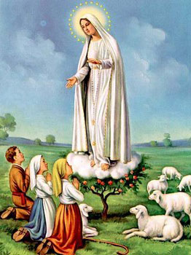
1. Dear Lady of Fatima we come on bended knee To beg your intercession for peace and unity. Dear Mary won't you show us the right and shining way? We pledge our love and offer you a Rosary each day.

Slide 67
2. You promised at Fatima Each time that you appeared To help us If we pray to you to banish war and fear. Dear Lady on first days we ask your guiding hand for grace and guidance here on earth protection for our land.

Slide 68
Ending Hymn: On This Day

Slide 69
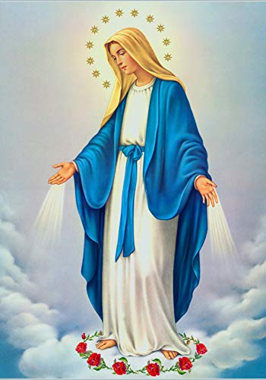
**. On this day, O beautiful Mother, On this day we give thee our love. Near the, Madonna, fondly we hover, Trusting thy gentle care to prove.

Slide 70
1. On this day we ask to share, Dearest Mother, thy sweet care; Aid us ere our feet astray Wanner from thy guiding way.

Slide 71
**. On this day, O beautiful Mother, On this day we give thee our love. Near the, Madonna, fondly we hover, Trusting thy gentle care to prove.

Slide 72
2. Queen of angels, deign to hear. Lisping children's humble prayer; Young hearts gain, O virgin pure, Sweetly to thyself allure.

Slide 73
THANK YOU
CÁM ƠN
MARAMING SALAMAT PO
MUCHAS GRACIAS
நன்றி (Naṉṟi)

Slide 74
THANK YOU
CÁM ƠN
MARAMING SALAMAT PO
MUCHAS GRACIAS
நன்றி (Naṉṟi)

