Slide 1
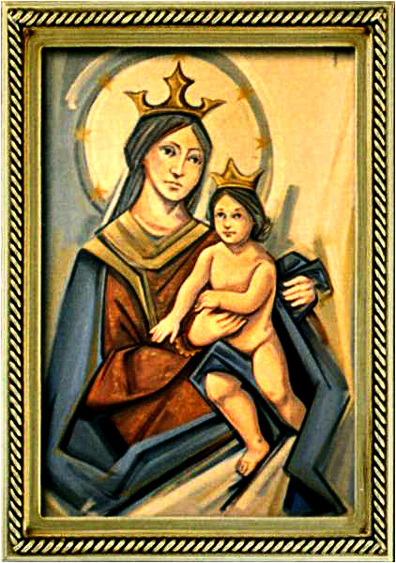
Solemnity of the Assumption of the Blessed Virgin Mary
Gather Hymn:
Hail Holy Queen
Responsorial Psalm: 132
Lord, go up to the place.
Prep. of the Gifts Hymn:
On This Day, O Beautiful
Communion Hymn:
Servant Song.
Immaculate Mary
Recessional Hymn:
Sing Of Ma

Slide 2
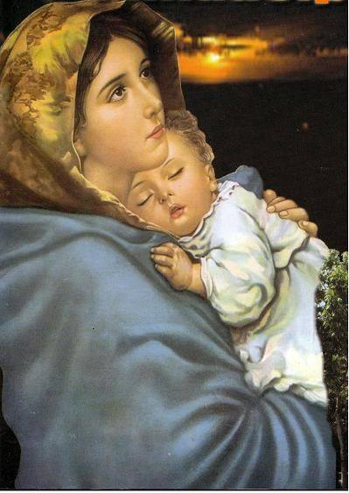
1. Hail Holy Queen enthron'd above, O Maria! Hail Mother of Mercy and of love.

Slide 3
O Maria! Triumph, all ye Cherubim; Sing with us ye Seraphim! Heav'n and earth resound the Hymn: Salve Salve Salve Regina.

Slide 4
2. Our life our sweetness here below O Maria. Our hope in sorrow and in woe.

Slide 5
O Maria! Triumph, all ye Cherubim; Sing with us ye Seraphim! Heav'n and earth resound the Hymn: Salve Salve Salve Regina.

Slide 6
3. And when our life breath leaves us, O Maria! Show us thy Son, Christ Jesus.

Slide 7
O Maria! Triumph, all ye Cherubim; Sing with us ye Seraphim! Heav'n and earth resound the Hymn: Salve Salve Salve Regina.

Slide 8
Penitential Act (Confiteor 2011) 1 of 3:

Slide 9
I confess to almighty God and to you, my brothers and sisters, that I have greatly sinned, in my thoughts and in my words,

Slide 10
in what I have done and in what I have failed to do, through my fault,
through my fault, through my most grievious fault;

Slide 11
therefore I ask blessed Mary ever-Virgin, all the Angels and Saints, and you, my brothers and sisters, to pray for me to the Lord our God.

Slide 12
Gloria Hymn

Slide 13
Refrain:
Glory to God, Glory to God. Glory to God in the highest, and on earth, peace on earth, peace to people of good will

Slide 14
1. We praise you, we bless you, we adore you, we glorify you, we give you thanks for your great glory. Lord God, heavenly King, O God, almighty Father.

Slide 15
Refrain:
Glory to God, Glory to God. Glory to God in the highest, and on earth, peace on earth, peace to people of good will

Slide 16
2. Lord Jesus Christ, only Begotten Son, Lord God, Lamb of God, Son of the Father, you take away the sins of the world, have mercy on us. You take way the sins of the world, receive our pray you are seated at the right hand, the right hand of the Father, have mercy on us

Slide 17
Refrain:
Glory to God, Glory to God. Glory to God in the highest, and on earth, peace on earth, peace to people of good will

Slide 18
3. For you alone are the Holy One, you alone are the Lord, you alone are the Most High, Jesus Christ with the Holy Spirit, in the glory of God the Father.

Slide 19
Refrain:
Glory to God, Glory to God. Glory to God in the highest, and on earth, peace on earth, peace to people of good will. Amen Amen.

Slide 20
Responsorial Psalm: 132 Lord, Go Up To Your Place

Slide 21
Responsorial Psalm: Psalm 132 Lord, go up to the place of your rest, you and the ark of your holiness.

Slide 22
Gospel Acclamation

Slide 23
Alleluia Alleluia Alleluia. Blessed are they who hear the word of God and observe it.

Slide 24
Profession Of Faith Creed

Slide 25
Nicene Creed p1
I believe in one God, the Father almighty, maker of heaven and earth, of all things visible and invisible.

Slide 26
Nicene Creed p2
I believe in one Lord Jesus Christ, the Only Begotten Son of God, born of the Father before all ages.

Slide 27
Nicene Creed p3
God from God, Light from Light, true God from true God, begotten, not made, consubstantial with the Father; through Him all things were made.

Slide 28
Nicene Creed p4
For us men and for our salvation He came down from heaven, and by the Holy Spirit was incarnate of the Virgin Mary, and became man.

Slide 29
Nicene Creed p5
For our sake He was crucified under Pontius Pilate, He suffered death and was buried, and rose again on the third day in accordance with the Scriptures.

Slide 30
Nicene Creed p6
He ascended into heaven and is seated at the right hand of the Father.

Slide 31
Nicene Creed p7
He will come again in glory to judge the living and the dead and His kingdom will have no end.

Slide 32
Nicene Creed p8
I believe in the Holy Spirit, the Lord, the giver of life, who proceeds from the Father and the Son,

Slide 33
Nicene Creed p9
who with the Father and the Son is adored and glorified, who has spoken through the prophets.

Slide 34
Nicene Creed p10
I believe in one, holy, catholic and apostolic Church. I confess one Baptism for the forgiveness of sins

Slide 35
Nicene Creed p11
and I look forward to the resurrection of the dead and the life of the world to come. Amen.

Slide 36
Preparation of The Gift Song: On This Day

Slide 37
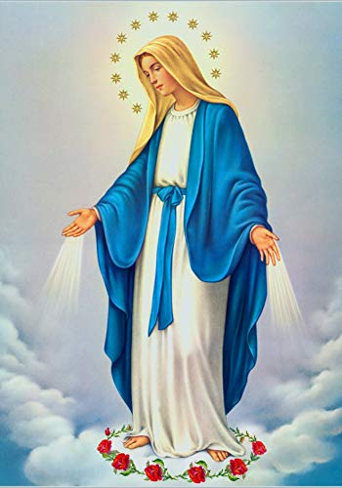
**. On this day, O beautiful Mother, On this day we give thee our love. Near the, Madonna, fondly we hover, Trusting thy gentle care to prove.

Slide 38
1. On this day we ask to share, Dearest Mother, thy sweet care; Aid us ere our feet astray Wanner from thy guiding way.

Slide 39
**. On this day, O beautiful Mother, On this day we give thee our love. Near the, Madonna, fondly we hover, Trusting thy gentle care to prove.

Slide 40
2. Queen of angels, deign to hear. Lisping children's humble prayer; Young hearts gain, O virgin pure, Sweetly to thyself allure.

Slide 41
**. On this day, O beautiful Mother, On this day we give thee our love. Near the, Madonna, fondly we hover, Trusting thy gentle care to prove.

Slide 42
Holy Holy

Slide 43
Holy, Holy, Holy Lord God of hosts. Heaven and earth are full, are full of your glory. Hosanna, Hosanna! Hosanna in the highest.

Slide 44
Blessed is he who comes, who comes in the name of the Lord. Hosanna, Hosanna! Hosanna in the highest.

Slide 45
Memorial Acclamation

Slide 46
We proclaim your Death, O Lord, and profess your Resurrection until you come again.

Slide 47
Amen

Slide 48
Amen, Amen. Amen, Amen Amen, Amen
Amen. Amen.

Slide 49
Lamb Of God

Slide 50
Lamb of God your take away the sins of the world. Have mercy on us. (repeat as needed)
Lamb of God your take away the sins of the world.
grant us peace.

Slide 51
Communion respond

Slide 52
Behold the Lamb of God,
behold him who takes away the sins of the world.
Blessed are those called to the supper of the Lamb. Lord, I am not worthy
that You should enter under my roof, but only say the word and my soul shall be healed.

Slide 53
Communion Hymn 1: Servant Song

Slide 54
1. What do you want of me, Lord? Where do you want me to serve you? Where can I sing your praises? I am your song. Refrain: Jesus, Jesus, You are The Lord. Jesus, Jesus, You are the way.

Slide 55
2. I hear you call my name, Lord, And I am moved within me. Your Spirit stirs my deepest self. Sing your songs in me. Refrain: Jesus, Jesus, You are The Lord. Jesus, Jesus,You are the way.

Slide 56
3. Above, below, and around me, Before, behind, and all through me, Your Spirit burns deep within me. Fire my life with your love. Refrain: Jesus, Jesus, You are The Lord. Jesus, Jesus, You are the way.

Slide 57
4. You are the light in my darkness. You are my strength when I’m weary. You give me sight when I’m blinded. Come, see for me. Refrain: Jesus, Jesus, You are The Lord. Jesus, Jesus, You are the way.

Slide 58
5. I am your song and servant, singing your praise like Mary. Surrendered to your Spirit, “Let it be done to me.” Refrain: Jesus, Jesus, You are The Lord. Jesus, Jesus, You are the way.

Slide 59
Communion Hymn 1: Immaculate Mary

Slide 60
1. Immaculate Mary, your praises we sing. You reign now in heaven with Jesus our King. Refrain: Ave, Ave, Ave, Maria! Ave, Ave, Ave, Maria!

Slide 61
2. In heaven the blessed your glory proclaim; On earth we your children invoke your fair name. Refrain: Ave, Ave, Ave, Maria! Ave, Ave, Ave, Maria!

Slide 62
3. We pray for our Mother, the Church upon earth,And bless, Holy Mary, the land of our birth. Refrain: Ave, Ave, Ave, Maria! Ave, Ave, Ave, Maria!

Slide 63
Ending Hymn: Sing Of Mary

Slide 64
1a. Sing of Mary, pure and lowly, Virgin Mother undefiled. Sing of God's own Son most holy, who became her little child.

Slide 65
1b. Fairest child of fairest Mother, God the Lord who came to earth, Word made flesh, our very brother, takes our nature by his birth.

Slide 66
2a. Sing of Jesus, son of Mary, in the home at Nazareth. Toil and labour cannot weary love enduring unto death.

Slide 67
2b. Constant was the love he gave her, though he went forth from her side, forth to preach, and heal, and suffer, till on Calvary he died.

Slide 68
THANK YOU
CÁM ƠN
MARAMING SALAMAT PO
MUCHAS GRACIAS
நன்றி (Naṉṟi)

Slide 69
THANK YOU
CÁM ƠN
MARAMING SALAMAT PO
MUCHAS GRACIAS
நன்றி (Naṉṟi)

