Slide 1
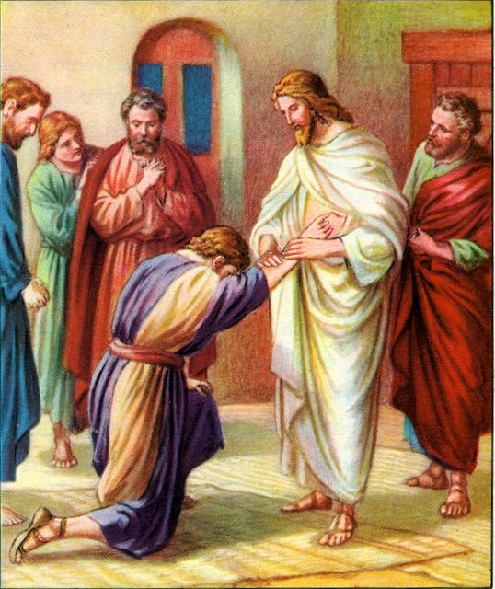
Easter Sunday 2
Gather Hymn:
Sing A New Song
Sprinkling Rite Hymn:
Water of Life
Responsorial Psalm:
118 Give Thanks to the Lord
Prep. of the Gifts Hymn:
Come, Follow Me.
Communion Hymn:
The Supper Of The Lord
Recessional Hymn:
Alleluia! Alleluia!

Slide 2
Sing a new song unto the Lord; let your song be sung from mountains high. Sing a new song unto the Lord, singing alleluia.
1. O Lord people dance for joy. O come before the Lord, and play for him on glad tambourines, and let your trumpet sound.

Slide 3
Sing a new song unto the Lord; let your song be sung from mountains high. Sing a new song unto the Lord, singing alleluia.
2. Rise, O children, from your sleep; your Savior now has come. He has turned your sorrow o joy and filled your soul with song.

Slide 4
Sing a new song unto the Lord; let your song be sung from mountains high. Sing a new song unto the Lord, singing alleluia.
3. Glad my soul for I have seen the glory of the Lord. The trumpet sounds; the dead shall be raised. I know my Savior lives.

Slide 5
Penitential Act

Slide 6
I confess to almighty God and to you, my brothers and sisters, that I have greatly sinned, in my thoughts and in my words,

Slide 7
in what I have done and in what I have failed to do, through my fault,
through my fault, through my most grievious fault;

Slide 8
therefore I ask blessed Mary ever-Virgin, all the Angels and Saints, and you, my brothers and sisters, to pray for me to the Lord our God.

Slide 9

Water of Life

Slide 10
Water of life, holy reminder; touching, renewing the body of Christ. Water of life, holy reminder; touching, renewing the body of life.

Slide 11
4. All generations, com forth and receive the blessing of this holy water; making us one with the God who forgives, the one who is faithful and just.

Slide 12
Water of life, holy reminder; touching, renewing the body of Christ. Water of life, holy reminder; touching, renewing the body of life.

Slide 13
5. Bringing new hope to the children of God, regardless of color or story; Cleansing our spirits with kindness and truth, and keeping the promise a live

Slide 14
Water of life, holy reminder; touching, renewing the body of Christ. Water of life, holy reminder; touching, renewing the body of life.

Slide 15
5. Deep as the heavens and wide as the sea, your mercy and love have no ending. Guiding our steps in the journey of faith, you show us the way to your king dom.

Slide 16
Gloria Hymn

Slide 17
Refrain:
Glory to God, Glory to God. Glory to God in the highest, and on earth, peace on earth, peace to people of good will

Slide 18
1. We praise you, we bless you, we adore you, we glorify you, we give you thanks for your great glory. Lord God, heavenly King, O God, almighty Father.

Slide 19
Refrain:
Glory to God, Glory to God. Glory to God in the highest, and on earth, peace on earth, peace to people of good will

Slide 20
2. Lord Jesus Christ, only Begotten Son, Lord God, Lamb of God, Son of the Father, you take away the sins of the world, have mercy on us. You take way the sins of the world, receive our pray you are seated at the right hand, the right hand of the Father, have mercy on us

Slide 21
Refrain:
Glory to God, Glory to God. Glory to God in the highest, and on earth, peace on earth, peace to people of good will

Slide 22
3. For you alone are the Holy One, you alone are the Lord, you alone are the Most High, Jesus Christ with the Holy Spirit, in the glory of God the Father.

Slide 23
Refrain:
Glory to God, Glory to God. Glory to God in the highest, and on earth, peace on earth, peace to people of good will. Amen Amen.

Slide 24
Psalm 118

Slide 25
Responsorial Psalm: Psalm 118 Give thanks to the Lord for he is good, his love is ever lasting.

Slide 26
Gospel Acclamation

Slide 27
Alleluia Alleluia Alleluia. You believe in me, Thomas, because you have seen me, says the Lord; You believe in me, Thomas, because you have seen me, says the Lord; blessed are those who have not seen me, but still believe!

Slide 28
Profession Of Faith Creed

Slide 29
Nicene Creed p1
I believe in one God, the Father almighty, maker of heaven and earth, of all things visible and invisible.

Slide 30
Nicene Creed p2
I believe in one Lord Jesus Christ, the Only Begotten Son of God, born of the Father before all ages.

Slide 31
Nicene Creed p3
God from God, Light from Light, true God from true God, begotten, not made, consubstantial with the Father; through Him all things were made.

Slide 32
Nicene Creed p4
For us men and for our salvation He came down from heaven, and by the Holy Spirit was incarnate of the Virgin Mary, and became man.

Slide 33
Nicene Creed p5
For our sake He was crucified under Pontius Pilate, He suffered death and was buried, and rose again on the third day in accordance with the Scriptures.

Slide 34
Nicene Creed p6
He ascended into heaven and is seated at the right hand of the Father.

Slide 35
Nicene Creed p7
He will come again in glory to judge the living and the dead and His kingdom will have no end.

Slide 36
Nicene Creed p8
I believe in the Holy Spirit, the Lord, the giver of life, who proceeds from the Father and the Son,

Slide 37
Nicene Creed p9
who with the Father and the Son is adored and glorified, who has spoken through the prophets.

Slide 38
Nicene Creed p10
I believe in one, holy, catholic and apostolic Church. I confess one Baptism for the forgiveness of sins

Slide 39
Nicene Creed p11
and I look forward to the resurrection of the dead and the life of the world to come. Amen.

Slide 40
Gift Though No Seeing You

Slide 41
Refrain: Though not seeing you, still we love you. Though not seeing you, we believe. By you rising Lord, Jesus, you have given us new birth; You have given us new birth.

Slide 42
1. You pass through doors that keep us locked in fear and despair, even when doubt assails us. Still you are there.

Slide 43
Refrain: Though not seeing you, still we love you. Though not seeing you, we believe. By you rising Lord, Jesus, you have given us new birth; You have given us new birth.

Slide 44
2. With the breath of your Spirit you have made us your own. Make us instruments of your reconciling love.

Slide 45
Refrain: Though not seeing you, still we love you. Though not seeing you, we believe. By you rising Lord, Jesus, you have given us new birth; You have given us new birth.

Slide 46
3. With your peace you sustain us, peace the world cannot give May your peace reign among us and our warring end

Slide 47
Refrain: Though not seeing you, still we love you. Though not seeing you, we believe. By you rising Lord, Jesus, you have given us new birth; You have given us new birth.

Slide 48
4. Though in glory, you show us wounded hands, wounded side, one with all the world's suff'ring the Crucified.

Slide 49
Refrain: Though not seeing you, still we love you. Though not seeing you, we believe. By you rising Lord, Jesus, you have given us new birth; You have given us new birth.

Slide 50
5. Your hand is upon us, touching wounds, healing pride, and with love now we cry out: "My Lord and God."

Slide 51
Refrain: Though not seeing you, still we love you. Though not seeing you, we believe. By you rising Lord, Jesus, you have given us new birth; You have given us new birth.

Slide 52
6. Give us eyes for the Kingdom, help our lack of belief. "Blest are those who have not seen and have believed".

Slide 53
Refrain: Though not seeing you, still we love you. Though not seeing you, we believe. By you rising Lord, Jesus, you have given us new birth; You have given us new birth.

Slide 54
7. Sing praise to the Father, sing praise to the Son, to the Spirit who leads us all praise be sung.

Slide 55
Gift Give Us Your Peace

Slide 56
Refrain: Give us your peace, oh God Give us your peace, your peace Give us your peace, oh God Give us your peace, your peace
1. When we’re afraid, running from truth Gather us back to you Take every fear, and fill our hearts Give us your peace, oh God

Slide 57
Refrain: Give us your peace, oh God Give us your peace, your peace Give us your peace, oh God Give us your peace, your peace
2. When we are tired, weary and worn Take us into your arms Where there is no need, there is no want Give us your peace, oh God

Slide 58
Refrain: Give us your peace, oh God Give us your peace, your peace Give us your peace, oh God Give us your peace, your peace
3. Lord we belong to you alone Show us the way back home Into your light, into your love Give us your peace, oh God

Slide 59
Holy Holy

Slide 60
Holy, Holy, Holy Lord God of hosts. Heaven and earth are full, are full of your glory. Hosanna, Hosanna! Hosanna in the highest.

Slide 61
Blessed is he who comes, who comes in the name of the Lord. Hosanna, Hosanna! Hosanna in the highest.

Slide 62
Memorial Acclamation

Slide 63
We proclaim your Death, O Lord, and profess your Resurrection until you come again.

Slide 64
Amen

Slide 65
Amen, Amen. Amen, Amen Amen, Amen
Amen. Amen.

Slide 66
Lamb Of God

Slide 67
Lamb of God your take away the sins of the world. Have mercy on us. (repeat as needed)
Lamb of God your take away the sins of the world.
grant us peace.

Slide 68
Communion respond

Slide 69
Behold the Lamb of God,
behold him who takes away the sins of the world.
Blessed are those called to the supper of the Lamb. Lord, I am not worthy
that You should enter under my roof, but only say the word and my soul shall be healed.

Slide 70
Bread of Angels

Slide 71
1. Bread of angels, we receive you; with us now abide. Precious Je-sus manna of ages, with us now reside.
Panis angélicus fit panis hó minnum, Dat panis cáelicus fi gúris términum

Slide 72
2. Cup of Mercy overflowing, fill us with your grace; wine of passion. O Son begot ten, we flee to your embrace.
O res mirá bilis mandúcat Dóminum, Pauper, Pauper, servus. et humilis.

Slide 73
3. Word incarnate, dwell within us; piece our hardened hearts. Tender Jesus, Love so gentle, never let us part. Te, trina Déitas únaque, póscimus, Sic nos tu vísita, sicut te cólimus.

Slide 74
4. Though unworthy, we receive you, sacrament divine. Bread of angels, accept our praises, let your glory shine! Per tuas sémitas duc nos quo téndimus, lucem, Ad lucem quam inhabitas.

Slide 75
Sending Hymn Alleluia

Slide 76
1. Alleluia! Alleluia! Hearts to heaven and voices raise. Sing to Go a hymn of gladness, Sing to God a hymn of praise. He who on the cross as Savior. For the world’s salvation bled, Jesus Christ, the King of Glory, Now is risen from the dead.

Slide 77
2. Now the iron bars are broken, Christ from death to life is born. Glorious life, and life immortal, on this resurrection morn; Christ has triumphed, and we conquer by his mighty enterprise, We with him to the life eternal by his resurrection rise

Slide 78
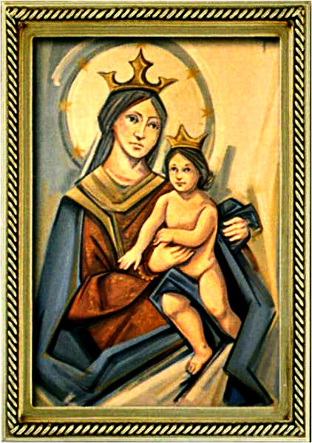
THANK YOU
CÁM ƠN
MARAMING SALAMAT PO
MUCHAS GRACIAS
நன்றி (Naṉṟi)

