Slide 1
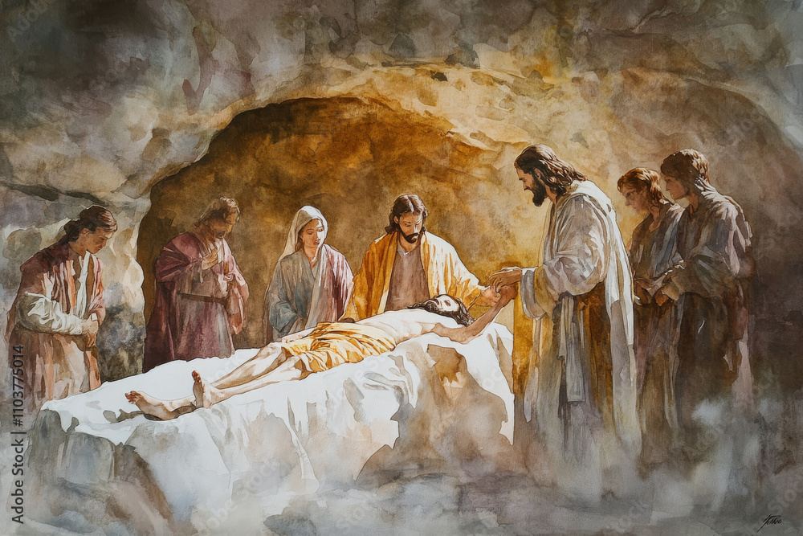
Fifth Sunday of Lent
Gather Song:
What Wondrous Love Is This
Responsorial Psalm 23:
The Lord is My Shepherd
Prep. of the Gifts:
There Is A Longing
Communion Song :
Holy Darkness
During the Lenten season, please be silent and wait for the presider to exit before we leave. Thank You

Slide 2
1. From the depths we cry to thee, God of sov-'reign majesty! Hear our prayers and hymn of praise; Bless our Lent of forty days.

Slide 3
2. Gracious God our hearts renew; Strengthen us thy will to do. Wash us make us pure within Cleanse us from the stain of sin.

Slide 4
3. Lord, accept our Lenten fast And forgive our sinful past, that we may partake with thee in the Easter mystery

Slide 5
Penitential Act

Slide 6
I confess to almighty God and to you, my brothers and sisters, that I have greatly sinned, in my thoughts and in my words,

Slide 7
in what I have done
and in what I have failed to do,
through my fault,
through my fault,
through my most grievious fault;

Slide 8
therefore I ask blessed Mary ever-Virgin, all the Angels and Saints, and you, my brothers and sisters, to pray for me to the Lord our God.

Slide 9
Responsorial Psalm:
Psalm 130
With The Lord

Slide 10
Responsorial Psalm 130:
With The Lord there is mercy and fullness of redemption.

Slide 11
Gospel Acclamation

Slide 12
Refrain: Praise to you, Lord Jesus Christ, Word from the heart of God
I am the resurrection and the life, says the Lord;
whoever believes in me, even if he dies, will never die.

Slide 13
Profession Of Faith
Creed

Slide 14
Nicene Creed p1
I believe in one God, the Father almighty, maker of heaven and earth, of all things visible and invisible.

Slide 15
Nicene Creed p2
I believe in one Lord Jesus Christ, the Only Begotten Son of God, born of the Father before all ages.

Slide 16
Nicene Creed p3
God from God, Light from Light, true God from true God, begotten, not made, consubstantial with the Father; through Him all things were made.

Slide 17
Nicene Creed p4
For us men and for our salvation He came down from heaven, and by the Holy Spirit was incarnate of the Virgin Mary, and became man.

Slide 18
Nicene Creed p5
For our sake He was crucified under Pontius Pilate, He suffered death and was buried, and rose again on the third day in accordance with the Scriptures.

Slide 19
Nicene Creed p6
He ascended into heaven and is seated at the right hand of the Father.

Slide 20
Nicene Creed p7
He will come again in glory to judge the living and the dead and His kingdom will have no end.

Slide 21
Nicene Creed p8
I believe in the Holy Spirit, the Lord, the giver of life, who proceeds from the Father and the Son,

Slide 22
Nicene Creed p9
who with the Father and the Son is adored and glorified, who has spoken through the prophets.

Slide 23
Nicene Creed p10
I believe in one, holy, catholic and apostolic Church. I confess one Baptism for the forgiveness of sins

Slide 24
Nicene Creed p11
and I look forward to the resurrection of the dead and the life of the world to come. Amen.

Slide 25
Preparation of The Gift Song:
I Know That My redeemer lives

Slide 26
1. I know that my Redeemer lives, the One who calls me home. I long to see God face to face, to see with my own eyes
Refrain: I know that my Redeemer lives, that Ishall rise again. I know that my Redeemer lives, that I shall rise again.

Slide 27
2. I know that I shall one day see the goodness of the Lord, when God will wipe away our tears, and death will no more.
Refrain: I know that my Redeemer lives, that Ishall rise again. I know that my Redeemer lives, that I shall rise again.

Slide 28
Holy Holy

Slide 29
Holy, Holy, Holy Lord God of hosts.
Heaven and earth are full, are full of your glory. Hosanna, Hosanna! Hosanna in the highest.

Slide 30
Blessed is he who comes, who comes in the name of the Lord.
Hosanna, Hosanna! Hosanna in the highest.

Slide 31
Memorial Acclamation

Slide 32
We proclaim your Death, O Lord,
and profess your Resurrection until you come again.

Slide 33
Amen

Slide 34
Amen, Amen.
Amen, Amen
Amen, Amen
Amen. Amen.

Slide 35
Lamb Of God

Slide 36
Lamb of God you take away the sins of the world. Have mercy on us. (repeat as needed)
Lamb of God you take away the sins of the world.
grant us peace.

Slide 37
Communion respond

Slide 38
Behold the Lamb of God,
behold him who takes away the sins of the world.
Blessed are those called to the supper of the Lamb.
Lord, I am not worthy
that You should enter under my roof, but only say the word and my soul shall be healed.

Slide 39
Communion:
Unless A Grain Of Wheat

Slide 40
Refrain: Unless a grain of wheat shall fall upon the ground and die, it remains but a single grain with no life.
1. If we have died with him, then we shall live with him; If we hold firm, we shall reign with him.

Slide 41
Refrain: Unless a grain of wheat shall fall upon the ground and die, it remains but a single grain with no life.
2. If any one serves me, then they must follow me; wherever I am, my servant will be.

Slide 42
Refrain: Unless a grain of wheat shall fall upon the ground and die, it remains but a single grain with no life.
3. Make your home in me as I make mine in you; those who remain in me bear much fruit.

Slide 43
Refrain: Unless a grain of wheat shall fall upon the ground and die, it remains but a single grain with no life.
4. If you remain in me and my word lives in you, then you will be my disciples.

Slide 44
Refrain: Unless a grain of wheat shall fall upon the ground and die, it remains but a single grain with no life.
5. Those who love me are loved by my Father; we shall be with them and dwell in them.

Slide 45
Refrain: Unless a grain of wheat shall fall upon the ground and die, it remains but a single grain with no life.
6. Peace I leave with you, my peace I give to you; peace which the world cannot give is my gift.

Slide 46
Sending Hymn
During the Lenten season, please be silent and wait for the presider to exit before we leave in silent.
Thank You

Slide 47
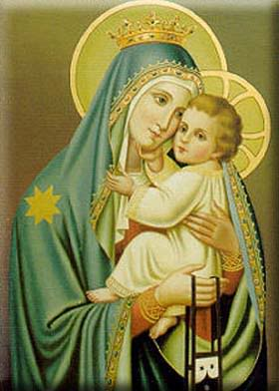
THANK YOU
CÁM ƠN
MARAMING SALAMAT PO
MUCHAS GRACIAS

