Slide 1
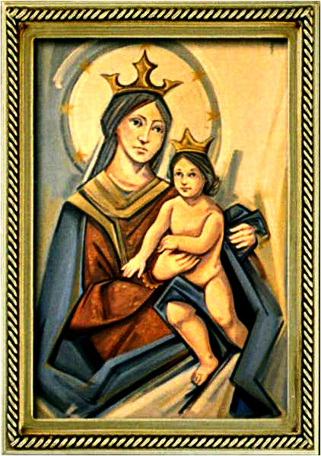
Ordinary Time 16 Year C
Gather Hymn:
I Heard The Voice of Jesus
Responsorial Psalm: 15
He who does justice.
Prep. of the Gifts Hymn:
Only In God
Communion Hymn:
There Is A Longing
Recessional Hymn:
We Are The Light of the World

Slide 2
1a. I heard the voice of Jesus say, “Come unto me and rest;
lay down, O weary one, lay down Thy head upon my breast.”

Slide 3
1b. I came to Jesus as I was,
so weary, worn, and sad;
I found him in a resting place,
and he has made me glad.

Slide 4
2a. I heard the voice of Jesus say, “Behold, I freely give
the living water, thirsty one,
stoop down and drink and live.”

Slide 5
2b. I came to Jesus, and I drank of that life-giving stream;
my thirst was quenched, my soul revived, and now I live in him.

Slide 6
3a. I heard the voice of Jesus say, “I am this dark world’s light; look unto me; Thy morn shall rise,

Slide 7
3b. and all your day be bright.”
I looked to Jesus, and I found
in him my star, my sun;
and in that light of life I’ll walk
till traveling days are done.

Slide 8
Penitential Act (Confiteor 2011) 1 of 3:

Slide 9
I confess to almighty God and to you, my brothers and sisters, that I have greatly sinned, in my thoughts and in my words,

Slide 10
in what I have done
and in what I have failed to do,
through my fault,
through my fault,
through my most grievious fault;

Slide 11
therefore I ask blessed Mary ever-Virgin, all the Angels and Saints, and you, my brothers and sisters, to pray for me to the Lord our God.

Slide 12
Gloria Hymn

Slide 13
Refrain:
Glory to God, Glory to God. Glory to God in the highest, and on earth, peace on earth, peace to people of good will

Slide 14
1. We praise you, we bless you, we adore you, we glorify you, we give you thanks for your great glory. Lord God, heavenly King, O God, almighty Father.

Slide 15
Refrain:
Glory to God, Glory to God. Glory to God in the highest, and on earth, peace on earth, peace to people of good will

Slide 16
2. Lord Jesus Christ, only Begotten Son, Lord God, Lamb of God, Son of the Father, you take away the sins of the world, have mercy on us. You take way the sins of the world, receive our pray you are seated at the right hand, the right hand of the Father, have mercy on us

Slide 17
Refrain:
Glory to God, Glory to God. Glory to God in the highest, and on earth, peace on earth, peace to people of good will

Slide 18
3. For you alone are the Holy One, you alone are the Lord, you alone are the Most High, Jesus Christ with the Holy Spirit, in the glory of God the Father.

Slide 19
Refrain:
Glory to God, Glory to God. Glory to God in the highest, and on earth, peace on earth, peace to people of good will. Amen Amen.

Slide 20
Responsorial Psalm: 15
He who does justice

Slide 21
Responsorial Psalm: Psalm 15
He who does justice will live in the presence of the Lord.

Slide 22
Gospel Acclamation

Slide 23
Alleluia Alleluia Alleluia.
Blessed are they who have kept the word with a generous heart and yield a harvest through perseverance.

Slide 24
Profession Of Faith
Creed

Slide 25
Nicene Creed p1
I believe in one God, the Father almighty, maker of heaven and earth, of all things visible and invisible.

Slide 26
Nicene Creed p2
I believe in one Lord Jesus Christ, the Only Begotten Son of God, born of the Father before all ages.

Slide 27
Nicene Creed p3
God from God, Light from Light, true God from true God, begotten, not made, consubstantial with the Father; through Him all things were made.

Slide 28
Nicene Creed p4
For us men and for our salvation He came down from heaven, and by the Holy Spirit was incarnate of the Virgin Mary, and became man.

Slide 29
Nicene Creed p5
For our sake He was crucified under Pontius Pilate, He suffered death and was buried, and rose again on the third day in accordance with the Scriptures.

Slide 30
Nicene Creed p6
He ascended into heaven and is seated at the right hand of the Father.

Slide 31
Nicene Creed p7
He will come again in glory to judge the living and the dead and His kingdom will have no end.

Slide 32
Nicene Creed p8
I believe in the Holy Spirit, the Lord, the giver of life, who proceeds from the Father and the Son,

Slide 33
Nicene Creed p9
who with the Father and the Son is adored and glorified, who has spoken through the prophets.

Slide 34
Nicene Creed p10
I believe in one, holy, catholic and apostolic Church. I confess one Baptism for the forgiveness of sins

Slide 35
Nicene Creed p11
and I look forward to the resurrection of the dead and the life of the world to come. Amen.

Slide 36
Preparation of The Gift Song:
Only In God

Slide 37
refrain: My stronghold my Savior
I shall not be afraid at all
My stronghold my Savior
I shall not be moved
1. Only in God is my soul at rest
In Him comes my salvation
He only is my Rock
My strength and my salvation

Slide 38
refrain: My stronghold my Savior
I shall not be afraid at all
My stronghold my Savior
I shall not be moved
2. Only in God is found safety
When the enemy pursues me
Only in God is found glory
When I am found meek and found lowly

Slide 39
Holy Holy

Slide 40
Holy, Holy, Holy Lord God of hosts.
Heaven and earth are full, are full of your glory. Hosanna, Hosanna! Hosanna in the highest.

Slide 41
Blessed is he who comes, who comes in the name of the Lord.
Hosanna, Hosanna! Hosanna in the highest.

Slide 42
Memorial Acclamation

Slide 43
We proclaim your Death, O Lord,
and profess your Resurrection until you come again.

Slide 44
Amen

Slide 45
Amen, Amen.
Amen, Amen
Amen, Amen
Amen. Amen.

Slide 46
Lamb Of God

Slide 47
Lamb of God your take away the sins of the world. Have mercy on us. (repeat as needed)
Lamb of God your take away the sins of the world.
grant us peace.

Slide 48
Communion respond

Slide 49
Behold the Lamb of God,
behold him who takes away the sins of the world.
Blessed are those called to the supper of the Lamb.
Lord, I am not worthy
that You should enter under my roof, but only say the word and my soul shall be healed.

Slide 50
Communion Hymn 1:
There is

Slide 51
Refrain: There is a longing in our hearts, o Lord. For you to reveal yourself to us. There is a longing in our hearts for love we only find in you, our God.
1. For Justice, for freedom. mercy; hear our prayer. In sorrow, in grief: Be near, hear our prayer, O God.

Slide 52
Refrain: There is a longing in our hearts, o Lord. For you to reveal yourself to us. There is a longing in our hearts for love we only find in you, our God.
2. For wisdom, For courage, for comfort: Hear our prayer. In weakness, in fear: be near, hear our prayer, O God.

Slide 53
Refrain: There is a longing in our hearts, o Lord. For you to reveal yourself to us. There is a longing in our hearts for love we only find in you, our God.
3. For Healing, for wholeness, For new life: Hear our prayer. In sickness, in death: Be near, hear our prayer, O God.

Slide 54
Refrain: There is a longing in our hearts, o Lord. For you to reveal yourself to us. There is a longing in our hearts for love we only find in you, our God.
4. Lord save us, take pity, light our darkness. We call you, we wait: Be near, hear our prayer, o God.

Slide 55
Announcements:

Slide 57
Ending Hymn:
We are The Light of the World

Slide 58
1. Blessed are they who are poor in spirit, Theirs is the kingdom of God. Bless us, O Lord, make us poor in spirit;
** Bless us, O Lord, our God. We are the light of the world, May our light shine before all, that they may see the good we do, and give glory to God

Slide 59
2. Blessed are they who are meek and humble. They will inherit the earth. Bless us, O Lord, make us meek and humble;
** Bless us, O Lord, our God. We are the light of the world, May our light shine before all, that they may see the good we do, and give glory to God

Slide 60
Ending Hymn:
Lady Of Fatima

Slide 61
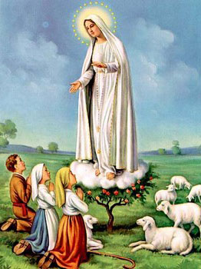
1. Dear Lady of Fatima we come on bended knee To beg your intercession for peace and unity. Dear Mary won't you show us the right and shining way? We pledge our love and offer you a Rosary each day.

Slide 62
2. You promised at Fatima Each time that you appeared To help us If we pray to you to banish war and fear. Dear Lady on first days we ask your guiding hand for grace and guidance here on earth protection for our land.

Slide 63
Ending Hymn:
On This Day

Slide 64
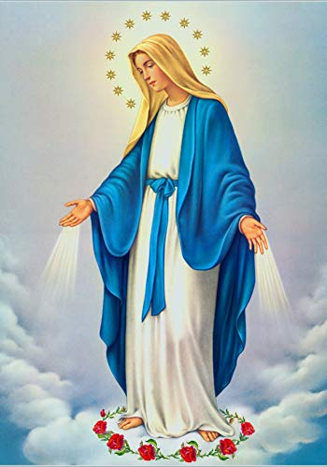
**. On this day, O beautiful Mother, On this day we give thee our love. Near the, Madonna, fondly we hover, Trusting thy gentle care to prove.

Slide 65
1. On this day we ask to share, Dearest Mother, thy sweet care; Aid us ere our feet astray Wanner from thy guiding way.

Slide 66
**. On this day, O beautiful Mother, On this day we give thee our love. Near the, Madonna, fondly we hover, Trusting thy gentle care to prove.

Slide 67
2. Queen of angels, deign to hear. Lisping children's humble prayer; Young hearts gain, O virgin pure, Sweetly to thyself allure.

Slide 68
THANK YOU
CÁM ƠN
MARAMING SALAMAT PO
MUCHAS GRACIAS
  நன்றி (Naṉṟi)

Slide 69
THANK YOU
CÁM ƠN
MARAMING SALAMAT PO
MUCHAS GRACIAS
  நன்றி (Naṉṟi)

