Slide 1
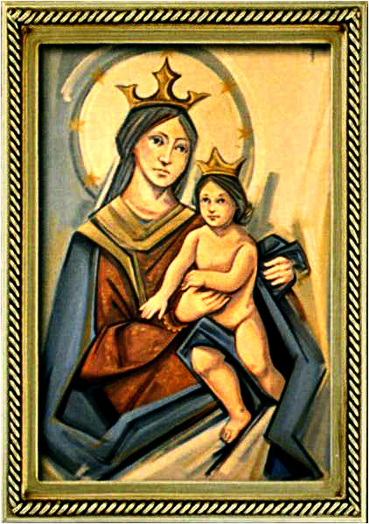
Ordinary Time 20 Year C
Gather Hymn:
All Are Welcome
Responsorial Psalm: 40
My God, Come to My Aid
Prep. of the Gifts Hymn:
The Lord is my life
Communion Hymn:
Spirit and Grace
Recessional Hymn:
Hail Holy Queen

Slide 2
Verse 1: Let us build a house where love can dwell And all can safely live, A place where saints and children tell How hearts learn to forgive.

Slide 3
Verse 2: Built of hopes and dreams and visions,
Rock of faith and vault of grace; Here the love of Christ shall end divisions;

Slide 4
Chorus: All are welcome, all are welcome,
All are welcome in this place.

Slide 5
Verse 3: Let us build a house where prophets speak, And words are strong and true, Where all God's children dare to seek To dream God's reign anew.

Slide 6
Verse 4: Here the cross shall stand as witness
And a symbol of God's grace; Here as one we claim the faith of Jesus:

Slide 7
Chorus: All are welcome, all are welcome,
All are welcome in this place.

Slide 8
Penitential Act (Confiteor 2011) 1 of 3:

Slide 9
I confess to almighty God and to you, my brothers and sisters, that I have greatly sinned, in my thoughts and in my words,

Slide 10
in what I have done
and in what I have failed to do,
through my fault,
through my fault,
through my most grievious fault;

Slide 11
therefore I ask blessed Mary ever-Virgin, all the Angels and Saints, and you, my brothers and sisters, to pray for me to the Lord our God.

Slide 12
Gloria Hymn

Slide 13
Refrain:
Glory to God, Glory to God. Glory to God in the highest, and on earth, peace on earth, peace to people of good will

Slide 14
1. We praise you, we bless you, we adore you, we glorify you, we give you thanks for your great glory. Lord God, heavenly King, O God, almighty Father.

Slide 15
Refrain:
Glory to God, Glory to God. Glory to God in the highest, and on earth, peace on earth, peace to people of good will

Slide 16
2. Lord Jesus Christ, only Begotten Son, Lord God, Lamb of God, Son of the Father, you take away the sins of the world, have mercy on us. You take way the sins of the world, receive our pray you are seated at the right hand, the right hand of the Father, have mercy on us

Slide 17
Refrain:
Glory to God, Glory to God. Glory to God in the highest, and on earth, peace on earth, peace to people of good will

Slide 18
3. For you alone are the Holy One, you alone are the Lord, you alone are the Most High, Jesus Christ with the Holy Spirit, in the glory of God the Father.

Slide 19
Refrain:
Glory to God, Glory to God. Glory to God in the highest, and on earth, peace on earth, peace to people of good will. Amen Amen.

Slide 20
Responsorial Psalm: 138
The Day I Called

Slide 21
Responsorial Psalm: Psalm 40
God, my God, come to my aid, come to my aid, come to my aid, come.

Slide 22
Gospel Acclamation

Slide 23
Alleluia Alleluia Alleluia.
My sheep hear my voice, says the Lord; I know them, and they follow me.

Slide 24
Profession Of Faith
Creed

Slide 25
Nicene Creed p1
I believe in one God, the Father almighty, maker of heaven and earth, of all things visible and invisible.

Slide 26
Nicene Creed p2
I believe in one Lord Jesus Christ, the Only Begotten Son of God, born of the Father before all ages.

Slide 27
Nicene Creed p3
God from God, Light from Light, true God from true God, begotten, not made, consubstantial with the Father; through Him all things were made.

Slide 28
Nicene Creed p4
For us men and for our salvation He came down from heaven, and by the Holy Spirit was incarnate of the Virgin Mary, and became man.

Slide 29
Nicene Creed p5
For our sake He was crucified under Pontius Pilate, He suffered death and was buried, and rose again on the third day in accordance with the Scriptures.

Slide 30
Nicene Creed p6
He ascended into heaven and is seated at the right hand of the Father.

Slide 31
Nicene Creed p7
He will come again in glory to judge the living and the dead and His kingdom will have no end.

Slide 32
Nicene Creed p8
I believe in the Holy Spirit, the Lord, the giver of life, who proceeds from the Father and the Son,

Slide 33
Nicene Creed p9
who with the Father and the Son is adored and glorified, who has spoken through the prophets.

Slide 34
Nicene Creed p10
I believe in one, holy, catholic and apostolic Church. I confess one Baptism for the forgiveness of sins

Slide 35
Nicene Creed p11
and I look forward to the resurrection of the dead and the life of the world to come. Amen.

Slide 36
Preparation of The Gift Song:
The Lord is my Light

Slide 37
1. The Lord is my light, my help, my salvation. Why should I fear? With God I fear no one. God protects all my life. With the Lord what should I dread?
** The Lord is my light, the Lord
is my help, the Lord is my salvation.

Slide 38
2. There is one thing I ask of
the Lord that I long for: all of
my days with God to be
dwelling, gazing with awe at
the beauty of God, and in
wonder look on God’s house.
** The Lord is my light, the Lord
is my help, the Lord is my salvation.

Slide 39
3. I know I will live to see the
Lord’s goodness; now, in this
life, I’m sure I will see it. Trust
in the Lord, be strong and be
brave; wait in hope for God,
our salvation.
** The Lord is my light, the Lord
is my help, the Lord is my salvation.

Slide 40
Holy Holy

Slide 41
Holy, Holy, Holy Lord God of hosts.
Heaven and earth are full, are full of your glory. Hosanna, Hosanna! Hosanna in the highest.

Slide 42
Blessed is he who comes, who comes in the name of the Lord.
Hosanna, Hosanna! Hosanna in the highest.

Slide 43
Memorial Acclamation

Slide 44
We proclaim your Death, O Lord,
and profess your Resurrection until you come again.

Slide 45
Amen

Slide 46
Amen, Amen.
Amen, Amen
Amen, Amen
Amen. Amen.

Slide 47
Lamb Of God

Slide 48
Lamb of God your take away the sins of the world. Have mercy on us. (repeat as needed)
Lamb of God your take away the sins of the world.
grant us peace.

Slide 49
Communion respond

Slide 50
Behold the Lamb of God,
behold him who takes away the sins of the world.
Blessed are those called to the supper of the Lamb.
Lord, I am not worthy
that You should enter under my roof, but only say the word and my soul shall be healed.

Slide 51
Communion Hymn 1:
Spirit and Grace

Slide 52
1. Spirit and grace, here in this meal; you are the wind that breathes through the field Gather the wheat and form us in Christ. Come, be our source and breath of life

Slide 53
Refrain: In the bread, blessed, broken and shared. Christ is our life, whose presence we bear Come, O spirit, make your grace revealed. in this holy meal.

Slide 54
2. Spirit and grace, here in this meal; you are the life: that flows through the wine. Gather this drink and form us in Christ. Come, be our source and blood of life.

Slide 55
Refrain: In the bread, blessed, broken and shared. Christ is our life, whose presence we bear Come, O spirit, make your grace revealed. in this holy meal.

Slide 56
3. Spirit and grace, here in this place; you are the light that shines in this space. Gather your people and form us in Christ. Come, be the heartbeat of our lives.

Slide 57
Refrain: In the bread, blessed, broken and shared. Christ is our life, whose presence we bear Come, O spirit, make your grace revealed. in this holy meal.

Slide 58
Announcements:

Slide 60
Ending Hymn:
Hail Holy Queen

Slide 61
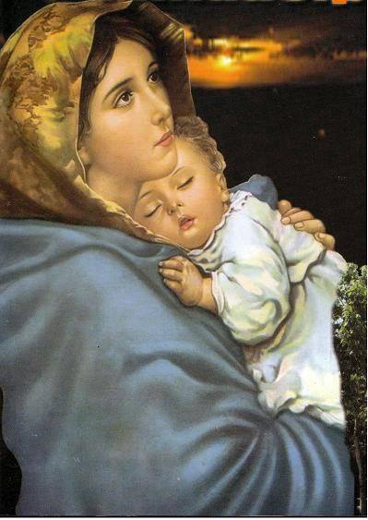
1. Hail Holy Queen enthron'd above, O Maria!
Hail Mother of Mercy and of love.

Slide 62
O Maria! Triumph, all ye Cherubim; Sing with us ye Seraphim!
Heav'n and earth resound the Hymn:
Salve Salve Salve Regina.

Slide 63
2. Our life our sweetness here below O Maria.
Our hope in sorrow and in woe.

Slide 64
O Maria! Triumph, all ye Cherubim; Sing with us ye Seraphim!
Heav'n and earth resound the Hymn:
Salve Salve Salve Regina.

Slide 65
3. And when our life breath leaves us, O Maria!
Show us thy Son, Christ Jesus.

Slide 66
O Maria! Triumph, all ye Cherubim; Sing with us ye Seraphim!
Heav'n and earth resound the Hymn:
Salve Salve Salve Regina.

Slide 67
Ending Hymn:
Lady Of Fatima

Slide 68
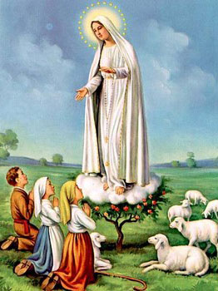
1. Dear Lady of Fatima we come on bended knee To beg your intercession for peace and unity. Dear Mary won't you show us the right and shining way? We pledge our love and offer you a Rosary each day.

Slide 69
2. You promised at Fatima Each time that you appeared To help us If we pray to you to banish war and fear. Dear Lady on first days we ask your guiding hand for grace and guidance here on earth protection for our land.

Slide 70
Ending Hymn:
On This Day

Slide 71
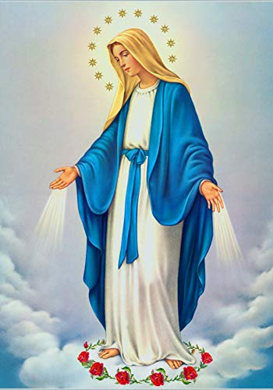
**. On this day, O beautiful Mother, On this day we give thee our love. Near the, Madonna, fondly we hover, Trusting thy gentle care to prove.

Slide 72
1. On this day we ask to share, Dearest Mother, thy sweet care; Aid us ere our feet astray Wanner from thy guiding way.

Slide 73
**. On this day, O beautiful Mother, On this day we give thee our love. Near the, Madonna, fondly we hover, Trusting thy gentle care to prove.

Slide 74
2. Queen of angels, deign to hear. Lisping children's humble prayer; Young hearts gain, O virgin pure, Sweetly to thyself allure.

Slide 75
THANK YOU
CÁM ƠN
MARAMING SALAMAT PO
MUCHAS GRACIAS
  நன்றி (Naṉṟi)

Slide 76
THANK YOU
CÁM ƠN
MARAMING SALAMAT PO
MUCHAS GRACIAS
  நன்றி (Naṉṟi)

